Slide 1

2019
Case Study: Market Share Prediction
Razmik Melikbekyan

Slide 2
Content
Objective
Data exploration and analysis
Data preparation
Modeling
Evaluation
Next Steps

Slide 3




Objective
Dataset includes
categorical
and numerical
predictors
Dataset of 1716
products from
different markets
MS > 0.7%
considered
as success
To create a model
that predicts
the success
of a product.

Slide 4
Data exploration and analysis
39 predictors (features) and 1 response variable - MarketShare
4 numeric features:
RETAILPACKPRICE
LEN
NCON
TRCONTE
Market Share
35 categorical features:
REGION
MARKET
BRANDFAMILY
ISSTRATEGIC
…

Slide 5
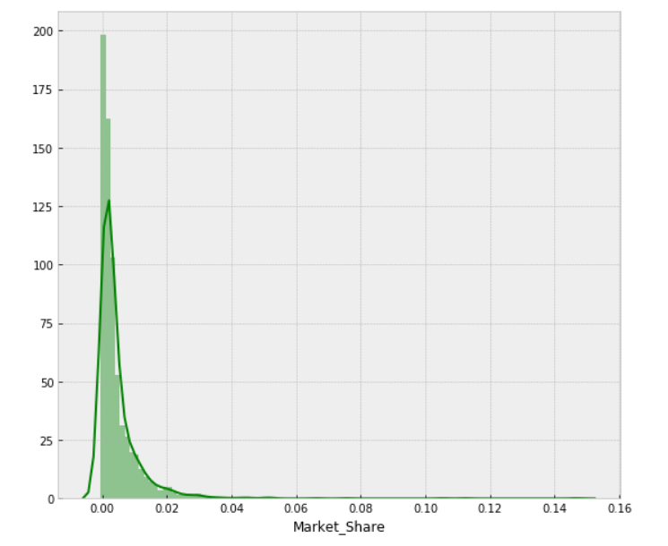
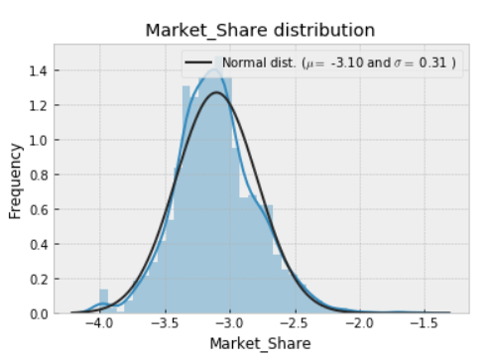
Data exploration and analysis
Market share distribution
As a classification data our dataset is imbalanced: only 19% of products in dataset are successful with given threshold 0.7%.
Exponential distribution shape, skew=7.5
Normal distribution shape, skew=0.35
BoxCox (lambda=0.25)
* BoxCox formula: y = (x**lambda - 1) / lambda (for lambda > 0)

Slide 6
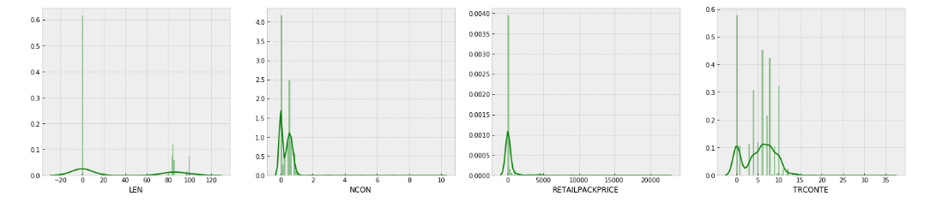
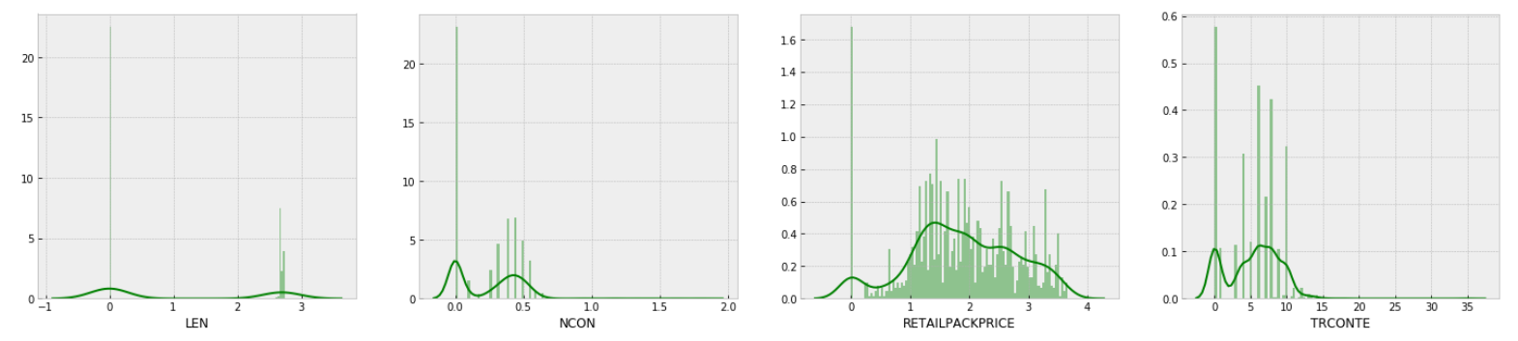
Data exploration and analysis
Numeric features distribution
LEN
NCON
RETAILPACKPRICE
TRCONTE
boxcox1p transformation in order to have less skew in features distributions.
boxcox1p (lambda = -0.25)
((1+x)**lambda - 1) / lambda

Slide 7
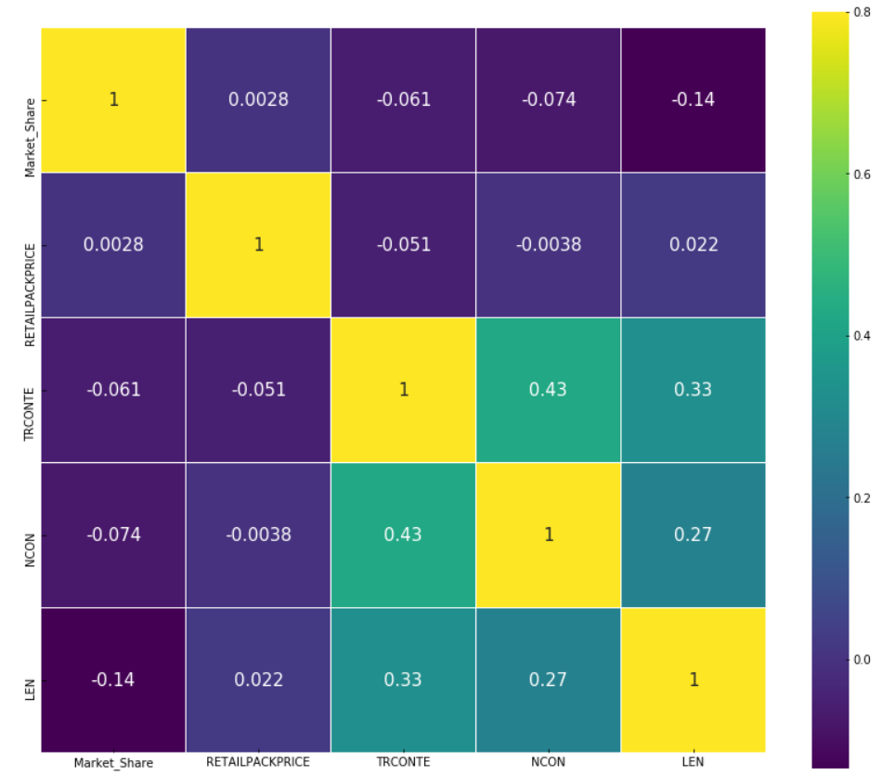
Data exploration and analysis
Market share and numeric features correlation
We can see that there is no linear relationship between numeric features and response variable.
This is gives us insight that most probably linear regression models will not have high accuracy on this data.

Slide 8
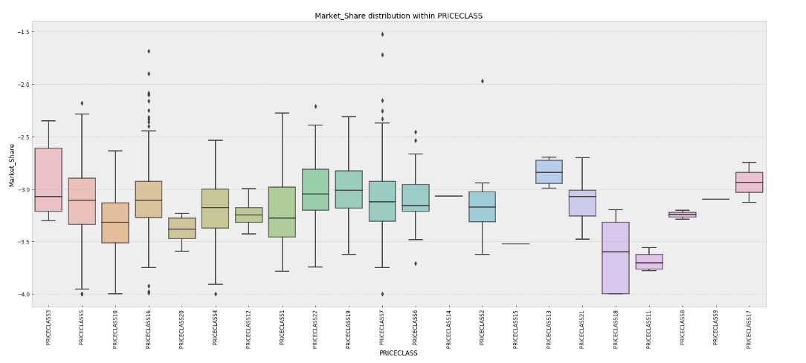
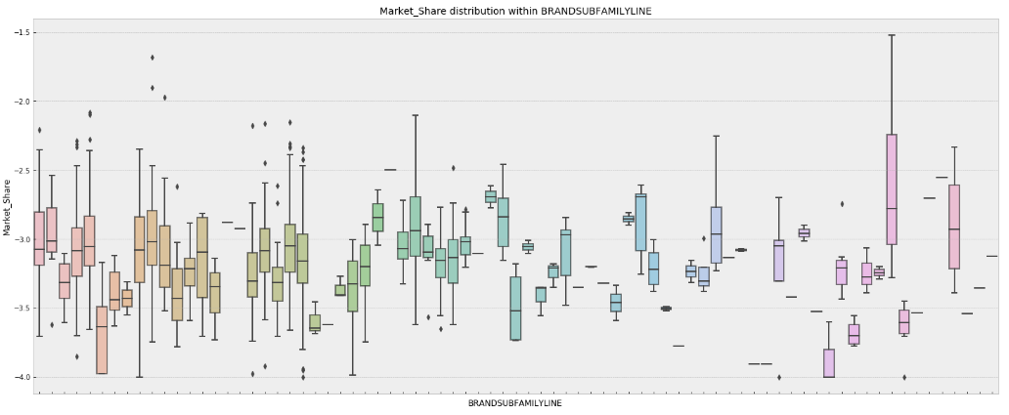
Data exploration and analysis
Market share and Categorical features
Box plots are used to find out relationships with categorical features and response variable. According to analysis we see that Market share distribution varies within MARKETs, BRANDs, PRICECLASSs, PCKTs and within some other categorical features.
As for numeric features, here also we could not find any strong relationship between any of categorical features and response variable.

Slide 9
Data preparation
Data Cleaning, Feature Engineering ,
Handling Categorical variables, Train-Validation-Test split
BoxCox transformations of response variable and numeric variables, for having small skew and being more normally distributed
BRMID - unique ID for each product, drop
LATESTPERIODINDEX - the same for all products and informing us that Market shares are 12 months after launch, drop
BRM, BRANDONMARKET, MARKETEDBRAND - these 3 features are the same, so we keep only one of them
BRANDSUBFAMILY, BRANDSUBFAMILYGROUPING - these 2 features are the same, so we keep only one of them
NPLLAUNCHDATE - split into LAUNCH_YEAR and LAUNCH_MONTH
NPLLAUNCHYEAR - drop this feature, as it is the same with LAUNCH_YEAR
RTYPE - 73% missing values
ITEMSHAPE - 53% missing values, drop
SPECIALFLAVOR - fill missing values of this feature with NOSPECIALFLAVOR as one additional category
TIPCOLOR - fill missing values of this feature with NOTIPCOLOR as one additional category
Data Cleaning
For TCLASS, REGION, LOCALCLASS, BLDIMAGE, MARKET, MINDICATOR, THICATEGORY,PCKT categorical features aggregation is done by numeric features, for example: for each from 4 different REGIONs calculated RETAILPACKPRICE mean, median, std and skew.
For each aggregation relative median is calculated, for example: for each product RETAILPACKPRICE is divided to its REGION median of RETAILPACKPRICE. In the feature we will see that these relative features are very important for models.
For numeric features LEN and RETAILPACKPRICE polynomial degrees are added (0.5, 2, 3)
Feature Engineering

Slide 10
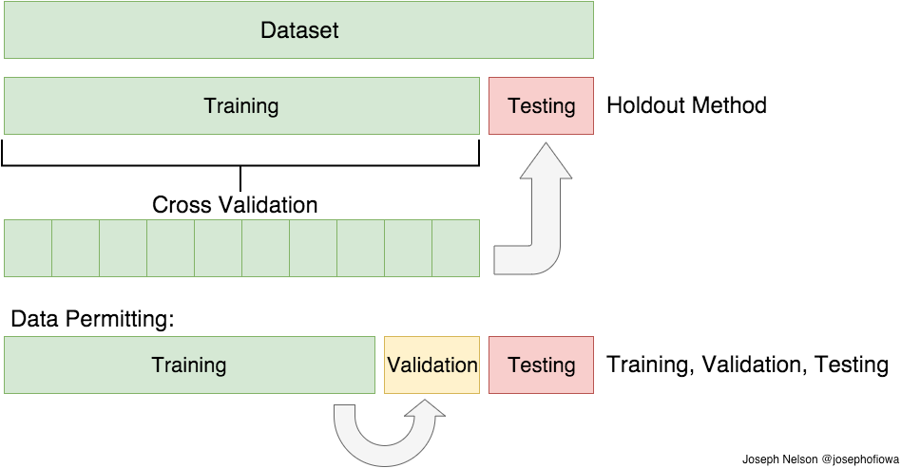
Data preparation
Data Cleaning, Feature Engineering ,
Handling Categorical variables, Train-Validation-Test split
As we have a many categorical features, we have to handle them somehow before giving to machine learning algorithms, because mostly models need numeric data as an input. There are many different methods for solving this problem (such as LabelEncoder, One-hot Encoding, Feature Hashing Scheme and etc.) . In this project One-hot Encoding is used:
REGION_1 -> [1, 0, 0, 0]
REGION_2 -> [0, 1, 0, 0]
REGION_3 -> [0, 0, 1, 0]
REGION_4 -> [0, 0, 0, 1]
Handling Categorical variables
15%
85%
Initial training data is split into train and test parts with 0.85 and 0.15 ratio. During models selection, their training and hyper-parameters tuning process models are evaluated with 5 fold cross validation scheme. This means that train data is randomly split into 5 parts, trained on 4 parts of it and validated on the 5th part of it. Afterwards as a validation part we select next part (next from 5 parts), model is initialized again, trained on 4 parts and validated on validation part. This process repeated 5 times, until all 5 parts are considered as a validation part. Afterwards the evaluation is done based on average of metrics for each validation part . Final testing of models is done on test part, which is not used during training and CV process.
Train-Validation-Test split

Slide 11


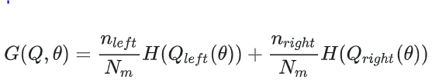

Modeling and Evaluation
BASE MODELS
LASSO Regression
Lasso is a linear model (like linear regression) with L1 regularization on regression coefficients. This regularization improves prediction error by shrinking large regression coefficients in order to reduce overfitting.
Elastic-Net Regression
Elastic-Net is a linear regression model, which linearly combines the L1 and L2 penalties of the Lasso and Ridge methods. Elastic-Net is useful when there are multiple features which are correlated with one another. Lasso is likely to pick one of these at random, while elastic-net is likely to pick both.
Extra-Trees Regressor
This model is ensemble of Decision Trees like RandomForest. As in random forests, a random subset of candidate features is used, but instead of looking for the most discriminative thresholds, thresholds are drawn at random for each candidate feature and the best of these randomly-generated thresholds is picked as the splitting rule.
Gradient Tree Boosting
This model is also ensemble of Decision Trees (learner). Gradient boosting combines weak "learners" into a single strong learner in an iterative fashion. the intuition behind gradient boosting algorithm is to repetitively leverage the patterns in residuals and strengthen a model with weak predictions and make it better.

Slide 12
Modeling and Evaluation
Evaluation Metrics
Overall 11 different metrics are used for models evaluation. 5 of them you can find below.
RMSE
Root Mean Squared Error – this metric measures the difference between predicted values and the actual values.
Regression Metric
TPR
True positive ratio or Recall – Probability that a model prediction will be success when the it is true success (When it is actually Y, how often does it predict Y?).
FPR
False positive ratio – Probability that model predicts success when it is true failure (When it is actually N, how often does it predict Y?).
Classification Metrics
AUC
The probability that the model ranks a random
positive example more highly than a random negative example.
PPV
Positive predictive value or Precision – Probability that it is true success when model predicted success (When it predicts Y, how often is it correct?).

Slide 13
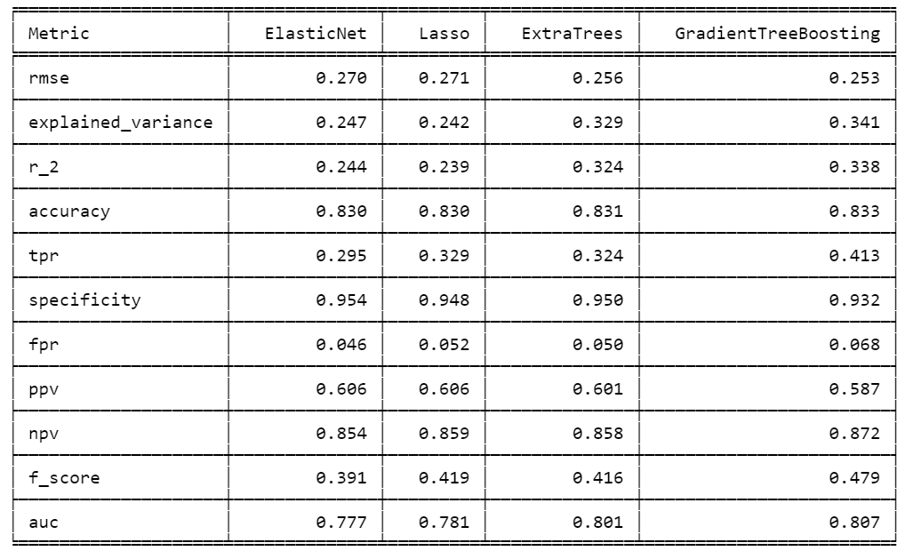
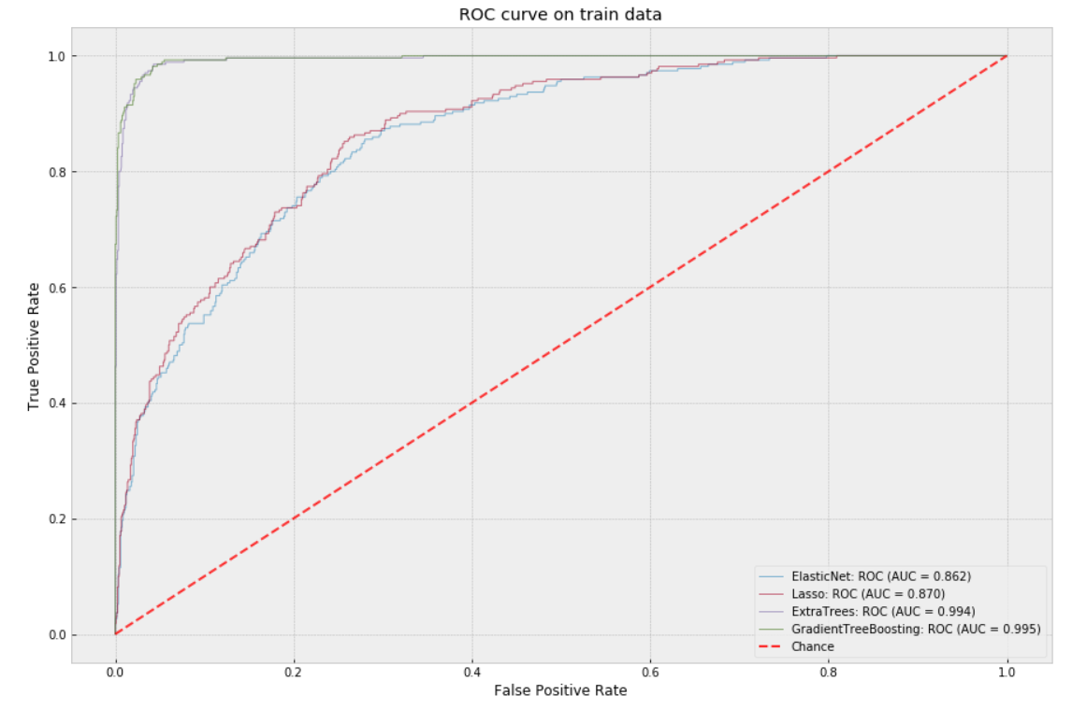
Modeling and Evaluation
5 fold CV average results
Training data fit results
Gradient Tree Boosting and Extra Trees are selected from 4 models.
Lasso and Elastic Net performances are almost similar and their performance is low compared to Decision Tree models, which is expected as we investigated that our data mostly is non linear.
We can assume that Gradient Tree Boosting model learned more from data than Extra Trees did (as it is more complex model by its nature), because it can differentiate more successful launches, but together with that the false positive ratio is more by 1.8%, which is not good from business prospective. So Gradient Tree Boosting models pays fpr increase cost (by 1.8%) for having higher ptr by 8.9%.
All models have low tpr, which is a result of having imbalanced dataset (only 19% are successes in dataset).
As we can see "linear" models Lasso and Elastic Net are not able to fully fit even on training data. So afterwards we will not consider using them.
In contrast, "non linear" models fitted with training data almost ideally, even more they have been over fitted, that is why our validation scores are not high enough. It is expected as our data is not big enough.
Notes:
If we compare GradientTreeBoosting and ExtraTrees then we can notice that their performances are comparable: mean validation RMSE is almost equal and AUC is almost equal. We see some difference for tpr (true positive ratio - When it is actually Y, how often does it predict Y?) and fpr (false positive ratio - When it is actually N, how often does it predict Y?) metrics for given 0.7% success threshold. As we can see both are bigger for GradientTreeBoosting based model (tpr: 0.413 vs 0.324, fpr: 0.068 vs 0.050). So what does it mean?

Slide 14
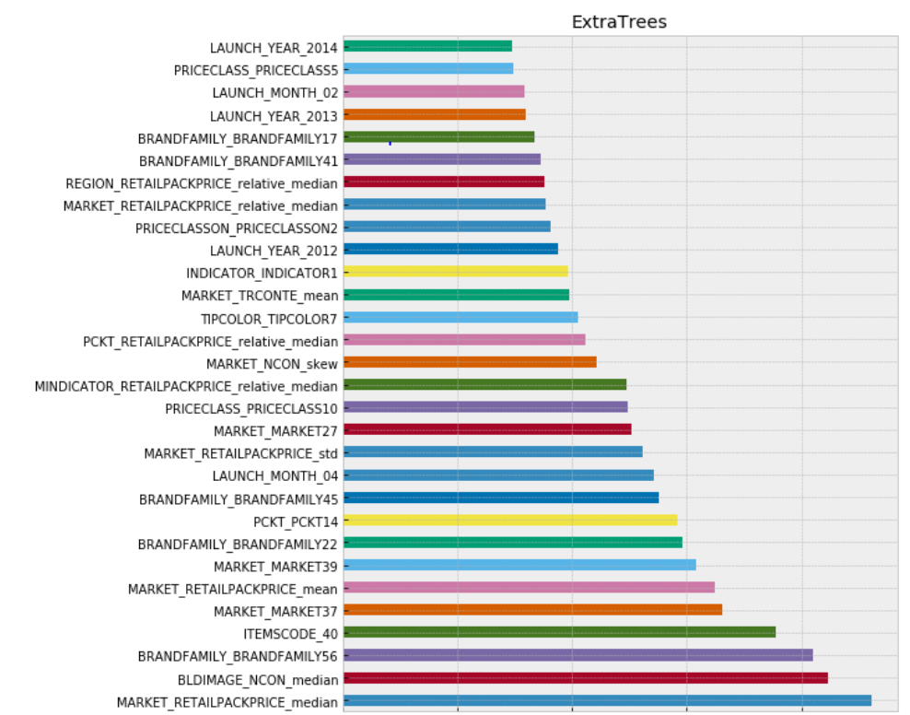
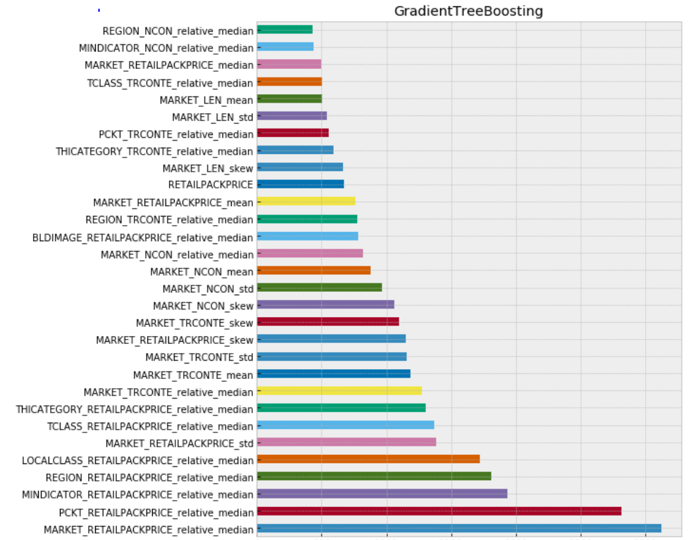
Modeling and Evaluation
Feature importance plots
Notes:
If we compare GradientTreeBoosting and ExtraTrees then we can notice that their performances are comparable: mean validation RMSE is almost equal and AUC is almost equal. We see some difference for tpr (true positive ratio - When it is actually Y, how often does it predict Y?) and fpr (false positive ratio - When it is actually N, how often does it predict Y?) metrics for given 0.7% success threshold. As we can see both are bigger for GradientTreeBoosting based model (tpr: 0.413 vs 0.324, fpr: 0.068 vs 0.050). So what does it mean?

Slide 15
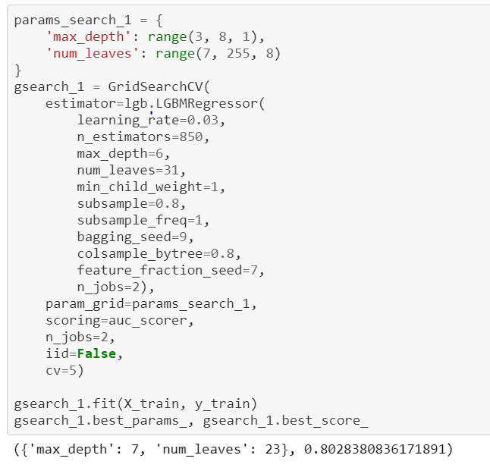
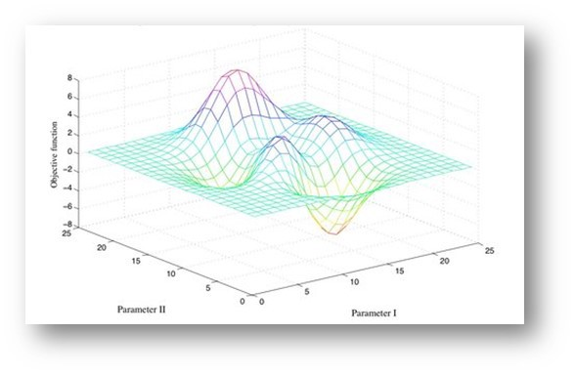
Modeling and Evaluation
Models hyper-parameters tuning
Our selected 2 models are ensembles of Decision Trees. They have hyper-parameters, which have tuned for better
handling overfitting and delivering more accurate CV results.
Some important parameters are:
n_estimators – number of decision trees in ensemble
max_depth – the maximum possible depth of tree
feature_fraction – the ratio of selected features for each training iteration
min_data_in_leaf – minimal number of data in one leaf
Some of parameters are deciding more complexity and some others trying to deal with overfitting.
There are different techniques for hyper-parameters tuning in ML, but we selected the simplest one: GridSearch with CV.

Slide 16
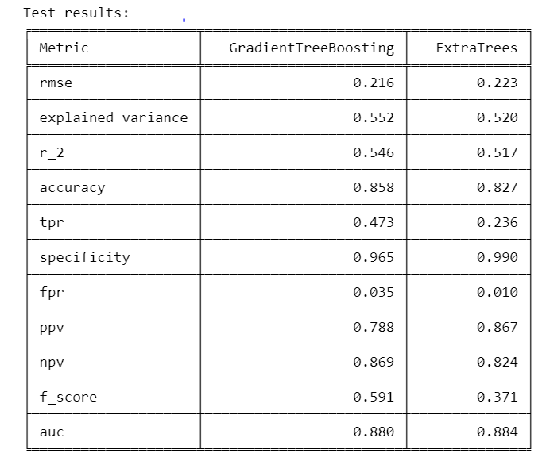

Modeling and Evaluation
Testing on 15% of data
So what model to select???
One of the models is very conservative and almost do not predicts wrong successes, but it classifies a lot of successes as failures. On the other hand second model in some cases can wrongly classify failure as a success, but it 2 times more correctly classifies successes.
GradientTreeBoosting is more powerful model than ExtraTrees in terms of tpr (0.473 vs 0.236).
ExtraTrees is more powerful model than GradientTreeBoosting in terms of fpr (0.010 vs 0.035).
As a result of having small fpr, ExtraTrees has more positive predictive value (0.86 vs 0.78).
When ExtraTrees says success, then with 0.86 probability and [0.69, 1.04] confidence interval it will be true success.
When GradientTreeBoosting says success, then with 0.78 probability and [0.65, 0.93] confidence interval it will be true success.
ExtraTrees says success 2 times rarely than GradientTreeBoosting in case of true success.

Slide 17
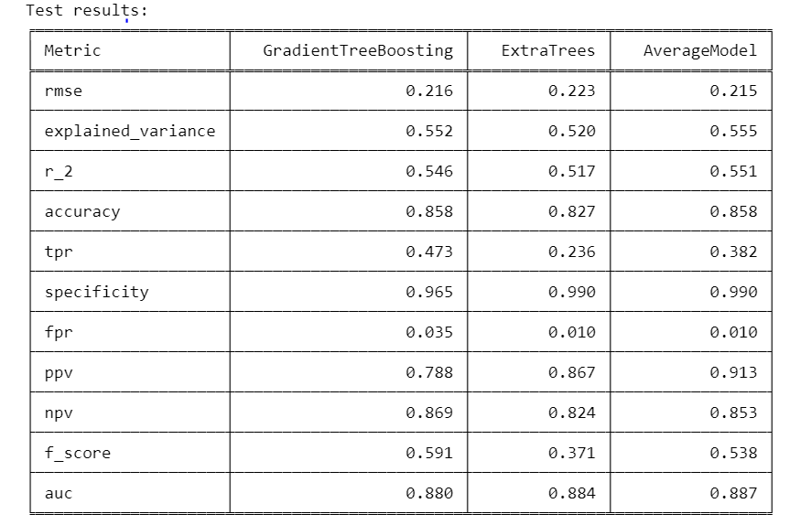
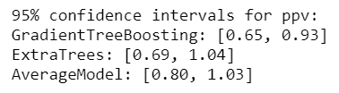
Modeling and Evaluation
Final model selection
When this model predicts success then with 9.13% probability it will be true success and there is only 1% percent of probability that this model will predict success in case of true failure.
We the final model will be the ensemble of both models with averaged prediction!!!
In case of true successes performance much better than ExtraTrees and close to GradientTreeBoosting.
Performance is similar to ExtraTrees and better than GradientTreeBoosting .
Positive predictive value is more than for each single model.
AUC is more than for each single model.

Slide 18


Next Steps
1
Data Related
Request for detailed information about
dataset features, so we can understand
technical and business specifications of
features. This will help to improve provided result.
More features about different market specifics.
More feature engineering.
2
Modeling Related
To try other Machine Learning algorithms such as
Neural Networks and Probabilistic Models.
To try other methods for hyper parameters tuning.
To try different approach: to treat problem directly
as classification problem (without estimating market
share number - to estimate product will be successful or not).

Slide 19
Q&A

