Slide 1

2019
Case Study: Market Share Prediction
Razmik Melikbekyan

Slide 2
Content
Objective
Data exploration and analysis
Data preparation
Modeling
Evaluation
Next Steps

Slide 3




Objective
Dataset includes
categorical
and numerical
predictors
Dataset of 1716
products from
different markets
MS > 0.7%
considered
as success
To create a model
that predicts
the success
of a product.

Slide 4
Data exploration and analysis
39 predictors (features) and 1 response variable - MarketShare
4 numeric features:
RETAILPACKPRICE
LEN
NCON
TRCONTE
Market Share
35 categorical features:
REGION
MARKET
BRANDFAMILY
ISSTRATEGIC
…

Slide 5
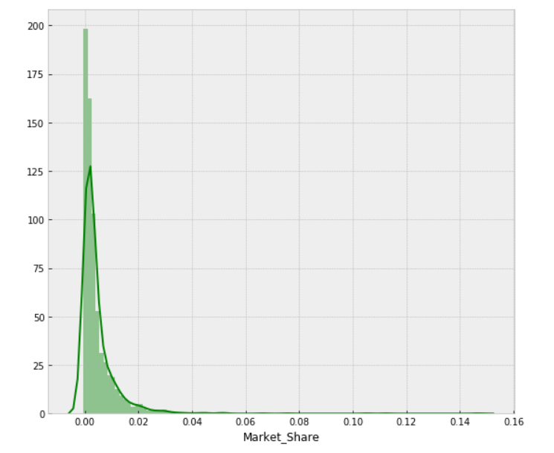
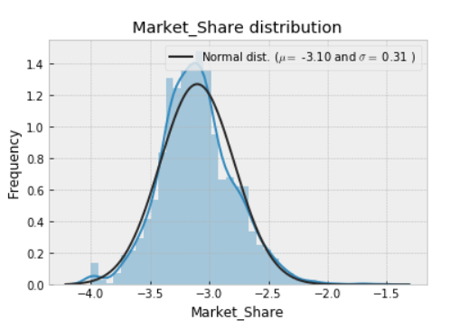
Data exploration and analysis
Market share distribution
As a classification data our dataset is imbalanced: only 19% of products in dataset are successful with given threshold 0.7%.
Exponential distribution shape, skew=7.5
Normal distribution shape, skew=0.35
BoxCox (lambda=0.25)
* BoxCox formula: y = (x**lambda - 1) / lambda (for lambda > 0)

Slide 6
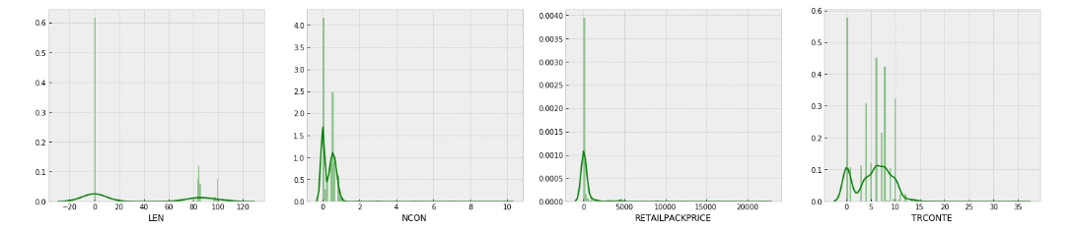
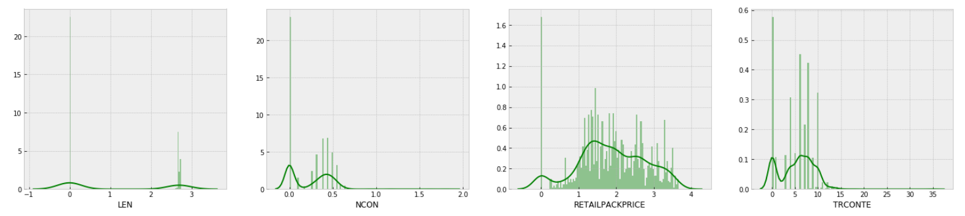
Data exploration and analysis
Numeric features distribution
LEN
NCON
RETAILPACKPRICE
TRCONTE
boxcox1p transformation in order to have less skew in features distributions.
boxcox1p (lambda = -0.25)
((1+x)**lambda - 1) / lambda
Skewness is asymmetry in a statistical distribution, in which the curve appears distorted or skewed either to the left or to the right.

Slide 7
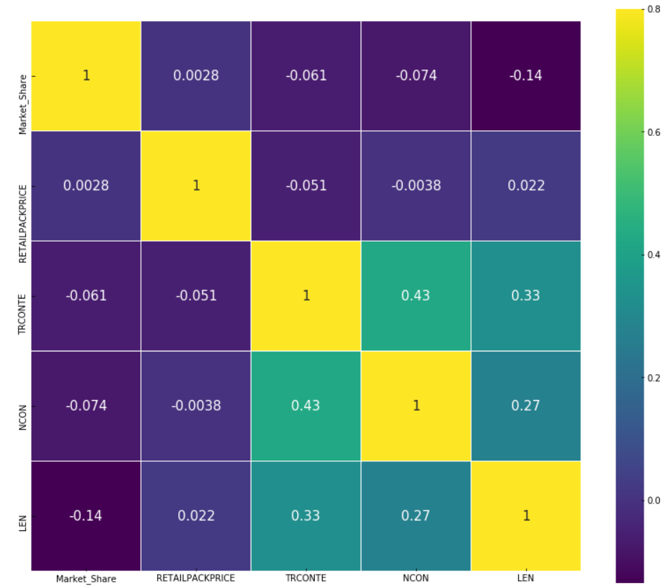
Data exploration and analysis
Market share and numeric features correlation
Correlation shows how close two variables are to having a linear relationship with each other.
We can see that there is no linear relationship between numeric features and response variable.
This is gives us insight that most probably linear regression models will not have high accuracy on this data.

Slide 8
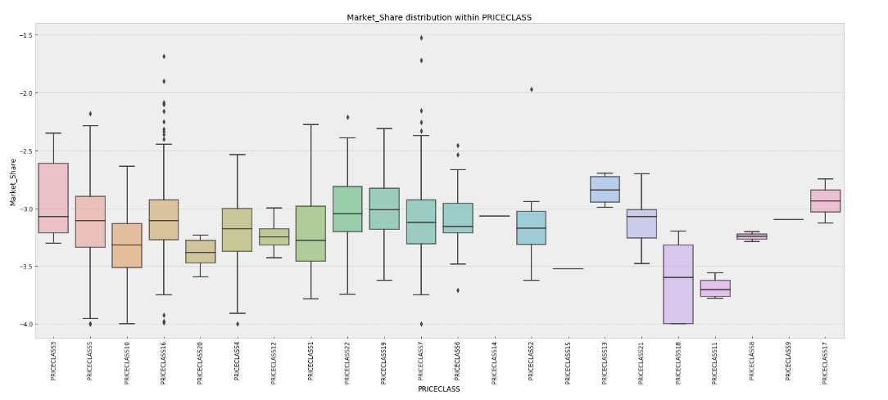
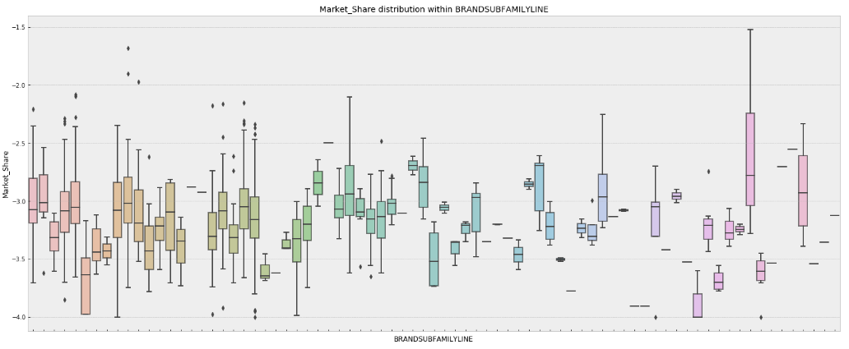
Data exploration and analysis
Market share and Categorical features
Box plots are used to find out relationships with categorical features and response variable.
According to analysis we see that Market share distribution varies within MARKETs, BRANDs, PRICECLASSs, PCKTs and within some other categorical features.
As for numeric features, here also we could not find any strong relationship between any of categorical features and response variable.
Notes:
A box plot shows the distribution of quantitative data in a way that facilitates comparisons across levels of a categorical variable. The box shows the quartiles of the dataset while the whiskers extend to show the rest of the distribution, except for points that are determined to be “outliers” using a method that is a function of the inter-quartile range.
The first quartile (Q₁) is defined as the middle number between the smallest number and the median of the data set. The second quartile (Q₂) is the median of the data. The third quartile (Q₃) is the middle value between the median and the highest value of the data set.
The median is the value separating the higher half from the lower half of a data sample.

Slide 9
Data preparation
Data Cleaning, Feature Engineering ,
Handling Categorical variables, Train-Validation-Test split
BoxCox transformations of response variable and numeric variables, for having small skew and being more normally distributed
BRMID - unique ID for each product, drop
LATESTPERIODINDEX - the same for all products and informing us that Market shares are 12 months after launch, drop
BRM, BRANDONMARKET, MARKETEDBRAND - these 3 features are the same, so we keep only one of them
BRANDSUBFAMILY, BRANDSUBFAMILYGROUPING - these 2 features are the same, so we keep only one of them
NPLLAUNCHDATE - split into LAUNCH_YEAR and LAUNCH_MONTH
NPLLAUNCHYEAR - drop this feature, as it is the same with LAUNCH_YEAR
RTYPE - 73% missing values, drop
ITEMSHAPE - 53% missing values, drop
SPECIALFLAVOR - fill missing values of this feature with NOSPECIALFLAVOR as one additional category
TIPCOLOR - fill missing values of this feature with NOTIPCOLOR as one additional category
Data Cleaning
For TCLASS, REGION, LOCALCLASS, BLDIMAGE, MARKET, MINDICATOR, THICATEGORY,PCKT categorical features aggregation is done by numeric features, for example: for each from 4 different REGIONs calculated RETAILPACKPRICE mean, median, std and skew.
For each aggregation relative median is calculated, for example: for each product RETAILPACKPRICE is divided to its REGION median of RETAILPACKPRICE. In the feature we will see that these relative features are very important for models.
For numeric features LEN and RETAILPACKPRICE polynomial degrees are added (0.5, 2, 3)
Feature Engineering

Slide 10
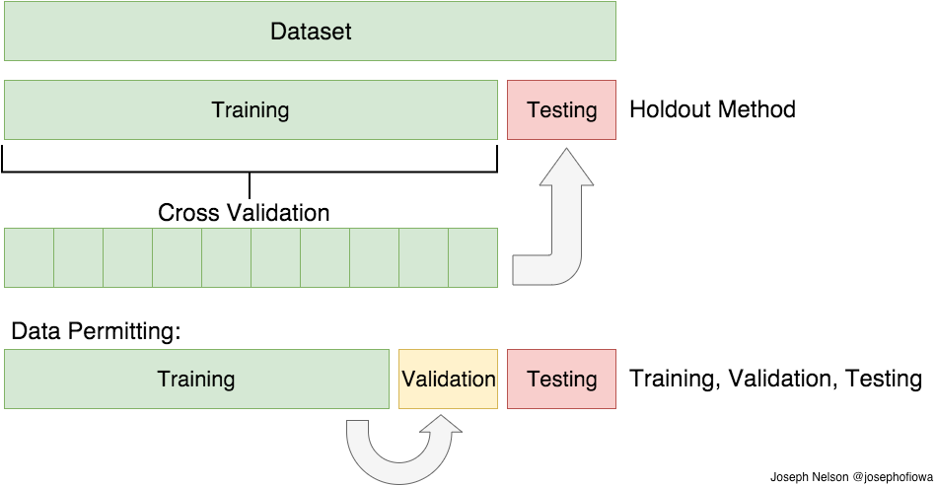
Data preparation
Data Cleaning, Feature Engineering ,
Handling Categorical variables, Train-Validation-Test split
As we have a many categorical features, we have to handle them somehow before giving to machine learning algorithms, because mostly models need numeric data as an input. There are many different methods for solving this problem (such as LabelEncoder, One-hot Encoding, Feature Hashing Scheme and etc.) . In this project One-hot Encoding is used:
REGION_1 -> [1, 0, 0, 0]
REGION_2 -> [0, 1, 0, 0]
REGION_3 -> [0, 0, 1, 0]
REGION_4 -> [0, 0, 0, 1]
Handling Categorical variables
15%
85%
Initial training data is split into train and test parts with 0.85 and 0.15 ratio. During models selection, their training and hyper-parameters tuning process models are evaluated with 5 fold cross validation scheme. This means that train data is randomly split into 5 parts, trained on 4 parts of it and validated on the 5th part of it. Afterwards as a validation part we select next part (next from 5 parts), model is initialized again, trained on 4 parts and validated on validation part. This process repeated 5 times, until all 5 parts are considered as a validation part. Afterwards the evaluation is done based on average of metrics for each validation part . Final testing of models is done on test part, which is not used during training and CV process.
Train-Validation-Test split

Slide 11


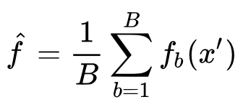
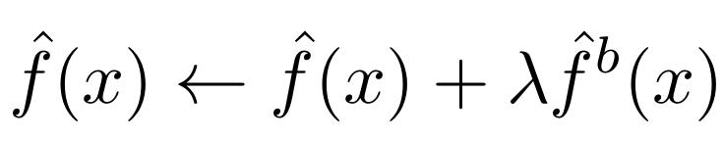
Modeling and Evaluation
LASSO Regression
Lasso is a linear regression model with L1 regularization on regression coefficients. This regularization improves prediction error by shrinking large regression coefficients in order to reduce overfitting.
Elastic-Net Regression
Elastic-Net is a linear regression model, which linearly combines the L1 and L2 regularization of the Lasso and Ridge methods. Elastic-Net is useful when there are multiple features which are correlated with one another. Lasso is likely to pick one of these at random, while elastic-net is likely to pick both.
BASE MODELS
Extra-Trees Regressor
This model is ensemble of Decision Trees like RandomForest. As in random forests, a random subset of candidate features is used, but instead of looking for the most optimal thresholds, thresholds are drawn at random for each candidate feature and the best of these randomly-generated thresholds is picked as the splitting rule.
Gradient Tree Boosting
This model is also ensemble of Decision Trees (learner). Gradient boosting combines weak "learners" into a single strong learner in an iterative fashion. The intuition behind gradient boosting algorithm is to repetitively leverage the patterns in residuals and strengthen a model with weak predictions and make it better.
Notes:
Linear model assume that the true relationship between X and Y takes the form Y = β 0 + β 1 X + e, where e is a mean-zero random error term. The error term is a catch-all for what we miss with this simple model: the true relationship is probably not linear, there may be other variables that cause variation in Y , and there may be measurement error. We typically assume that the error term is independent of X.
Decision tree based models involve segmenting the predictor space into a number of simple regions. In order to make a prediction for a given observation, we typically use the mean or the mode of the training observations in the region to which it belongs. Since the set of splitting rules used to segment the predictor space can be summarized in a tree, these types of approaches are known as decision tree methods.
Bagging:
To apply bagging to regression trees, we simply construct B regression trees using B bootstrapped training sets, and average the resulting predictions. These trees are grown deep, and are not pruned. Hence each individual tree has high variance, but low bias. Averaging these B trees reduces the variance.
RandomForest:
As in bagging, we build a number of decision trees on bootstrapped training samples. But when building these decision trees, each time a split in a tree is considered, a random sample of m predictors is chosen as split candidates from the full set of p predictors. The split is allowed to use only one of those m predictors. A fresh sample of m predictors is taken at each split.
ExtraTrees:
While similar to ordinary random forests in that they are an ensemble of individual trees, there are two main differences: first, each tree is trained using the whole learning sample (rather than a bootstrap sample), and second, the top-down splitting in the tree learner is randomized. Instead of computing the locally optimal cut-point for each feature under consideration, a random cut-point is selected. This value is selected from a uniform distribution within the feature's empirical range (in the tree's training set). Then, of all the randomly generated splits, the split that yields the highest score is chosen to split the node. Similar to ordinary random forests, the number of randomly selected features to be considered at each node can be specified.
Boosting:
Instead of creating a single powerful model, boosting combines multiple simple models into a single composite model. The idea is that, as we introduce more and more simple models, the overall model becomes stronger and stronger. In boosting terminology, the simple models are called weak models or weak learners.
To improve its predictions, gradient boosting looks at the difference between its current approximation, y_pred, and the known correct target vector, y_true, which is called the residual, y_true - y_pred. It then trains a weak model that maps feature vector to that residual vector. Adding a residual predicted by a weak model to an existing model's approximation nudges the model towards the correct target. Adding lots of these nudges, improves the overall models approximation. The residual is negative gradient of L2 loss.

Slide 12
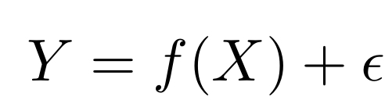
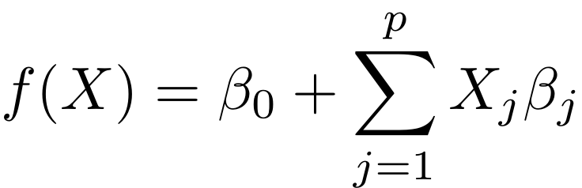
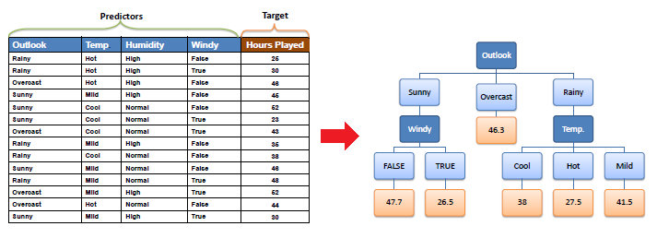
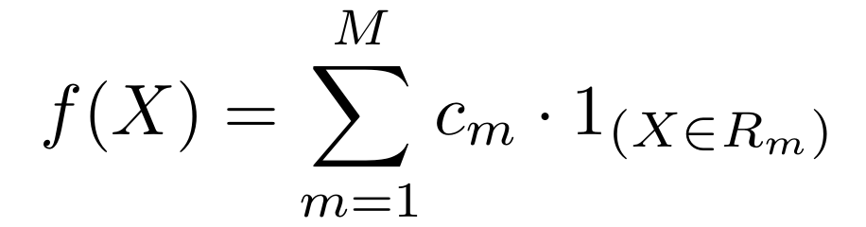
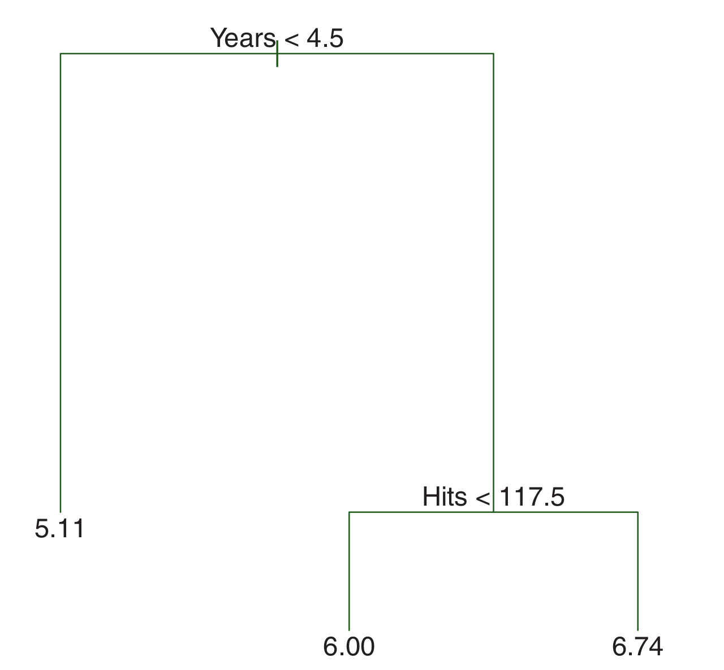
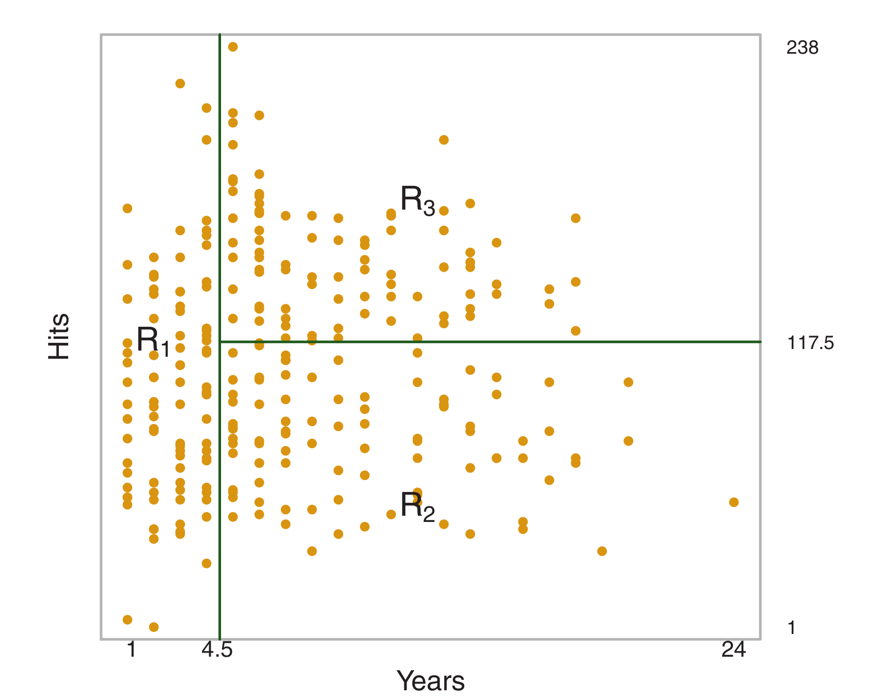
Modeling and Evaluation
Linear Methods:
Lasso ->
Elastic Net ->
Decision Tree:
Notes:
Once the regions R 1 , . . . , R J have been created, we predict the response for a given test observation using the mean of the training observations in the region to which that test observation belongs. c_m is mean or mode

Slide 13
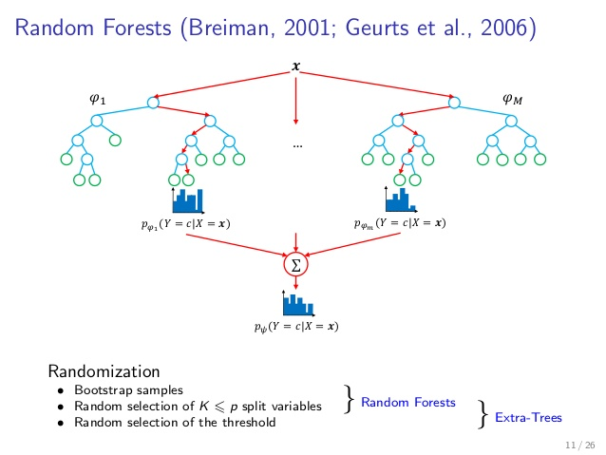
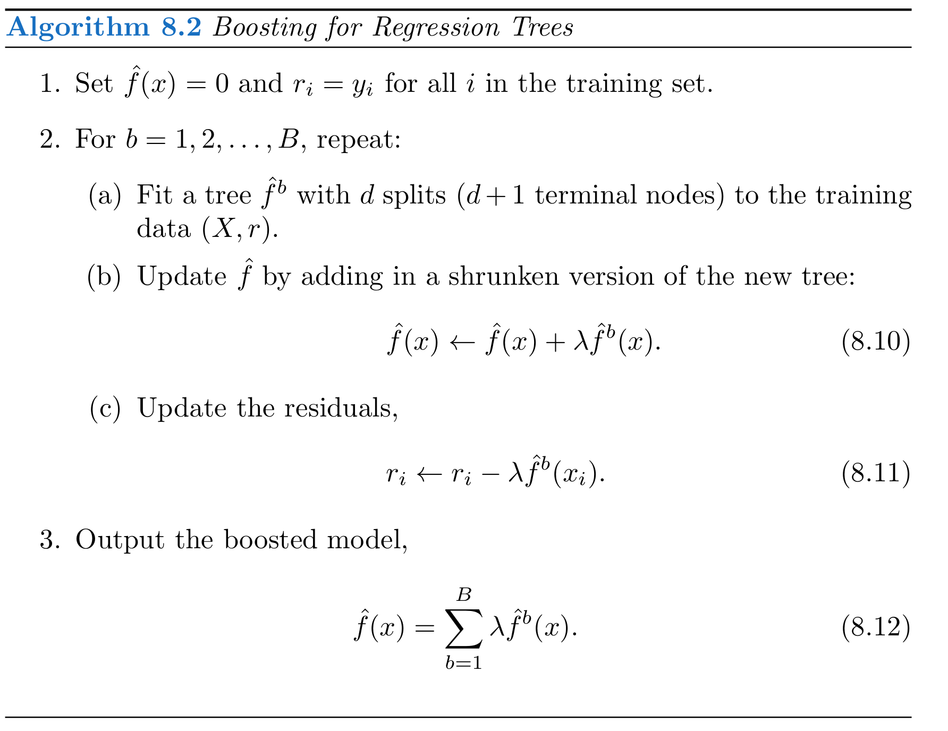
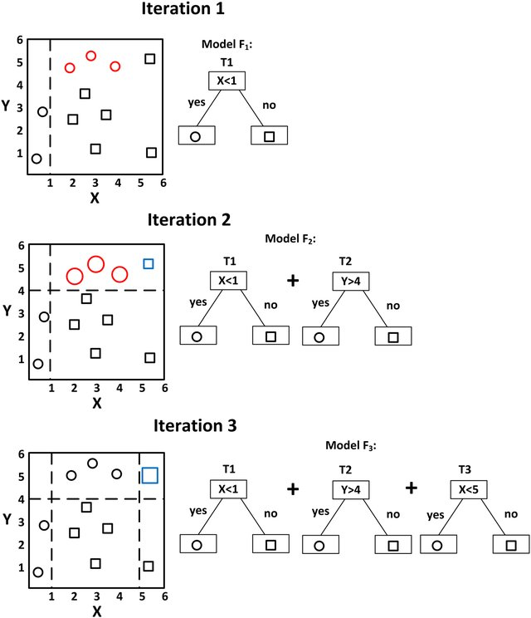
Modeling and Evaluation
Extra-Trees
Gradient Tree Boosting

Slide 14
Modeling and Evaluation
Evaluation Metrics
Overall 11 different metrics are used for models evaluation. 5 of them you can find below.
RMSE
Root Mean Squared Error – this metric measures the difference between predicted values and the actual values.
Regression Metric
TPR
True positive ratio or Recall – Probability that a model prediction will be success when the it is true success (When it is actually Y, how often does it predict Y?).
FPR
False positive ratio – Probability that model predicts success when it is true failure (When it is actually N, how often does it predict Y?).
Classification Metrics
AUC
The probability that model will rank a randomly chosen positive instance higher than a randomly chosen negative one.
PPV
Positive predictive value or Precision – Probability that it is true success when model predicted success (When it predicts Y, how often is it correct?).

Slide 15
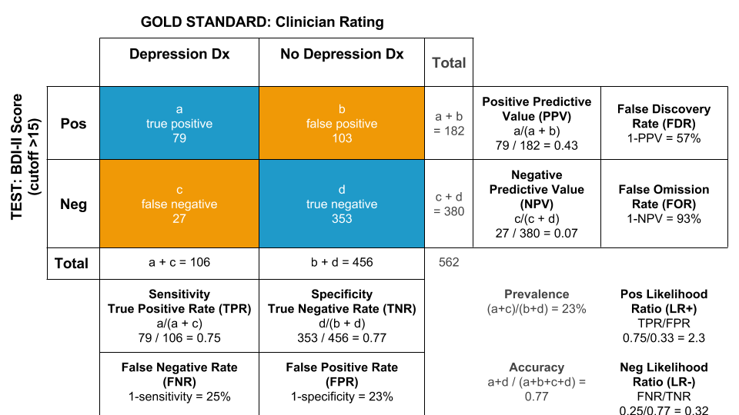
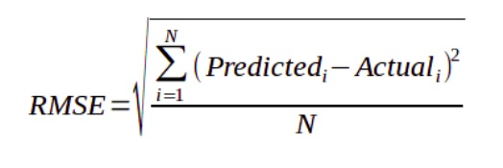
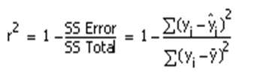
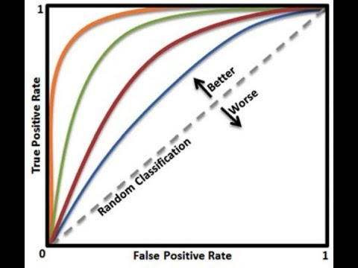
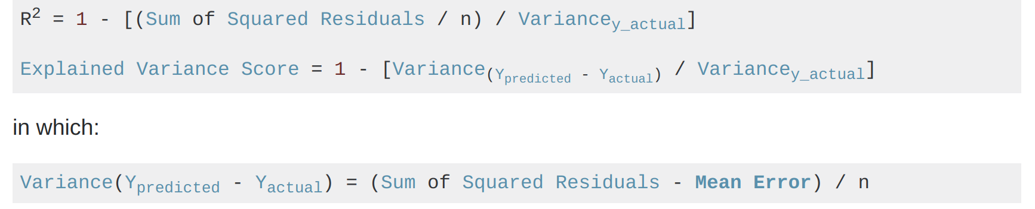
Modeling and Evaluation

Slide 16
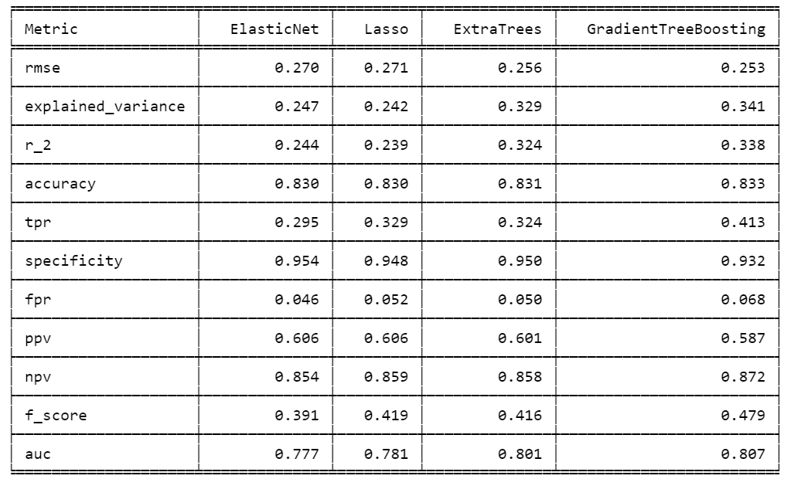
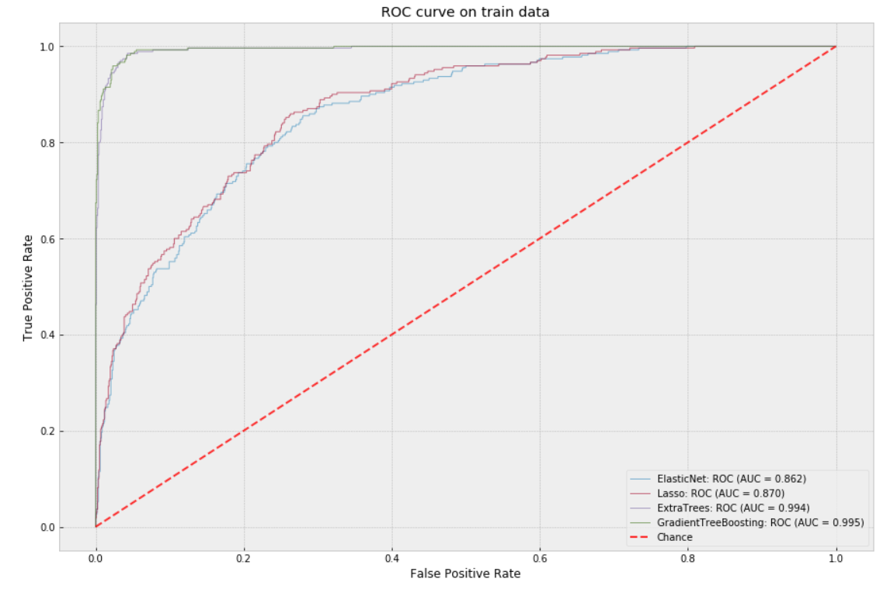
Modeling and Evaluation
5 fold CV average results
Training data fit results
Gradient Tree Boosting and Extra Trees are selected from 4 models.
Lasso and Elastic Net performances are almost similar and their performance is low compared to Decision Tree models, which is expected as we investigated that our data mostly is non linear.
We can assume that Gradient Tree Boosting model learned more from data than Extra Trees did (as it is more complex model by its nature), because it can differentiate more successful launches, but together with that the false positive ratio is more by 1.8%, which is not good from business prospective. So Gradient Tree Boosting models pays fpr increase cost (by 1.8%) for having higher tpr by 8.9%.
All models have low tpr, which is a result of having imbalanced dataset (only 19% are successes in dataset).
As we can see "linear" models Lasso and Elastic Net are not able to fully fit even on training data. So afterwards we will not consider using them.
In contrast, "non linear" models fitted with training data almost ideally, even more they have been over fitted, that is why our validation scores are not high enough. It is expected as our data is not big enough.
Notes:
The ROC curve is a popular graphic for simultaneously displaying the two types of errors for all possible thresholds. The overall performance of a classifier, summarized over all possible thresholds, is given by the area under the (ROC) curve (AUC). An ideal ROC curve will hug the top left corner, so the larger the AUC the better the classifier.

Slide 17
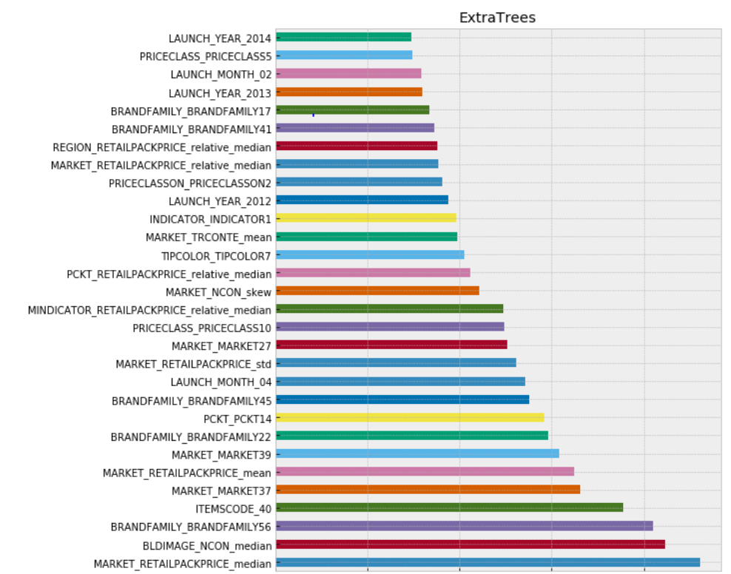
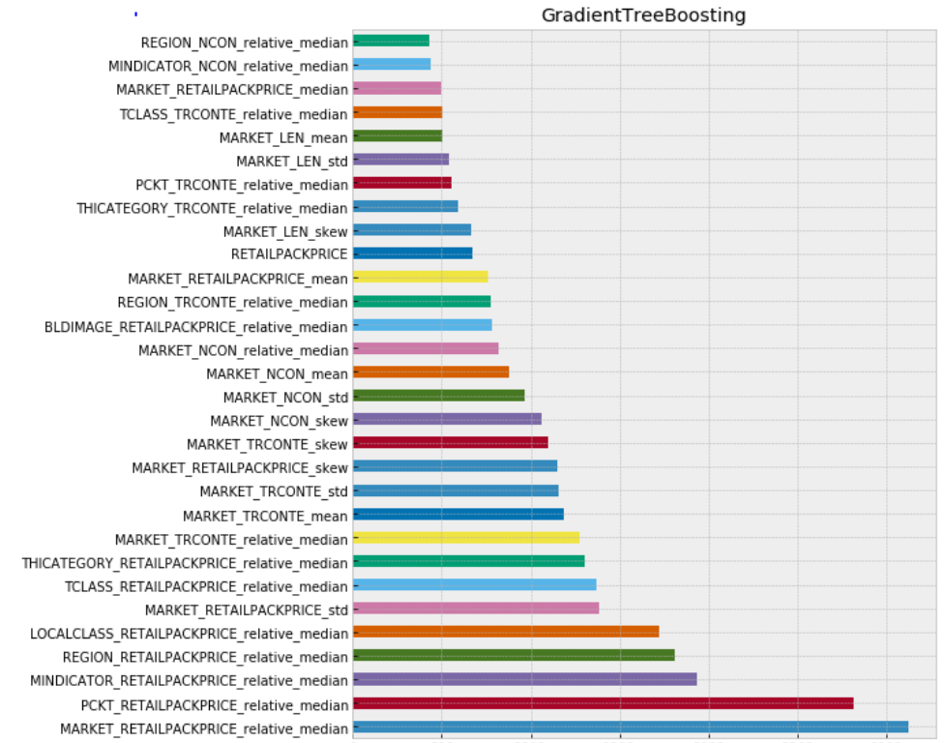
Modeling and Evaluation
Feature importance plots

Slide 18
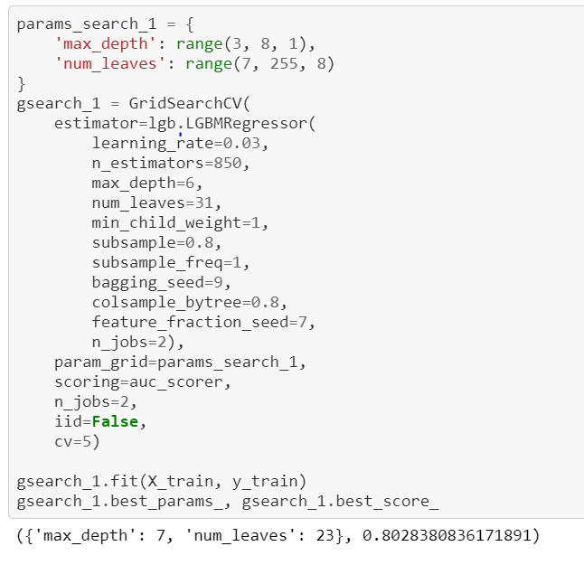
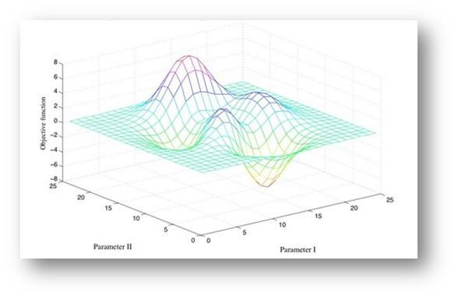
Modeling and Evaluation
Models hyper-parameters tuning
Our selected 2 models are ensembles of Decision Trees. They have hyper-parameters, which have tuned for better
handling overfitting and delivering more accurate CV results.
Some important parameters are:
n_estimators – number of decision trees in ensemble
max_depth – the maximum possible depth of tree
feature_fraction – the ratio of selected features for each training iteration
min_data_in_leaf – minimal number of data in one leaf
Some of parameters are responsible for complexity and some others trying to deal with overfitting.
There are different techniques for hyper-parameters tuning in ML, but we selected the simplest one: GridSearch with CV.

Slide 19
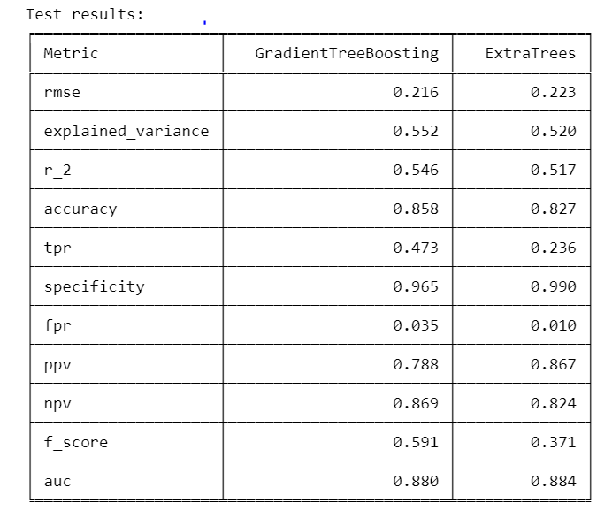

Modeling and Evaluation
Testing on 15% of data
So what model to select???
One of the models is very conservative and almost do not predicts wrong successes, but it classifies a lot of successes as failures. On the other hand second model in some cases can wrongly classify failure as a success, but it 2 times more correctly classifies successes.
GradientTreeBoosting is more powerful model than ExtraTrees in terms of tpr (0.473 vs 0.236).
ExtraTrees is more powerful model than GradientTreeBoosting in terms of fpr (0.010 vs 0.035).
As a result of having small fpr, ExtraTrees has more positive predictive value (0.86 vs 0.78).
When ExtraTrees says success, then with 0.86 probability and [0.69, 1.04] confidence interval it will be true success.
When GradientTreeBoosting says success, then with 0.78 probability and [0.65, 0.93] confidence interval it will be true success.
ExtraTrees says success 2 times rarely than GradientTreeBoosting in case of true success.
Notes:
You estimating the true value based on your data. True value is a fixed but unknown quantity. In contrast, your estimate is a random variable as it depends on your data xx which was generated from your data generating process. Thus, you realize that you get different estimates each time you repeat your study.
The above understanding leads to the following methodology to assess where the true parameter is in relation to your estimate. Define an interval, I≡[lb(x),ub(x)]I≡[lb(x),ub(x)] with the following property:
P(θ∈I)=0.95
An interval constructed like the above is what is called a confidence interval. Since, the true value is unknown but fixed, the true value is either in the interval or outside the interval. The confidence interval then is a statement about the likelihood that the interval we obtain actually has the true parameter value. Thus, the probability statement is about the interval (i.e., the chances that interval which has the true value or not) rather than about the location of the true parameter value.
As a result, to express uncertainty in our knowledge after an experiment, the frequentist approach uses a "confidence interval" -- a range of values designed to include the true value of the parameter with some minimum probability, say 95%. A frequentist will design the experiment and 95% confidence interval procedure so that out of every 100 experiments run start to finish, at least 95 of the resulting confidence intervals will be expected to include the true value of the parameter. The other 5 might be slightly wrong, or they might be complete nonsense -- formally speaking that's ok as far as the approach is concerned, as long as 95 out of 100 inferences are correct. (Of course we would prefer them to be slightly wrong, not total nonsense.)
A commonly used formula for a binomial confidence interval relies on approximating the distribution of error about a binomially-distributed observation, {\displaystyle {\hat {p}}}, with a normal distribution.^{[2]} This approximation is based on the central limit theorem and is unreliable when the sample size is small or the success probability is close to 0 or 1.^{[3]}
Using the normal approximation, the success probability p is estimated as
[p - z * (p* (1 - p) / n)^(½), p + z * (p* (1 - p) / n)^(½)]
where p = n_success / n and and z is the 1 - alpha / 2 quantile of a standard normal distribution (i.e., the probit) corresponding to the target error rate alpha. For a 95% confidence level, the error alpha =1-0.95=0.05, so 1-alpha/2=0.975 and z = 1.96. P(Z > z) = alpha/2

Slide 20
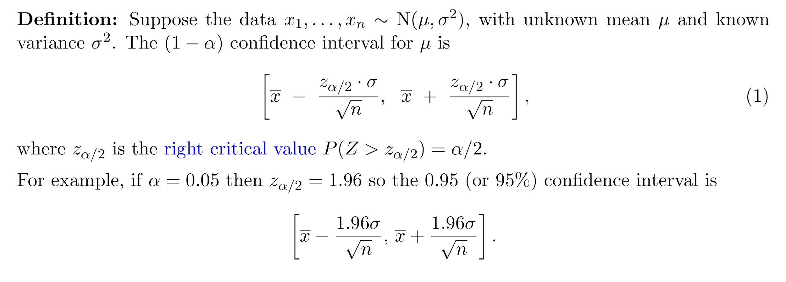
Modeling and Evaluation

Slide 21
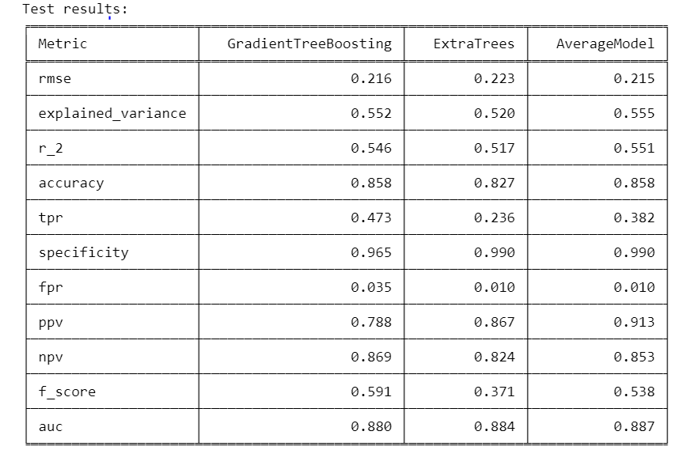
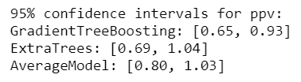
Modeling and Evaluation
Final model selection
When this model predicts success then with 91.3% probability it will be true success and there is only 1% percent of probability that this model will predict success in case of true failure.
We the final model will be the ensemble of both models with averaged prediction!!!
In case of true successes performance much better than ExtraTrees and close to GradientTreeBoosting.
Performance is similar to ExtraTrees and better than GradientTreeBoosting .
Positive predictive value is more than for each single model.
AUC is more than for each single model.

Slide 22


Next Steps
1
Data Related
Request for detailed information about
dataset features, so we can understand
technical and business specifications of
features. This will help to improve provided result.
More features about different market specifics.
More feature engineering.
2
Modeling Related
To try other Machine Learning algorithms such as
Neural Networks and Probabilistic Models.
To try other methods for hyper parameters tuning.
To try different approach: to treat problem directly
as classification problem (without estimating market
share number - to estimate product will be successful or not).

Slide 23
Q&A

