Slide 1
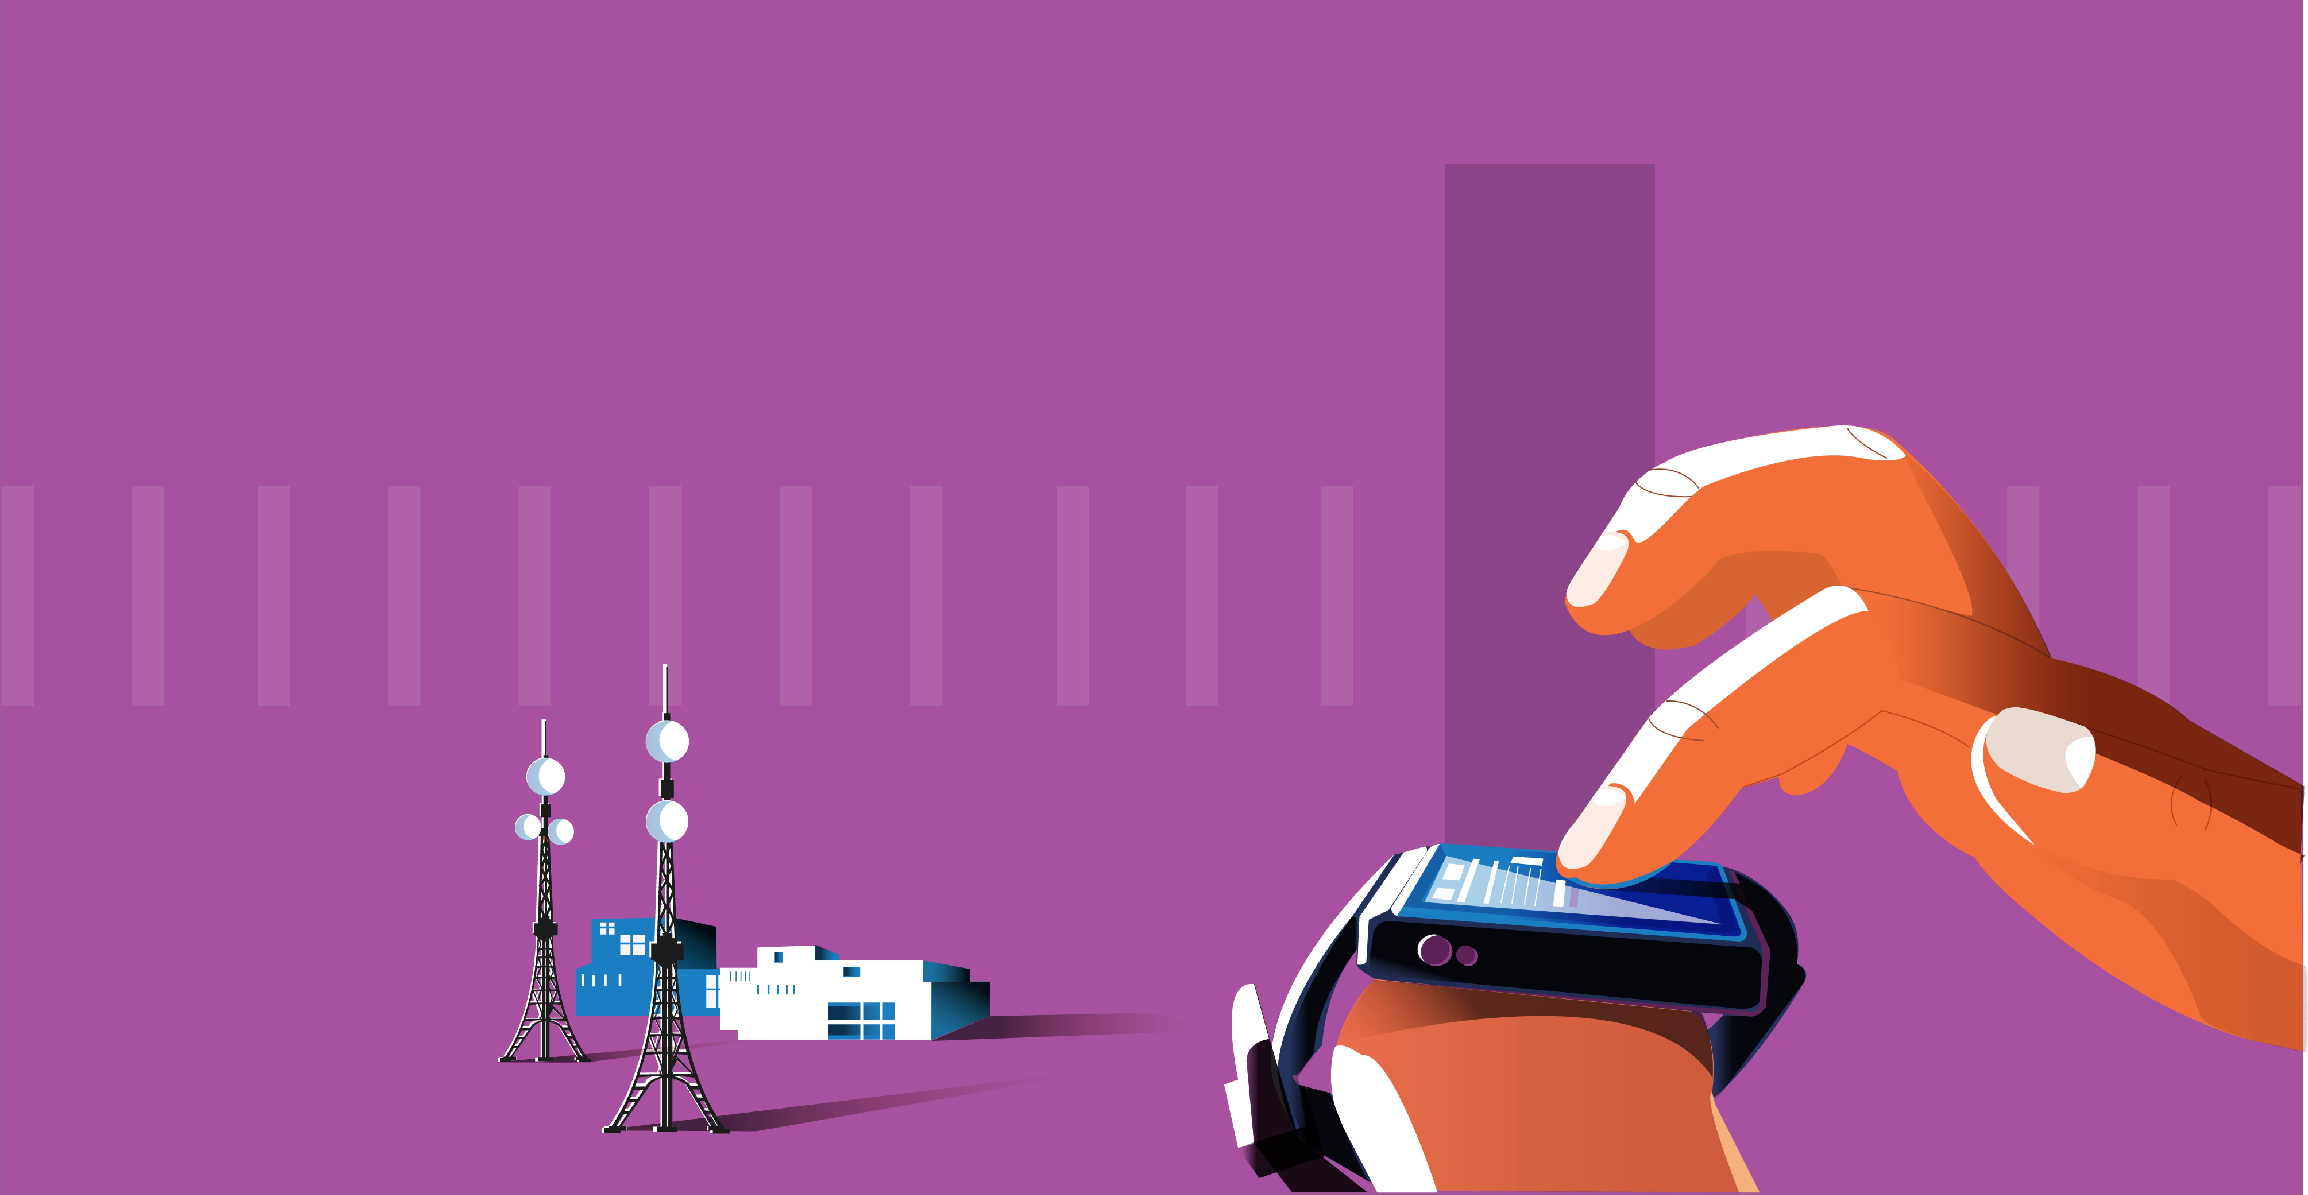
Geo Based Healthcare Monitoring
Team: Dreamers
Razmina K
Haritha U Reddy
Sareen Ansari
Anapalli Reddy

Slide 2
Why This Project?
Health influences the overall characteristics of a nation in every dimension, from education to productivity, impacting the overall economic output.
Governments put an enormous effort and substantial resources to ensure good health and wellbeing of its citizens.
The effectiveness of such efforts mainly depends upon the identification of the beneficiaries who are in an actual need for attention towards their health and nourishment.​
Artificial Intelligence and Geographic Information System will help towards “Geographical monitoring & strengthening of Healthcare”
Our Solution: We come up with an application incorporating Machine Learning and geographical monitoring & strengthening of Healthcare Programs. There are multiple features covering various aspects.
Malnutrition detection (Undernutrition, overnutrition, and obesity) with height, weight, and age.
Disease prediction based on symptoms.
Predicting groundwater level

Slide 3

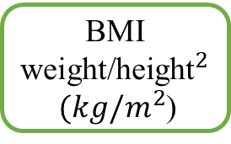
Malnutrition
According to WHO, addressing all forms of malnutrition is one of the greatest health challenges around the world.
Our solution can detect whether a person is suffering from undernutrition or is overweight, or is obese based on their height, weight, and age of the person.
The Government can then utilize this data to visualize the overall picture at state and subdivision levels and prioritize delivery of their schemes to the correct population.
Undernutrition
Height
BMI
weight/${\text{height}}^{2}$
$(kg/m^{2}$)
Overnutrition
Weight
Obesity
WHO standards for BMI, predicting malnutrition:
Undernutrition, if BMI<18.5
Normal, if 18.5<=BMI<25
Overweight, if 25<=BMI<30
Obesity, if BMI>=30

Slide 4
Disease Prediction
Most of the common diseases like diabetes, hypertension, malaria, typhoid, jaundice, tuberculosis, etc. require laboratory diagnosis.
Our application features an algorithm to detect some of these diseases based on the symptoms associated to them using advanced machine learning techniques.
Helps in early detection and treatment of diseases.
Provides map-based at state and subdivision level, helpful in monitoring the prevalence of these diseases.
Fatigue
Restlessness
weight_loss
blurred_and_distorted_vision
excessive_hunger
ML model
Disease Predictor
Diabetes
Use Case: Prediction of diabetes
Provide government with deep insights in designing healthcare programs for diseases prevalent in target regions
Helps in effective utilization of existing programs by prioritizing areas in actual need.

Slide 5
Prediction of Groundwater level
Drinking water is also an important factor that determines health in a locality.
According to UNESCO, groundwater is an important freshwater resource that provides about 50% of the available drinking water.
Population growth and urban expansion have dramatically increased the demand of clean drinking water, leading to over exploitation of
This emphasizes the importance of predicting future groundwater level for a sustainable future.
We plan to use a regression-based approach to predict the groundwater levels in the upcoming years based on sequences of monthly groundwater maps.
The Gravity Recovery and Climate Experiment (GRACE) dataset is an adequate source to build such a machine learning algorithm.
Accurate groundwater forecasts will help government authorities to determine the best approach towards effective groundwater management.

Slide 6
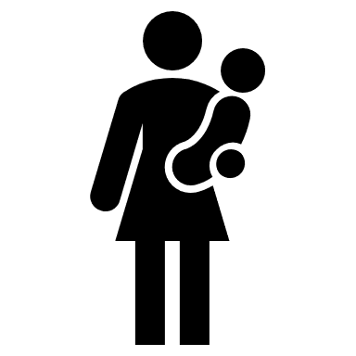

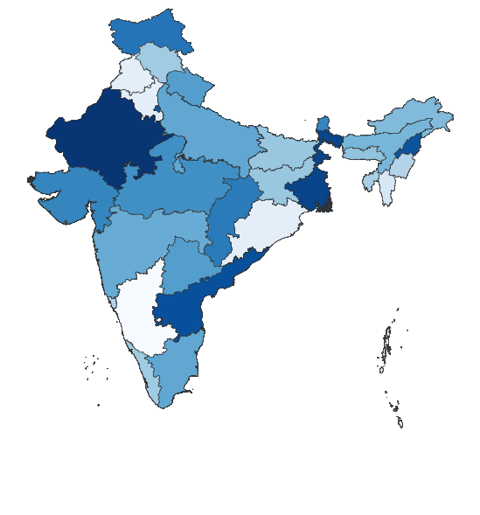
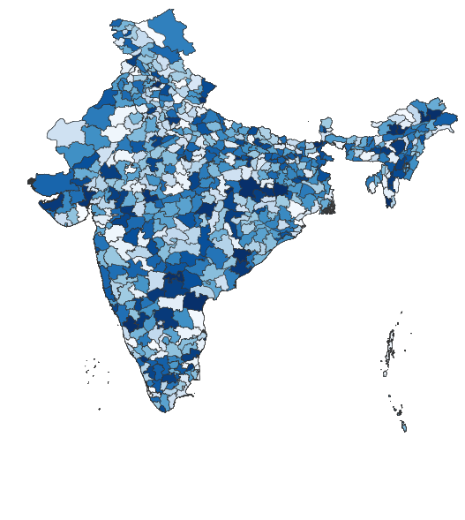
Database
Data Collection and Cleaning
Height
Weight
Age
Location data
Symptoms
Location data
Anganwadi
Data Collection
Model Training
Disease Prediction
Government Scheme/Policy makers
Malnutrition Prediction
Height
Weight
Age
Location data
Malnutrition Prediction
Data Cleaning
Machine learning Models
Machine Learning models
Predictions
Symptoms
Location data
Disease Prediction
Visualization
Model generation
State level
Subdivision level

Slide 7
Conclusion
Our solution aims to increase the effective beneficiaries of the government schemes.
The use case we demonstrated is towards the identification of malnutrition and prediction of diseases at state and subdivision levels.
We will also include ground water forecasting for effective groundwater management.
We also plan to in-corporate GIS to analyze and modify the prioritization based on state and subdivision level with live tracking.

Slide 8
Thank You

