Slide 1


College Costs and Career Pay
Data to Find the Balance

Slide 2
Project Summary
OVERVIEW: According to the Department of Education, the typical undergraduate student with loans graduates with nearly $25,000 in debt. Since 1980, the total cost of four-year public and four-year private college has nearly tripled, even after accounting for inflation. College costs are more important than ever when considering where to go and what to study, while keeping a focus on what someone will earn once they graduate.
OBJECTIVE: We believe that by studying these datasets, we can better understand how to optimize college expenses in relation to the early career salary. This data-driven research could provide another layer of insight to future college bound students, coupled with their intuition and/or personal experience.

Slide 3











Technologies and Platforms
Data Cleaning and EDA Analysis
Database Storage and Diagram
Machine Learning Libraries and Flowchart
Dashboard

Slide 4
Data Sources
Our data was sourced from Kaggle and below is a breakdown of where the data originated.
School name, tuition, fees, school type, degree length, state and in-state vs out-of-state comes from The Chronicle of Higher Education.
Enrollment size comes from TuitionTracker.org.
Potential salary data and percentage of STEM degrees comes from payscale.com.
Region and division of states comes from United States Census Bureau.

Slide 5
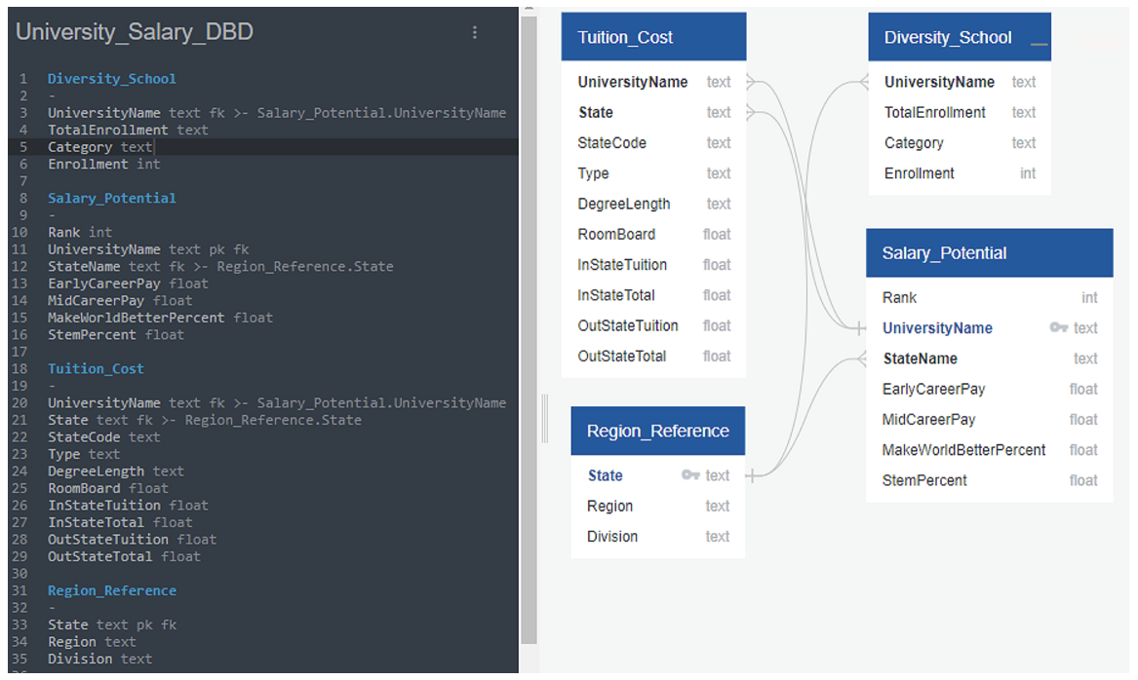
Database
Overview PostgreSQL, via PGAdmin, is used to store the tables of data. We used SQLAlchemy as our Object Relational Mapper.
Below is our entity relational diagram that outlines our datasets and assisted us with our EDA process.
The two most common features within our datasets is State and UniversityName.

Slide 6
Exploratory Data Analysis
INITIAL QUESTIONS
How many colleges are in each state?
How many public, private, and for-profit colleges are in each state?
What are the average tuition costs by state of a two-year and four-year college?
How does field of study influence early career pay?
What states have the highest early career salary?
What regions have the highest early career salary?

Slide 7
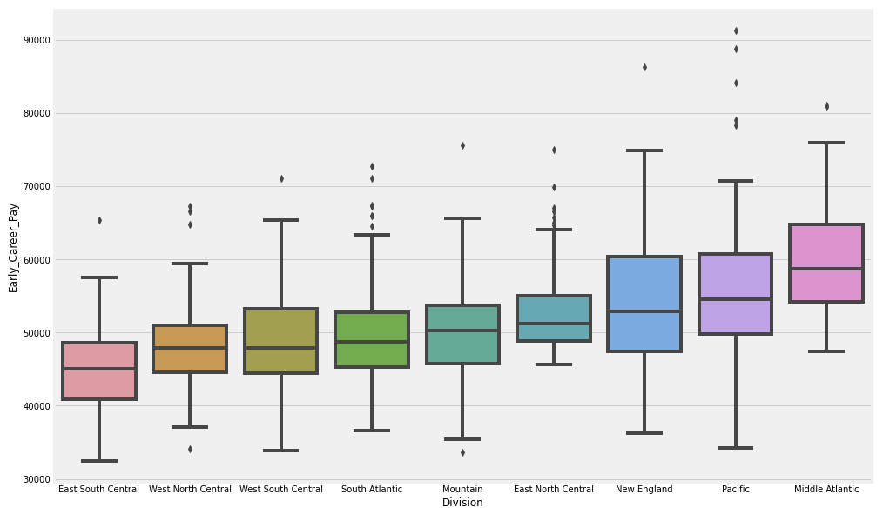
Exploratory Data Analysis - Visuals and Descriptions
After cleaning the data, which entailed matching and formatting the school names, we were left with 907 rows and 27 columns. Overall, the initial review showed that Mississippi had the lowest average of Early Career Pay while New York edged out California for the highest. Here are some highlights we found during the EDA process.
This visual shows the average Early Career Pay by Division. The divisions are comprised of smaller groups with the regions, as defined by the U.S. Census Bureau. The Middle Atlantic includes New York and East South Central includes Mississippi.

Slide 8
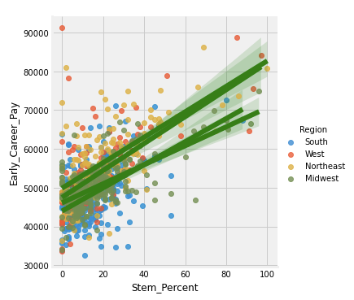
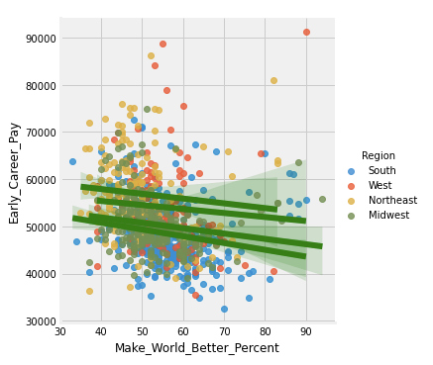
Exploratory Data Analysis - Visuals and Descriptions
What we found most interesting was the correlation of Stem Percent (the percentage of students enrolled in STEM fields of study) to Early Career Pay. The higher the percentage, the higher the pay. In sharp contrast, the lower the Make World Better Percent (the percentage of students who identified themselves in fields of study to better the world around them) the lower the Early Career Pay. As you can see, these patterns exist across all regions of the United States.

Slide 9
Machine Learning
Preliminary Data Preprocessing
Assessed the data types
Replaced the nulls with zero
Dropped the unnecessary columns: University Name, Rank, Mid Career Pay, and Degree Length
Pandas.get_dummies was used to convert Division, State, Region, and Type to integers
Preliminary Feature Selection and Engineering Process We elected to convert the target column values (Early Career Pay) to either “Low” (less than $45,000) or “Medium/High” for all other amounts.
Of the dropped columns above we selected to remove Mid Career Pay and Rank for the initial phase of modeling. These features may be added back in pending further testing.
While we were initially interested in the difference of Early Career Pay between two-year and four-year degrees, we only had six rows of data associated with two-year degrees. Therefore, we did not use the Degree Length column.

Slide 10
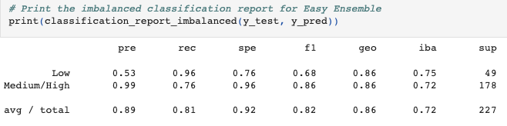
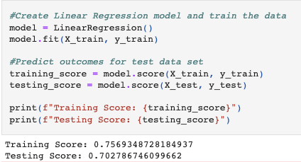
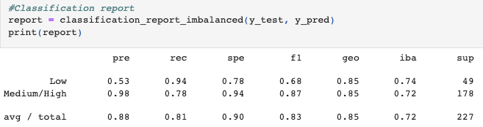
Machine Learning - Model Training and Testing
Easy Ensemble AdaBoost Classifier
Training and Testing Sets We used the Sklearn train_test_split for all four of the models in our repository. In addition, 80% of our data was used for training and 20% for testing.
Linear Regression
Balanced Random Forest Classifier
Deep Neural Network - using tf.keras

Slide 11
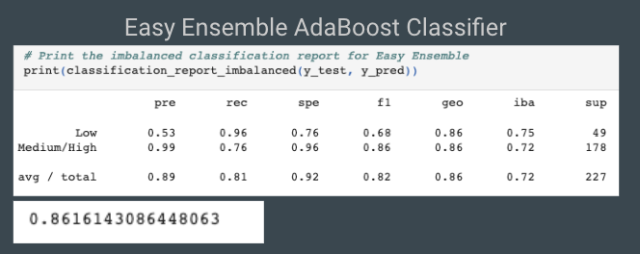
Machine Learning - Model Selection with Benefits and Limitations
As presented on the previous slide, the best performing models were the Easy Ensemble AdaBoost Classifier and Balanced Random Forest Classifier. Ultimately, we believe that the AdaBoost is the most favorable for our dataset. It narrowly beats out the Random Forest with regards to precision and accuracy.
Benefits
The AdaBoost learns by giving higher weights to errors in the previous stump. It also utilizes bootstrapping and random undersampling for balance. In this instance, the AdaBoost learners actually reduce the issue with oversampling.
Limitations
The most notable limitation is that the AdaBoost is harder to interpret the outcome. It doesn’t include feature importance or decision path like the Balanced Random Forest.

Slide 12
Dashboard
Overview We expect to have the Dashboard be a single page to remove any frustration from going back and forth to cross reference various data points.
Future college bound students typically have a general idea of where they wish to attend school, geographically speaking, so we will focus on an interactive United States Map. This will allow the user to obtain the information they find most relevant to them, while still allowing for direct comparisons (among other states, for example) as they see fit. The visuals can be found on the following slide.
Description of Tools The interactive dashboard will be created and hosted on Tableau Public.

Slide 13
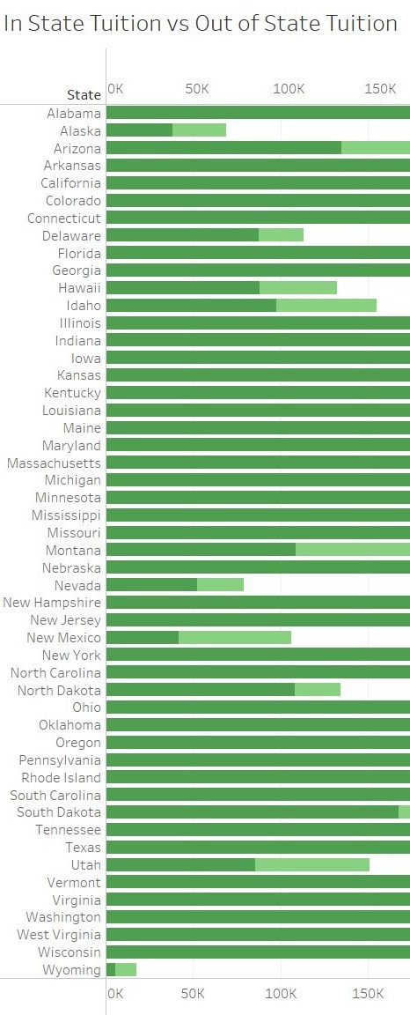
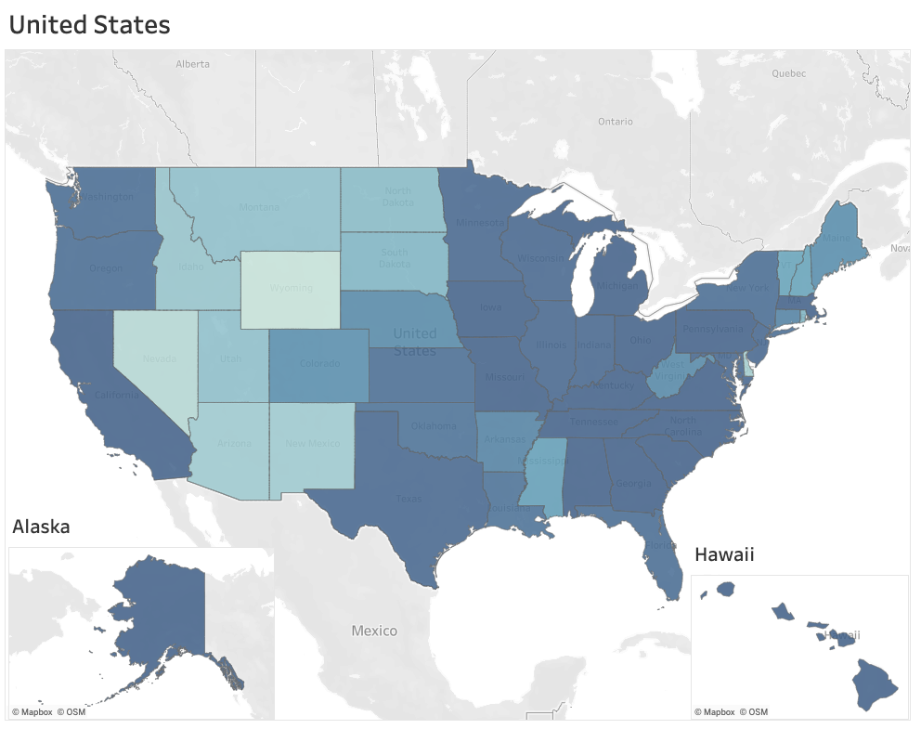
Dashboard - Storyboard and Interactive Elements
We intend to provide a bar chart for a comparison of In-State Tuition vs. Out-of-State Tuition for each state. Similar to the first visual shown below. Our primary focus for the Dashboard will be utilizing a Map where we plan to have most of our interactive elements reside.
INTERACTIVE ELEMENTS
Filter by Salary Range - states that met the selected criteria will be highlighted (with additional information in the Tooltip).
In-State Tuition Average with Early Career Pay Average.
Out-of-State Tuition Average with Early Career Pay Average.
Public vs Private regarding Early Career Pay by State - list the top school of each type for the state selected.
*Further adjustments/additions to the interactive elements are possible as the project continues.

