Slide 1


Slide 2

IMPORTANCE OF BLOOD
SAFETY AND AVAILABLITY

Slide 3

IMPORTANCE OF BLOOD
SAFETY AND AVAILABLITY
The patient lost 30% of her total blood volume while giving birth
The hospital does not have supply of blood on hand
Medical personnel put out a call to the woman's family for emergency donations
They were only able to raise several units of blood (was not enough)
The baby survived, but the women did not.

Slide 4
IMPORTANCE OF BLOOD
SAFETY AND AVAILABLITY
Red Cross says new blood donor needed
every 5 minutes
to meet growing demand
The patient lost 30% of her total blood volume while giving birth
The hospital does not have supply of blood on hand
Medical personnel put out a call to the woman's family for emergency donations
They were only able to raise several units of blood (was not enough)
The baby survived, but the women did not.

Slide 5

PROBLEMS

Slide 6

PROBLEMS

Slide 7

PROBLEMS

Slide 8

PROBLEMS

Slide 9




SOLUTION
HOW IT WORKS
PHILIPPINE RED CROSS
BLOOD BANKS
HOSPITALS
DIALYSIS
CENTERS

Slide 10


SOLUTION
HOW IT WORKS
PHILIPPINE RED CROSS
BLOOD BANKS
HOSPITALS
DIALYSIS
CENTERS

Slide 11
SOLUTION
HOW IT WORKS
PHILIPPINE RED CROSS
BLOOD BANKS
HOSPITALS
DIALYSIS
CENTERS

Slide 12

SOLUTION
HOW IT WORKS
MONITORS BLOOD SUPPLY FOR EACH BLOOD BANK ACCEPTS REQUESTS FROM BLOOD BANKS
PHILIPPINE RED CROSS
BLOOD BANKS
HOSPITALS
DIALYSIS
CENTERS

Slide 13

SOLUTION
HOW IT WORKS
MONITORS BLOOD SUPPLY FOR EACH BLOOD BANK ACCEPTS REQUESTS FROM BLOOD BANKS
PHILIPPINE RED CROSS
BLOOD BANKS
HOSPITALS
SENDS REQUESTS TO PRC
MONITORS BLOOD SUPPLY
DIALYSIS
CENTERS

Slide 14
SOLUTION
HOW IT WORKS
MONITORS BLOOD SUPPLY FOR EACH BLOOD BANK ACCEPTS REQUESTS FROM BLOOD BANKS
PHILIPPINE RED CROSS
BLOOD BANKS
HOSPITALS
SENDS REQUESTS TO PRC
MONITORS BLOOD SUPPLY
DIALYSIS
CENTERS

Slide 15

OUR PRODUCT

Slide 16

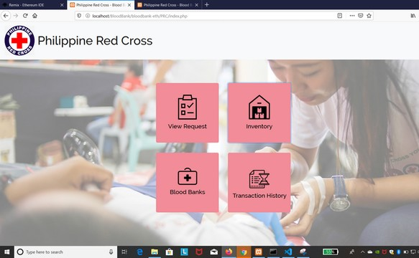
OUR PRODUCT
bChain: Computerized Blood Supply Monitoring System

Slide 17

bChain System (Blood Bank Page)

Slide 18
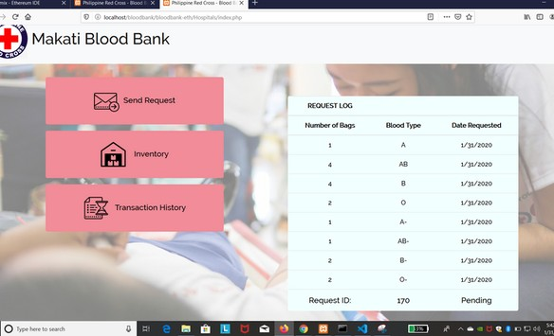
bChain System (Blood Bank Page)
Home Page

Slide 19

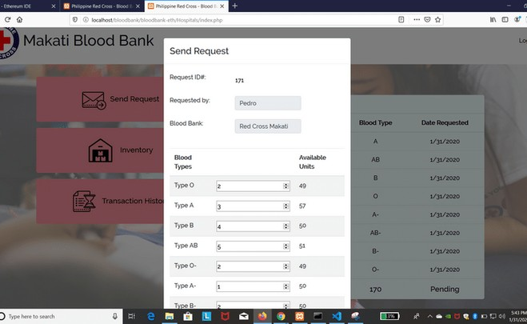
bChain System (Blood Bank Page)
Send Request Page
Home Page

Slide 20
bChain System(PRC Page)

Slide 21
bChain System(PRC Page)
Home Page

Slide 22
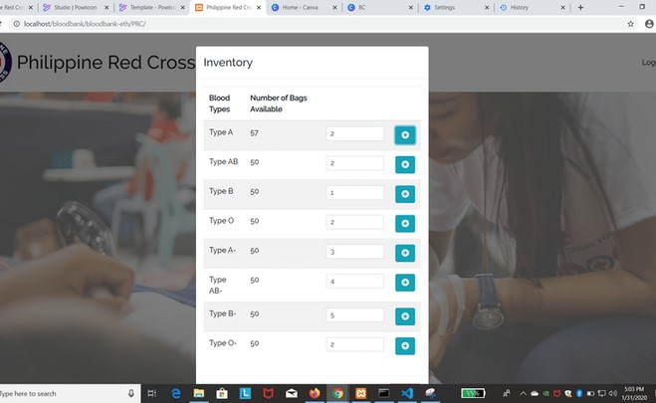
bChain System(PRC Page)
Inventory Page
Home Page

Slide 23
bChain System (PRC Page)

Slide 24
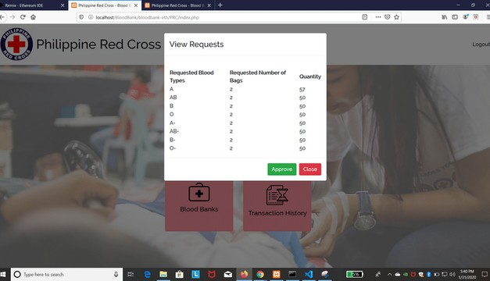
bChain System (PRC Page)
PRC View Request Page

Slide 25
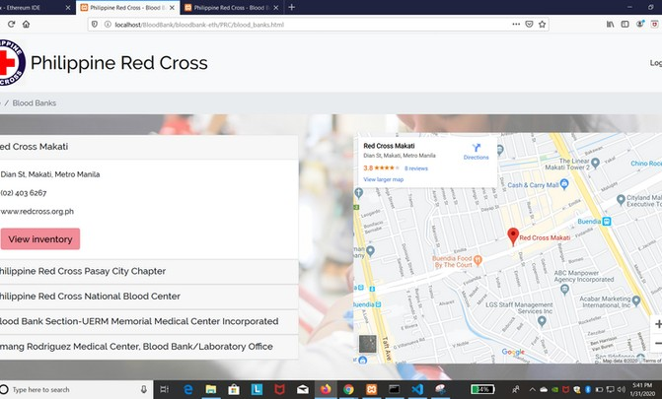
bChain System (PRC Page)
PRC View Request Page
PRC Blood Bank Maps

Slide 26

BUSINESS MODEL

Slide 27



BUSINESS MODEL
OPPORTUNITIES
14 %
of blood pints that had been donated are being discarded.
Government Funding

Slide 28


BUSINESS MODEL
OPPORTUNITIES
TARGET MARKET
14 %
of blood pints that had been donated are being discarded.
Government Funding
HOSPITALS
DIALYSIS CENTERS

Slide 29

bChain System

