Slide 1
Inside Olist
What 100,000 Brazilian e-commerce orders tell us
Data inspection & analysis · Sep 2016 – Oct 2018
Notes:
Today I want to walk you through a real dataset from a Brazilian online marketplace called Olist. It covers about one hundred thousand orders, placed over two years, from late 2016 to late 2018.
I will not assume you know anything about data. The plan is simple. First, what is in the data and can we trust it. Then who buys, what they buy, and how they pay. Then who sells. Then the part I find most interesting: delivery, and what it does to customer happiness. And finally, how new sellers are recruited.
If you remember only one thing, remember this: in this data, **when the parcel arrives matters more than almost anything else.**

Slide 2
Eleven tables, one story
order_payments
103,886 rows
products
32,951 rows
category_translation
71 rows
customers
99,441 rows
orders
99,441 rows
order_items
112,650 rows
leads_qualified
8,000 rows
geolocation
1,000,163 rows
order_reviews
99,224 rows
sellers
3,095 rows
leads_closed
842 rows
Green = transactions · Blue = reference data · Yellow = seller-recruiting funnel · everything revolves around the order
Notes:
The data lives in one database file with eleven tables. Think of eleven spreadsheets that are linked together.
Everything revolves around the **order**, in the middle. Each order points to the customer who placed it, the items inside it, the payments, and the review the customer wrote afterwards. Each item points to a product and to the seller who sold it. Those are the green boxes, the transactions.
The blue boxes are reference material: a list of product categories with their English names, and a table of map coordinates for postcodes.
The yellow boxes are a separate story: the marketing funnel, that is, businesses that were approached to become sellers, and which of them signed up.
In total there are about one and a half million rows, but one table, the map coordinates, is a million of them. The real business is about a hundred thousand orders, ninety-six thousand customers, three thousand sellers and thirty-three thousand products.

Slide 3
Can we trust the data?
0
broken links between tables: every order, item, product, seller and customer matches
26%
of map-coordinate rows are exact duplicates, so they are averaged per postcode
92%
of the extra seller-profile fields are empty, so we do not draw conclusions from them
96,096
real customers, versus 99,441 customer IDs: a new ID is issued with every order
Notes:
Before analysing anything, I checked the data quality, and the news is mostly good.
First, the tables link together perfectly. Every order points to a real customer, every item to a real product and seller. Zero broken links.
Second, there are things to be careful about. A quarter of the map-coordinate table is exact duplicates, so we average it per postcode. Some timestamps are impossible, for example, about a hundred and sixty orders where the parcel was apparently handed to the carrier before the order was placed. That is a tiny fraction, and we noted it.
Third, the sparse parts. Some fields in the seller-recruitment table are more than ninety percent empty, so I do not draw conclusions from those.
And one trap worth knowing about: the customer table has a new customer ID for every order. To count real people you must use a second ID. Counted properly there are about ninety-six thousand people, not ninety-nine thousand.
Finally, about one percent of orders were canceled or unavailable. I removed those from revenue figures.

Slide 4
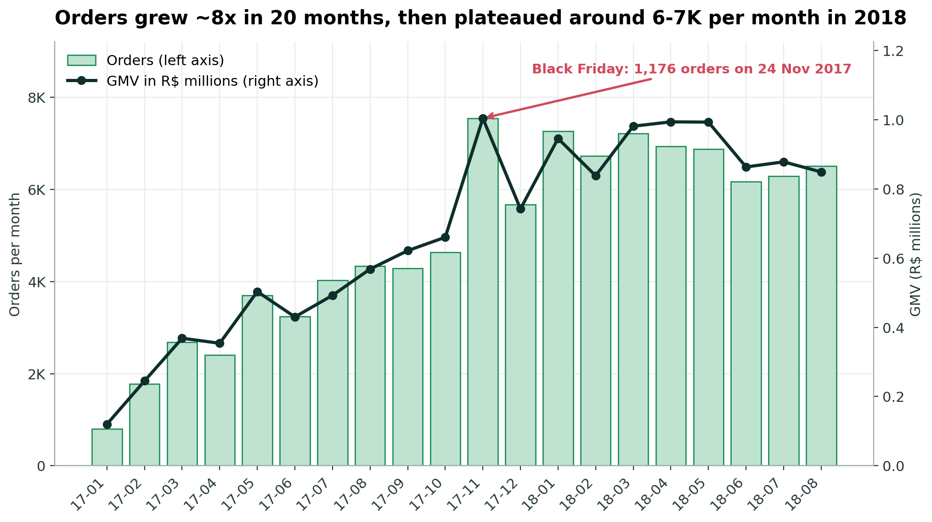
Growth came from volume
135%
more orders, Jan–Aug 2018 vs 2017
R$13.5M
GMV of items sold (excl. shipping)
1,176
orders on Black Friday (24 Nov 2017)
Notes:
Here is the story over time. In January 2017 the marketplace took about eight hundred orders a month. By August 2018 it was about six and a half thousand. That is roughly eight times bigger in twenty months.
Compare the same eight months, January to August, one year apart: orders more than doubled, up a hundred and thirty-five percent, and revenue up a hundred and thirty-eight percent.
Then growth flattened. Throughout 2018, the business sat at around six to seven thousand orders a month.
The tall bar in November 2017 is Black Friday. On the twenty-fourth of November alone there were over eleven hundred orders in a single day. That is about eleven times a normal day at that time of year.
One more detail, and I find it important: the average basket did not grow. An average order was about a hundred and thirty-seven reals in the first eight months of 2017, and again in the first eight months of 2018. So the growth came from **more orders, not bigger orders.**
In total, the items sold were worth about thirteen and a half million reals, plus about two point two million in shipping.

Slide 5
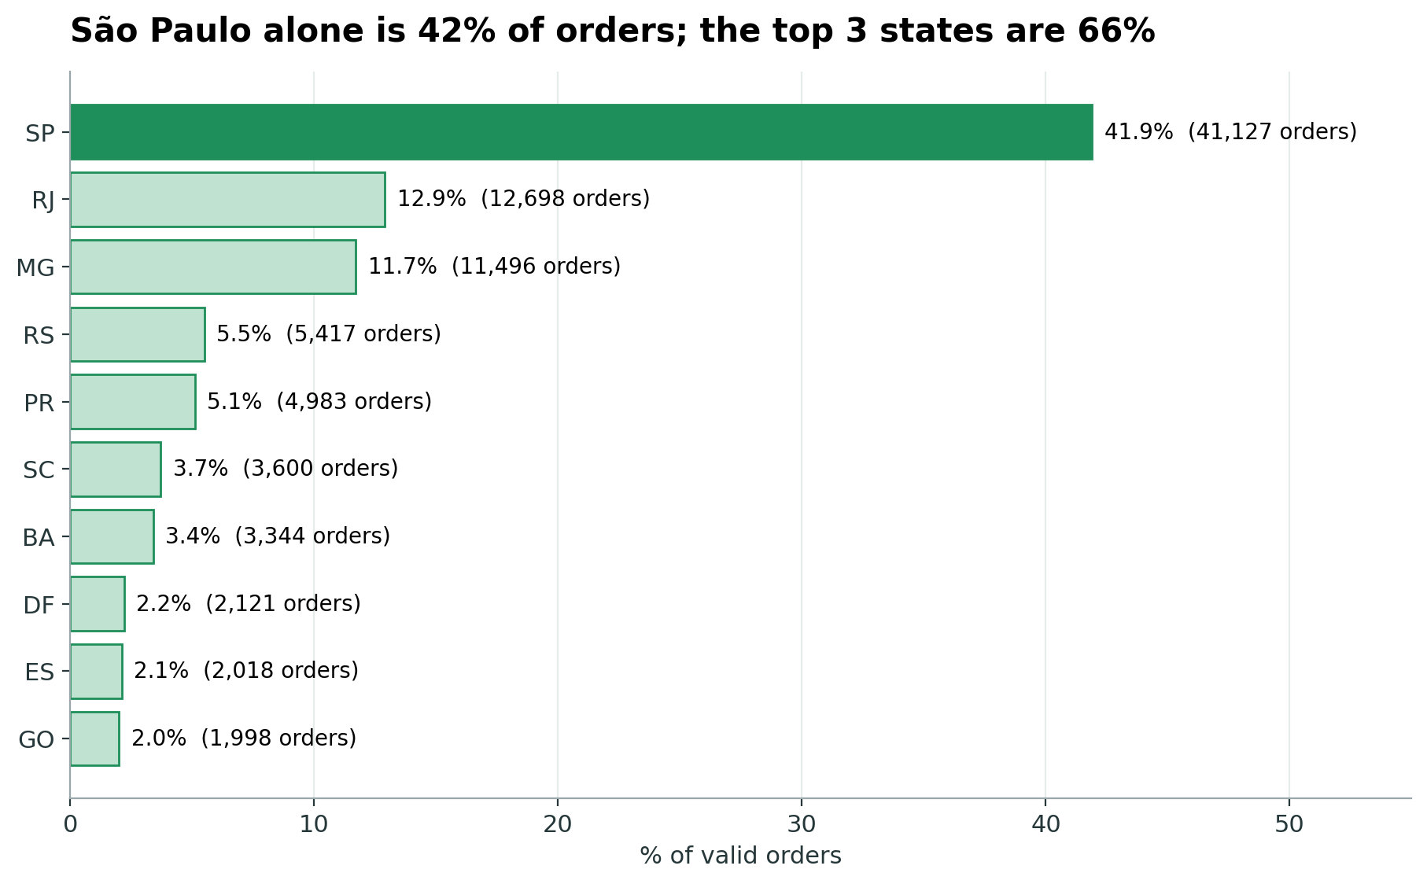
A São Paulo-centred market
42%
of orders come from São Paulo state
66%
come from SP, RJ and MG combined
27
states served, very unevenly
Notes:
Where do these customers live? Brazil has twenty-seven states, and the marketplace serves all of them, but very unevenly.
São Paulo state alone is forty-two percent of all orders. Add Rio de Janeiro and Minas Gerais and the top three states make up two thirds of the business. The city of São Paulo by itself is about sixteen percent of all customers.
On the map in your handout, you can see the picture: customers cover the whole country, but they are thickest along the south-east coast. The Amazon region, in the north, is thin.
This matters because geography will come back later. It drives how long delivery takes.

Slide 6
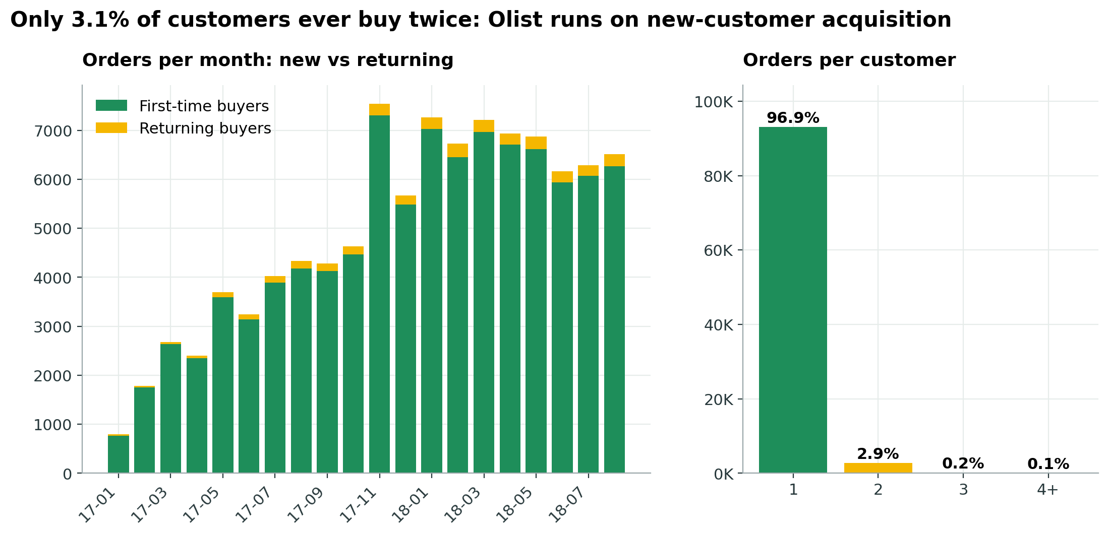
Customers rarely return
3.1%
of customers ever order twice
27 days
median wait before a 2nd order
5.7%
of revenue comes from repeat buyers
Notes:
Here is the number that surprised me most. Of about ninety-six thousand customers, **only three percent ever ordered a second time.** Ninety-seven percent bought once and never again.
Even among the few who did come back, the median wait was about twenty-seven days, and almost a third of them placed their second order on the same day. Those are probably people who forgot something, not loyal fans.
Repeat customers account for under six percent of revenue.
What does that tell us? This marketplace runs on finding new customers all the time. If it could convince even a few more people to buy a second time, that would be a big lever, because it is far cheaper than finding a stranger.
A caution: this is only two years of data, and customers who might return after the data ends are not visible. But three percent is very low.

Slide 7
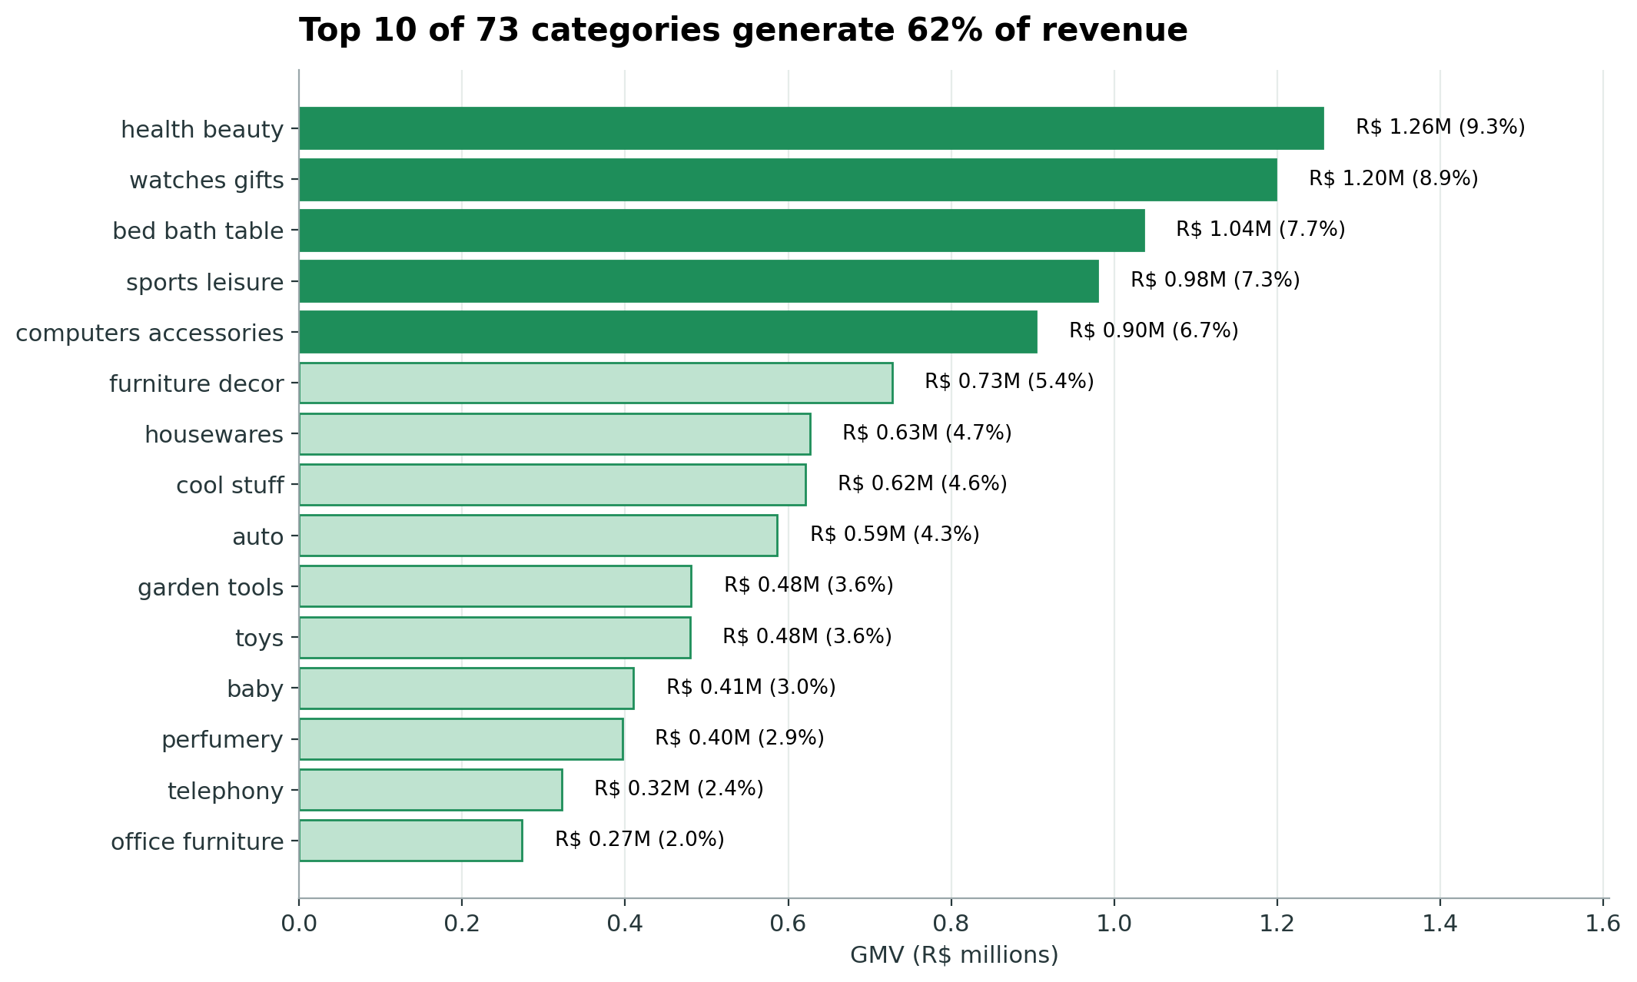
A few categories dominate
62%
of revenue from the top 10 of 73 categories
9.3%
of revenue from #1: health & beauty
R$75
median item price (mean: R$121)
Notes:
What do they buy? There are seventy-three product categories, but ten of them bring in sixty-two percent of the revenue.
Number one is health and beauty, with about nine percent of revenue. Close behind are watches and gifts, then bed, bath and table, which means home textiles, then sports and leisure, then computer accessories.
Notice the difference between volume and value. Bed, bath and table sells the most individual items, over eleven thousand. Watches and gifts sell far fewer, but at about two hundred reals each, so they rank higher in money.
Overall, products are cheap. The typical item costs seventy-five reals. Two thirds of items cost under a hundred reals.
And shipping adds real weight to cheap items: for the lightest, cheapest products, shipping is around thirty percent of the product price. For about four percent of items, shipping costs more than the product itself.

Slide 8
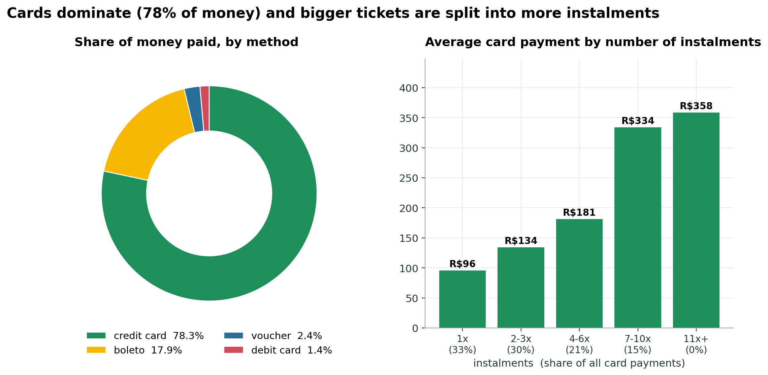
Cards and instalments rule
78%
of money paid is by credit card
67%
of card payments use 2+ instalments
18%
paid by boleto (bank slip)
Notes:
How do they pay? Credit cards, overwhelmingly. Seventy-eight percent of all the money paid came through credit cards. Next comes the boleto, the bank slip, at about eighteen percent. Vouchers and debit cards are tiny.
Now look at instalments. Two thirds of card payments are split into two or more monthly parts. One in five is split into six or more. This is a normal feature of Brazilian shopping: you spread the cost over months.
And the chart on the right shows a clear pattern: the bigger the purchase, the more instalments. A card payment in one go averages about ninety-six reals. A payment split into seven to ten parts averages over three hundred and thirty.
So instalments are what make bigger purchases possible for many customers.

Slide 9
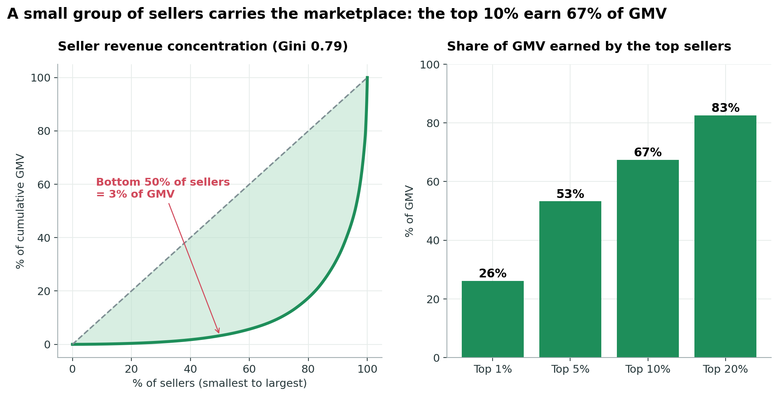
Sellers: a powerful few
67%
of revenue earned by the top 10% of sellers
60%
of sellers are in São Paulo state
46%
of sellers made 5 orders or fewer
Notes:
Now the other side of the market: the sellers. There are about three thousand of them.
The key word here is **concentrated.** The top ten percent of sellers, about three hundred businesses, earn two thirds of all the revenue. The top one percent, just thirty-one sellers, earn over a quarter. The bottom half of all sellers together earn about three percent.
The curve on the left shows it: the further it bows away from the diagonal line, the more unequal the market. The inequality score, called the Gini coefficient, is zero point seven nine, where zero would mean perfectly equal and one means one seller has everything.
At the same time, there is a long tail. Almost half the sellers sold five orders or fewer in the whole period, and the typical seller has sold just seven.
Also, sixty percent of sellers are in São Paulo state, and about seventy percent of all items ship from there. But only forty-two percent of customers live there. So many parcels have a long way to travel. And that brings us to delivery.
On the bright side, the seller base keeps growing: from about two hundred and twenty active sellers a month in early 2017 to about twelve hundred and sixty by August 2018.

Slide 10
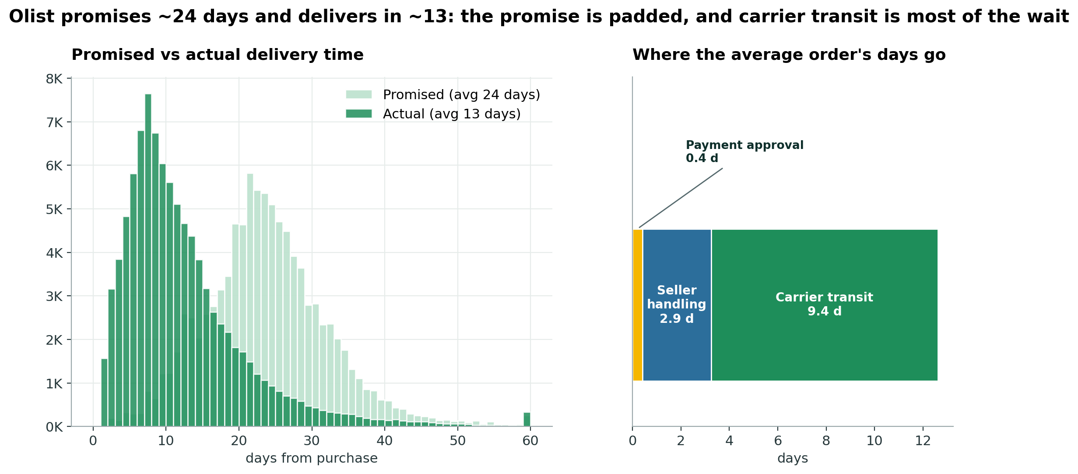
Delivery: fast but uneven
12.6 days
average time from order to delivery
23.7 days
average delivery time promised
6.8%
of orders arrive after the promised date
Notes:
Delivery. On average, an order arrives about thirteen days after it is placed. The middle order takes ten.
Now look at what customers were *promised*. The estimated delivery date shown at checkout averages almost twenty-four days. So most orders arrive around twelve days *before* the estimate. The estimates are very cautious.
Because the estimates are so cautious, only about seven percent of orders arrive after the promised date. Keep that seven percent in mind.
Where do the thirteen days go? The bar on the right splits it. Payment approval takes under half a day. The seller needs about three days to pack and hand over the parcel. And the carrier, the actual journey, takes about nine and a half days. That is roughly three quarters of the wait.
And that journey depends on distance. Almost two thirds of items cross a state line. Same-state parcels arrive in about eight days and cost about thirteen reals to ship. Cross-state parcels take about fifteen days and cost about twenty-four.
By state, São Paulo customers wait about nine days. Customers in Alagoas wait about twenty-four, nearly three times as long.
Lateness also comes in waves. In November 2017, around Black Friday, twelve percent of orders were late. In February and March 2018 it was worse: fourteen and then nineteen percent in March.

Slide 11
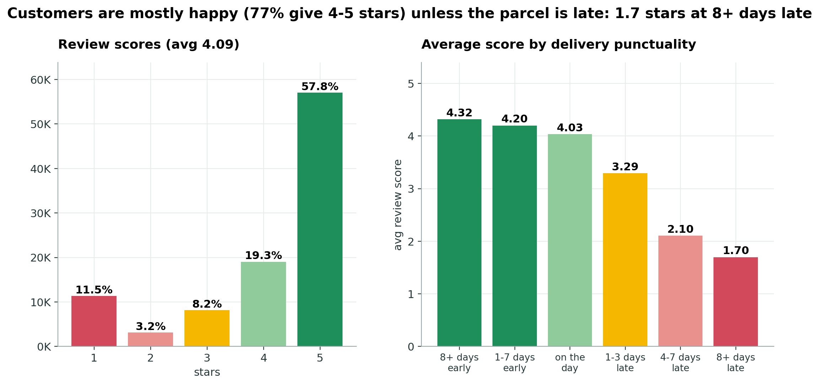
Late means unhappy
4.09
average review score (out of 5)
4.3 vs 2.3
avg stars: on-time vs late orders
54% vs 7%
1-star share: late vs on-time orders
Notes:
This is the slide that ties everything together.
Customers are mostly happy. The average review is four point one out of five. Fifty-eight percent give five stars, and seventy-seven percent give four or five.
But look at the right-hand chart. It splits orders by how early or late they were compared with the promised date. If the order arrives early, or on time, the average score is about four point three. If it arrives even one to three days late, the score drops to three point three. Four to seven days late, two point one. More than a week late: one point seven, and seventy percent of those customers give one star.
Put another way: among late orders, more than half get a one-star review. Among on-time orders, only seven percent do.
Late orders are only about seven percent of deliveries, but they account for more than a third of all one-star reviews.
What do unhappy customers write? Among the one-star comments, almost a quarter say, in Portuguese, that they never received the product. The five-star comments praise the delivery being earlier than promised, and say "I recommend".
There are other signals too. Price barely matters for satisfaction. Category does: books and luggage score highest, around four and a third to four and a half; office furniture scores lowest, around three and a half.
One more finding to flag: orders that contain items from more than one seller are rare, about one point three percent, but they average only two point nine stars. We cannot prove why from this data. One guess is that items arrive in separate parcels, while the recorded delivery date only reflects one of them.
I should be honest about the limits: this shows a strong *association*, not proof of cause. But the pattern is very clear, and it points at the last mile.

Slide 12
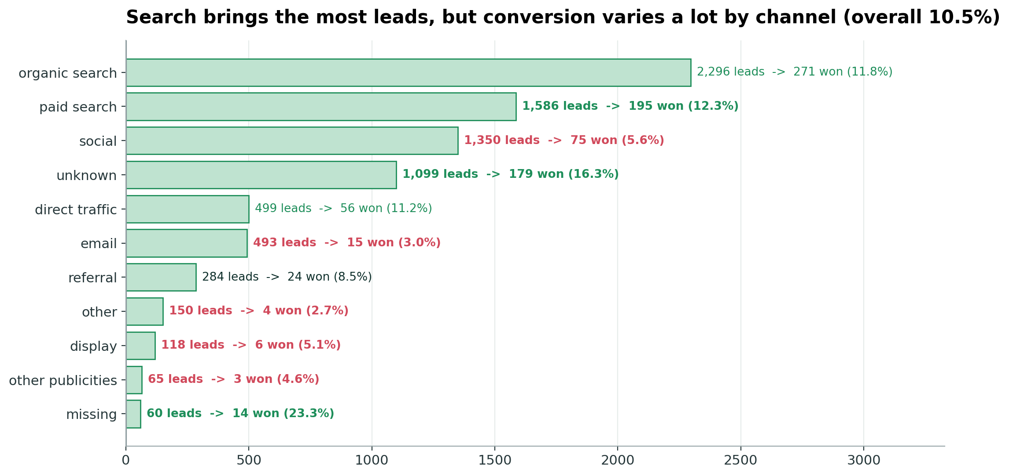
Recruiting: 1 in 10 is won
10.5%
of 8,000 leads were won (842)
15 days
median time from contact to won
12% vs 3%
conversion: paid search vs email
Notes:
Last topic: how does the marketplace recruit new sellers? The second set of tables tracks eight thousand businesses that were identified as promising leads, and what became of them.
Out of eight thousand, eight hundred and forty-two signed up. That is a conversion rate of about ten and a half percent, so roughly one in ten.
It is fairly quick when it works: the median deal closes within fifteen days of first contact, and about two thirds close within a month. But there is a long tail, and eighteen percent take more than ninety days.
Where do leads come from? Mostly search engines: organic and paid search together bring about half of all leads, and they convert at around twelve percent. Social media brings a lot of leads, about seventeen percent of the total, but converts at only about five and a half percent. Email is the weakest, at three percent.
One flag: about fourteen percent of leads have an unknown origin, and those actually convert best, at sixteen percent. That is a tracking gap worth fixing.
Who signs up? Seventy percent are resellers rather than manufacturers. Home décor and health and beauty are the biggest segments.
And a final note: only about 380 of the 842 won sellers can be found in the sellers table. One possible reason is that the recruiting records run past the end of the order records, but the data does not say for sure. Of those 380, nearly all made at least one sale, and together they account for five percent of revenue.

Slide 13
Four things to remember
1
Growth = volume
2
Almost nobody returns
Orders +135% year on year, while the average basket stayed flat at about R$137.
Only 3.1% of customers order twice: the biggest untapped lever.
3
The last mile drives reviews
4
Concentration everywhere
On-time orders average 4.3 stars; late orders 2.3 stars.
São Paulo = 42% of orders · 10 categories = 62% · top 10% of sellers = 67%.
Notes:
Let me finish with four takeaways.
One. **Growth was about volume, not basket size.** Comparing the first eight months of 2018 with the same months of 2017, orders more than doubled, up a hundred and thirty-five percent, but the average order stayed the same, around a hundred and thirty-seven reals.
Two. **Almost nobody comes back.** Three percent repeat buying is the biggest untapped opportunity in the data.
Three. **The last mile decides the reputation.** On-time orders average about four and a third stars. Late ones, about two and a quarter. The delays cluster in particular months, and in distant states.
Four. **The marketplace is concentrated** in three ways: a few states, where São Paulo is over forty percent; a few categories, where ten bring in sixty percent; and a few sellers, where ten percent earn two thirds of the revenue. That concentration is both a strength and a risk.
Based on this, the actions I would suggest are: fix late deliveries first, especially before big sales events; give customers a reason to come back; recruit sellers closer to the customers outside São Paulo; and keep a close eye on the quality of the top sellers, because they define the platform's reputation.
Thank you. I am happy to take questions, and everything I have shown is in the folder of charts and fact sheets.

