Slide 1



DATA BRIEFING - GOOGLE MAPS BUSINESS LISTINGS
Bangladesh's Food Market,
Measured.
A full inspection of 10,755 restaurants and food places across all 64 districts - what customers say, where attention lives, and where the openings are.
919,308
customer reviews
62 of 64
districts covered
4.08
average rating of rated places
Source: restaurants.csv - 12,703 raw listings, de-duplicated | October 2025
Notes:
- Open by setting the expectation: this is a 4-minute data walkthrough of Bangladesh's national food landscape on Google Maps.
- Scope in one line: 10,755 unique restaurants and food places across all 64 districts, cleaned up from 12,703 raw listings.
- Point to the three chips: 919,308 customer reviews, coverage in 62 of 64 districts, and a 4.08 average rating among rated places.
- Frame the promise of the deck: what customers say, where attention lives, and where the openings are.

Slide 2

THE DATASET AT A GLANCE
restaurants.csv - de-duplicated
Ten and a half thousand places, 919K reviews -
and a raw file that needs care.
✦
✦
12,703
10,755
919,308
raw rows become unique places after removing 1,948 duplicates
real customer reviews (the raw file double-counts 2.07M)
✦
✦
23.5%
47.8%
of places have never been rated - a 0 rating means unrated, not bad
of places have 2 reviews or fewer - half the market is invisible online
DATA CAVEATS
Rating 0 = not yet rated (2,529 places)
Affluence column 90.5% empty - do not use
110 rows are not restaurants (mosques, parks, furniture); 63 addresses are in India
Notes:
- Stress that every number quoted from here on comes from the de-duplicated file: 12,703 raw rows become 10,755 unique places.
- Duplicates inflate raw review totals by ~1.15M - the raw file shows 2.07M, the real count is 919,308.
- 23.5% of places have never been rated: a 0 rating means unrated, not bad (2,529 places).
- 47.8% have 2 reviews or fewer - half the market is effectively invisible online.
- Hygiene flags: affluence column 90.5% empty, 110 rows are not restaurants, 63 addresses are in India.

Slide 3
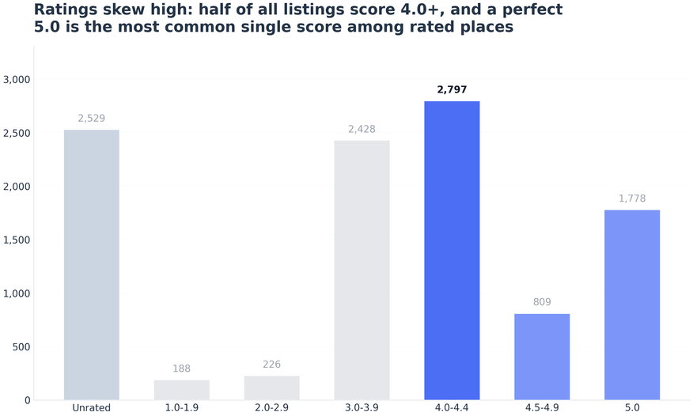
RATINGS
Ratings skew high - and big venues get graded harder.
★
01 · THE AVERAGE
AVERAGE RATING DISTRIBUTION
▦
4.08 average rating; two-thirds (65.5%) of rated places score 4.0+
♛
02 · THE MODE
A perfect 5.0 is the most common single score - 21.6% of rated places
↘
03 · VOLUME VS GRADE
The busiest venues average only 3.4-4.4 stars; correlation between reviews and rating is negative (Spearman rho = -0.25) - popularity attracts harsher grading
▦
Source: restaurants.csv - Google Maps business listings, de-duplicated
ⓘ
Reminder: a 0 rating means not yet rated - 2,529 places sit in that bucket.
Notes:
- Ratings skew high: 4.08 average, 65.5% of rated places score 4.0+, and a perfect 5.0 is the single most common score (21.6%).
- Offer both readings: either the food scene is genuinely strong, or weak performers disappear from Maps.
- Volume is not praise: the busiest venues average only 3.4-4.4 stars; Spearman rho = -0.25 between review count and rating.
- Punchline: popularity attracts harsher grading - big venues cannot hide behind a small fan base.

Slide 4
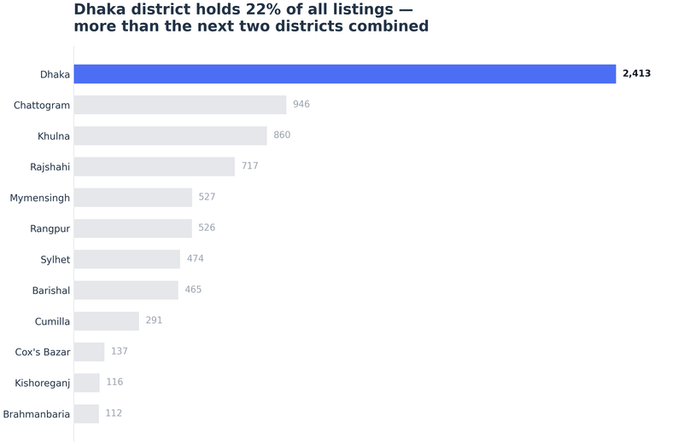
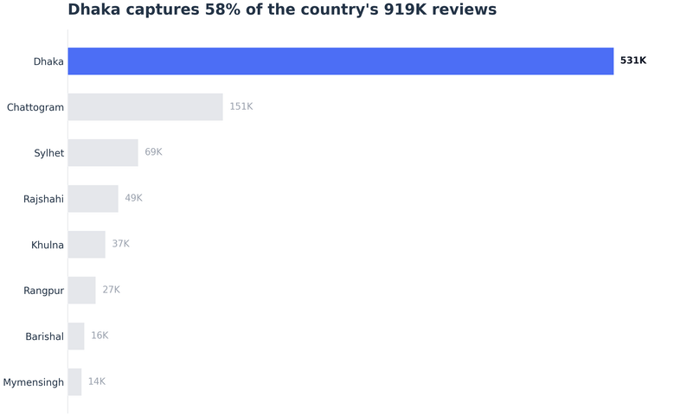
GEOGRAPHY
Dhaka holds a quarter of the places - and 58% of the attention.
Listings mark where supply sits; reviews mark where customer attention actually lands.
◎
Listings by district
◉
Reviews by division
♛
CONCENTRATION
THE LONG TAIL
TOURIST EFFECT
Top 1% of places (~108 venues) hold 40.4% of ALL reviews
⊘
⚑
Sylhet: 69K reviews from just 703 listings - tourist traffic works
5,138 places (47.8%) have 2 reviews or fewer
Notes:
- Dhaka is ~25% of listings but 58% of all reviews — attention is far more concentrated than supply.
- Key line: visibility, not quality, is the scarce resource on Google Maps.
- Chattogram is a distant #2 on both listings and reviews.
- Top 1% of venues (~108 places) take 40.4% of ALL reviews; 5,138 places (47.8%) have 2 reviews or fewer.
- Sylhet punchline: 69K reviews from only 703 listings — tourist traffic converts into reviews.

Slide 5
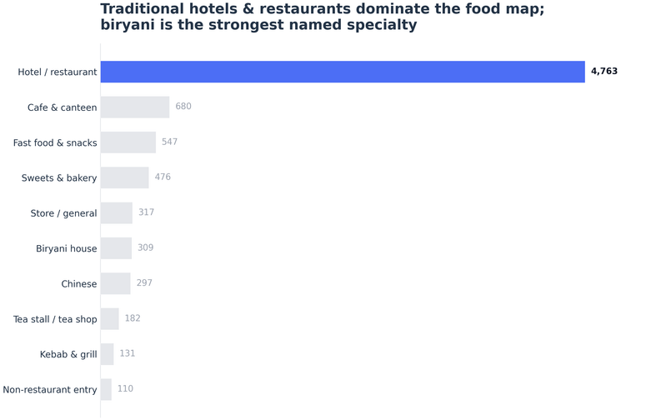
CATEGORIES & TAKEAWAYS
What the market is made of - and three moves.
▣
Place types from name keywords (EN + Bangla)
01
Compete for the invisible half.
47.8% of places have almost no reviews; a program that digitizes and engages the long tail fights for space nobody is contesting.
02
Over-index on Dhaka, harvest the corridors.
57.8% of reviews sit in Dhaka; Sylhet and tourist districts give the best review economics per listing.
03
Biryani is the strongest named specialty.
309 dedicated biryani houses beat Chinese (297) and kebab & grill (131); 32.4% of businesses name themselves in Bangla script - local language is mainstream, not niche.
Notes:
- Walk the three moves in order: invisible half → Dhaka plus corridors → category and language signals.
- Move 01: 47.8% of places have almost no reviews — uncontested space for a digitization program.
- Move 02: 57.8% of reviews sit in Dhaka; Sylhet and tourist districts offer the best review economics per listing.
- Move 03: 309 biryani houses lead named specialties (vs Chinese 297, kebab & grill 131); 32.4% name in Bangla script.
- Close on the three moves, then hand over to Q&A — full factsheets and cleaned CSV are in the package.

