Slide 1
Bangladesh Restaurant Data
What is inside, what to trust, and what to watch out for
10,755
921,186
24%
unique places
reviews
unrated
Notes:
Good morning everyone. Today I'm going to walk you through a dataset of restaurants and food places across Bangladesh. It looks simple: a name, a location, a star rating, and a review count. But it hides some surprises, and if you don't know about them, you can easily draw the wrong conclusions. By the end, you'll know what's in this data, what to trust, and what to be careful with.

Slide 2
The data at a glance
8 columns
place_id, name, latitude, longitude, rating, number_of_reviews, affluence, address
63 border places are in India (flagged)
Affluence = a 1-4 level, probably price (undocumented)
12,703
10,755
raw rows in the file
unique places after cleaning
8,226
921,186
places with a star rating
reviews in total
Notes:
Let's start with the basics. The file we received has 12,703 rows and eight columns: an ID, the name, latitude and longitude, a rating, a number of reviews, something called 'affluence', and an address.
But 12,703 is not the real number of places. After cleaning, we have 10,755 unique places. Of those, 8,226 have a star rating, and together they have collected 921,186 reviews.
Geographically, almost everything is inside Bangladesh, from the far north to Cox's Bazar in the south. A small number, 63 places, sit just across the border in India, so we flagged those.

Slide 3




What we had to clean
15% duplicate rows
Rating 0 means none
12,703 rows shrink to 10,755 unique places
2,528 places (24%) have no rating and no reviews
Affluence is sparse
Not all restaurants
90% empty, and only filled for places with 4+ reviews
~3% look like shops, telecoms or schools (flagged)
Notes:
Before any analysis, we had to fix four things.
First, duplicates. 15% of the rows were exact copies of another row. One restaurant appeared 13 times. If we hadn't removed these, popular places would look even more popular than they are.
Second, the rating zero. 2,528 places, about 24%, have a rating of zero. But zero stars isn't a real rating. Every one of those places also has no reviews. So zero here simply means 'nobody has rated this yet'. If we counted them as real zeros, the average rating would drop from 4.08 to about 3.1, which would be completely misleading.
Third, the affluence column is 90% empty. And it's not empty at random. It only exists for places with at least 4 reviews. I'll come back to that.
Fourth, not everything in the file is a restaurant. By a conservative name check, about 3% look like shops, telecom stores, schools and farms. The true number is probably higher. We flagged these rather than deleting them.

Slide 4
Ratings are generous, with a spike at 5.0
4.08
average rating (rated places)
1,778
perfect 5.0s: the most common rating
Notes:
Now the ratings. Among the 8,226 rated places, the average is 4.08 stars, and the median is 4.1. People are generous: 65% of rated places score 4.0 or higher, and only 5% score below 3.
Look at the chart. There's a hump around 4.0, which is what you'd expect. But look at the right edge. There's a huge spike at a perfect 5.0: 1,778 places. That's the single most common rating in the whole dataset. Real restaurants don't behave like that, so something else is going on. Let's look at why.

Slide 5
A perfect 5.0 usually means 1-2 reviews
61%
of 1-review places score 5.0
0
perfect 5.0s among places with 50+ reviews
Notes:
Here's the key insight of this whole analysis. Look at how the share of perfect 5.0 scores changes with the number of reviews.
Places with just one review: 61% of them have a perfect 5.0. With two to four reviews, 32%. With ten to forty-nine reviews, it drops to under 1%. And with fifty or more reviews, there are zero perfect scores. Not a single one. In fact no 5.0 place has more than 20 reviews.
So a 5.0 doesn't mean 'excellent'. It usually means 'one or two people liked it'. The more reviews a place has, the more its rating settles around 4. Among places with a hundred reviews or more, the highest rating anywhere is 4.7.
The practical lesson: never rank restaurants by raw rating. Either require a minimum number of reviews, or use an adjusted score that pulls small-sample ratings towards the average. We did the second, and I'll show you the results shortly.

Slide 6
A few places get most of the reviews
36%
of reviews: top 1% of places
83%
of reviews: top 10% of places
6
reviews at the median place
Notes:
Reviews are extremely unequal. The typical place has just 6 reviews. The average is 112, which is far higher because a few giants pull it up. The biggest, Hotel Noorjahan in Cumilla, has 17,655 reviews.
59% of places with reviews have ten or fewer. Only 192 places have a thousand or more. Yet the top one percent of places hold 36% of all reviews, and the top ten percent hold 83%.
What does this mean? Review count measures visibility, not quality. A place with seventeen thousand reviews and 3.5 stars is very famous, not necessarily very good. And it means only about 21% of the dataset, 2,253 places, has both a rating and at least thirty reviews. That's the trustworthy core.

Slide 7
Affluence only exists for popular places
10%
of all places have affluence
66%
of labelled places are level 2
Notes:
Now the mysterious affluence column. It runs from 1 to 4 and looks like a price level, but I want to stress that's our assumption, because there is no documentation.
Only 1,026 places, 10%, have a value. Look at the chart: places with fewer than ten reviews almost never have one. Among places with a thousand or more reviews, 86% do. So affluence exists mostly for popular places.
Among those that have it, level 2 dominates with 66%, level 1 has 29%, and levels 3 and 4 are rare: just 41 and 13 places. Average ratings creep up slightly with affluence, from 3.96 at level 1 to 4.26 at level 4, but with only 13 places at the top level, I wouldn't build a story on that.

Slide 8
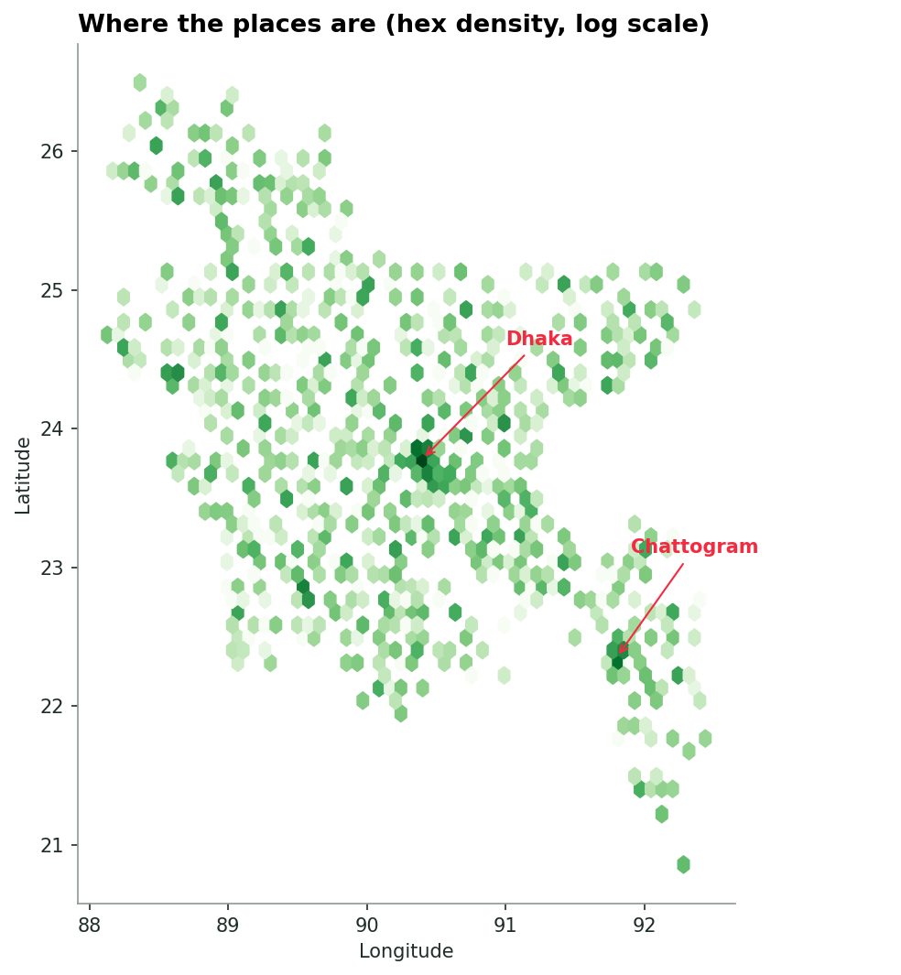
Dhaka dominates the attention
12%
51%
of places in Greater Dhaka
of all reviews
Notes:
Now geography. The map shows the density of places. Notice how the whole country is covered, with big concentrations around Dhaka and Chattogram.
By division, Dhaka has the most, about 35% of the places, followed by Chattogram, Rajshahi and Khulna. One note: our geographic data uses the older seven-division map, so the newer Mymensingh division is counted inside Dhaka.
But the real story is the gap between the capital and the rest. Greater Dhaka, meaning within twenty kilometres of the centre, holds only 12% of the places, yet it gets 51% of all the reviews. The median Dhaka place has 55 reviews. Elsewhere it's 5. And 25% of places outside Greater Dhaka have no rating at all, compared with 11% inside.
Average ratings are very similar across divisions, around 4.0 to 4.2. But outside the big cities those averages rest on much thinner evidence.

Slide 9
What is in a name
32%
of names are in Bengali script
30% vs 20%
unrated: Bengali vs English
Notes:
Let's peek at the names. About 32% are written in Bengali script and the rest in English letters. That matters for two reasons. First, the same business can be spelled many ways, so matching names needs both scripts. Second, Bengali-named places tend to be less visible online: 30% of them are unrated, compared with 20% of English-named ones, and only 2% are in Greater Dhaka.
Looking at keywords, 'Restaurant' appears in 3,762 names and 'Hotel' in 2,445. In Bangladesh, a 'hotel' is usually a local eatery, not somewhere to sleep. Then come cafes, fast food, sweets and bakeries.
We also see repeated names that suggest chains or popular naming: 'Bismillah' appears in 162 names and 'Bhai Bhai' in 118.

Slide 10
The standouts
Most reviewed
Best rated, 500+ reviews (adjusted)
Place | Reviews | Rating
Hotel Noorjahan | 17,655 | 3.5
Star Kebab & Restaurant | 16,992 | 4.2
Sultan's Dine Dhanmondi | 15,622 | 4.3
Panshi Restaurant | 13,616 | 4.2
Pach Vai Restaurant | 11,459 | 4.4
Place | Reviews | Rating
Yum Cha District | 2,814 | 4.5
Izumi Japanese Kitchen | 1,425 | 4.5
Izakaya | 1,116 | 4.5
Pach Vai Restaurant | 11,459 | 4.4
Takeout Banani | 5,433 | 4.4
English-script names only; full lists are in facts/08_top_lists.txt
Notes:
Finally, who are the standouts? On the left, the most-reviewed places in the file. Hotel Noorjahan, Star Kebab and Sultan's Dine each have more than fifteen thousand reviews.
On the right, the best places once we correct for small samples, looking only at places with at least five hundred reviews. These are genuinely well-loved: high ratings backed by thousands of reviews. Notice the ratings are around 4.5, not 5.0. That's what real excellence looks like in this data.
One caveat: our charts only show English-script names, because of font limits, so some famous Bengali-named places are not shown. The full lists are in the text files.

Slide 11
Five things to remember
1
12,703 rows, but only 10,755 real places
2
A rating of 0 means no rating, not a bad score
3
A perfect 5.0 usually means 1-2 reviews
4
Reviews measure fame, concentrated in Dhaka
5
Affluence covers only well-reviewed places
Notes:
Let me close with five things to remember.
One: this file has 12,703 rows but only 10,755 real places.
Two: a rating of zero means 'no rating', never a bad score.
Three: a perfect 5.0 almost always means one or two reviews. Don't trust it.
Four: reviews are concentrated in a few places, mainly in Dhaka, so review count measures fame, not quality.
Five: affluence is incomplete and only covers popular places.
If you remember nothing else: remove duplicates, treat zero as missing, and require a minimum number of reviews before you rank anything. Thank you. I'm happy to take questions.

