Slide 1
DATA READ-OUT
Student Dropout
Risk 2026
32.0%
WHO LEAVES · AND WHY
dropped out
What 100,000 student records tell us about who leaves — and why
that is 1 in every 3 students
100,000
34
32.0%
records
variables
dropout rate
Full inspection · deep-dive analysis · read-out deck — October 2026
Notes:
- Welcome the room; frame the session: a full data read-out on who drops out and why.
- Scale: 100,000 student records across 34 variables — the entire cohort under inspection.
- Data quality is perfect: 0 missing values, 0 duplicates — every finding runs on clean fields.
- Anchor the headline: 32.0% dropout rate — effectively 1 in 3 students.

Slide 2
The headline numbers
32.0%
83.5% →2.4%
of students dropped out
dropout rate, GPA <1.0 vs GPA 3–4
32,004 of 100,000 records
a 35x spread — GPA behaves like a cliff, not a slope
42.9% vs20.0%
0
low-income vs high-income dropout rate
missing values and duplicate records
2.1x gap — the strongest demographic factor
all 34 fields pass range validation — no cleaning needed
◆
Risk is concentrated, not evenly spread — and concentrated risk is targetable.
Notes:
- Walk the four cards: 32.0% overall; the GPA cliff 83.5% → 2.4% (a 35x spread); the income gap 42.9% vs 20.0% (2.1x); and 0 missing values or duplicates.
- The GPA gradient is the steepest signal in the entire dataset — a cliff, not a slope.
- Income is the strongest demographic factor — but still smaller than the academic cliff.
- Land the takeaway line: risk is concentrated, and concentrated risk is targetable.

Slide 3
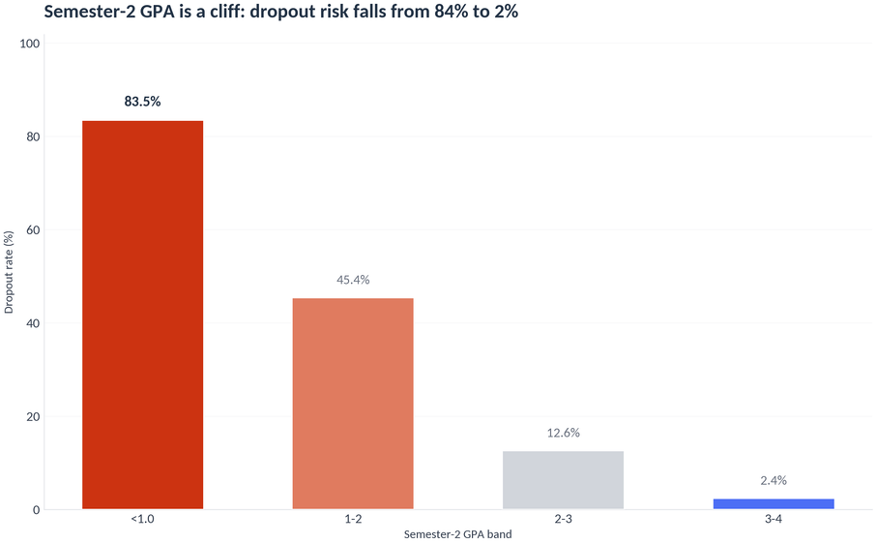
Academic signals — grades and engagement diverge early
GPA gap is huge — dropouts averaged 1.91 vs 2.88 in semester 1 (Cohen's d ≈ 1.5)
Behavior trail — attendance 67.9% vs 78.5% · assignments 63.4% vs 75.2% · missed deadlines 3.4 vs 1.9
Admission grades barely differ: 128 vs 136 / 200 — students don't arrive doomed, they disengage after arrival
Engagement fades first — library visits 3.2 vs 4.9/month, LMS logins 6.1 vs 7.8/week
Dropout rate by semester-2 GPA band — 83.5% / 45.4% / 12.6% / 2.4%
Effect sizes: Welch t-tests, all p < 0.001, n = 100,000
Notes:
- Read the chart left to right: 83.5% below GPA 1.0 → 45.4% → 12.6% → 2.4% at GPA 3–4. A cliff, not a slope.
- Behavior trails grades: attendance 67.9% vs 78.5%, assignments 63.4% vs 75.2%, missed deadlines 3.4 vs 1.9.
- Preempt the counterpoint: admission grades barely differ (128 vs 136 / 200) — students don't arrive doomed, they disengage after arrival.
- Engagement fades first — library visits 3.2 vs 4.9/month, LMS logins 6.1 vs 7.8/week — that is the early-warning window.
- All effects: Welch t-tests, p < 0.001, n = 100,000.

Slide 4
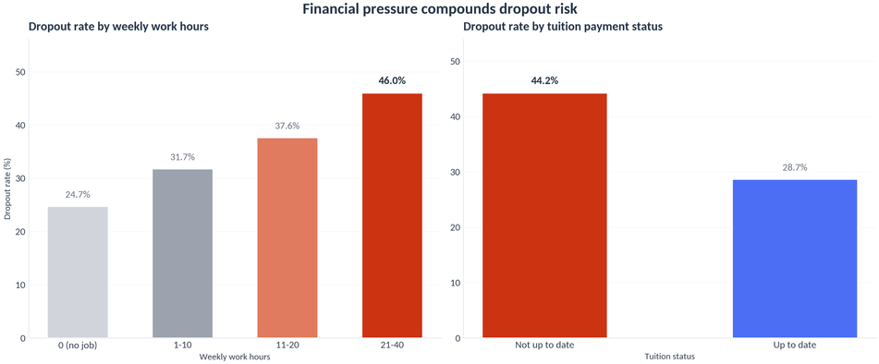
Financial pressure compounds the risk
Income gradient — Low 42.9% · Middle 30.0% · High 20.0% (Cramér's V = 0.19, strongest categorical factor)
Dose-response in work hours — 24.7% with no job rising to 46.0% at 21–40 h/week: nearly doubles the risk
Overdue tuition is a red flag — 44.2% vs 28.7% for students current on payments
First-generation students 37.4% vs 28.1% — and the honest caveat: scholarship holders show no difference (31.1% vs 33.2%)
Top — dropout rate by weekly work hours: 24.7% / 31.7% / 37.6% / 46.0%
Bottom — dropout rate by tuition status: 44.2% vs 28.7%
Chi-square independence tests + Cramér's V, all reported effects p < 0.001
Notes:
- Income gradient: Low 42.9% · Middle 30.0% · High 20.0% — Cramér's V = 0.19, the strongest categorical factor.
- Work hours show a dose-response: 24.7% with no job rising to 46.0% at 21–40 h/week — risk nearly doubles.
- Overdue tuition is the cheap, checkable red flag: 44.2% vs 28.7% for students current on payments.
- First-generation students 37.4% vs 28.1% — but state the honest null: scholarship holders show no difference (31.1% vs 33.2%).
- Methods: chi-square independence tests + Cramér's V; all reported effects p < 0.001.

Slide 5
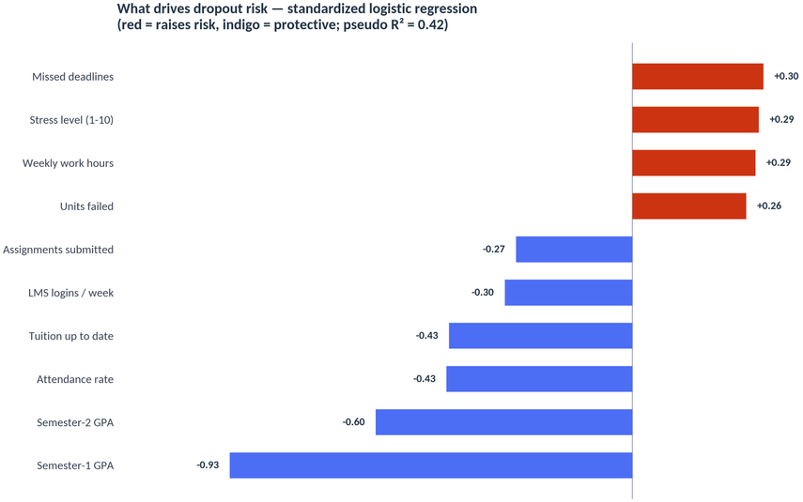
What matters most — and what to do about it
1
Flag early
semester-1 GPA < 2.0 AND attendance < 75% → outreach in week 1 of semester 2
2
Target finances
low-income students working 11+ h/week plus overdue tuition: three cheap, identifiable flags
3
Monitor weekly
LMS logins and attendance fall weeks before the GPA crash: real-time early warning
Standardized logistic-regression ranking — red bars raise risk, indigo bars protect
Nulls worth stating: gender, nationality, course type and international status show no effect — risk is about circumstances and behavior, not demographics.
We can't change who students are — but the data says we don't need to. The risks that matter are the ones we can see coming.
Notes:
- Read the ranking top-down: standardized logistic regression — GPA (−0.93) towers over everything; tuition status is the top financial factor.
- Action 1: flag semester-1 GPA < 2.0 AND attendance < 75% → outreach in week 1 of semester 2.
- Action 2: target the financial cluster — low income + 11+ work hours + overdue tuition; three cheap, identifiable flags.
- Action 3: monitor LMS logins and attendance weekly — they fall weeks before the GPA crash.
- State the nulls plainly (gender, nationality, course type, international status — no effect), then close on the final line: the risks that matter are the ones we can see coming.

