Slide 1
PSD
LEFT (stim durations)
OFF (total) – 1536 mins
.1A (~100mins)
.5A (~100mins)
.7A (~150mins)
.8A (~600mins)
RIGHT (stim durations)
OFF (total) – 1520 mins
.2A (~120mins)
.5A (~110mins)
.7A (~144mins)
.8A (~40mins)

Slide 2
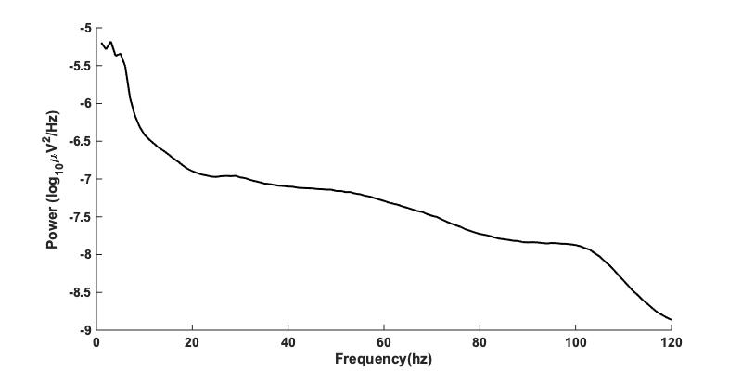
RCS04 STN 0-2 LEFT
OFF

Slide 3
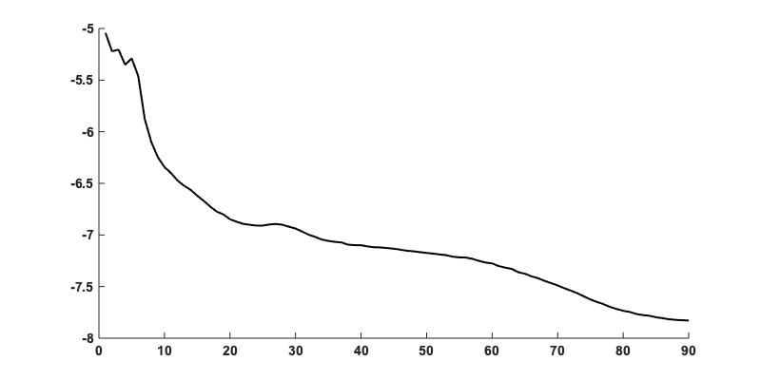
RCS04 STN 0-2 RIGHT
OFF
Power (log ₁₀ μ V ²/Hz)
Frequency (Hz)

Slide 4
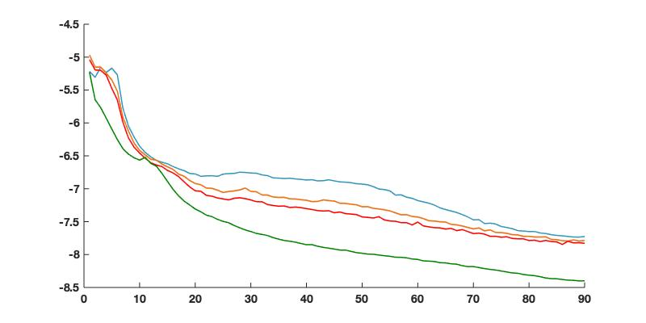
RCS04 STN 0-2 LEFT
.1A
Power (log ₁₀ μ V ²/Hz)
.5A
.7A
.8A
Frequency (Hz)

Slide 5
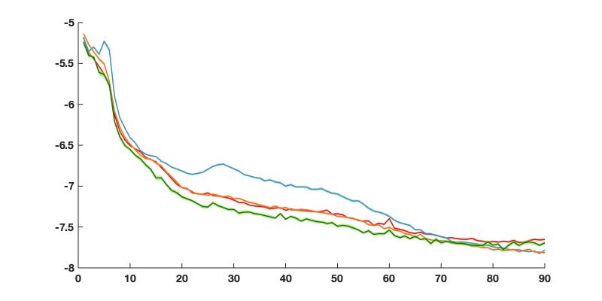
RCS04 STN 0-2 RIGHT
.2A
Power (log ₁₀ μ V ²/Hz)
.5A
.7A
.8A
Frequency (Hz)

Slide 6
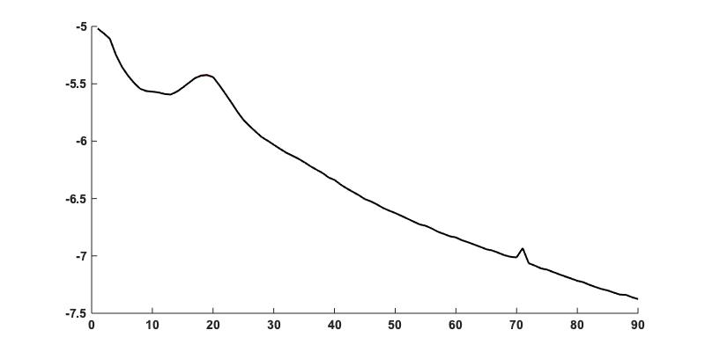
RCS04 STN 8-9 LEFT
OFF
Power (log ₁₀ μ V ²/Hz)
Frequency (Hz)

Slide 7
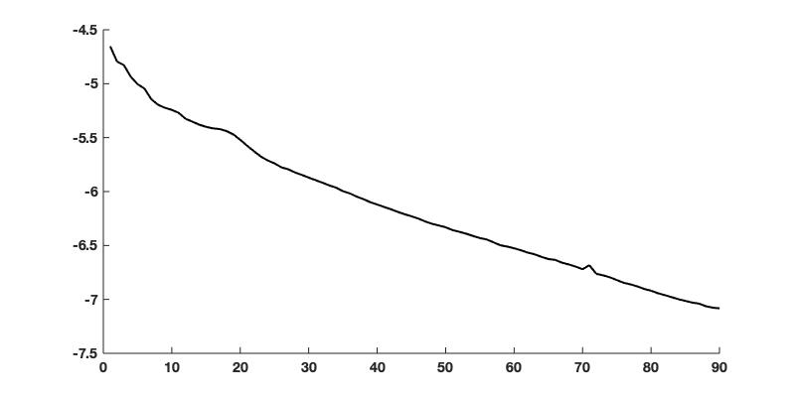
RCS04 STN 8-9 RIGHT
OFF
Power (log ₁₀ μ V ²/Hz)
Frequency (Hz)

Slide 8
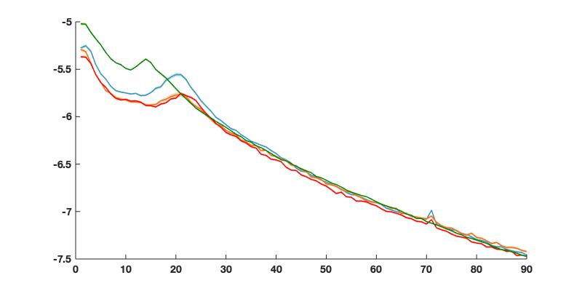
RCS04 MOTOR 8-9 LEFT
.1A
Power (log ₁₀ μ V ²/Hz)
.5A
.7A
.8A
Frequency (Hz)

Slide 9
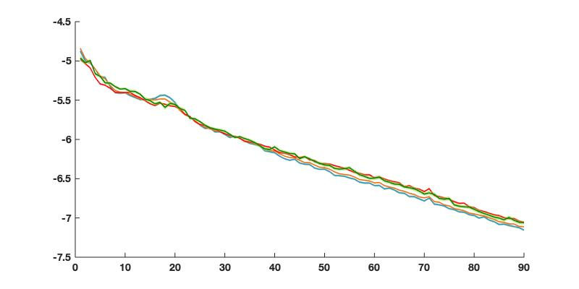
RCS04 MOTOR 8-9 RIGHT
.2A
Power (log ₁₀ μ V ²/Hz)
.5A
.7A
.8A
Frequency (Hz)

Slide 10
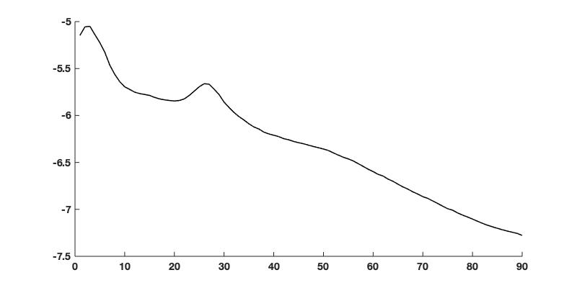
RCS04 STN 10-11 LEFT
OFF
Power (log ₁₀ μ V ²/Hz)
Frequency (Hz)

Slide 11
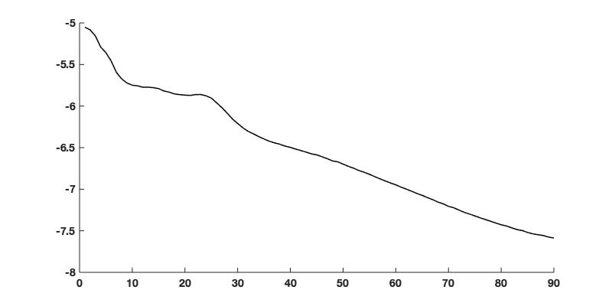
RCS04 STN 10-11 RIGHT
OFF
Power (log ₁₀ μ V ²/Hz)
Frequency (Hz)

Slide 12
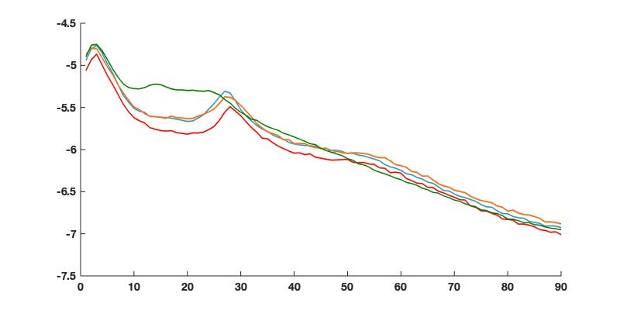
RCS04 MOTOR 10-11 LEFT
.1A
Power (log ₁₀ μ V ²/Hz)
.5A
.7A
.8A
Frequency (Hz)

Slide 13
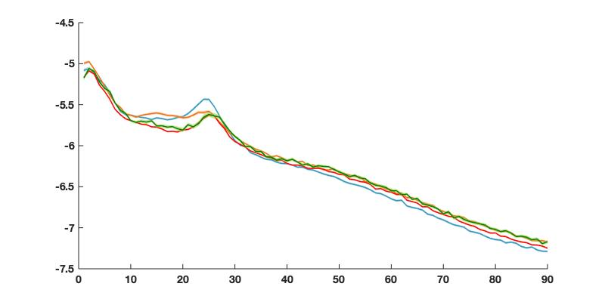
RCS04 MOTOR 10-11 RIGHT
.2A
Power (log ₁₀ μ V ²/Hz)
.5A
.7A
.8A
Frequency (Hz)

Slide 14
Coherence

Slide 15
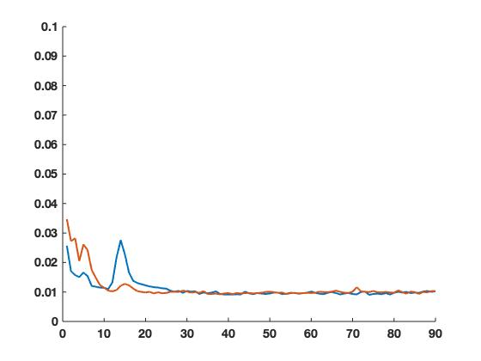
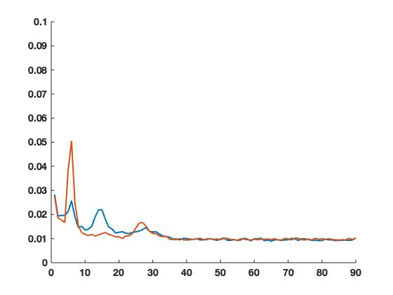

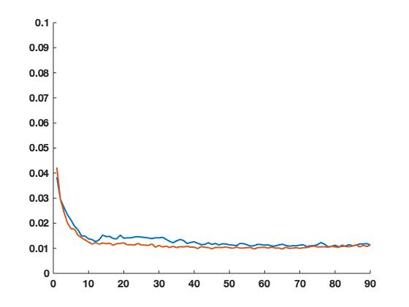
RCS04 0-2 & 8-9 LEFT
RCS04 0-2 & 10-11 LEFT
ON
OFF
Frequency (Hz)
Frequency (Hz)
RCS04 10-11 & 8-9 LEFT
Frequency (Hz)

Slide 16
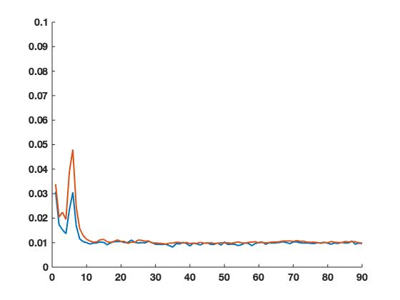
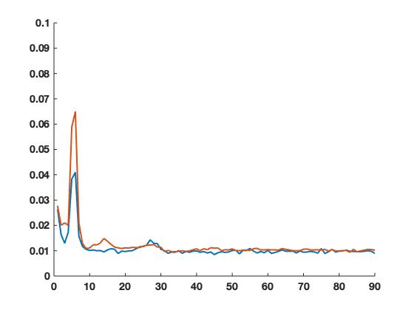
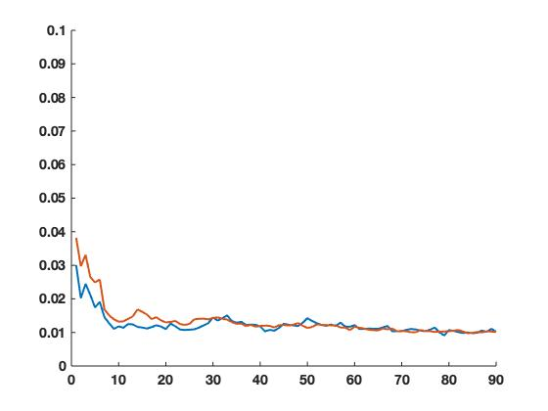
RCS04 0-2 & 8-9 RIGHT
RCS04 0-2 & 10-11 RIGHT
ON
OFF
Frequency (Hz)
Frequency (Hz)
RCS04 10-11 & 8-9 RIGHT
Frequency (Hz)

Slide 17
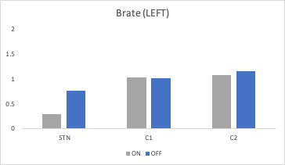
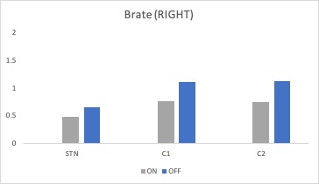
Bursts (need to repeat plots again)

