Slide 1
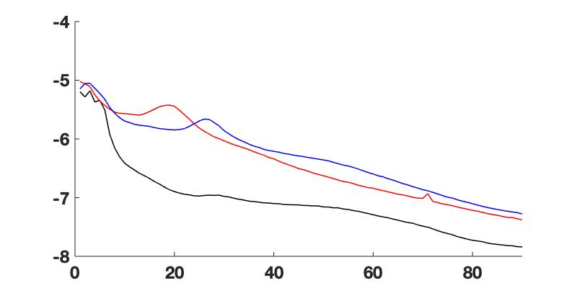
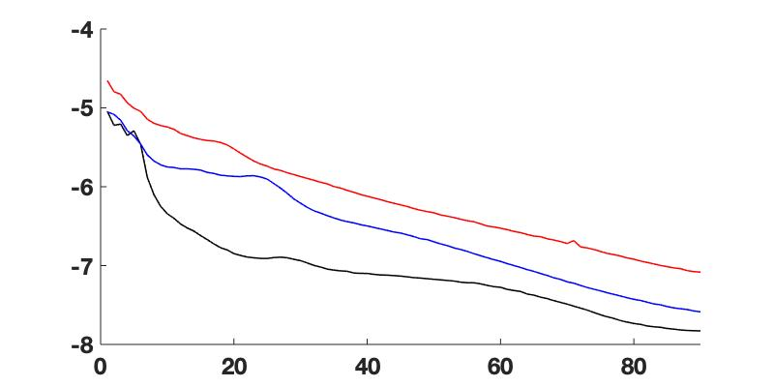

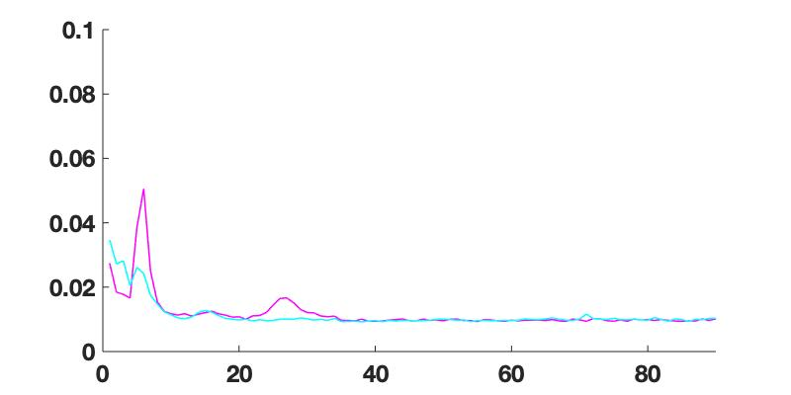
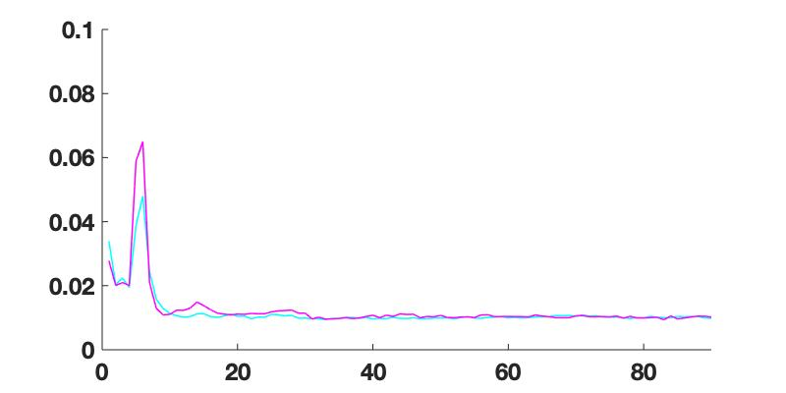

Power (log ₁₀ mV²/Hz)
Power (log ₁₀ mV²/Hz)
OFF LEFT
OFF RIGHT
0-2
8-9
10-11
Coherence
Coherence
Frequency (Hz)
Frequency (Hz)
OFF LEFT
OFF RIGHT
0-2 & 8-9
0-2 & 10-11
Frequency (Hz)
Frequency (Hz)

