Slide 1
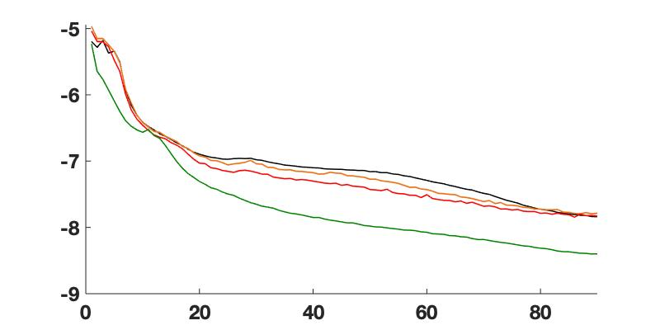
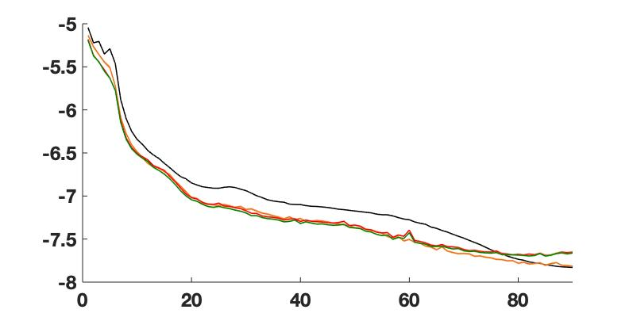

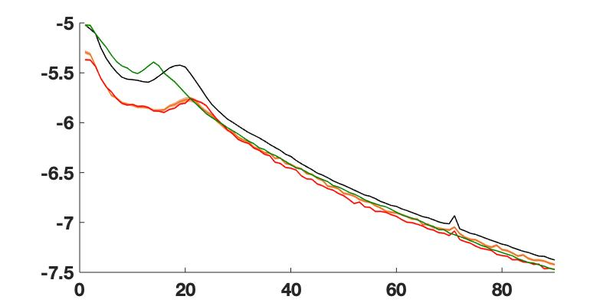
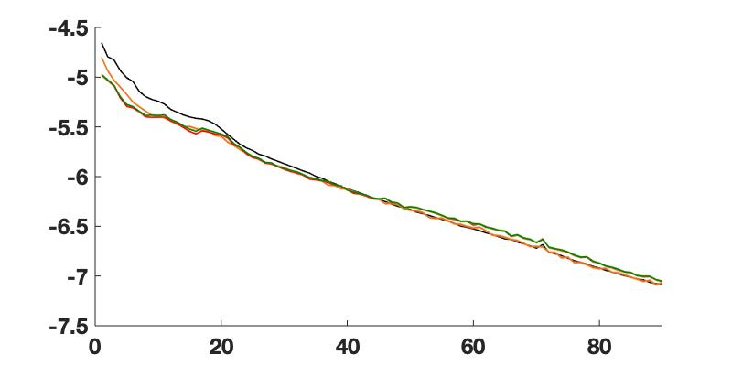
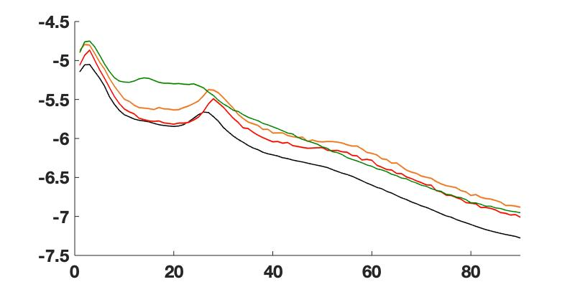
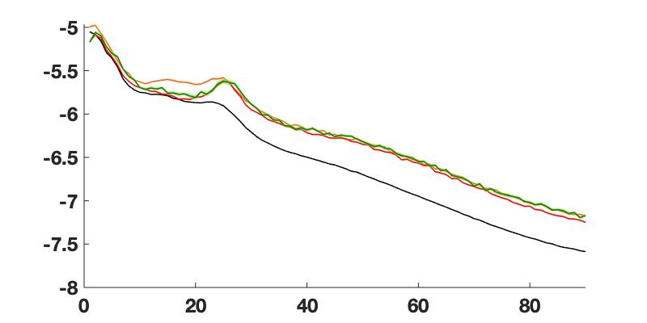
Power (log ₁₀ mV²/Hz)
Power (log ₁₀ mV²/Hz)
0-2 LEFT
0-2 RIGHT
OFF
.5A
.7A
.8A
Frequency (Hz)
Frequency (Hz)
Power (log ₁₀ mV²/Hz)
8-9 LEFT
Power (log ₁₀ mV²/Hz)
8-9 RIGHT
Frequency (Hz)
Frequency (Hz)
Power (log ₁₀ mV²/Hz)
10-11 LEFT
Power (log ₁₀ mV²/Hz)
10-11 RIGHT
Frequency (Hz)
Frequency (Hz)

Slide 2
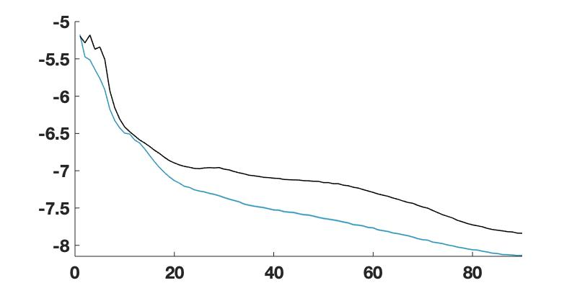
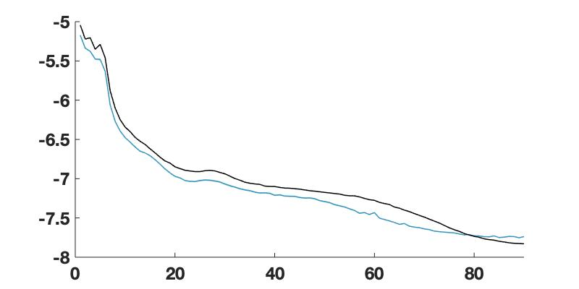

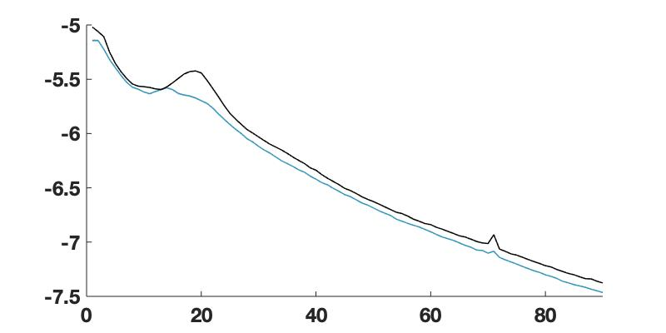
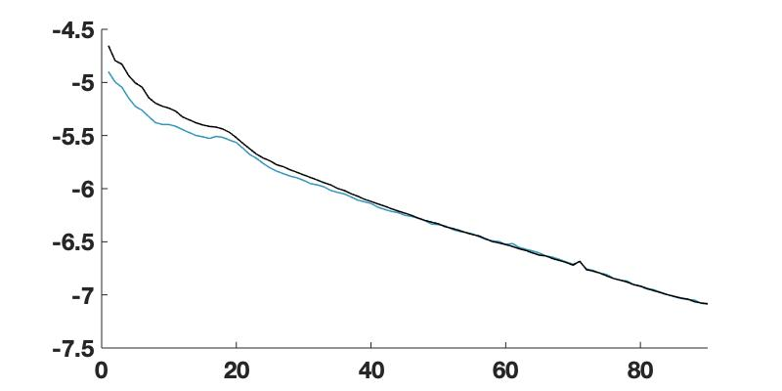
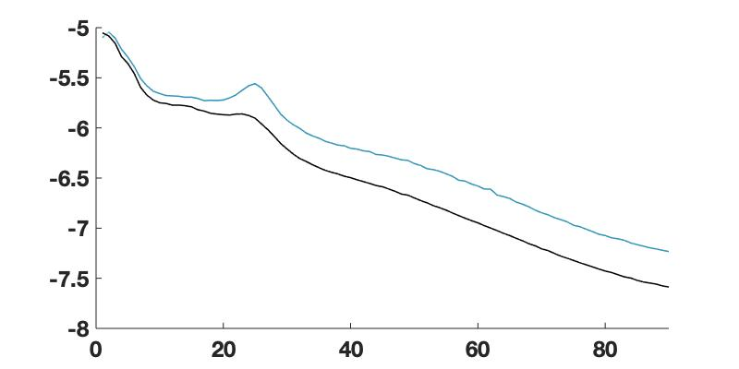
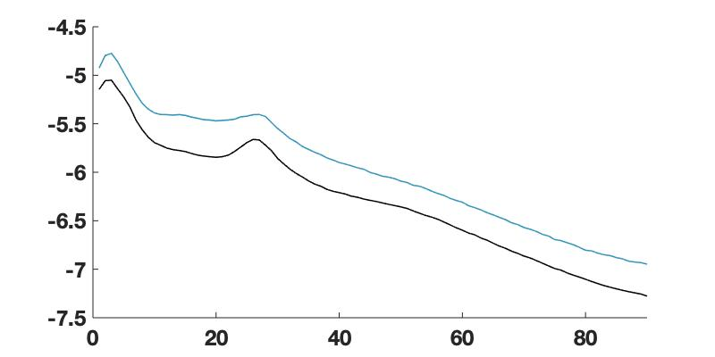
Power (log ₁₀ mV²/Hz)
0-2 LEFT
Power (log ₁₀ mV²/Hz)
0-2 RIGHT
Frequency (Hz)
Frequency (Hz)
Power (log ₁₀ mV²/Hz)
8-9 LEFT
Power (log ₁₀ mV²/Hz)
8-9 RIGHT
Frequency (Hz)
Frequency (Hz)
Power (log ₁₀ mV²/Hz)
10-11 LEFT
Power (log ₁₀ mV²/Hz)
10-11 RIGHT
Frequency (Hz)
Frequency (Hz)

