Slide 1
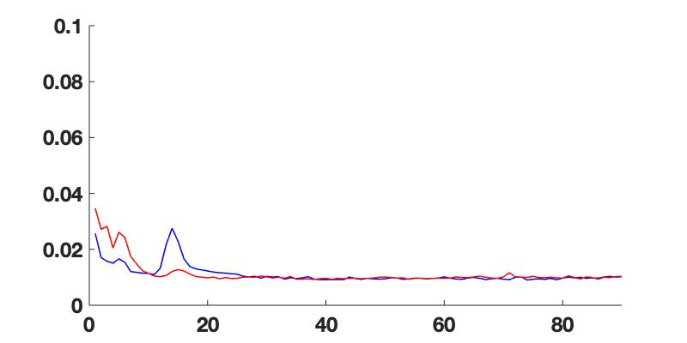
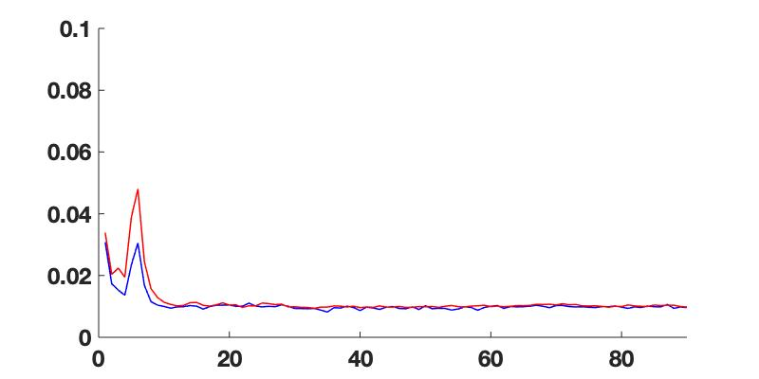

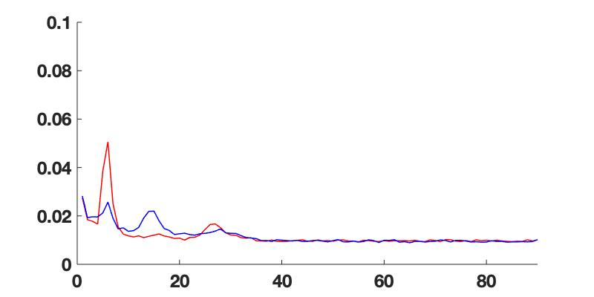
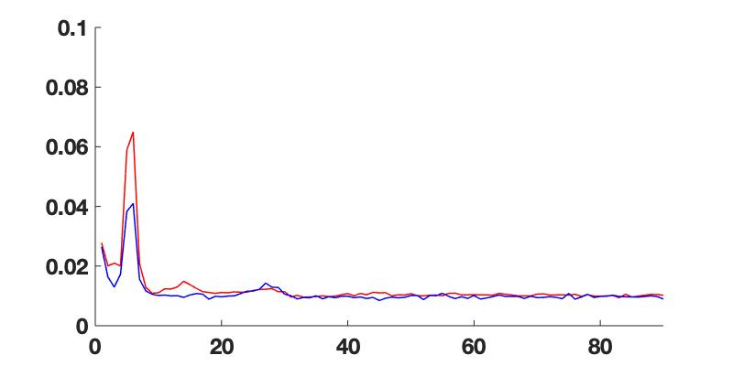
Coherence
0-2 & 8-9 LEFT
Coherence
0-2 & 8-9 RIGHT
ON
OFF
0-2 & 10-11 LEFT
Coherence
0-2 & 10-11 RIGHT
Coherence
Burst Rate
Burst Rate

