Slide 1
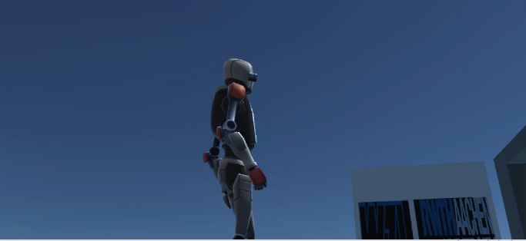
Robotic Sensor Systems (RSS) Project
Group Number 7
Bhavika Chawla
Rohit Despande
Suvid Shinde
Nikhil Rane
Shaunak
Prof. Dr.-Ing. Robert Schmitt
Laboratory for Machine Tools and Production Engineering WZL, RWTH Aachen University
Winter Semester 2024/25

Slide 2
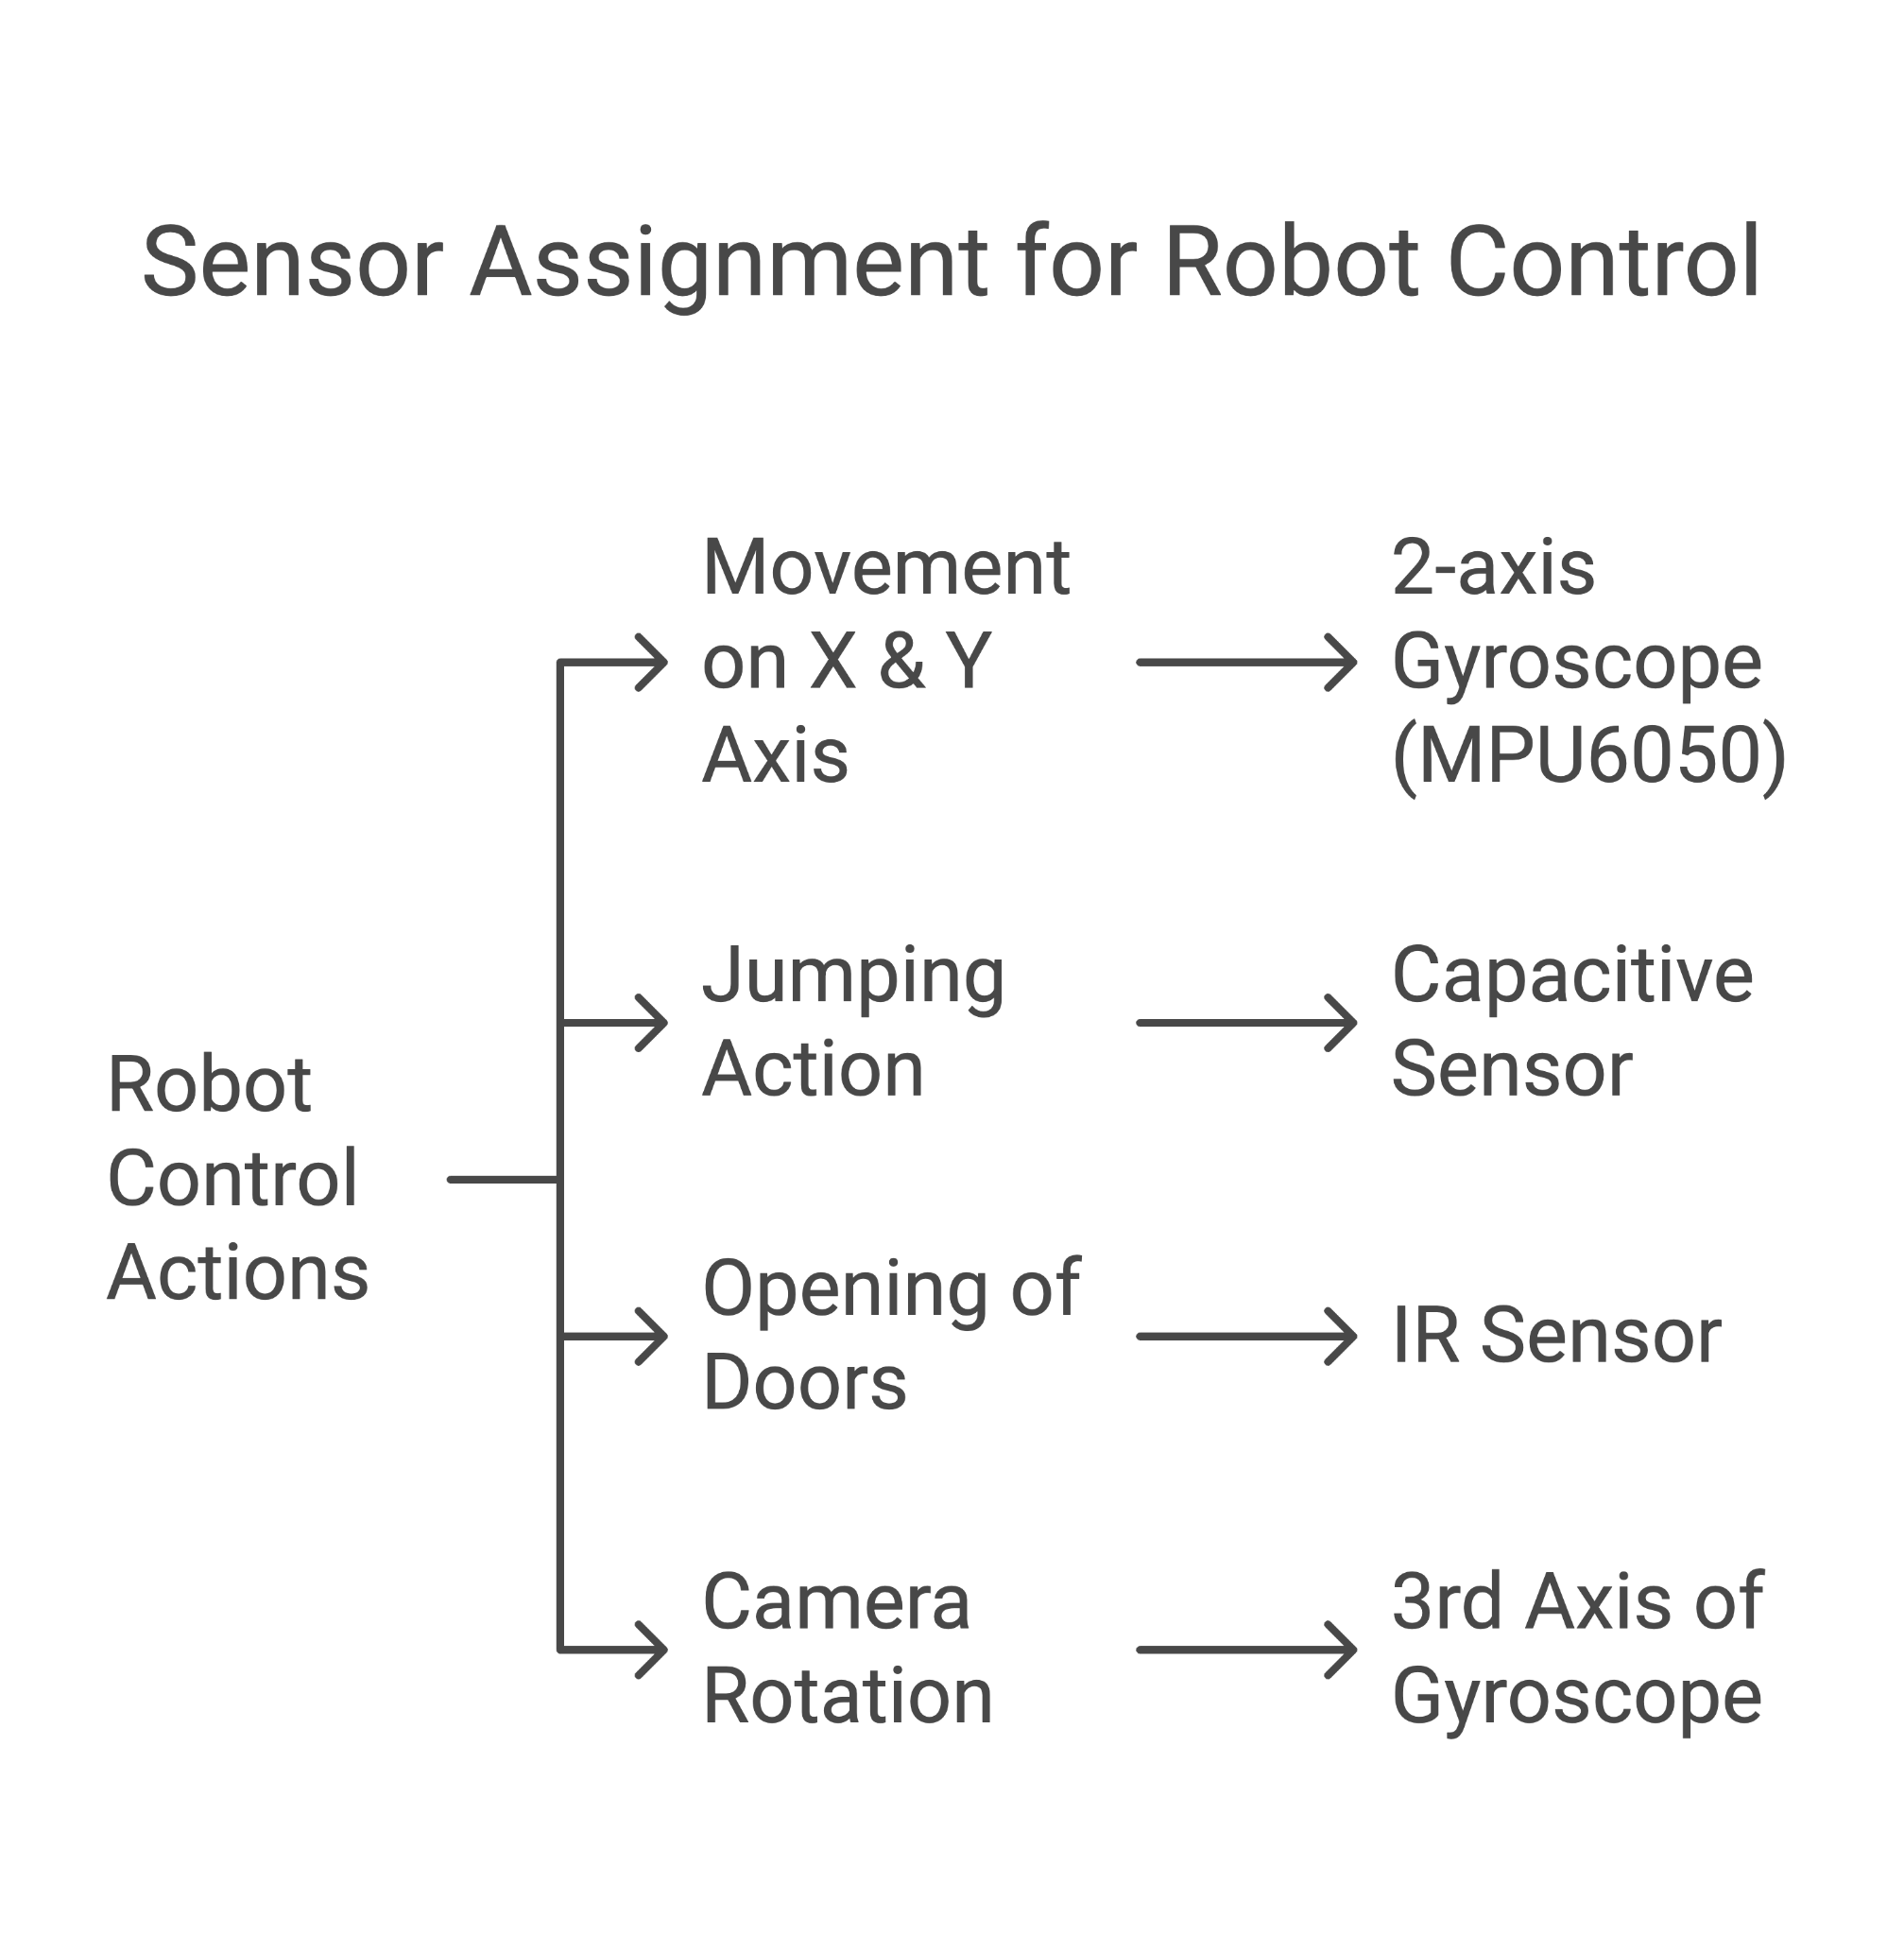
Mapping Sensor Inputs to Robot Actions
Full Control over the robot
Regular Movement: 2 axes of Gyroscope for x and y movement of robot
Running: Triggered by the Infrared sensor
Jumping: Using a Capacitive Touch Sensor
Full control over the camera movement: 3rd axis of Gyroscope used for Yaw rotation of camera
Doors controlling: Triggered by 2nd Infrared sensor (For all doors once robot is in specified range)
Display the temperature of the room: Temperature sensor on the MPU6050
Filter: Average filter
Creativity
Implemented a sound sensor to trigger the jump functionality of the robot

Slide 3
Working of Sensors
IR Sensor: Infrared sensors emit IR light, which is reflected by nearby objects. The sensor detects the reflected light, and based on its intensity and time of flight, it determines the presence of objects.
Gyroscope: Gyroscopes use the principle of conservation of angular momentum. Vibrating elements (MEMS gyroscopes) or spinning rotors detect angular velocity and orientation changes by measuring the Coriolis effect or resistance to changes in angular motion.
Temperature Sensor: Temperature sensors, such as thermocouples and thermistors, work by sensing temperature-induced changes in electrical properties like voltage, resistance, or current and converting them into readable signals for monitoring or control.
Capacitive Sensor: Capacitive sensors measure changes in capacitance between two conductive plates. The capacitance varies with the distance between the plates, the area of overlap, or the dielectric constant of the material between them, enabling detection of touch, proximity, or material properties.
Rotary Encoder: A rotary encoder converts the angular position or motion of a shaft into an electrical signal. It uses optical or magnetic sensors to detect patterns from rotating disks, producing pulses that determine the direction, speed, and position of the shaft.

Slide 4
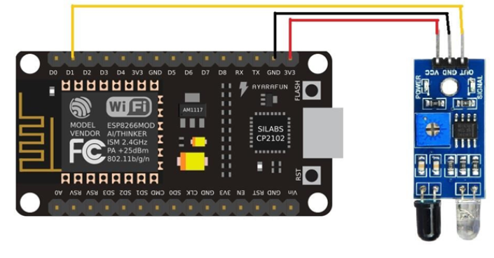
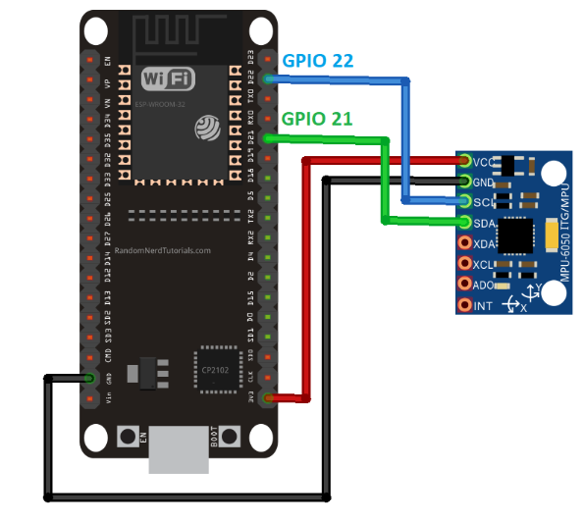
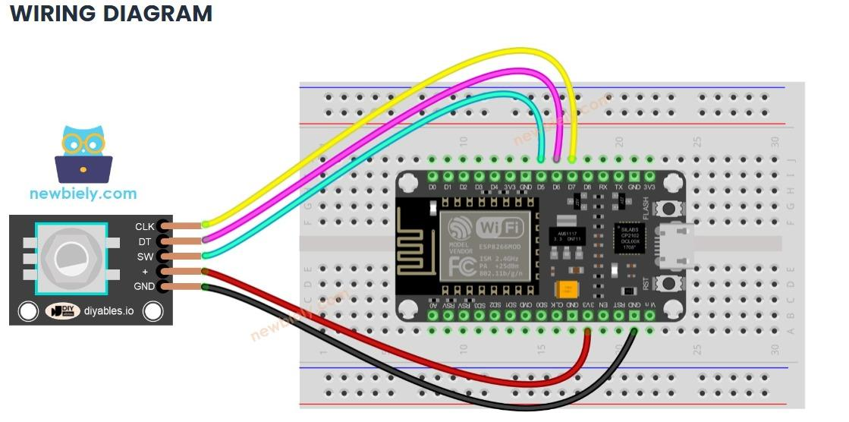
Electrical connections
ESP8266 and IR Sensor
IR Sensor VCC → ESP8266 3.3V .
IR Sensor GND → ESP8266 GND.
IR Sensor OUT → ESP8266 GPIO pin D3
ESP8266 and MPU6050
MPU6050 VCC → ESP8266 3.3V.
MPU6050 GND → ESP8266 GND.
MPU6050 SCL → ESP8266 GPIO pin D1
MPU6050 SDA → ESP8266 GPIO pin D2
ESP8266 Capacitive Touch sensor
One terminal of foil → ESP8266 3.3V
Other terminal of foil → ESP8266 Pin A0
ESP8266 and Rotary Encoder
VCC → ESP8266 3.3V pin.
GND → ESP8266 GND pin.
CLK (Clock) → ESP8266 GPIO pin D5
DT (Data) → ESP8266 GPIO pin D6
SW (Switch) → ESP8266 GPIO pin D7
IR sensor and ESP
MPU6050 and ESP
Rotary Encoder and ESP

Slide 5
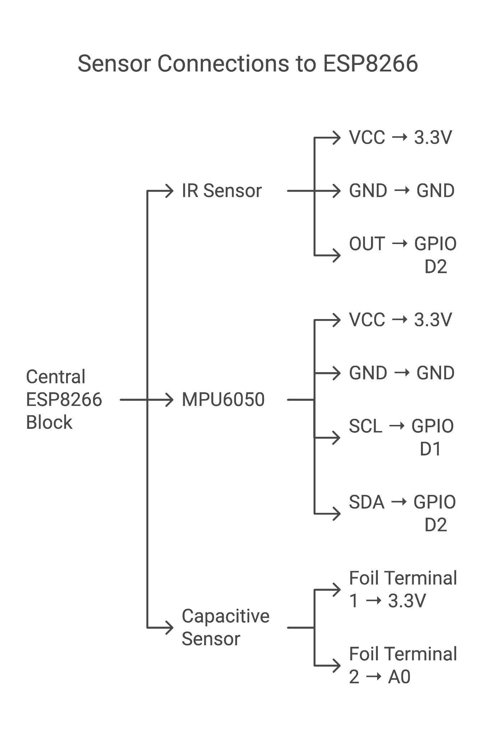
Working Electrical connections

Slide 6
Smooth transmission of Data to Unity
Necessity of Filters:
Noise Reduction: Gyroscope data often includes high-frequency noise due to mechanical vibrations or environmental interference. A filter helps smooth the data before transmission.
Accuracy Improvement: Filters reduce random fluctuations in raw gyroscope data, providing more reliable and meaningful values for downstream applications.

Slide 7
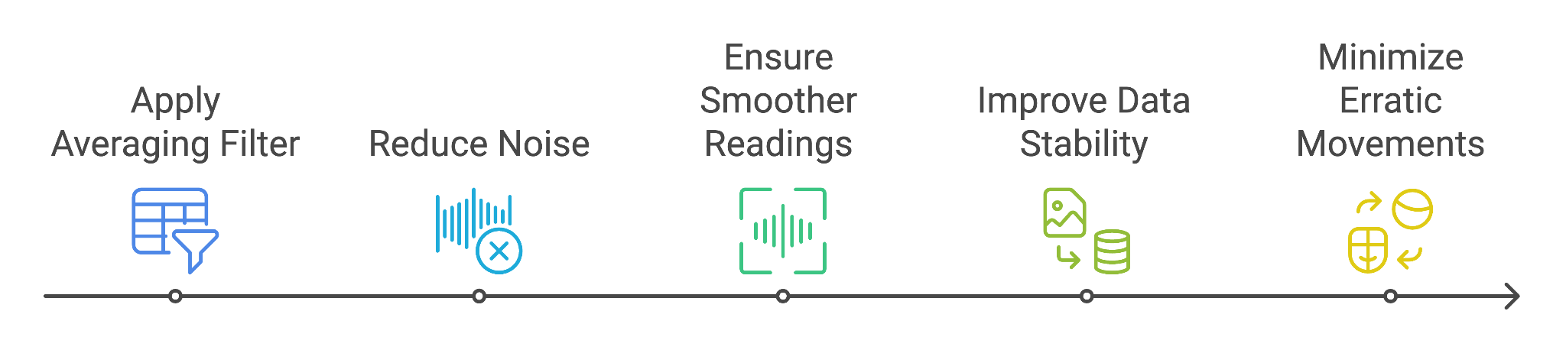
Filter Selection
Advantages of Averaging Filter:
Simplicity: An averaging filter is easy to implement and requires minimal computational resources, making it suitable for embedded systems and IoT devices.
Noise Mitigation: By taking the average of multiple samples, it smooths out sudden spikes or drops in data, ensuring steady and interpretable output.
Improved Data Quality: Reduces jitter and provides a more stable reading, which is especially useful for real-time applications like robotics, where consistent orientation data is critical.
Adaptable for MQTT Transmission: It minimizes the frequency of significant data changes, reducing unnecessary MQTT message transmissions, which can help conserve network and processing resources.

Slide 8
Why MQTT
Lightweight & Efficient: Uses minimal bandwidth, making it ideal for real-time robotics applications.
Publisher-Subscriber Model: Enables seamless communication between multiple devices without direct connections.
Integration with ROS: ROS (Robot Operating System) supports MQTT, making it easy to extend this system for more advanced robotics applications.
Cross-Platform Compatibility: Works with Unity, Arduino, Python, and cloud services

Slide 9
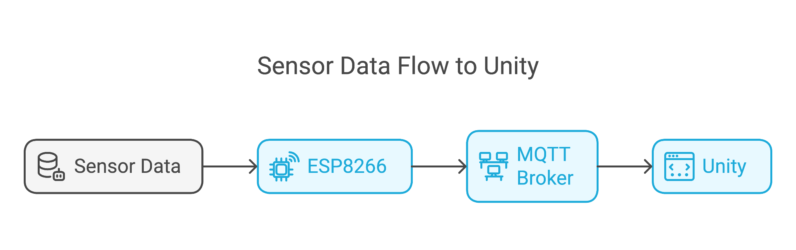
Data Flow
PUBLISHER
SUBSCRIBER

Slide 10
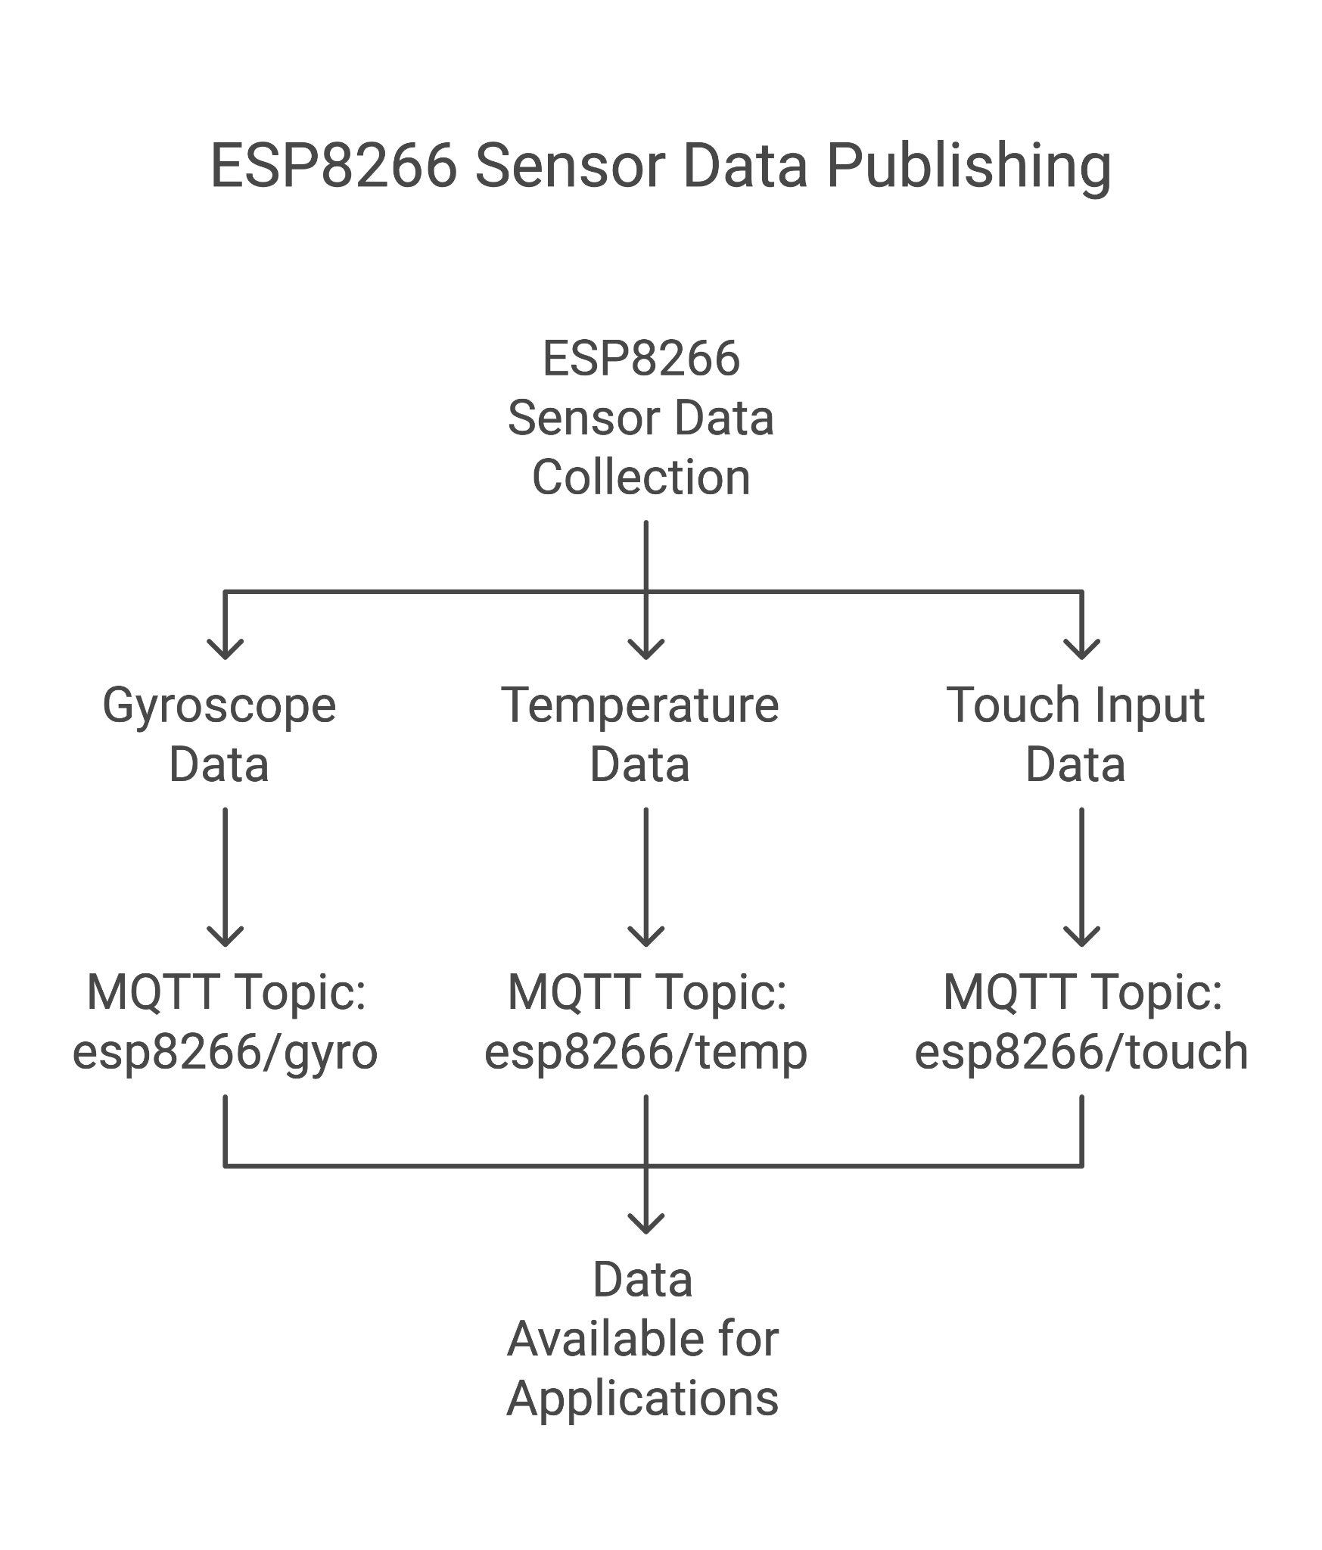
Unity Setup with MQTT
Wi-Fi and MQTT Setup:
ESP8266 connects to Wi-Fi using SSID and password.
Configures MQTT broker details: IP address, port, username, and password.
Data Transmission:
ESP8266 acts as a publisher node and publishes all the sensor data.
One topic is published for each seperate functionality in the enviornment.
Mosquitto has been setup as MQTT-Broker.
MQTT Subscriber receives data from broker.

Slide 11
Unity Integration with MQTT
Unity as an MQTT Subscriber:
Unity Subscribes to the following topics published by ESP8266:
esp8266/gyro - Controls robot's X and Y movements.
esp8266/temp - Monitors environmental temperature.
esp8266/touch - Triggers robot’s jump
esp8266/ir - Opens Doors when robot is in the vicinity
esp8266/cam - Controls Yaw angle of camera in the scene.
esp8266/run - Detects and responds to the robot's running state.
Event-Driven Updates:
Each topic triggers specific Unity events to update the virtual robot's behaviour dynamically.

Slide 12
Game mechanics integration
Regular Movement of Robot :
X and Y direction movememnts are controlled by the rotation of gyroscope in one axis each.
Running action of Robot :
A separate IR sensor is used to trigger the running of robot.
As soon as IR is triggered externally, robot starts running in the same direction as before using the gyroscope data.
Temperature Display :
Inbuilt temperature sensor on MPU is used.
It requires I2C communication interface.
Jumping of Robot :
Capacitive touch sensor is made using two aluminium foils as electrodes connected to the ESP.
When a finger touches the foil, the capacitance increases and thus ESP detects this as touch and generates a signal.
Opening of Doors :
If the robot is within a certain distance of the door and the corresponding IR Sensor is trigerred, the door opens.
The door closes as soon as robot leaves its vicinity.

Slide 13
Game mechanics integration
Camera movement in the Enviornment :
Third rotation axis of gyroscope is used to control the Yaw movement of Camera.
Pitch movement of camera was planned to be controlled by rotary encoder. (could not be completed due to hardware issues)

Slide 14
THANK YOU

