Slide 1


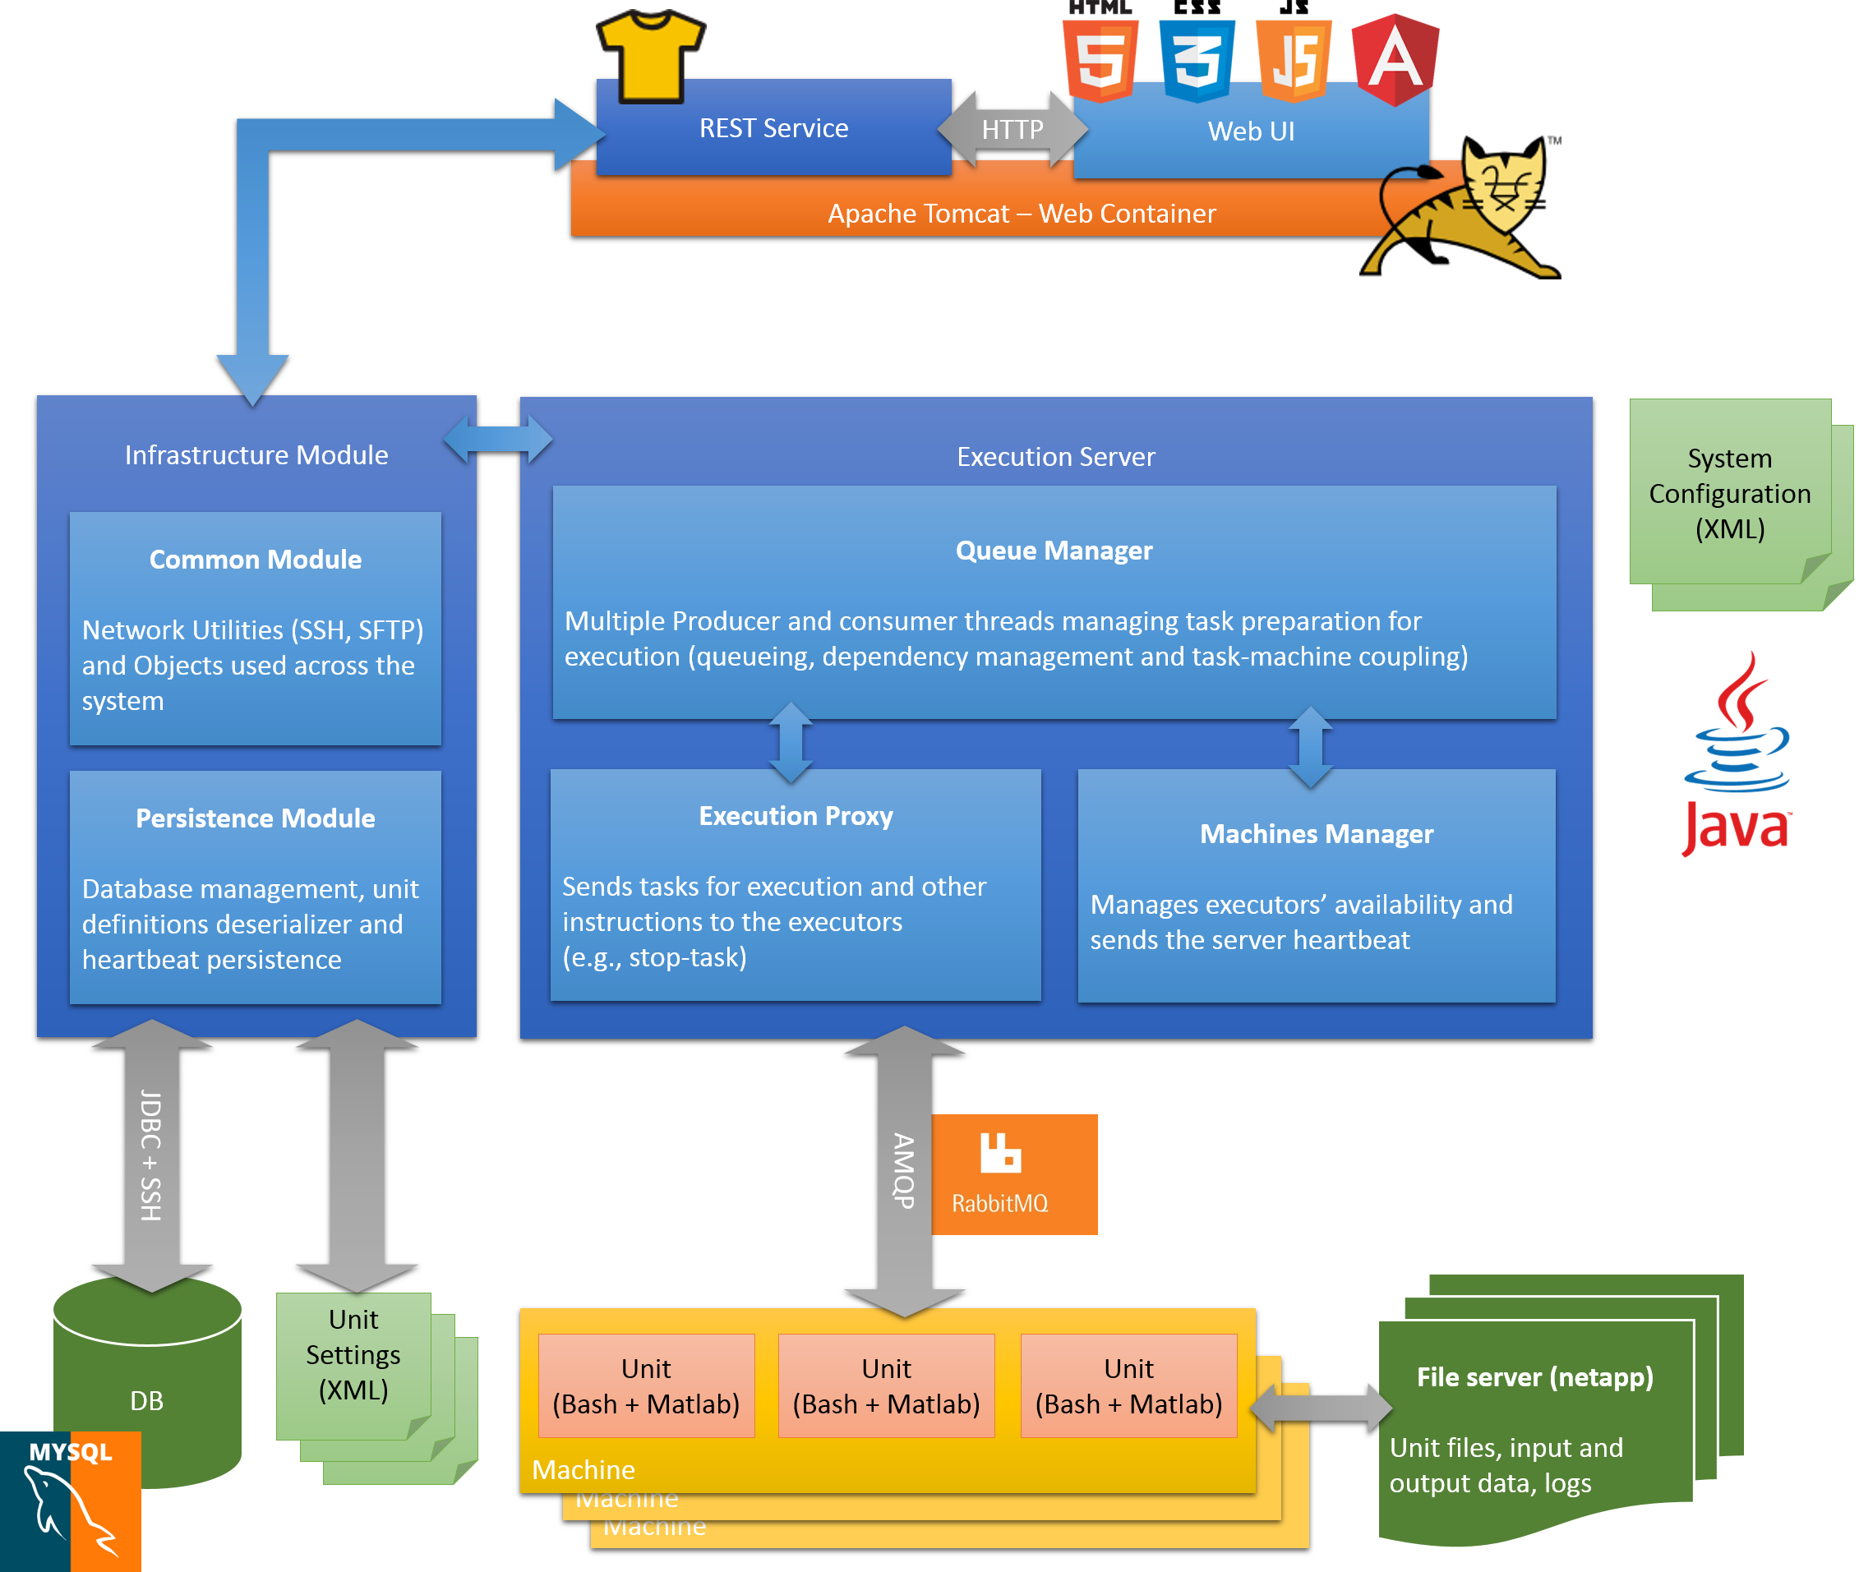
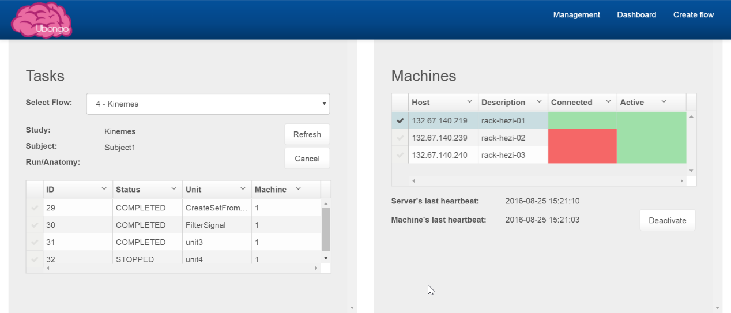
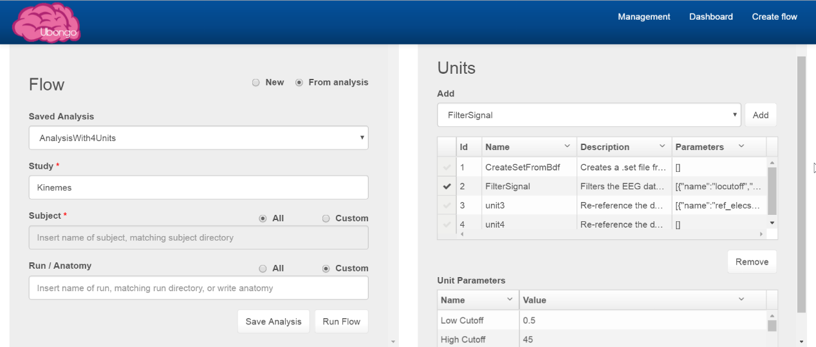
Neuroscience Analyses Execution and Management System
Project Number: 15-1-1-774
By: Shelly Bar, Raz Regev Advisor: Ori Ossmy
Project Carried Out at Sagol School of Neuroscience
TEL AVIV UNIVERSITY
THE IBY AND ALADAR FLEICHMAN FACULTY OF ENGINEERING
אוניברסיטת תל-אביב
הפקולטה להנדסה
ע"ש איבי ואלדר פליישמן
Abstract: we developed a system for executing and managing analyses on large sets of data, typical to neuroscientific experiments. Our system includes a main Java server, a RESTful HTTP service, a Web-UI, and multiple Java server instances that execute analyses as Bash-Matlab scripts. The system supports running many analyses of various kinds on different sources of data in parallel by multiple users. The system will be used for the benefit of the Sagol School of Neuroscience.

