Slide 1




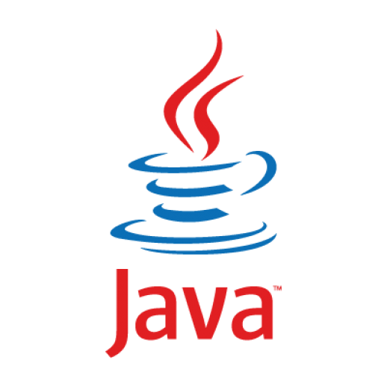


REST Service
HTTP
Web UI
Apache Tomcat – Web Container
Infrastructure Module
Execution Server
System
Configuration
(XML)
Common Module
Network Utilities (SSH, SFTP) and Objects used across the system
Queue Manager
Multiple Producer and consumer threads managing task preparation for execution (queueing, dependency management and task-machine coupling)
Persistence Module
Database management, unit definitions deserializer and heartbeat persistence
Execution Proxy
Sends tasks for execution and other instructions to the executors
(e.g., stop-task)
Machines Manager
Manages executors’ availability and sends the server heartbeat
JDBC + SSH
AMQP
DB
Unit Settings
(XML)
File server (netapp)
Unit files, input and output data, logs
Unit Settings
(XML)
Machine
Unit Settings
(XML)
Unit
(Bash + Matlab)
Unit
(Bash + Matlab)
Unit
(Bash + Matlab)
Machine
Machine

Slide 2
REST Service
HTTP
Web UI
Apache Tomcat – Web Container
Infrastructure Module
Execution Server
System
Configuration
(XML)
Common Module
Network Utilities (SSH, SFTP) and Objects used across the system
Queue Manager
Multiple Producer and consumer threads managing task preparation for execution (queueing, dependency management and task-machine coupling)
Persistence Module
Database management, unit definitions deserializer and heartbeat persistence
Execution Proxy
Sends tasks for execution and other instructions to the executors
(e.g., stop-task)
Machines Manager
Manages executors’ availability and sends the server heartbeat
JDBC + SSH
AMQP
DB
Unit Settings
(XML)
File server (netapp)
Unit files, input and output data, logs
Unit Settings
(XML)
Machine
Unit Settings
(XML)
Unit
(Bash + Matlab)
Unit
(Bash + Matlab)
Unit
(Bash + Matlab)
Machine
Machine

