Slide 1


heart disease prediction
upGrad
NAME : Pravesh Kumar , Sahil Raj , Gautam Kumar , Satyanand Kumar
REG NO : 12018926 , 12018697 , 12019286, 12019290
SECTION : K20UR
COURSE NAME : CSE 441 (INDUSTRY INTERNSHIP PROJECT)
MENTOR NAME : Aditya Prashant Ardak

Slide 2
introduction
upGrad
Heart disease is a leading cause of death worldwide, and there is a need for accurate prediction models to identify individuals at high risk of developing Heart disease. Machine learning algorithms have been shown to be effective in predicting heart disease risk, and Python provides a powerful platform for building and training these models.

Slide 3

ABOUT THE PROJECT
upGrad
In today’s era , the cases of heart disease are increasing at rapid rate . Blood pressure imbalance and high cholesterol is a leading causse of heart disease
We prepared a heart disease prediction system to predict whether the patient is likely to be diagnosed with a heart disease or not using the medical history of the patient electronic data.
We are going to use different maching learing algorithm like logistic regression, Random Forest (RF) and KNN to predict and classify the patient with heart disease.

Slide 4
dAta DEFINATION
upGrad
Cigs Per Day: the number of cigarettes that the person smoked on average in one day.(can be considered continuous as one can have any number of cigarettes, even half a cigarette.)
BP Meds: whether or not the patient was on blood pressure medication (Nominal) Prevalent Stroke: whether or not the patient had previously had a stroke (Nominal)
Prevalent Hyp: whether or not the patient was hypertensive (Nominal)
Tot Chol: total cholesterol level (Continuous)
Sys BP: systolic blood pressure (Continuous)
Dia BP: diastolic blood pressure (Continuous)
BMI: Body Mass Index (Continuous)
Glucose: glucose level (Continuous)
10 year risk of coronary heart disease CHD(binary: “1”, means “Yes”, “0” means “No”)

Slide 5
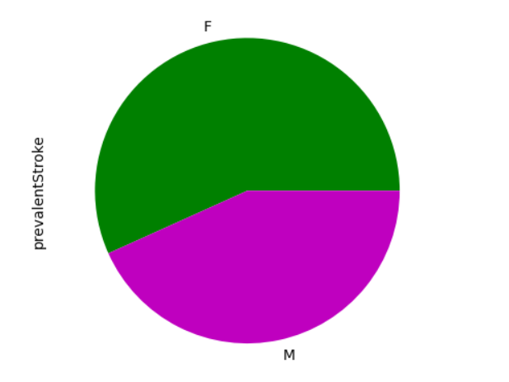
dAta VISUALIZATION
upGrad
Pie Plot of prevalent stroke
From this pie plot we can conclude that female has more chance to get stroke

Slide 6
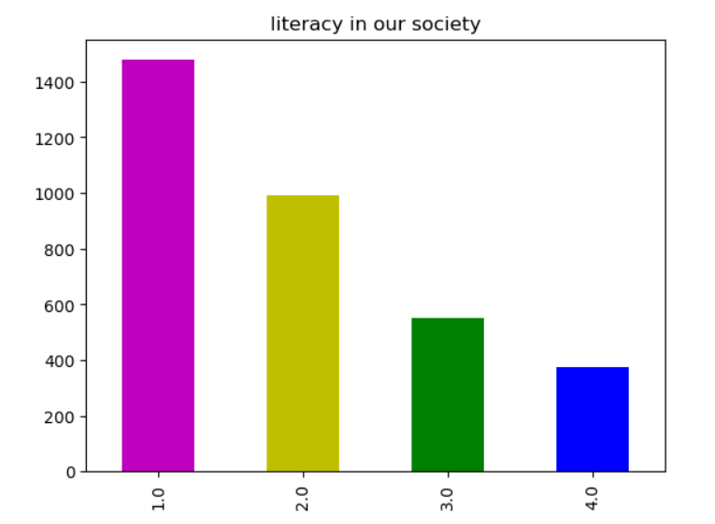
dAta VISUALIZATION
upGrad
Bar Graph of literacy in our society
From this graph we can conclude that people are more educated in society

Slide 7
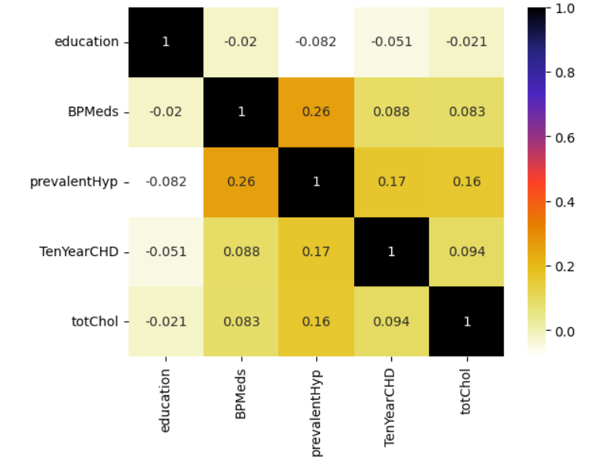
dAta VISUALIZATION
upGrad
Heatmap
From this heat map we can conclude that BPMeds are more correlated with TenYearCHD , totChol is more correlated with BPMeds

Slide 8
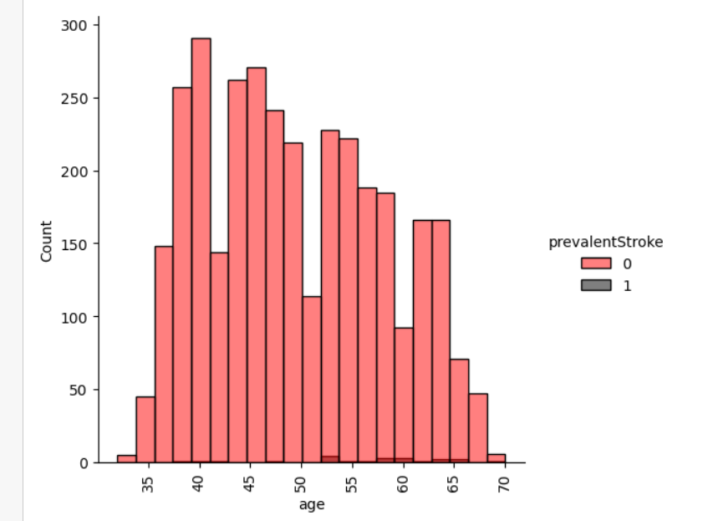
dAta VISUALIZATION
upGrad
Distrbution plot
How age and prevalentstroke is releated to each other
People ages between 53 to 65 they got more number of prevalent stroke

Slide 9
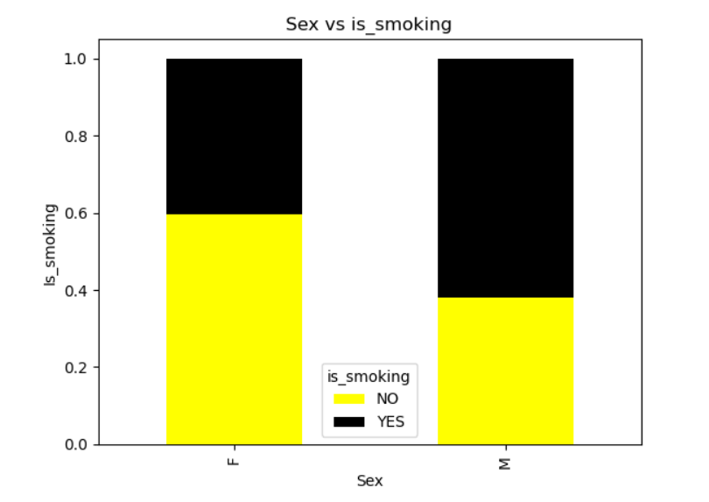
dAta VISUALIZATION
upGrad
we found that male smoke more as compare to female

Slide 10
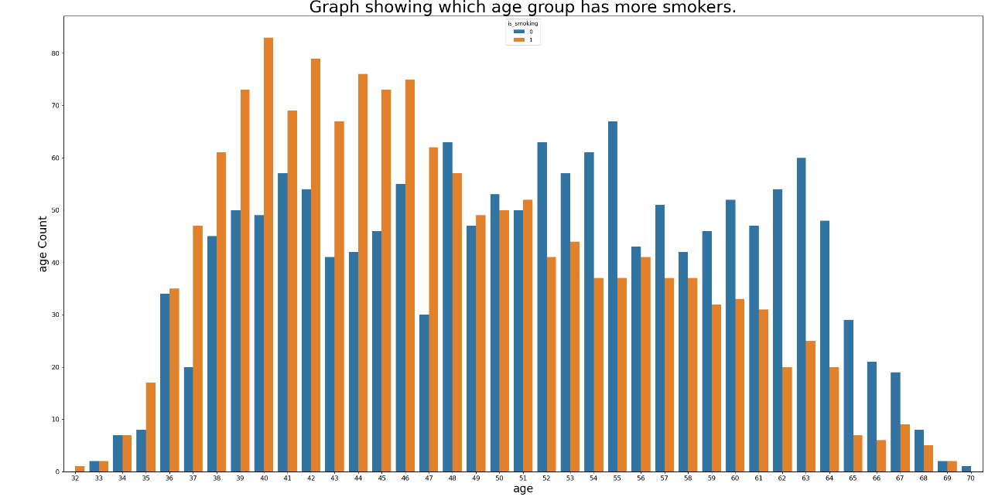
dAta VISUALIZATION
upGrad
Mid-age groups ranging from the age of 38 - 46 have more number of currentSmokers No currentSmokers observed below the age of 32 maximum age for a currentSmokers is 70

Slide 11
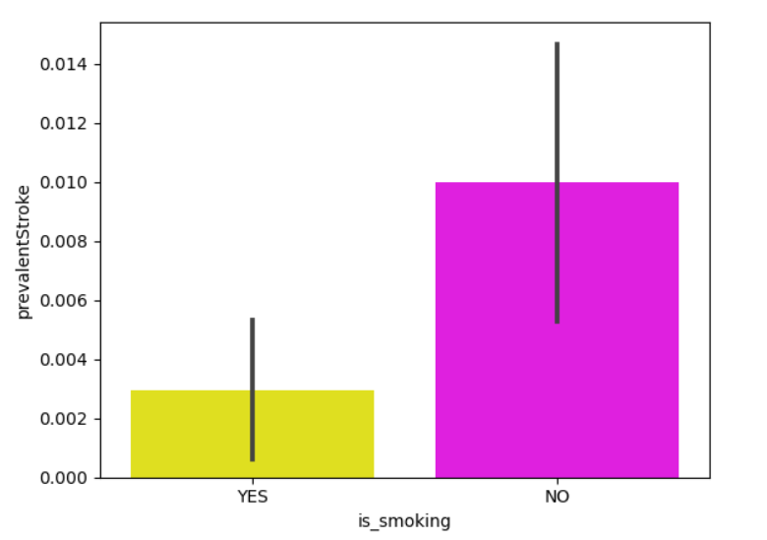
dAta VISUALIZATION
upGrad
Therefore from the graph i conclude that somking is not correlated with stroke or pevelent -stroke which means that if i they dose not smoke there is a chance to get stroke

Slide 12
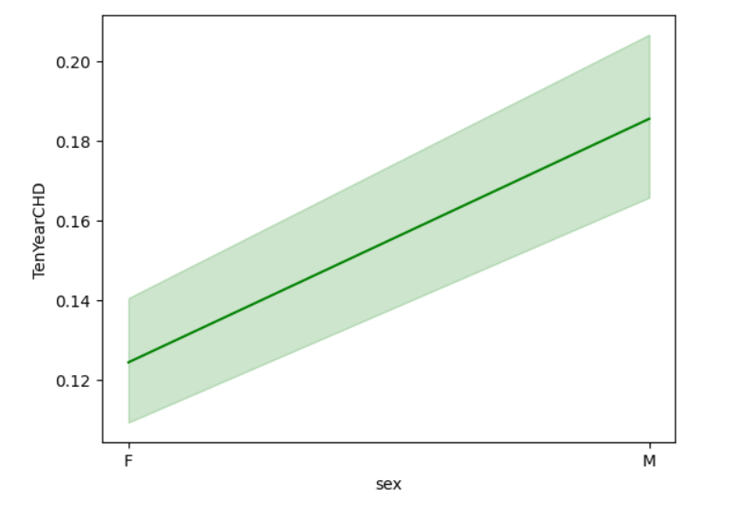
dAta VISUALIZATION
upGrad
who are having more chances to get infected with CHD male or female
From this linegraph we conclude that there is more risk to male to get CHD (10 year risk of coronary heart disease CHD)as compared to female

Slide 13
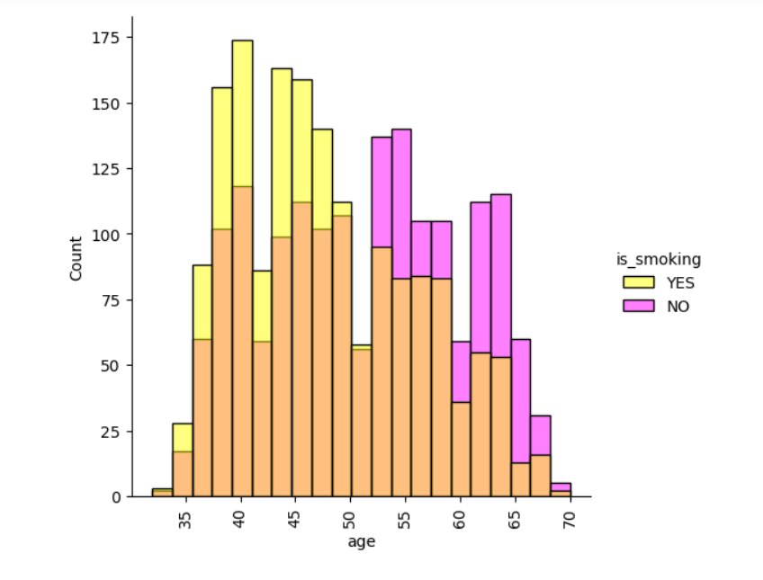
dAta VISUALIZATION
upGrad
With the increase in age (means 40+)the percentage of smoker decreases and from 28 to 40 it increases rapidly(means people smoke more at this stage ).

Slide 14
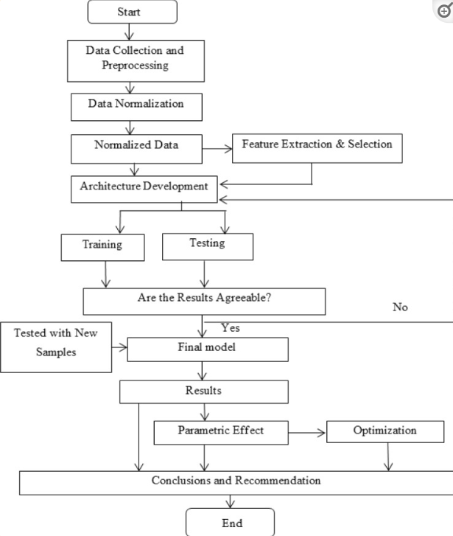
STEPS OF EDA
upGrad
Data Collection using beautifulsoup and request library from healthplix and medical information system website.
Data Preprocessing, removed duplicate data and null values.
Univariate,Bivariate and multivariate Analysis .
Horizontal Bar Graph ,Boxplot , Heatmap , line plot etc.
.

Slide 15
conclusion
upGrad
A lot of people die from heart disease, so it's crucial to predict who's at risk. Using machine learning algorithms, we can make effective predictions. Is great for building and training these prediction models. By using these tools, we can find out who might get heart disease early on and help them before it's too late. This is important for improving heart health around the world.

Slide 16
References
Sahoo, P. & Jeripothula, P. (2020) Heart Failure Prediction Using Machine Learning Techniques. SSRN Electronic Journal.
Chicco, D. & Jurman, G. (2020) Machine learning can predict survival of patients with heart failure from serum creatinine and ejection fraction alone. BMC Medical Informatics and Decision
Fitriyani N. L., Syafrudin M., Alfian G., Rhee J. HDPM: an effective heart disease prediction model for a clinical decision support system.
Zhenya Q., Zhang Z. A hybrid cost-sensitive ensemble for heart disease prediction. BMC Medical Informatics and Decision Making
C. Beyene and P. Kamat, “Survey on prediction and analysis the occurrence of heart disease using data mining techniques,” International Journal of Pure and Applied Mathematics
Yuan X., Chen J., Zhang K., Wu Y., Yang T. A stable ai-based binary and multiple class heart disease prediction model for IoMT
V. V. Ramalingam, A. Dandapath, and M. K. Raja, “Heart disease prediction using machine learning techniques

Slide 17
thank you
upGrad

