Slide 1
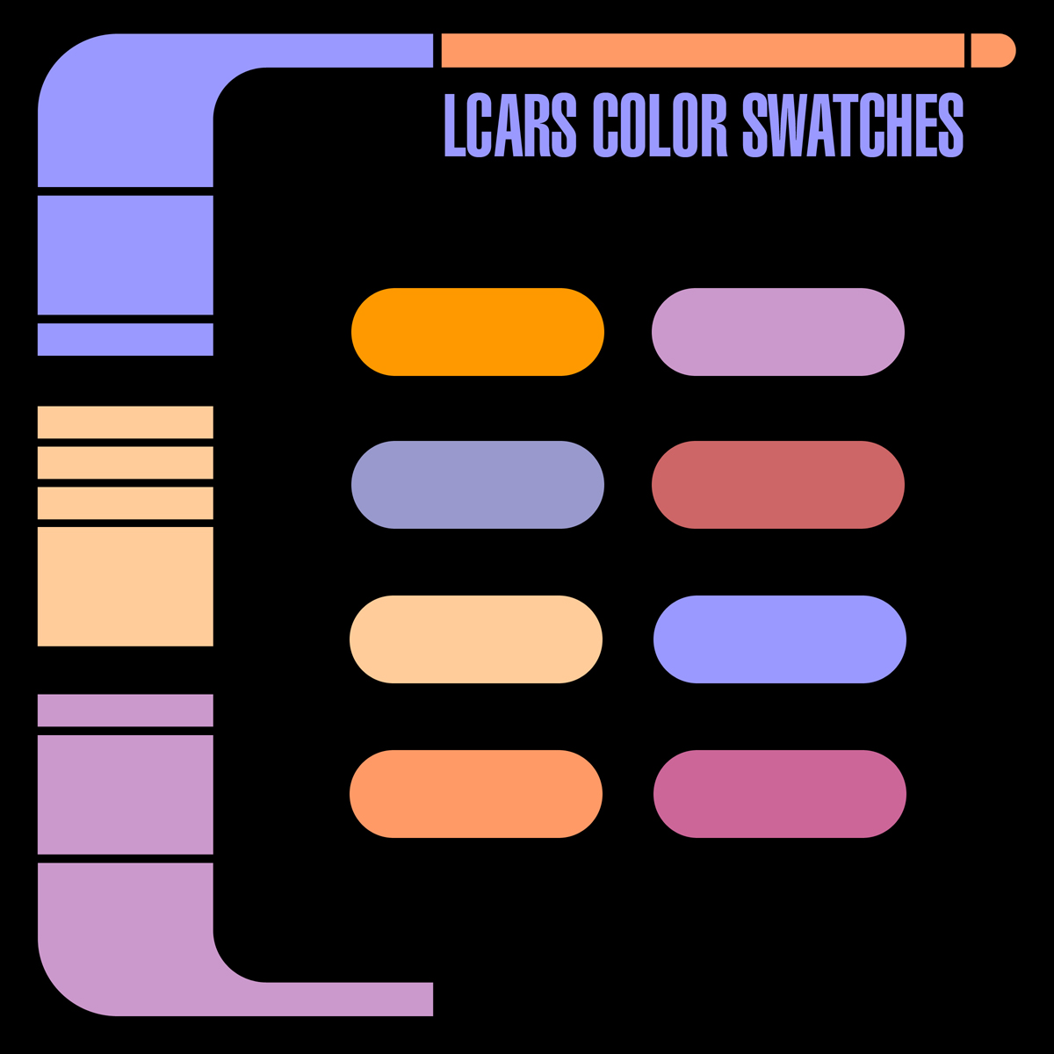
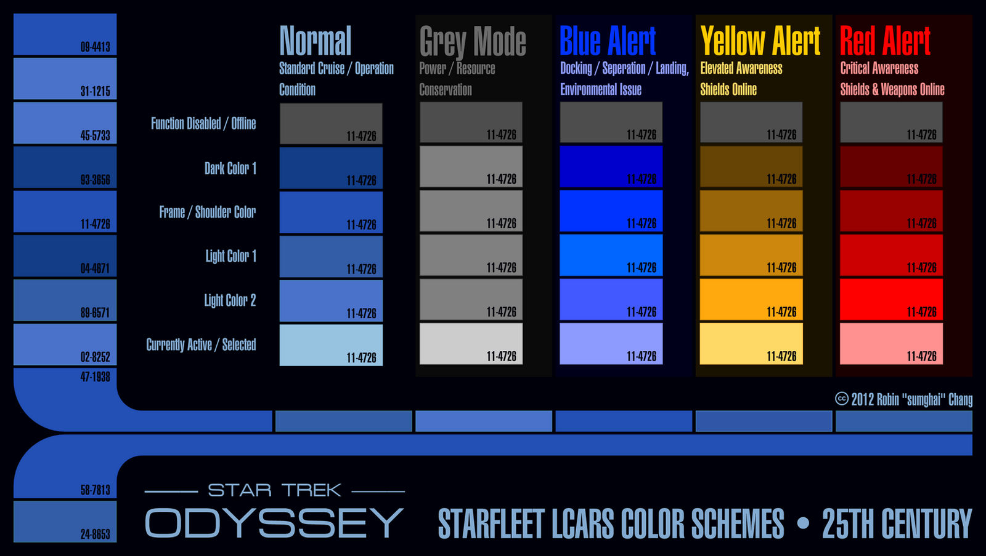
Smart Board Modular Platform LCARS Data Node
SUBLEVEL {441 188} COMMUNICATION MASTER CONTROL
USS STARLIGHT [NCC-1602] classified ACCESS SYSTEM 47

Slide 2
Smart Board Modular Platform Def Stealth Mode
SUBLEVEL {441 188} COMMUNICATION MASTER CONTROL
USS STARLIGHT [NCC-1602] classified ACCESS SYSTEM 47

Slide 3
Smart Board Modular Platform LCARS Data Node
USS STARLIGHT [NCC-1602] classified ACCESS SYSTEM 47

Slide 4
Smart Board Modular Platform Def Stealth Mode
USS STARLIGHT [NCC-1602] classified ACCESS SYSTEM 47

Slide 5
Smart Board Modular Platform LCARS Data Node
USS STARLIGHT [NCC-1602] classified ACCESS SYSTEM 47

Slide 6
Smart Board Modular Platform Def Stealth Mode
USS STARLIGHT [NCC-1602] classified ACCESS SYSTEM 47

