Slide 1

OAuth for Web Applications
Specialised Protocols in Computer Networks
Petruta Razvan-Dumitru

Slide 2
Agenda
Authentication vs Authorization
What is OAuth?
Why OAuth?
History of OAuth
OAuth 1.0 vs OAuth 2.0
OAuth 2.0 terminology
OAuth 2.0 flow
Authorization Codes and Grant Types
Popular OAuth Services
Demo

Slide 3
Authentication and Authorization in Web Applications
Authentication: Verifying user identity.
Authorization: Controlling user access and permissions.

Slide 4
What is OAuth (Open Authorization)?
OAuth is an open standard for access delegation commonly used as a way for Internet users to grant websites or applications access to their information on other websites without giving them the credentials.

Slide 5
Why OAuth? Before OAuth...
Before OAuth, if a third party app needed some information from other apps, you would have to provide your username and password to the third-party.
Problems:
Apps store the user’s password
Apps get complete access to user’s account
Users can revoke access only by changing the password
Compromised apps exposed user’s password

Slide 6
History of OAuth
OAuth 1.0: first introduced in 2007
OAuth 2.0: the blueprint and first draft was released in 2010 as RFC(Request For Comments) 5849 by IETF (Internet Engineering Task Force), and after significant changes and improvements, the final version was released in 2012 as RFC 6749.

Slide 7
OAuth 1.0 vs OAuth 2.0
OAuth 1.0 has a consumer, service provider and a user, and it doesn’t explicitly separate the roles of the resource server and authorization server.
OAuth 2.0 has a client, authorization server, resource server and resource owner. That’s why these versions don’t have backward compatibility.

Slide 8
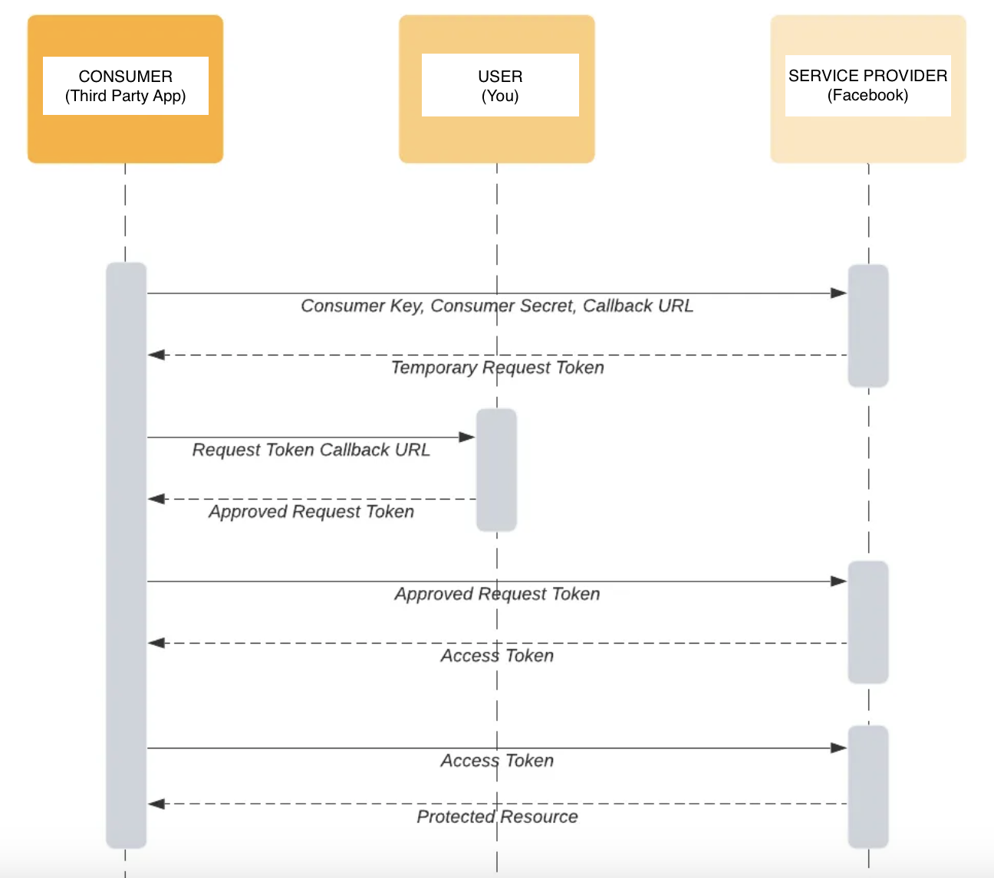
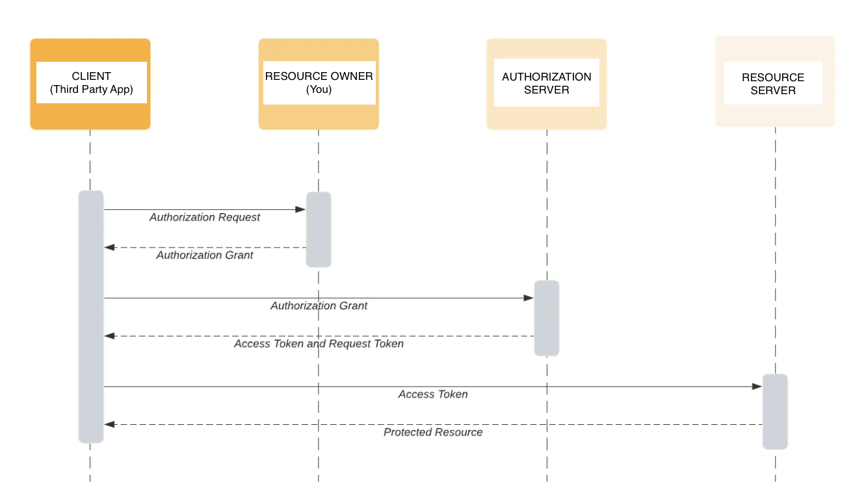
OAuth 1.0 OAuth 2.0

Slide 9
OAuth 2.0 terminology
Resource Owner: the owner of the protected resources
Client: the third party application that sends an access request to the resource owner’s protected resources
Resource Server: the external server that the user integrates with
Authorization Server: the server that accepts the credentials of the resource owner and checks to see if they are authorized to access the resource. It gives away tokens via resource owner’s consent

Slide 10
OAuth 2.0 flow
To access the protected resources that are owned by the resource owner (the user), the client (third party app) sends an authorization request to the authorization server (API) to request authorization by conducting the user to the authorized endpoint. The client supplies the client ID token as an instrument for identification.
The resource owner validates the application’s access request by authenticating and authorizing it. The client provides an endpoint URI, or a redirect URI, to which it sends the authorization grant (authorization code), and it also presents the scopes that the resource owners authorize. Then, the authorized endpoint gives the client an OAuth 2.0 protocol authorization grant.
The client requests an access token (in URL form) from the authorization server by exchanging authorization grant for a token. The grant, as well as the authentication of the grant’s identity, is returned to the token endpoint.
If the authorization grant is valid and the client identity is authenticated, the client is given an access token either by the provider of the authentication or the authorization server.
With this authentication access token, the client is allowed to request the credentials from the resource server.

Slide 11
Authorization Codes and Grant Types
An authorization grant gives the client permission to retrieve an access token on behalf of the end user.
Authorization Code: A common and secure flow where the client redirects the user to the authorization server for authentication, and upon approval, receives an authorization code to exchange for an access token (usage in web applications)
Authorization Code Grant with Proof Key for Code Exchange (PKCE): An extension of the Authorization Code Grant designed to secure public clients where the client cannot securely store a client secret (usage in mobile applications and single page applications)
Implicit Grant: In this flow, the access token is returned directly to the client without exchanging an authorization code (not recommended, used in single page applications)
Resource Owner Credentials Grant Type: The client collects the user's credentials directly and sends them to the authorization server to obtain an access token (usage in scenarios where the client is highly trusted)
Client Credentials Grant: The client directly exchanges its own credentials (client ID and client secret) for an access token (usage in server to server communication)
Refresh Token Grant: If an access token expires, the client can use a refresh token to obtain a new access token without requiring the user to re-authenticate (after initial authorization, the client periodically refreshes the access token)
Device Authorization Flow: Allows a device to prompt the user to set up a link on a different device and authorize the app instead of authenticating the user directly (usage for devices with limited input capabilities, such as smart tvs)

Slide 12
Popular OAuth services
GOOGLE: google account information, like access to Drive files or access to Youtube channel information (see https://console.cloud.google.com/)
FACEBOOK: facebook account information, like username, email, profile picture, friends list, etc.
Twitter
Discord
Github
…

Slide 13
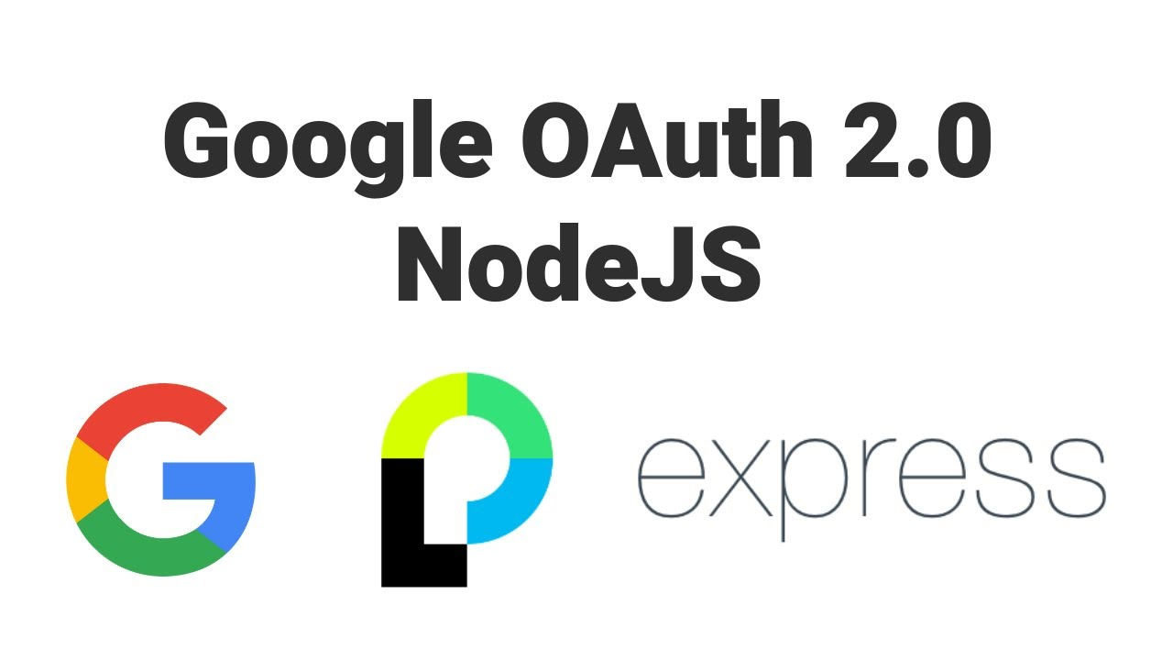
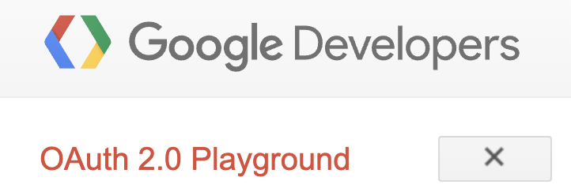
DEMO

Slide 14
References
https://www.upguard.com/blog/oauth
https://medium.com/identity-beyond-borders/oauth-1-0-vs-oauth-2-0-e36f8924a835
https://www.loginradius.com/blog/engineering/google-authentication-with-nodejs-and-passportjs/
https://www.youtube.com/watch?app=desktop&v=Q0a0594tOrc

