Slide 1
A Comparative Analysis of Text Representation Methods for Romanian Fake News Detection
Supervisor
Lect. PhD. Lupea Mihaiela-Ana
Author
Pop Răzvan-Gabriel
Babeș-Bolyai University, Cluj-Napoca, Romania
Faculty of Mathematics and Computer Science
July 3, 2025

Slide 2
Problem & Motivation
Problem
Fake news spreads rapidly on digital platforms.
There are very few automated detection tools specifically for the Romanian language.
Motivation
Disinformation has influenced public opinion on topics like elections, public health, and the economy.
There is a clear need for automated tools that can analyze and understand Romanian text.

Slide 3
Related Work and Main Objectives
Related Work
Main Objectives
Previous studies show good results for Romanian fake news classification using models like CNN, SVM, and BERT.
Recent research explored emotional processing and how it affects belief in fake news.
Work with a dataset in the Romanian Language.
Analyze the data to find the key linguistic and emotional patterns that can be turned into features.
Compare different text representations to see which performs best with an SVM classifier.
Build a working web application to apply the findings in practice.

Slide 4
Text Representation Techniques
Corpus-Based
Dynamic and Contextualized
Word2Vec: dense, static, word-level.
Doc2Vec: dense, static, document-level.
TF-IDF: sparse, high-dimensional, keyword-based
RoBERT (CLS Token): dynamic, context-aware representation.

Slide 5
Classification and Clustering Algorithms
Supervised
Unsupervised
Support Vector Machine(SVM):
The main algorithm used for classification in all experiments.
Works by finding the best possible boundary (hyperplane) to separate the different news categories.
Chosen to ensure a fair and direct comparison between all text representation methods.
K-Means Clustering:
Used to automatically group similar documents into clusters based on their Doc2Vec vectors.
Its role was for feature engineering: the ID of the cluster a document belonged to was used as a single feature in the hybrid model.

Slide 6
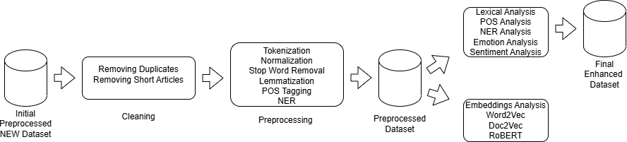
Dataset Analysis Perspective
Preprocessing: Tokenization, Normalization, Stop Word Removal, Lemmatization, POS Tagging, Named Entity Recognition (NER).

Slide 7
NEW Dataset for Romanian Fake News Detection
Category | Count | Percentage
Real | 1,032 | 23.8%
Misinformation | 916 | 21.1%
Satire | 870 | 20.1%
Fake | 812 | 18.7%
Propaganda | 704 | 16.2%
Real News: Factual, verifiable information that aims to inform objectively.
Fake News: Intentionally false content designed to deceive an audience, often for financial or political gain.
Misinformation: False information that is spread, but not necessarily with the intent to deceive.
Propaganda: Biased or misleading information used to promote a specific political cause or point of view.
Satire: Content that uses humor, irony, and exaggeration to criticize or offer commentary on issues.

Slide 8
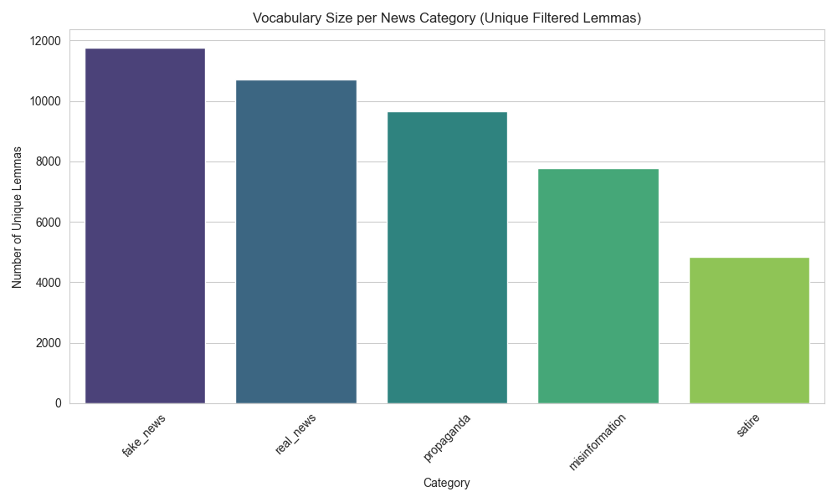
Dataset Analysis: Lexical and Syntactic Analysis I

Slide 9
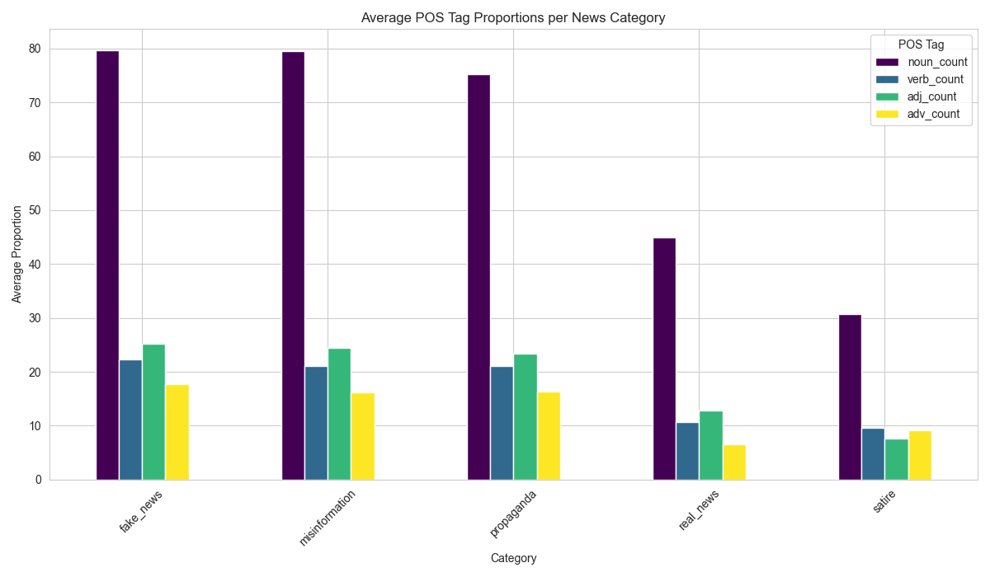
Dataset Analysis: Lexical and Syntactic Analysis II

Slide 10
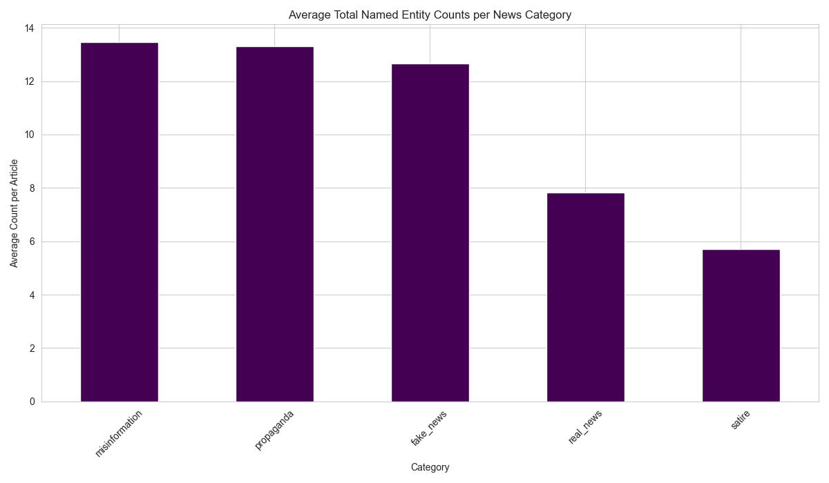
Dataset Analysis: Lexical and Syntactic Analysis III

Slide 11
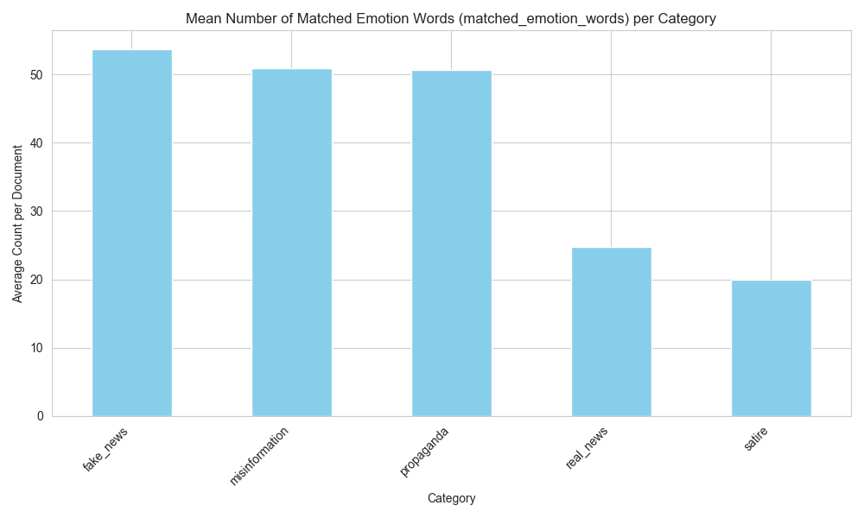
Dataset Analysis: Emotion and Sentiment Analysis I

Slide 12
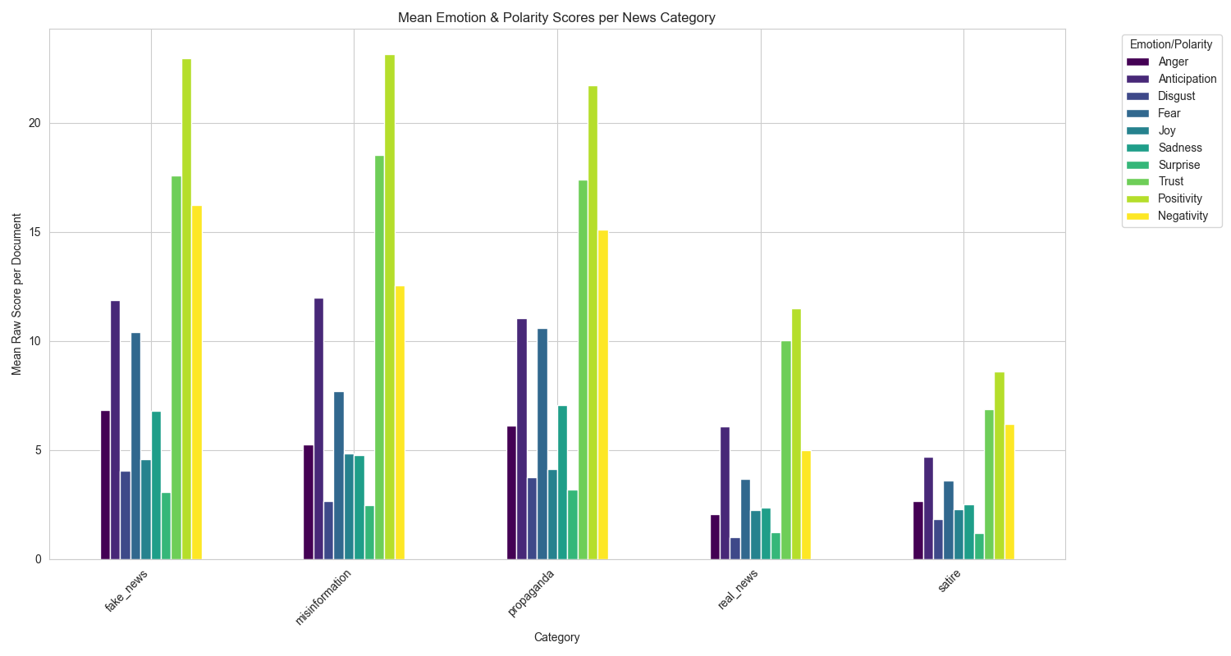
Dataset Analysis: Emotion and Sentiment Analysis II

Slide 13
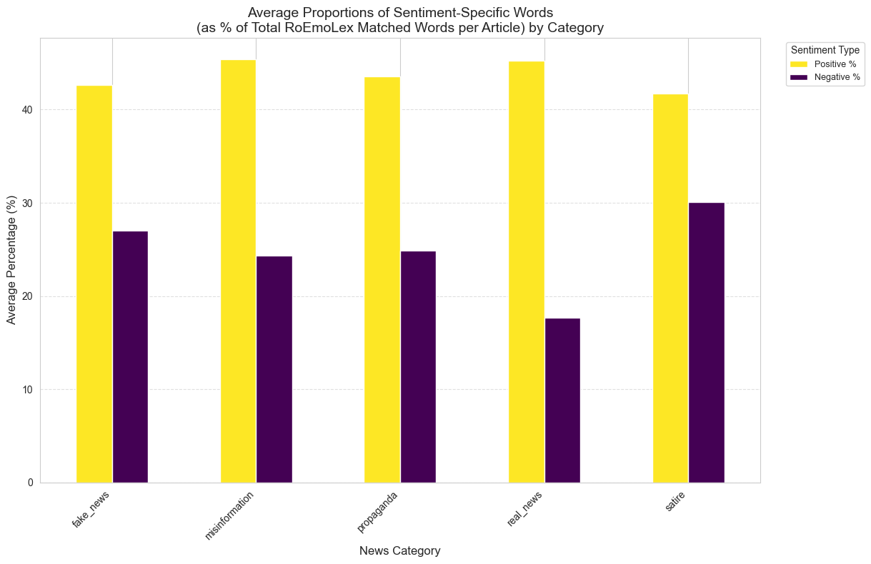
Dataset Analysis: Emotion and Sentiment Analysis III

Slide 14
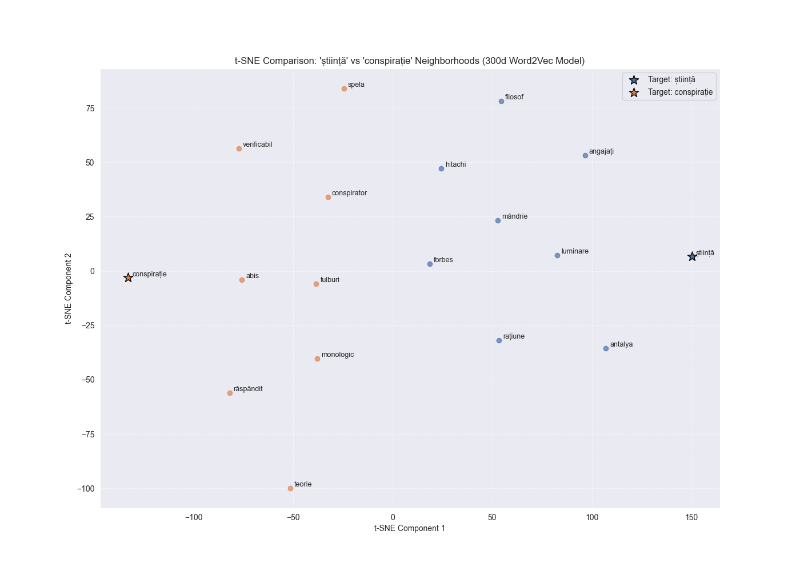
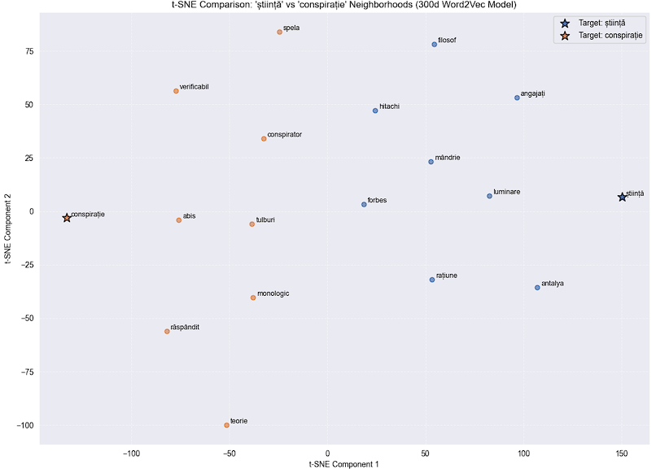
Dataset Analysis: Embeddings Analysis
Word2Vec(300 dimensions)
The custom Word2Vec model successfully learned the specific, biased meanings of words within the news dataset.
It clearly separated the semantic neighborhoods of opposing concepts, such as știință (science) and conspirație (conspiracy), showing it understood their usage in this context.

Slide 15
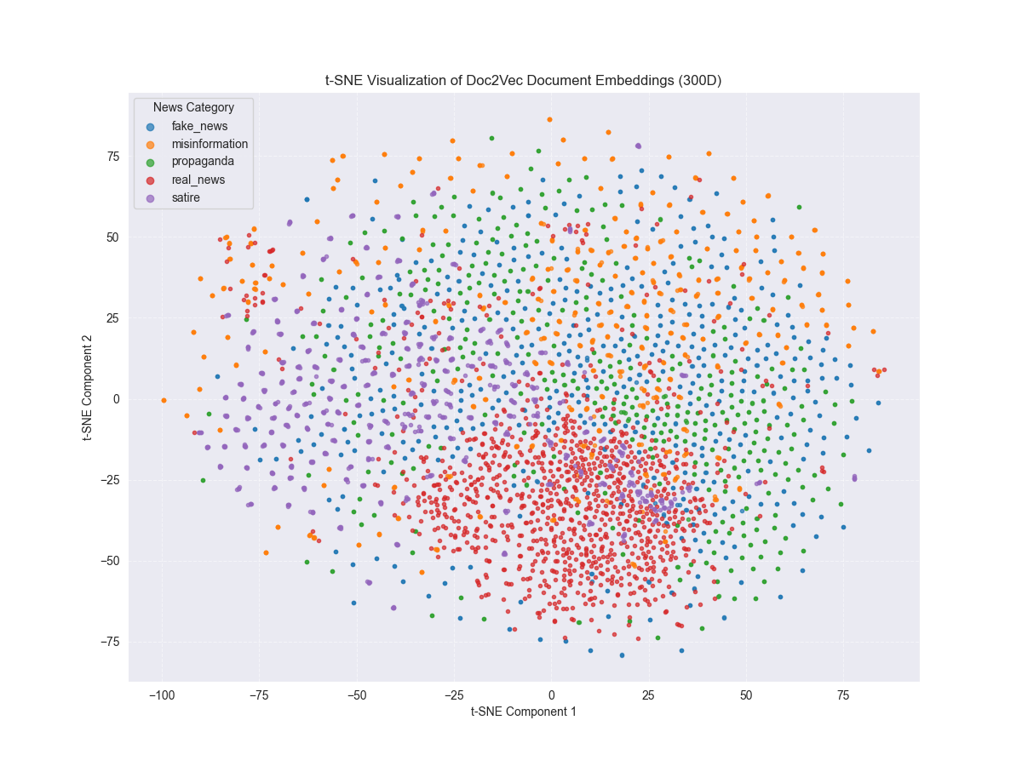
Dataset Analysis: Embeddings Analysis
Doc2Vec(300 dimensions)
The Doc2Vec model was used to create a single vector representing the overall meaning of each article.
significant overlap between all five categories, meaning they often discuss the same topics.
Observations: Real news articles (in red) form a dense semantic core. The other categories, especially fake news (blue) and satire (purple), are more scattered around this central core.
Conclusion: This suggests that real news is more thematically consistent, while disinformation is more varied in its style and content.

Slide 16
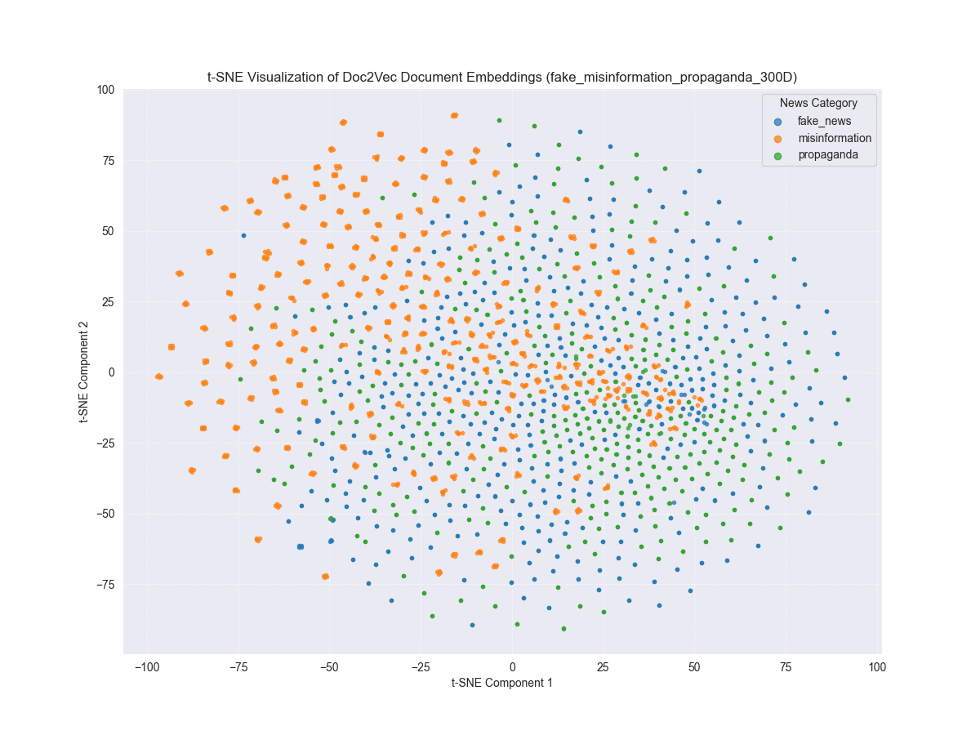
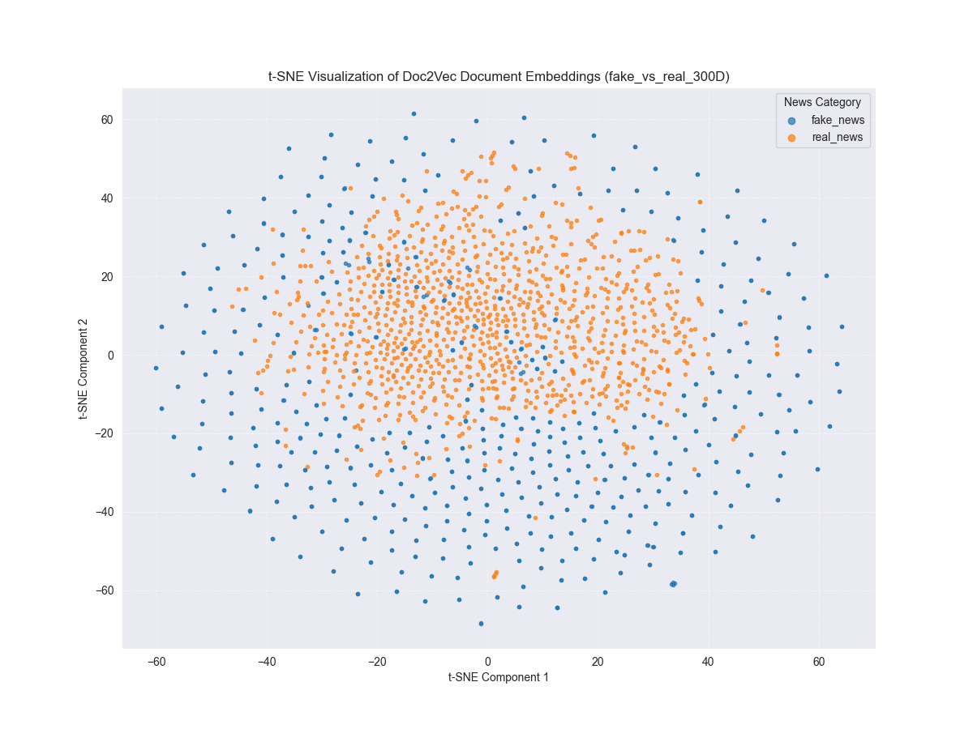
Dataset Analysis: Embeddings Analysis​
Doc2Vec(300 dimensions)

Slide 17
Classification: Methodology
Text Representations Tested
Evaluation
TF-IDF (Keyword-based vectors)
Word2Vec (Averaged word vectors)
Doc2Vec (Document vectors)
RoBERT [CLS] (non-fine-tuned)
Hybrid Model (Doc2Vec + Engineered Features)
To ensure a fair comparison, a Support Vector Machine (SVM) was used as the classifier for all experiments.
Performance was measured using 5-fold stratified cross-validation.

Slide 18
Engineered Features
Word count: Total filtered lemmas
Vocabulary richness: Unique filtered lemmas / total filtered lemmas ration
Part-of-speech proportions: Nouns, verbs, adjectives and adverbs
Total entities: people, nationalities, religious, political groups, organizations, facilities, events, money, locations
Entity density: Entities / total lemmas ratio
Emotion word count: Lemmas matching RoEmoLex lexicon
Emotions proportions: anger, joy, sadness, trust, anticipation, disgust, fear, surprise
Polarity counts (Positivity & Negativity): Positive and negative lemma frequencies
Polarity percentages: Sentiment proportions as percentages
Cluster ID: Document cluster assignment

Slide 19
Classification: Results
Experimental Method | Mean F1-Score
TF-IDF | 0.9570 ± 0.0067
Hybrid Model | 0.9169 ± 0.0141
Doc2Vec | 0.8046 ± 0.0117
Word2Vec (Averaged) | 0.7686 ± 0.0113
RoBERT [CLS] (no fine-tune) | 0.7376 ± 0.0072

Slide 20
Web Application
Technology: The application was developed using the Django web framework.
Core Feature: It classifies text using the best-performing method from the experiments (TF-IDF + SVM), which was then re-trained on the full dataset.
Unique Logic: The results are displayed differently based on the model's confidence score (>80%, 60-80%, <60%).
Analysis Tool: It includes a separate page for exploring the custom Word2Vec models and allowing users to download them.

Slide 21
Conclusion & Main Contributions
Main Conclusions
Key Contributions
The linguistic and emotional analysis revealed clear, measurable differences between real news and disinformation.
For classification, a TF-IDF model performed best (~96%), showing that specific keywords are a very powerful signal.
A Hybrid Model (~92%), combining document vectors with engineered features, is also a highly effective strategy.
A detailed analysis of a Romanian news dataset, creating a "fingerprint" for disinformation.
Two custom, lemmatized Word2Vec models for the Romanian news domain.
A functional web application that demonstrates the practical use of the research.

Slide 22
Future Work
Create a more diverse dataset.
Fine-tune a RoBERT model.
Deploy the application to the cloud.

Slide 23
Thank You
Questions?

Slide 24
NLP techniques used for text preprocessing
Tokenization & Normalization: The text was split into individual words (tokens), converted to lowercase, and cleared of punctuation.
Stop Word Removal: Common words with little meaning (like și, cu) were filtered out to focus on important terms.
Lemmatization: Each word was reduced to its base dictionary form (e.g., the words merg, mergi, and merge all become the lemma "merge").
POS Tagging: The grammatical role of each word (noun, verb, adjective, etc.) was identified.
Named Entity Recognition (NER): Names of people, organizations, and locations were identified and categorized.

Slide 25
Text Representations Techniques
Term Frequency-Inverse Document Frequency (TF-IDF): Assigns a weight to each word based on how frequently it appears in a document (TF) and how rare it is across the entire corpus (IDF), helping to highlight terms that are important and distinctive to that document.
Word2Vec: Represents each word as a numerical vector, where words with similar meanings are placed closer together in a vector space.
Doc2Vec: An extension of Word2Vec that generates a single vector representation for an entire document, capturing its overall meaning.
RoBERT (CLS Token): A contextualized transformer-based language model. We used the final hidden state of the special [CLS] token—designed to capture aggregated information about the entire input sequence—as a fixed-size vector representation of each document.
TODO: doua coloane, corpus based si dynamic contextualized TF-IDF: SPARSE, HIG,…

Slide 26


Text Representations Techniques
The Term Frequency (TF) measures how often a term t appears in a document d.
The Inverse Document Frequency (IDF) measures how important a term is by
looking at how often it appears across all documents D in the corpus.
TODO: Add Word2Vec, Doc2Vec and RoBERT architectures.
The final TF-IDF score for a term in a document is the product of these two
values.

Slide 27
Dataset Overview
Source: The work began with the "NEW preprocessed dataset", which combines articles from FakeRom and Veridica.ro.
Initial State: This dataset was already balanced and contained 5,160 articles.
Data Validation: An additional cleaning phase was performed to ensure data quality by removing duplicate articles and very short texts.
Final Dataset: The final dataset used for all analysis consists of 4,334 unique articles, labeled into five categories(real, fake, misinformation, propaganda or satire).
Final Distribution: The cleaning process resulted in an imbalanced dataset: real news (23.8%), misinformation (21.1%), satire (20.1%), fake news (18.7%), and propaganda (16.2%).

Slide 28
Classification and Clustering Algorithms -> sup and unsup
Support Vector Machine (SVM)
The main algorithm used for classification in all experiments.
Works by finding the best possible boundary (hyperplane) to separate the different news categories.
Chosen to ensure a fair and direct comparison between all text representation methods.
K-Means Clustering
Used to automatically group similar documents into clusters based on their Doc2Vec vectors.
Its role was for feature engineering: the ID of the cluster a document belonged to was used as a single feature in the hybrid model.

Slide 29
Dataset Analysis: Lexical and Syntactic Analysis
Article Length: Disinformation-related articles (fake, propaganda) tend to be longer than real or satire news. On average, a fake news article is 85% longer than a real one.
Vocabulary Size: Fake news and real news use the largest vocabularies, suggesting they cover diverse topics. Satire has the smallest and most focused vocabulary.
Grammatical Structure (POS): Analysis of nouns, verbs, adjectives, and adverbs shows that disinformation articles use significantly more nouns and adjectives, suggesting a more descriptive and evocative writing style.
Named Entities (NER): Disinformation articles have a higher average number of entities (people, organizations, etc.) per article. Misinformation, in particular, overuses references to political and national groups.
Word Clouds: Word clouds revealed that each category has a distinct focus: real news uses institutional language, fake news and satire use conspiracy terms, propaganda uses pseudo-scientific language, and misinformation focuses on socio-economic and political themes.

Slide 30
Dataset Analysis: Lexical and Syntactic Analysis

Slide 31
Dataset Analysis: Emotion & Sentiment Analysis
More Emotional Language: An average fake news article uses more than double the number of emotionally-charged words compared to a real news article.
A Mix of Emotions: Disinformation articles scored highest not only in negative emotions like Fear and Anger but also in Trust. This suggests a deliberate strategy: using negative emotions to create alarm while using trust-related words to build a false sense of credibility.
Sentiment Polarity: Satire and fake news had the highest percentage of negative emotional words, while real news had the lowest. This supports the idea that, while real news does express emotion, it does so with a much more neutral and balanced tone than fake news or satire.

Slide 32
Dataset Analysis: Emotion and Sentiment Analysis

Slide 33
Classification: Results
Performance Comparison
Key Takeaways TODO: aici le mentionez verbal.
Experimental Method | Mean F1-Score
TF-IDF | 0.9570 ± 0.0067
Hybrid Model | 0.9169 ± 0.0141
Doc2Vec | 0.8046 ± 0.0117
Word2Vec (Averaged) | 0.7686 ± 0.0113
RoBERT [CLS] (no fine-tune) | 0.7376 ± 0.0072
TF-IDF was the best performer (~96%). This shows that for this dataset, the presence of specific keywords is the most powerful signal for classification.
The Hybrid Model also performed well (~92%). This model combined Doc2Vec vectors with 22 engineered features, including a K-Means cluster ID.
The non-fine-tuned RoBERT model performed poorly, even worse than the simpler Word2Vec method, highlighting the need for fine-tuning.

Slide 34
Future Work
Create a more diverse dataset: The most important next step is to build a larger dataset with articles from more domains (e.g., politics, finance) and time periods.
Fine-tune a RoBERT model: The baseline RoBERT model performed poorly, but fine-tuning it on this specific task is expected to achieve state-of-the-art results.
Deploy the application to the cloud: Moving the application from a local server to a cloud platform would make it publicly accessible for real-world use and feedback.

