Slide 1
A Comparative Analysis of Text Representation Methods for Romanian Fake News Detection
Supervisor
Lect. PhD. Lupea Mihaiela-Ana
Author
Pop Răzvan-Gabriel
Babeș-Bolyai University, Cluj-Napoca, Romania
Faculty of Mathematics and Computer Science
July 3, 2025

Slide 2
Problem & Motivation
Problem
Fake news spreads rapidly on digital platforms.
There are very few automated detection tools specifically for the Romanian language.
Motivation
Disinformation has influenced public opinion on topics like elections, public health, and the economy.
There is a clear need for automated tools that can analyze and understand Romanian text.

Slide 3
Related Work and Main Objectives
Related Work
Main Objectives
Previous studies show good results for Romanian fake news classification using models like CNN, SVM, and BERT.
Recent research explored emotional processing and how it affects belief in fake news.
Work with a dataset in the Romanian Language.
Analyze the data to find the key linguistic and emotional patterns that can be turned into features.
Compare different text representations to see which performs best with an SVM classifier.
Build a working web application to apply the findings in practice.

Slide 4
Text Representation Techniques
Corpus-Based
Dynamic and Contextualized
Word2Vec: dense, static, word-level.
Doc2Vec: dense, static, document-level.
TF-IDF: sparse, high-dimensional, keyword-based
RoBERT (CLS Token): dynamic, context-aware representation.

Slide 5
Classification and Clustering Algorithms
Supervised
Unsupervised
Support Vector Machine(SVM):
The main algorithm used for classification in all experiments.
Works by finding the best possible boundary (hyperplane) to separate the different news categories.
Chosen to ensure a fair and direct comparison between all text representation methods.
K-Means Clustering:
Used to automatically group similar documents into clusters based on their Doc2Vec vectors.
Its role was for feature engineering: the ID of the cluster a document belonged to was used as a single feature in the hybrid model.

Slide 6
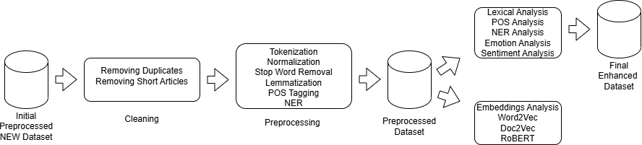
Dataset Analysis Perspective
Preprocessing: Tokenization, Normalization, Stop Word Removal, Lemmatization, POS Tagging, Named Entity Recognition (NER).

Slide 7
NEW Dataset for Romanian Fake News Detection
Category | Count | Percentage
Real | 1,032 | 23.8%
Misinformation | 916 | 21.1%
Satire | 870 | 20.1%
Fake | 812 | 18.7%
Propaganda | 704 | 16.2%
Real News: Factual, verifiable information that aims to inform objectively.
Fake News: Intentionally false content designed to deceive an audience, often for financial or political gain.
Misinformation: False information that is spread, but not necessarily with the intent to deceive.
Propaganda: Biased or misleading information used to promote a specific political cause or point of view.
Satire: Content that uses humor, irony, and exaggeration to criticize or offer commentary on issues.

Slide 8
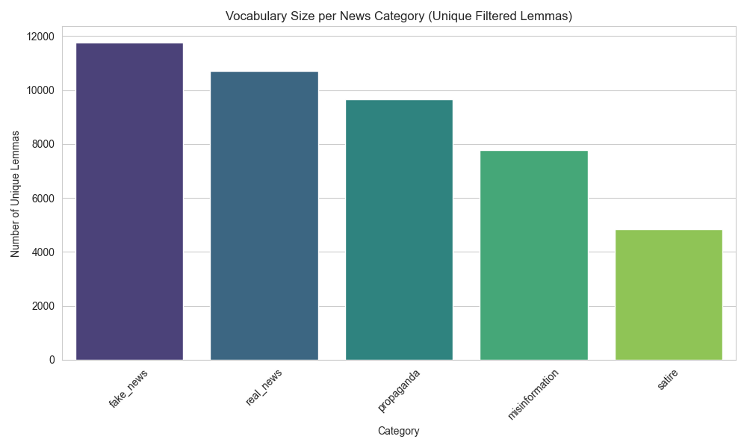
Dataset Analysis: Lexical and Syntactic Analysis I

Slide 9
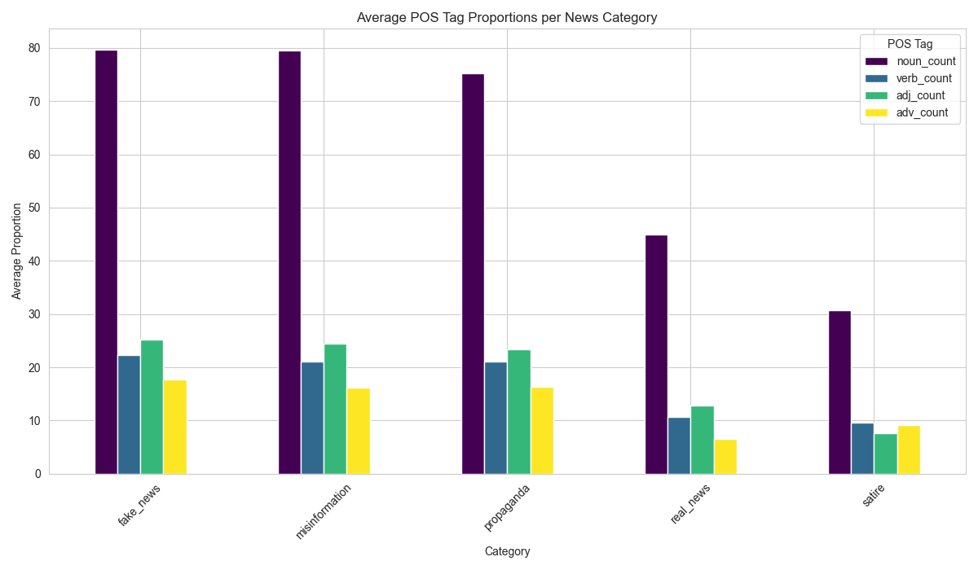
Dataset Analysis: Lexical and Syntactic Analysis II

Slide 10
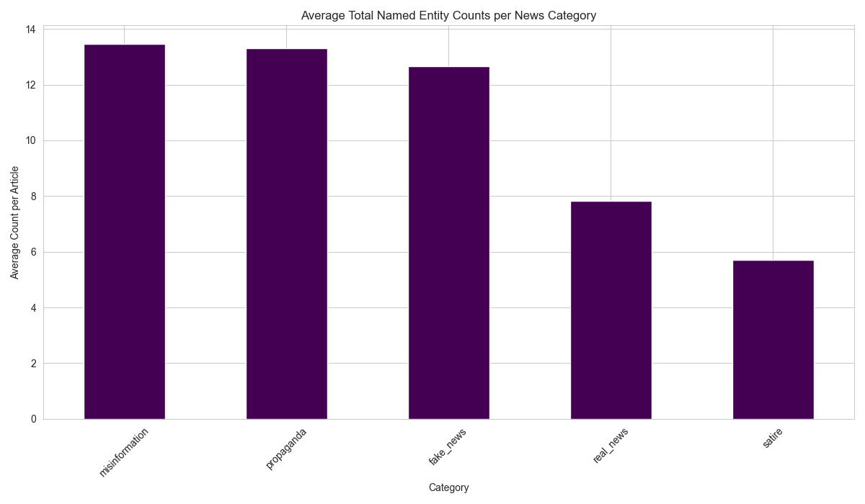
Dataset Analysis: Lexical and Syntactic Analysis III

Slide 11
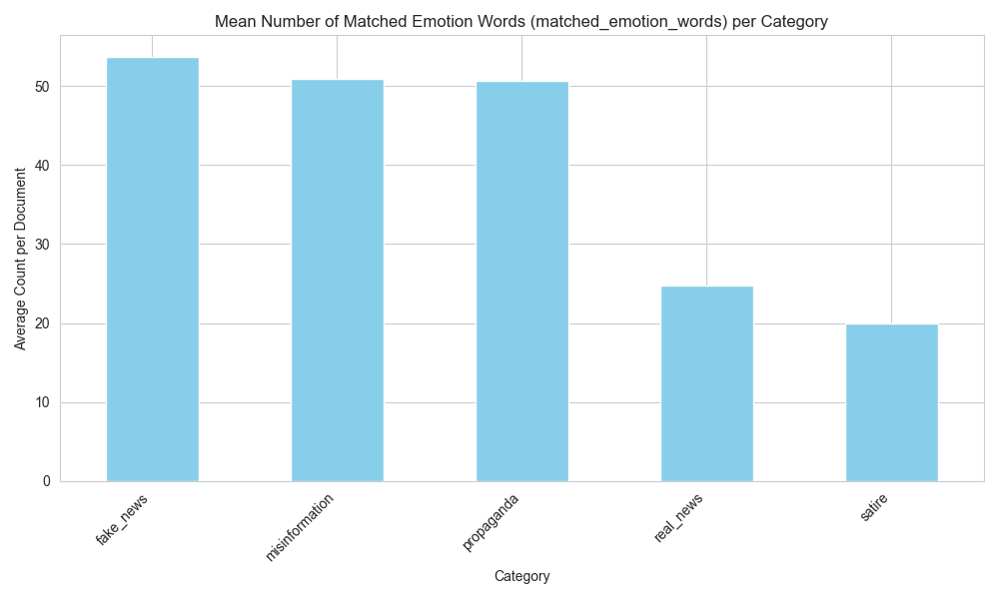
Dataset Analysis: Emotion and Sentiment Analysis I

Slide 12
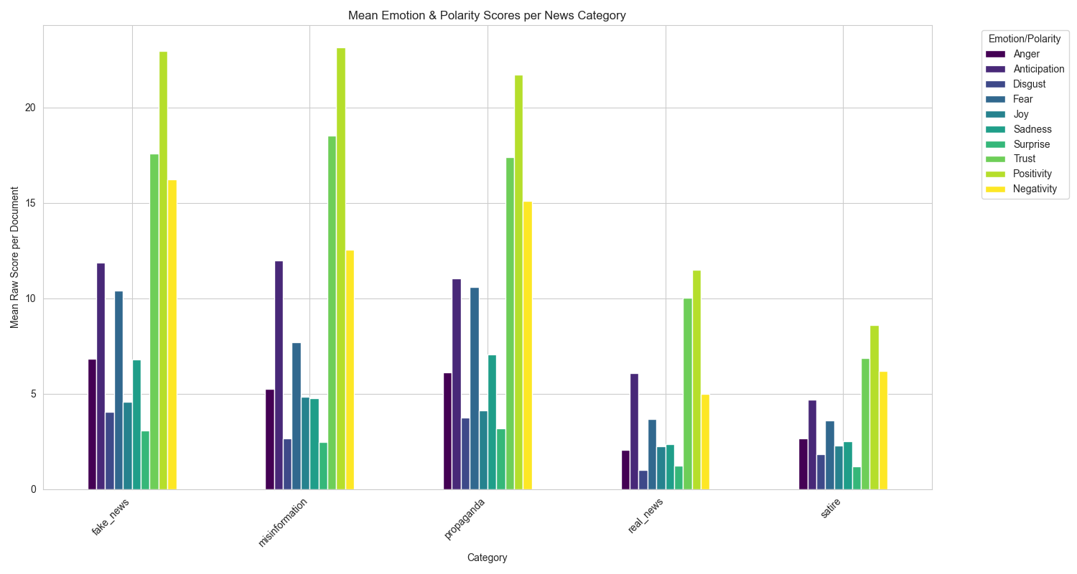
Dataset Analysis: Emotion and Sentiment Analysis II

Slide 13
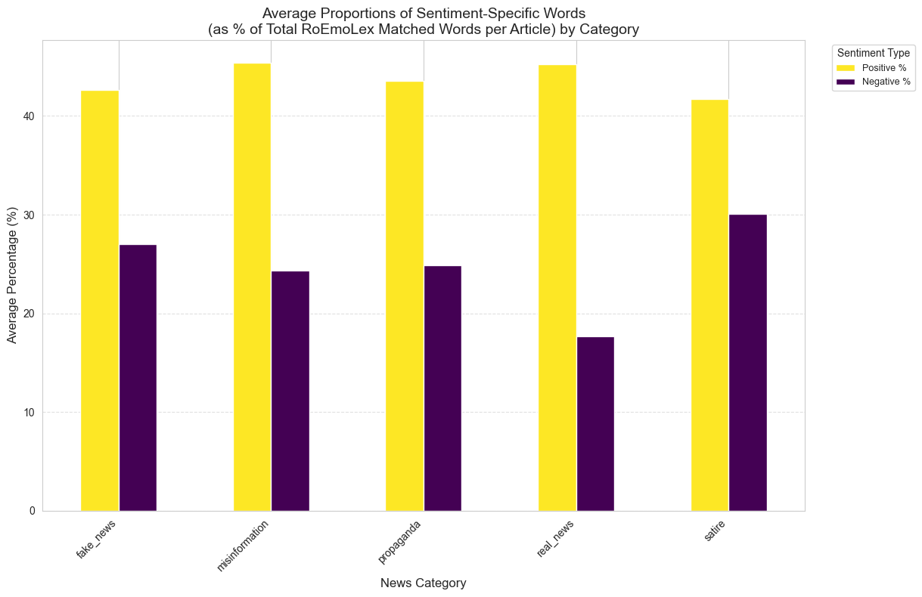
Dataset Analysis: Emotion and Sentiment Analysis III

Slide 14
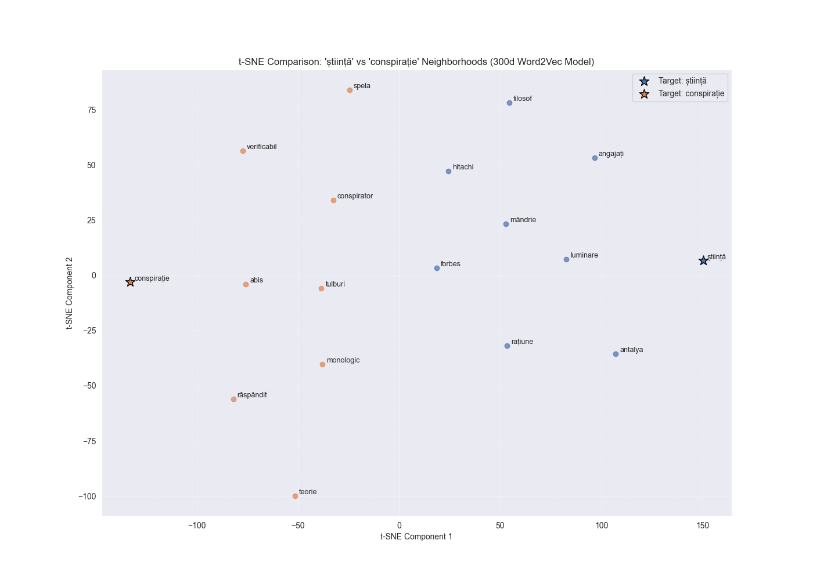
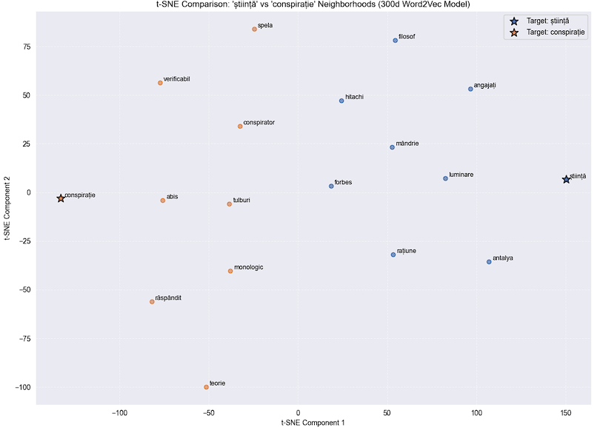
Dataset Analysis: Embeddings Analysis
Word2Vec(300 dimensions)
The custom Word2Vec model successfully learned the specific, biased meanings of words within the news dataset.
It clearly separated the semantic neighborhoods of opposing concepts, such as știință (science) and conspirație (conspiracy), showing it understood their usage in this context.

Slide 15
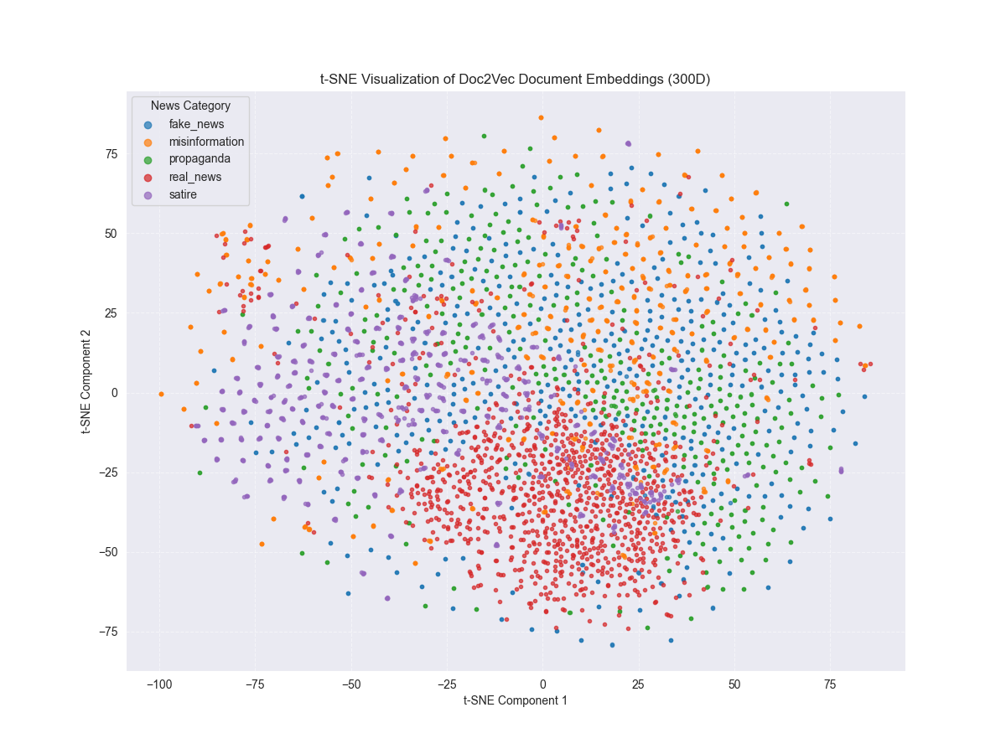
Dataset Analysis: Embeddings Analysis
Doc2Vec(300 dimensions)
The Doc2Vec model was used to create a single vector representing the overall meaning of each article.
significant overlap between all five categories, meaning they often discuss the same topics.
Observations: Real news articles (in red) form a dense semantic core. The other categories, especially fake news (blue) and satire (purple), are more scattered around this central core.
Conclusion: This suggests that real news is more thematically consistent, while disinformation is more varied in its style and content.

Slide 16
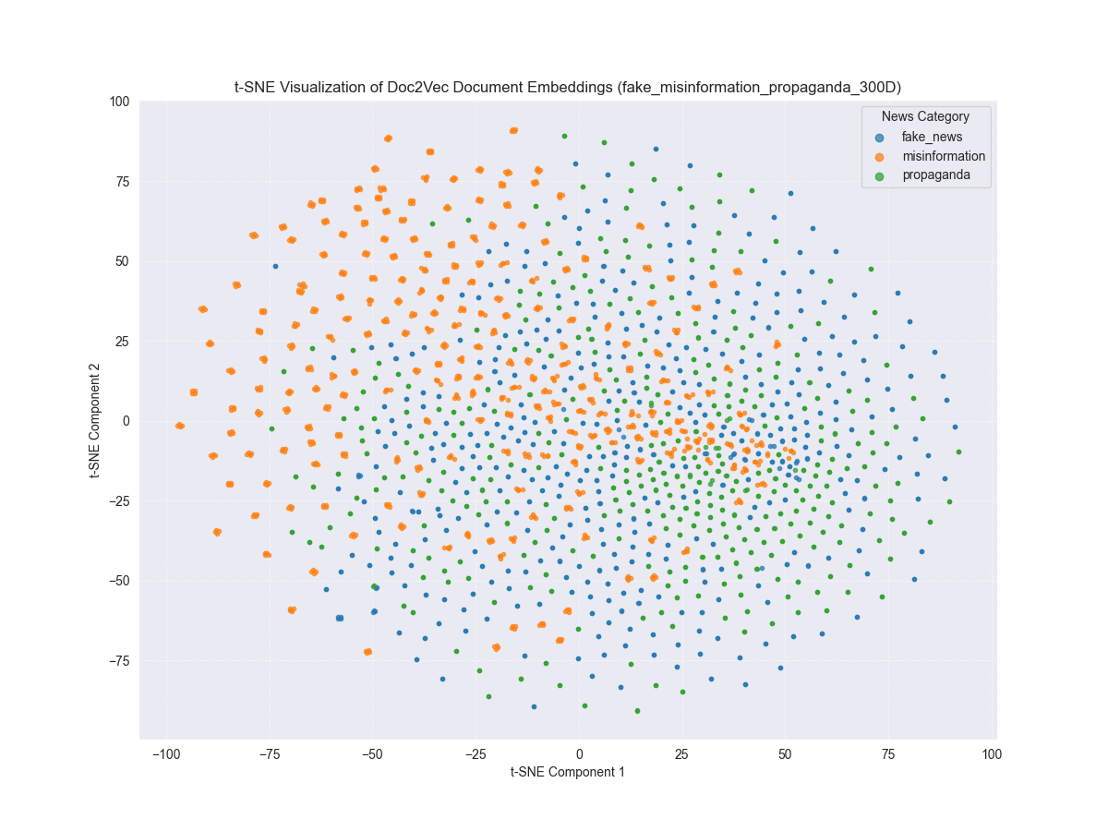
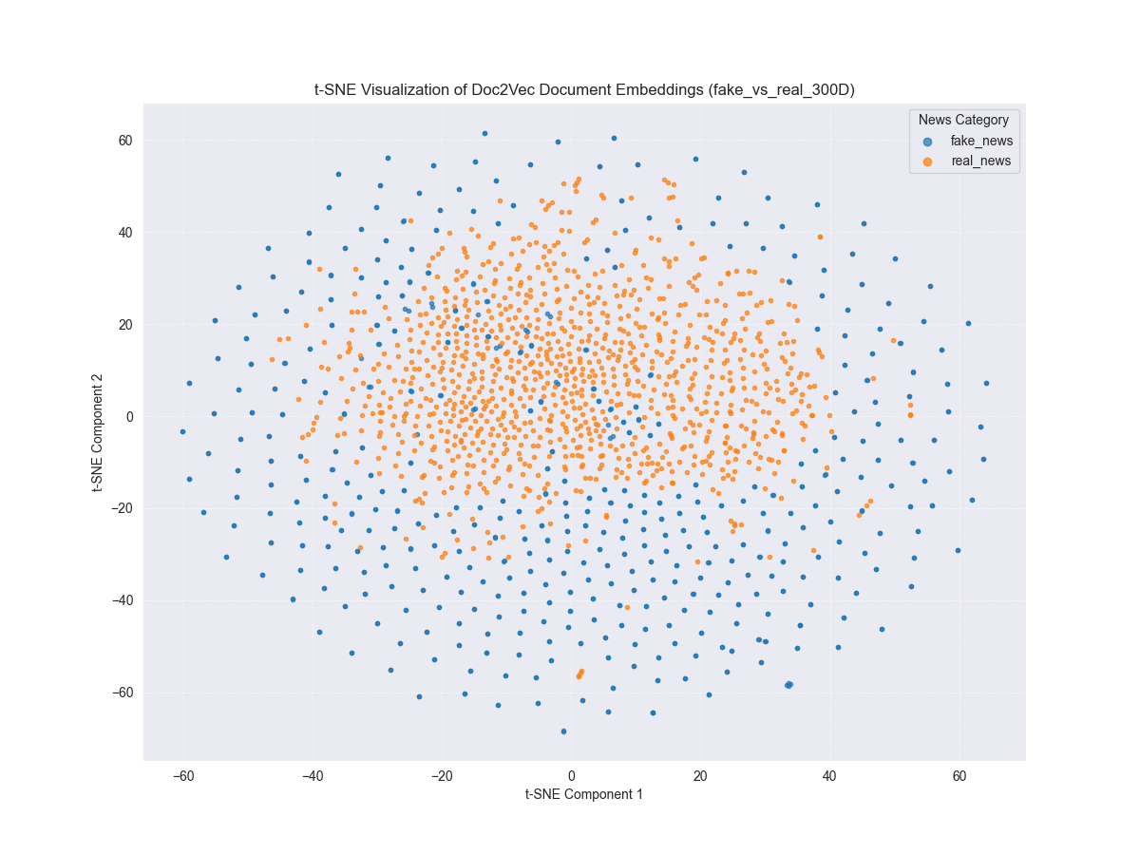
Dataset Analysis: Embeddings Analysis​
Doc2Vec(300 dimensions)

Slide 17
Classification: Methodology
Text Representations Tested
Evaluation
TF-IDF (Keyword-based vectors)
Word2Vec (Averaged word vectors)
Doc2Vec (Document vectors)
RoBERT [CLS] (non-fine-tuned)
Hybrid Model (Doc2Vec + Engineered Features)
To ensure a fair comparison, a Support Vector Machine (SVM) was used as the classifier for all experiments.
Performance was measured using 5-fold stratified cross-validation.

Slide 18
Engineered Features
Word count: Total filtered lemmas
Vocabulary richness: Unique filtered lemmas / total filtered lemmas ration
Part-of-speech proportions: Nouns, verbs, adjectives and adverbs
Total entities: people, nationalities, religious, political groups, organizations, facilities, events, money, locations
Entity density: Entities / total lemmas ratio
Emotion word count: Lemmas matching RoEmoLex lexicon
Emotions proportions: anger, joy, sadness, trust, anticipation, disgust, fear, surprise
Polarity counts (Positivity & Negativity): Positive and negative lemma frequencies
Polarity percentages: Sentiment proportions as percentages
Cluster ID: Document cluster assignment

Slide 19
Classification: Results
Experimental Method | Mean F1-Score
TF-IDF | 0.9570 ± 0.0067
Hybrid Model | 0.9169 ± 0.0141
Doc2Vec | 0.8046 ± 0.0117
Word2Vec (Averaged) | 0.7686 ± 0.0113
RoBERT [CLS] (no fine-tune) | 0.7376 ± 0.0072

Slide 20
Web Application
Technology: The application was developed using the Django web framework.
Core Feature: It classifies text using the best-performing method from the experiments (TF-IDF + SVM), which was then re-trained on the full dataset.
Unique Logic: The results are displayed differently based on the model's confidence score (>80%, 60-80%, <60%).
Analysis Tool: It includes a separate page for exploring the custom Word2Vec models and allowing users to download them.

Slide 21
Conclusion & Main Contributions
Main Conclusions
Key Contributions
The linguistic and emotional analysis revealed clear, measurable differences between real news and disinformation.
For classification, a TF-IDF model performed best (~96%), showing that specific keywords are a very powerful signal.
A Hybrid Model (~92%), combining document vectors with engineered features, is also a highly effective strategy.
A detailed analysis of a Romanian news dataset, creating a "fingerprint" for disinformation.
Two custom, lemmatized Word2Vec models for the Romanian news domain.
A functional web application that demonstrates the practical use of the research.

Slide 22
Future Work
Create a more diverse dataset.
Fine-tune a RoBERT model.
Deploy the application to the cloud.

Slide 23
Thank You
Questions?

