Slide 1
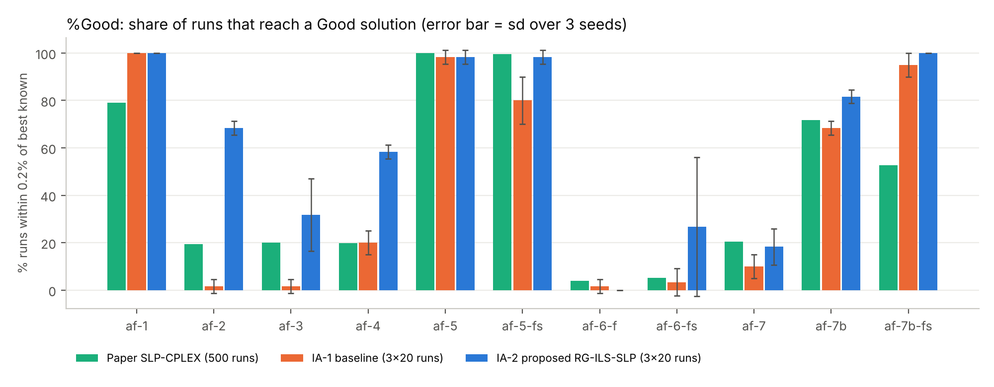
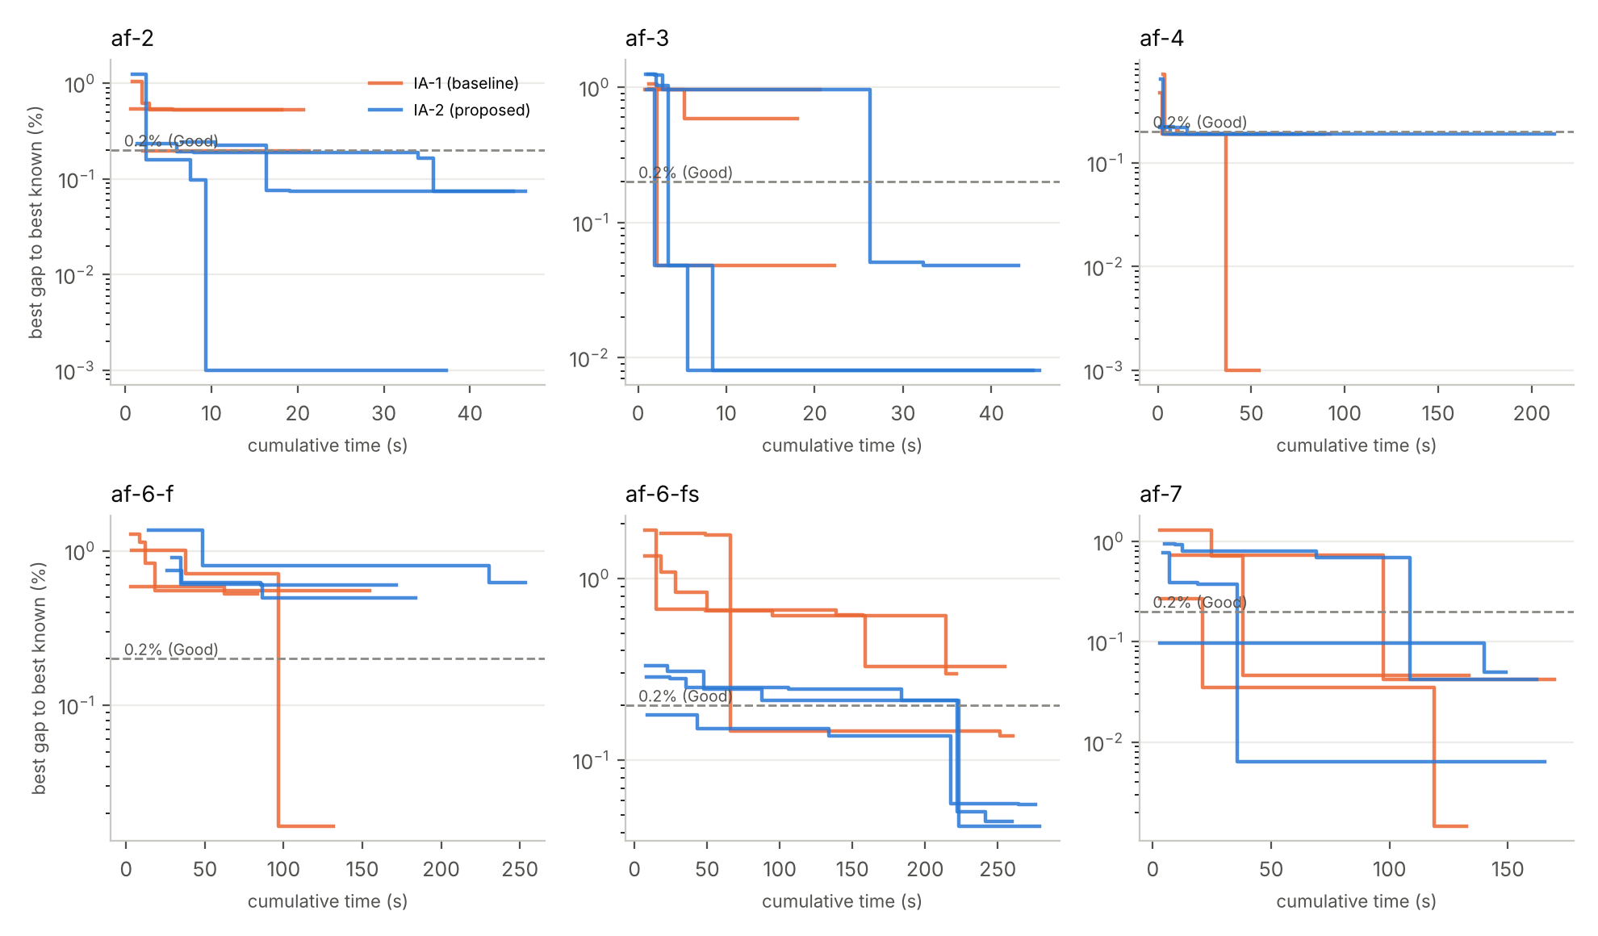
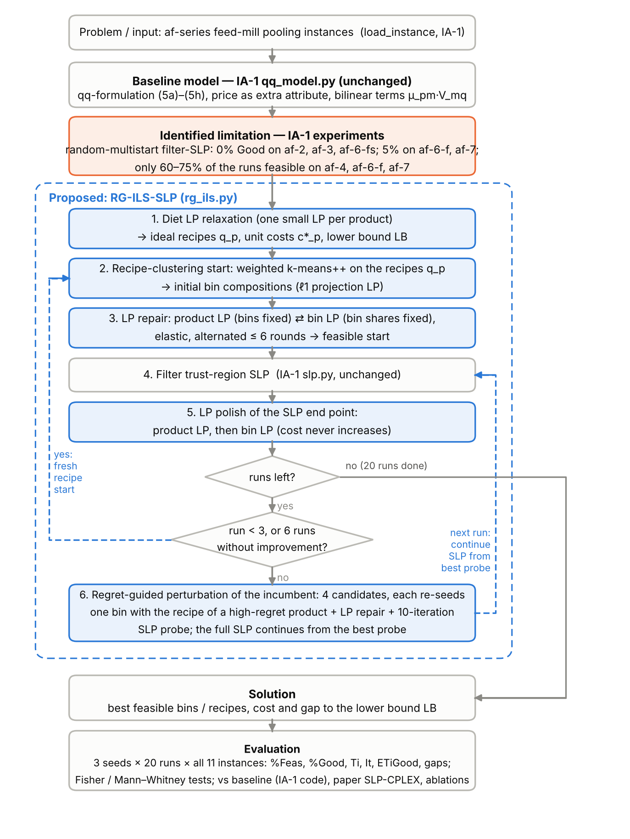
Recipe-Guided Iterated Local Search around SLP for the Fixed-Demand Pooling Problem: Extending our IA-1 Filter-SLP Code
Group OPT-09 · Razzan Tambe (15) · Saurabh Tripathi (04) · Vivek Sharma (12)
Introduction to Optimization Techniques (IA-2) · Dept. of IT, K. J. Somaiya College of Engineering
1. Problem
5. Results (11 instances, 3×20 runs)
Feed mills blend raw materials through a few shared mixing bins into many products with nutrient specs and fixed demands.
Bin compositions are decisions, so product quality Σ μ_pm v_mn is bilinear: nonconvex, with very many local optima.
34%
96%
5.0×
IA-2 %Good, 6 hard inst. (IA-1 6%, paper 15%)
IA-2 mean %Feas (IA-1 88%)
IA-2 vs IA-1: shorter time to a Good solution
2. Baseline & research gap
Baseline: qq-formulation + trust-region filter SLP + random multistart [1], as re-implemented in our IA-1 code (qq_model.py, slp.py; Python + HiGHS).
Gap: in [1] only 4–20% of random starts are Good on the hard instances. With our IA-1 code, af-2, af-3 and af-6-fs never reached 0.2% and af-4 had 40% infeasible runs. Runs are independent and the LP structure is unused.
3. Proposed: RG-ILS-SLP
Highlights
IA-2 %Good: af-2 68% (paper 19.4%), af-4 58% (19.8%), af-3 32% (20%), af-6-fs 27% (5.2%); af-7 18% (20.4%) and af-6-f 0% (4.0%) stay below the paper
IA-2 vs IA-1 significant: Fisher p < 0.01 on 5 instances, Mann–Whitney on 9 of 11
Diet LP bound on af-1 = Baron's bound (295.93), in milliseconds; easy instances ~2× slower
6. Conclusion
Keeping our IA-1 model and SLP solver unchanged but making restarts structure-aware (LP repair, LP polish, regret-guided re-seeding with SLP probes) turns random-multistart SLP into a reliable method on the hard feed-mill instances. Next: more seeds, adaptive moves, parallel probes, stronger bounds.
4. Key formulations (new)
Diet relaxation c*_p = min Σ c_i w_pi s.t. specs, Σ w = 1; LB = Σ t_p c*_p ≤ f*
Product LP bins λ fixed ⇒ (5c),(5g) linear in μ → exact feasibility
Bin LP shares μ_pm fixed ⇒ d linear in (λ, μ^S)
Regret regret_p = t_p max(0, c^D_p − c*_p): re-seed a bin with a high-regret product's recipe; best of 4 by 10-iteration SLP probe
[1] A. Grothey, K. McKinnon, On the effectiveness of sequential linear programming for the pooling problem, Ann. Oper. Res. 322 (2023) 691–711. [2] C. Audet et al., Pooling problem: alternate formulations and solution methods, Manag. Sci. 50 (2004). [3] Group OPT-09, IA-1 report (2026). Data: Grothey & McKinnon (2020). Code: Python + SciPy/HiGHS.

