Slide 1
Recipe-Guided Iterated Local Search around SLP for the Fixed-Demand Pooling Problem
IA-2 · Introduction to Optimization Techniques · extending our IA-1 filter-SLP code
Group OPT-09 · Razzan Tambe (15) · Saurabh Tripathi (04) · Vivek Sharma (12)
Dept. of IT, K. J. Somaiya College of Engineering
Notes:
Introduce the team and the topic. In IA-1 we re-implemented Grothey & McKinnon (2023); IA-2 extends that code.

Slide 2
Shared bins make feed blending nonconvex
straight (direct, extra cost)
Fixed demands t_p must meet N nutrient specs
Bin compositions λ are decisions, shared by many products
Product quality = Σ μ_pm · v_mn → bilinear, nonconvex
Many local optima even with fixed demands (96 in a 2-nutrient toy example)
Mills re-solve many times a day → need near-optimal recipes in seconds
bins (λ)
raw materials
products (μ)
Notes:
Explain the pooling structure; bilinear terms come from mixing bins shared by products.

Slide 3
Baseline: the paper's method, as implemented in our IA-1 code
qq-formulation (Grothey & McKinnon, 2023)
863×
20×
min Σ_p t_p c^D_p
v_mn = Σ_i λ_mi r_in
d_pn = Σ_i μ_pi r_in + Σ_m μ_pm v_mn (bilinear)
c^D_p = Σ_i μ_pi c_i + Σ_m μ_pm c^M_m (bilinear)
Σ λ = 1, Σ μ = 1, d̲ ≤ d ≤ d̄, bounds
faster to a good solution than FilterSQP
faster than the global solver Baron
But on the hard instances only
4–20%
of random starts end within 0.2% of the best known cost (af-2, af-3, af-4, af-6, af-6-fs, af-7)
SLP: linearise, solve LP in an ∞-norm trust region, accept with a filter
Random multistart: every run independent
IA-1: qq_model.py + slp.py (Python, HiGHS); af-1 best known 296.44604 reproduced
Notes:
Summarise the baseline paper and its headline result; point out the weakness on hard instances.

Slide 4
Research gap: random restarts waste most of the run time
Instance | Paper %Good | Paper ETiGood | IA-1 code %Feas | IA-1 code %Good
af-2 | 19.4% | 6.7 s | 95% | 0%
af-3 | 20% | 6.5 s | 100% | 0%
af-4 | 19.8% | 8.6 s | 60% | 25%
af-6-f | 4% | 112.5 s | 65% | 5%
af-6-fs | 5.2% | 125 s | 90% | 0%
af-7 | 20.4% | 22.5 s | 75% | 5%
What we observed
Runs land in poor basins; nothing is learned from earlier runs
Some runs stall in feasibility restoration (af-4, af-7)
The structure is unused: fix the bins, or the bin shares, and the problem is an LP
Gap found via: limitation stated by the authors + IA-1 implementation experience + IA-1 results vs the paper
IA-1 code = our IA-1 notebook, 20 runs, seed 12345 (the IA-1 report validated af-1 only: 20/20 Good; af-2, af-6-f, af-7b-fs re-run with the same code and seed). af-6-f = the paper's af-6. ETiGood = 100·Ti / %Good.
Notes:
State the gap precisely with the paper's own numbers and our IA-1 numbers.

Slide 5
RG-ILS-SLP: same IA-1 model and solver, smarter search
1
New
2
Modified
3
New
4
Retained
5
New
Diet LP
Recipe clustering
LP repair
Filter-SLP
LP polish
each product's ideal recipe + lower bound
weighted k-means on recipes → initial bins
product LP / bin LP until the start is feasible
IA-1 slp.py, unchanged
exactly feasible, never worse
6
Regret-guided iterated local search (new). From the best solution so far, build 4 candidates: re-seed a bin with the ideal recipe of a product that pays a lot for bin sharing (regret), LP-repair, probe with a 10-iteration SLP; continue the full SLP from the best probe. Runs 1–3 and any run after 6 failures use a fresh recipe start. One pass = one run; 20 runs.
Notes:
Walk through the loop; emphasise that the qq model and the SLP are unchanged.

Slide 6
Three exact LPs exploit the bilinear structure
Diet relaxation
Product LP (bins fixed)
Bin LP (bin shares fixed)
c*_p = min Σ c_i w_pi
s.t. specs on Σ w_pi r_in, Σ w = 1
LB = Σ t_p c*_p ≤ f*
λ fixed ⇒ v, c^M constants
(5c), (5g) become linear in μ
→ optimal recipes, exact feasibility
μ_pm fixed ⇒ d linear in (λ, μ^S)
alternate with product LP
→ cost never increases
af-1: LB 295.932 = Baron's 2-hour bound
used to repair starts and polish SLP end points
classical recursion / ALT idea (Haverly; Audet et al.)
Recipe regret regret_p = t_p · max(0, c^D_p − c*_p). Pick product p ∝ regret and a bin m, set λ_m ← Proj((1−α) q_p + α λ_m), α ~ U(0, 0.5); 4 such candidates are ranked by a 10-iteration SLP probe. The model (5a)–(5h) itself is unchanged.
Notes:
Mathematical changes: one convex relaxation and two exact linear restrictions of the bilinear rows.

Slide 7
Experimental setup
Item | Details
Instances | all 11: af-1, af-2, af-3, af-4, af-5, af-5-fs, af-6-f (= paper's af-6), af-6-fs, af-7, af-7b, af-7b-fs
Code | IA-1 qq_model.py + slp.py unchanged; new rg_ils.py; run_experiments.py --method
Software / HW | Python 3.13, NumPy, SciPy 1.18 (HiGHS LP); 2-vCPU cloud container, 1 thread per run
Runs | 3 seeds (12345 = IA-1 seed, 2024, 7) × 20 runs per instance and method
IA-1 vs IA-2 | IA-1 = baseline (our IA-1 code, unchanged; seed 12345 reproduces the IA-1 notebook); IA-2 = proposed RG-ILS-SLP
Metrics | %Feas, %Good (≤ 0.2% of best known), Ti, It, ETiGood, gaps; Fisher and Mann–Whitney tests
Also compared | published SLP-CPLEX (500 runs); 2 ablations (seed 12345)
Notes:
Same code base for baseline and proposed, so the comparison isolates our contribution.

Slide 8
IA-1 vs IA-2 at a glance
 | IA-1 (baseline) | IA-2 (proposed)
Model + SLP solver | qq_model.py + slp.py | same files, unchanged
Starting points | uniform random | recipe clustering (diet LP) + LP repair
Restarts | independent random multistart | regret-guided ILS, 4 SLP-probed moves, fresh starts after 6 failures
SLP end point | returned as is | LP polish (product LP, bin LP)
Lower bound | none | diet LP (af-1 = Baron's bound)
Mean %Feas (11 inst.) | 87.9% | 96.1%
Mean %Good (11 inst.) | 43.6% | 62.0%
%Good, 6 hard inst. (paper 14.8%) | 6.4% | 33.9%
ETiGood, hard inst. | 1.0× | 5.0× shorter
Notes:
Side-by-side: what IA-2 changes relative to IA-1, and what it achieves. Same instances, seeds and machine for both.

Slide 9
IA-2 vs IA-1: many more runs reach a Good solution on the hard instances
68%
af-2 (paper 19.4%, IA-1 1.7%)
58%
af-4 (paper 19.8%, IA-1 20.0%)
0%
af-6-f (paper 4%, IA-1 1.7%) — not solved
Notes:
3 seeds x 20 runs. Equal on easy instances, large gains on af-2, af-3, af-4, af-6-fs; af-7 improves but stays just below the paper; af-6-f is not solved by either method.

Slide 10
IA-2 vs IA-1: more feasible runs, faster to a good solution
88% → 96%
44% → 62%
5.0×
mean %Feas, IA-1 → IA-2
mean %Good, IA-1 → IA-2
shorter ETiGood on the hard instances (geo-mean, af-6-f excluded)
Instance | Paper ETiGood | IA-1 ETiGood | IA-2 ETiGood
af-2 | 6.7 s | 60.1 s | 3.1 s
af-3 | 6.5 s | 60.9 s | 7.0 s
af-4 | 8.6 s | 16.9 s | 10.7 s
af-6-f | 112.5 s | 369.6 s | no Good run
af-6-fs | 125.0 s | 368.3 s | 50.9 s
af-7 | 22.5 s | 72.6 s | 43.4 s
Reading the times
An IA-2 run costs more (repair, 4 probes, polish) but far fewer runs are wasted
Easy instances (af-1, af-5, af-5-fs, af-7b-fs): overhead, ETiGood up to ~2× worse
Paper times: CPLEX in C, 500 runs; ours: HiGHS from Python
Notes:
Feasibility and time-to-quality improvements.

Slide 11
The gains are statistically significant
Instance | Good: IA-1 → IA-2 | p (Fisher) | Feasible: IA-1 → IA-2 | p (Fisher) | p (Mann–Whitney, gaps)
af-1 | 60/60 → 60/60 | 1.0000 | 60/60 → 60/60 | 1.0000 | 0.0634
af-2 | 1/60 → 41/60 | < 0.0001 | 59/60 → 58/60 | 0.8782 | < 0.0001
af-3 | 1/60 → 19/60 | < 0.0001 | 58/60 → 60/60 | 0.2479 | < 0.0001
af-4 | 12/60 → 35/60 | < 0.0001 | 41/60 → 52/60 | 0.0138 | < 0.0001
af-5 | 59/60 → 59/60 | 0.7521 | 59/60 → 60/60 | 0.5000 | 0.0004
af-5-fs | 48/60 → 59/60 | 0.0010 | 48/60 → 60/60 | 0.0001 | 0.0002
af-6-f | 1/60 → 0/60 | 1.0000 | 44/60 → 44/60 | 0.5817 | 0.7554
af-6-fs | 2/60 → 16/60 | 0.0003 | 54/60 → 60/60 | 0.0137 | < 0.0001
af-7 | 6/60 → 11/60 | 0.1475 | 42/60 → 60/60 | < 0.0001 | 0.0020
af-7b | 41/60 → 49/60 | 0.0696 | 57/60 → 60/60 | 0.1218 | 0.0023
af-7b-fs | 57/60 → 60/60 | 0.1218 | 58/60 → 60/60 | 0.2479 | 0.0003
One-sided tests, IA-2 better than IA-1, 60 vs 60 runs per instance (3 seeds × 20). Shaded: p < 0.05. ILS runs within a seed are dependent, so the per-seed results in the paper (Table A1) are the conservative check.
Notes:
More Good runs is significant on af-2, af-3, af-4, af-5-fs, af-6-fs; lower gaps on 9 of 11 instances.

Slide 12
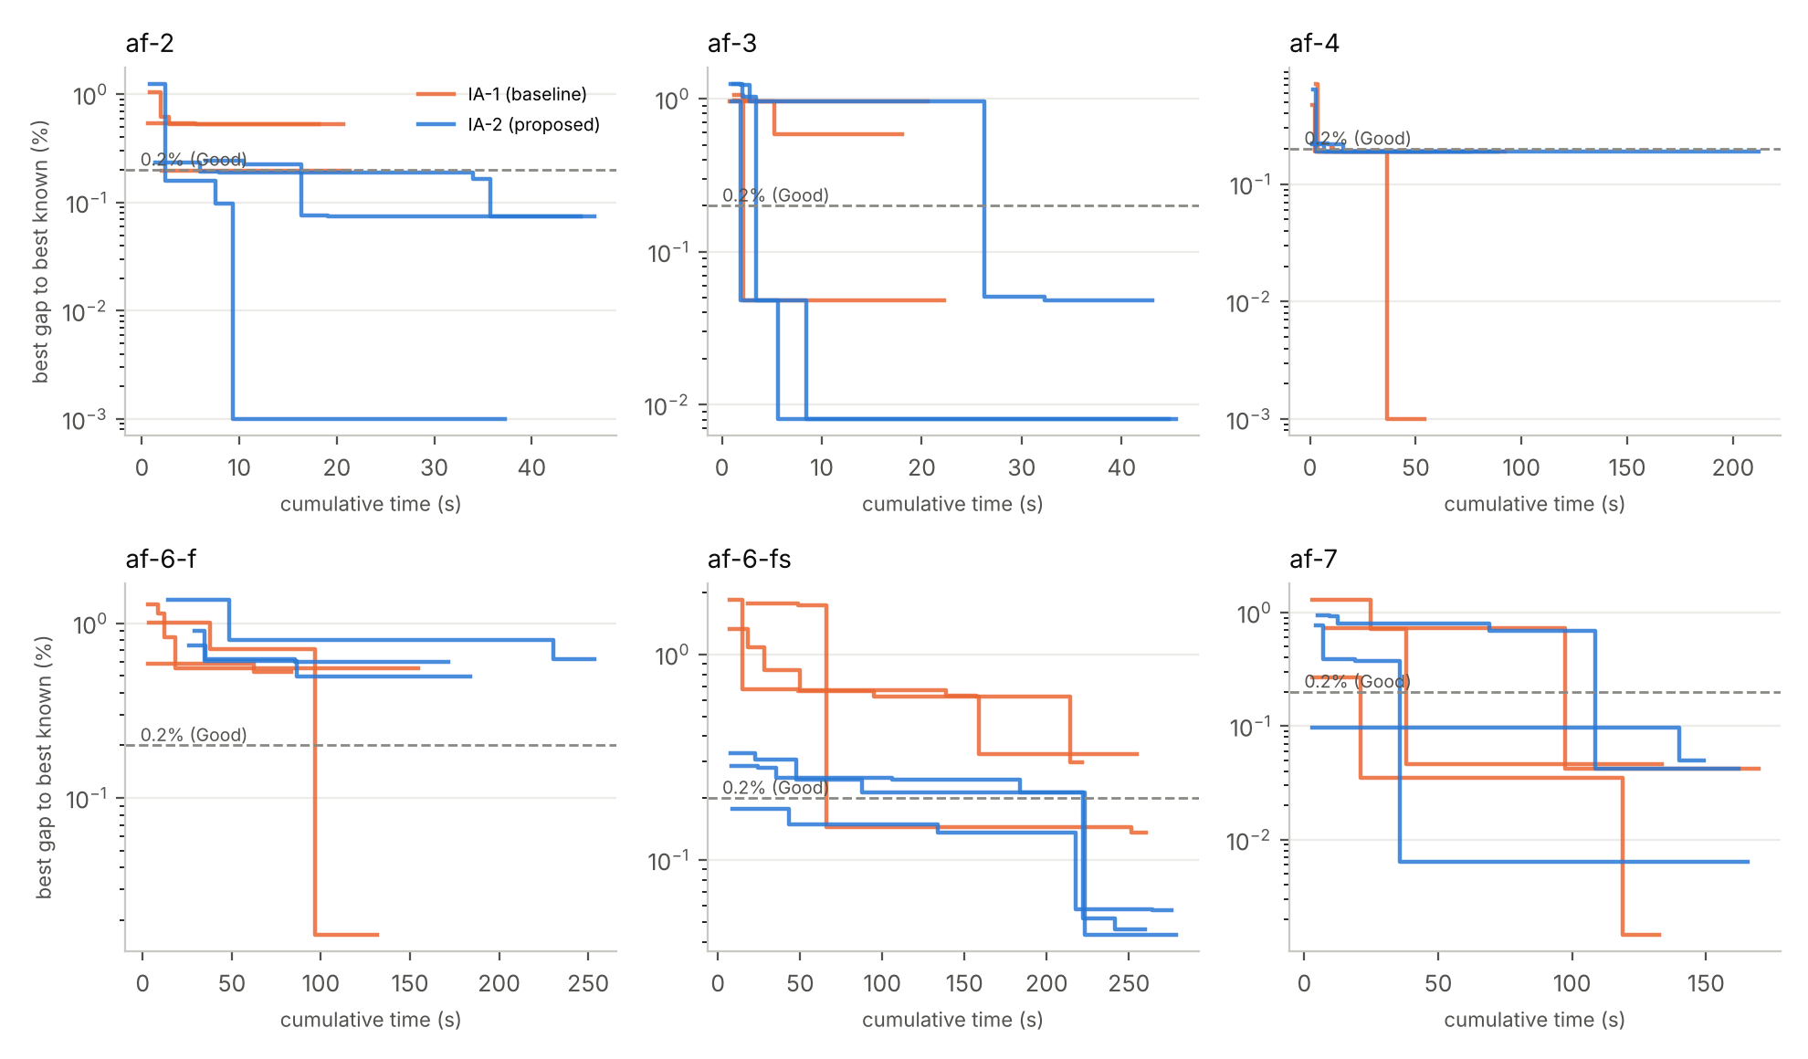
The guided search keeps the incumbent below the 0.2% line (except af-6-f)
IA-2 best found: af-2 = best known (IA-1 +0.20%), af-3 +0.008% (IA-1 +0.048%), af-6-fs +0.04% (IA-1 +0.14%). On af-4 (+0.19%) and af-6-f (+0.50%) an IA-1 run was better: more reliable, not always better in the single best run.
Best gap to the best-known cost vs cumulative time (log scale), one line per seed; blue = IA-2, orange = IA-1; dashed = Good threshold.
Notes:
Convergence curves: the incumbent improves quickly once the search is guided.

Slide 13
Ablation: the components complement each other
Instance | IA-1 (baseline) | A: random + polish | B: recipe start, no ILS | IA-2 (full)
af-1 | 100% / 100% | 100% / 100% | 100% / 90% | 100% / 100%
af-2 | 95% / 0% | 100% / 0% | 100% / 20% | 95% / 65%
af-3 | 100% / 0% | 100% / 0% | 95% / 5% | 100% / 15%
af-4 | 60% / 25% | 70% / 25% | 100% / 25% | 80% / 60%
af-5 | 100% / 100% | 100% / 100% | 100% / 100% | 100% / 100%
af-5-fs | 90% / 90% | 100% / 100% | 100% / 95% | 100% / 100%
af-6-f | 65% / 5% | 70% / 5% | 60% / 15% | 80% / 0%
af-6-fs | 90% / 0% | 100% / 0% | 100% / 20% | 100% / 5%
af-7 | 75% / 5% | 85% / 5% | 95% / 20% | 100% / 20%
af-7b | 95% / 70% | 100% / 75% | 100% / 90% | 100% / 85%
af-7b-fs | 100% / 100% | 100% / 95% | 100% / 95% | 100% / 100%
Polish alone mainly fixes feasibility (af-4 60→70%, af-6-fs 90→100%).
Recipe starts alone are best on af-6-f, af-6-fs and af-7b, but weak on af-2, af-3 and af-4.
The probed ILS adds the big gains on af-2 (65%), af-3 (15%) and af-4 (60%), but over-refines on af-6-f (0%).
Diversity (fresh starts) + depth (ILS) together.
Cells show %Feas / %Good over 20 runs, seed 12345.
Notes:
Explain the ablation: each component's contribution.

Slide 14
Discussion and limitations
Gap addressed
Trade-offs
Limitations
%Good up on 5 of 6 hard instances (af-7 seed 2024: tie)
96% of IA-2 runs feasible (IA-1 88%)
Significant: Fisher p < 0.01 on 5 instances
IA-1 model and SLP unchanged
Extra LPs and probes cost time per run
Easy instances get slower (ETiGood up to ~2×)
ILS runs within a seed are dependent → 3 seeds
af-6-f not solved (IA-2 0% vs paper 4.0%, IA-1 1.7%)
af-7: 18.3% vs paper 20.4%
af-4 single best run: IA-1 found the best known value
3×20 runs vs 500 in the paper; other hardware/LP solver
Diet bound tight only on af-1
Notes:
Be honest about the comparison limits.

Slide 15
Structure-aware restarts make our IA-1 SLP reliable on hard pooling instances
Mean %Feas 87.9% → 96.1%, %Good 43.6% → 62.0%; hard instances 6.4% → 33.9% (paper 14.8%), ETiGood 5.0× shorter
Future: more seeds / full benchmark, adaptive choice of moves, parallel probes, stronger bounds, capacity limits

Slide 16
References
[1] A. Grothey, K. McKinnon, Annals of Operations Research 322 (2023) 691–711.
[2] M. Terzi et al., Computers & Operations Research 163 (2024) 106507.
[3] S. Sass et al., European Journal of Operational Research 316 (2024) 36–45.
[4] P. E. Gill, M. Zhang, Computational Optimization and Applications 88 (2024) 37–70.
[5] M. Muehlebach, M. I. Jordan, Mathematical Programming 215 (2026) 407–452.
[6] D. di Serafino et al., Mathematical Programming 205 (2024) 107–134.
[7] C. Audet et al., Management Science 50 (2004) 761–776. [8] C. A. Haverly, ACM SIGMAP Bulletin 25 (1978).
[9] A. Grothey, K. McKinnon, Pooling problem test data (2020). [10] R. Fletcher, S. Leyffer, Math. Programming 91 (2002).
[11] H. R. Lourenço et al., Iterated local search, Handbook of Metaheuristics (2019). [12] D. Arthur, S. Vassilvitskii, k-means++, SODA (2007).
[13] Group OPT-09, IA-1 report: SLP for nonlinear pooling optimization problems (2026).

