Slide 1
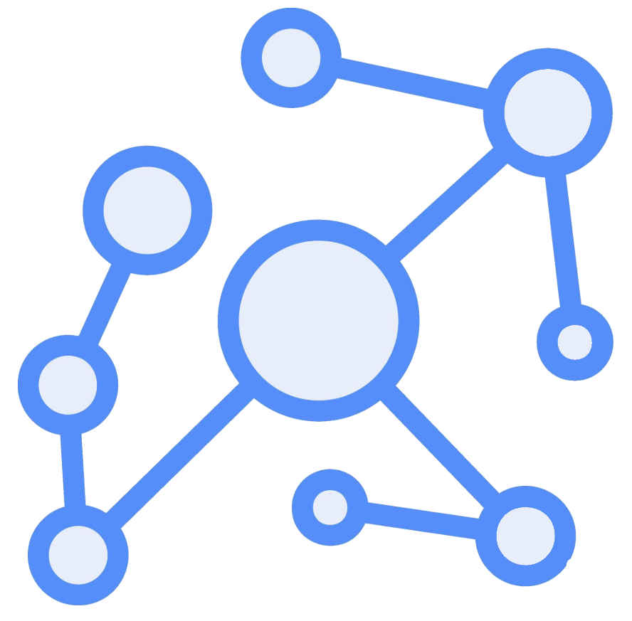


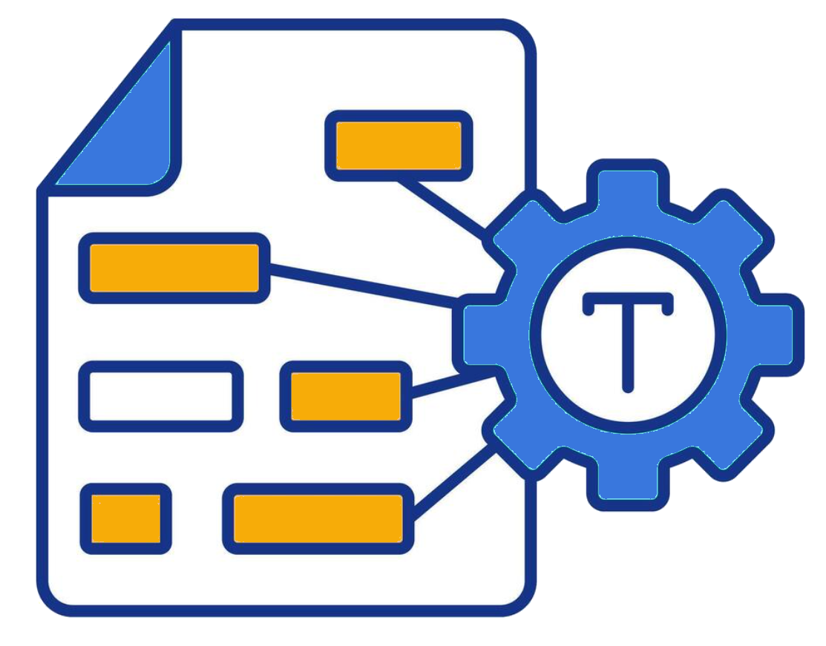
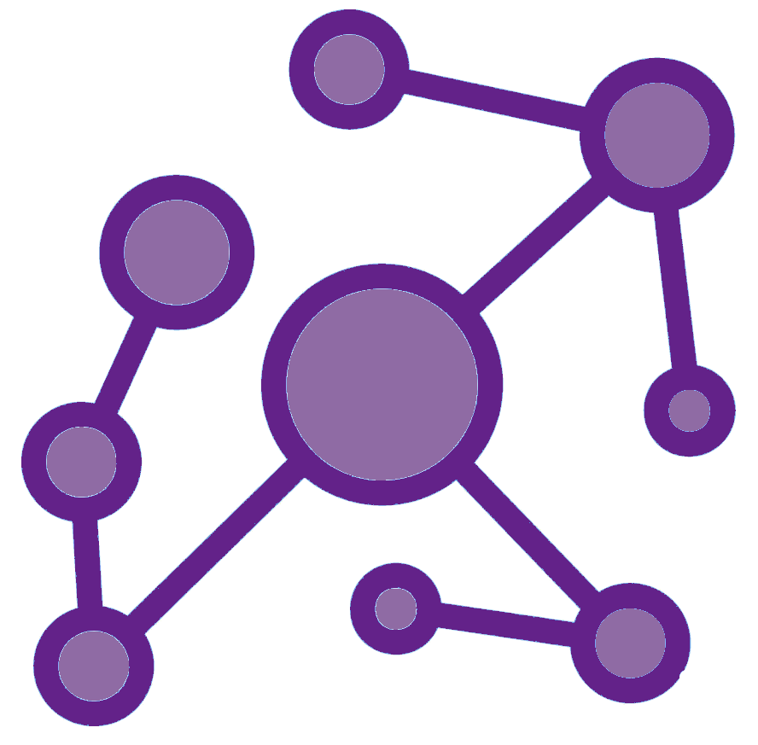
Patient Graph with Diagnosis, etc.
train
MIMIC
test
Vector Embeddings
Patient Similarity Pairings
Relational Graph Convolutional Network
RAG System

Slide 2
argmax
Embeddings
Feed Forward
Linear [6x3]
ELU
Linear [4x6]
custom feature
Predictions
Electra-small

Slide 3
Embeddings
Linear [64x32]
patient head
Relu
Linear [64x64]
sum
graph conv.
GraphConv [64x64]
sum
GraphConv [-1 x64]
Graph data

