Slide 1
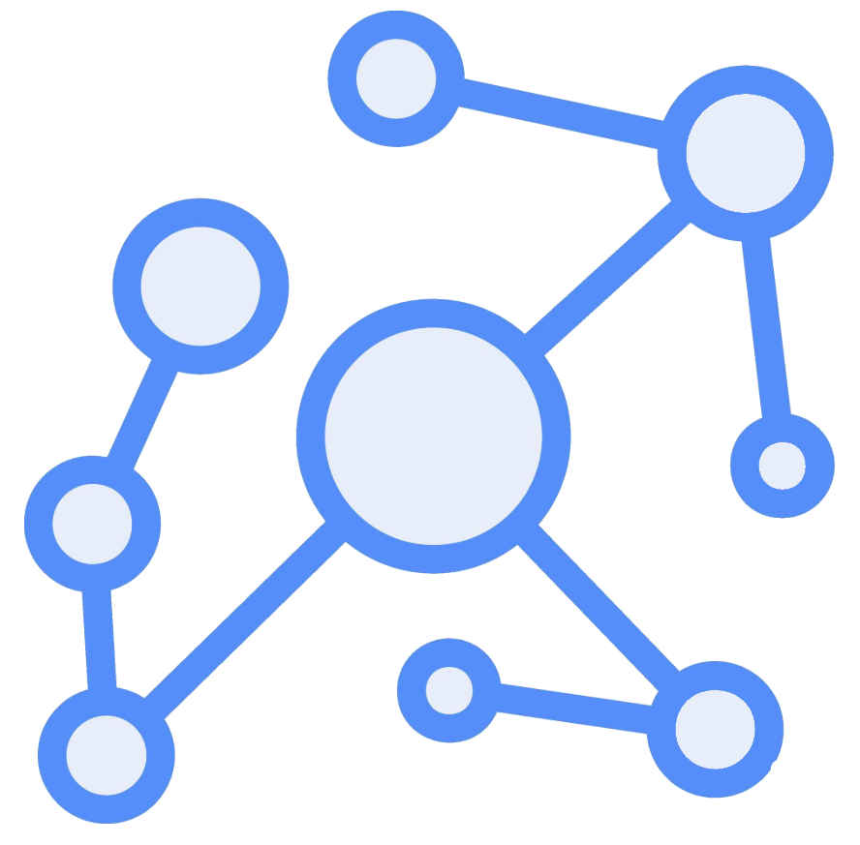

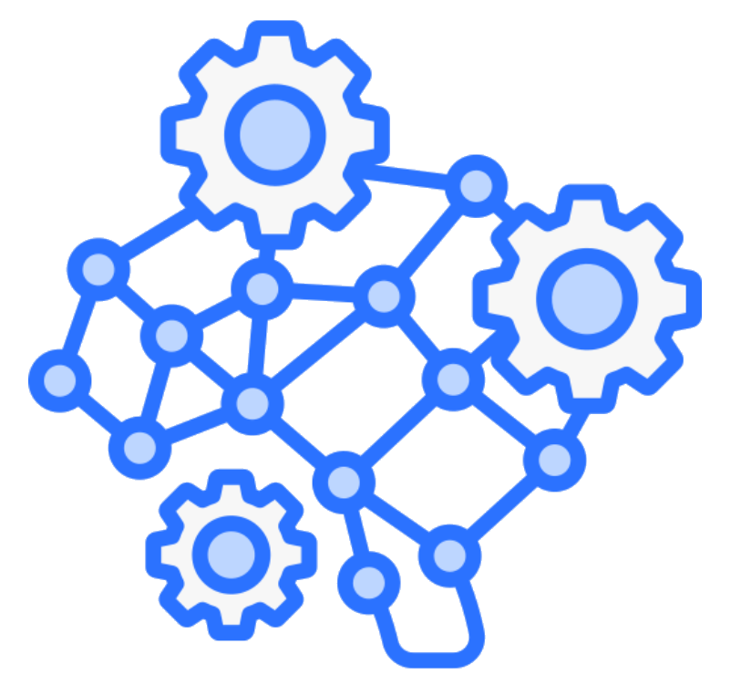
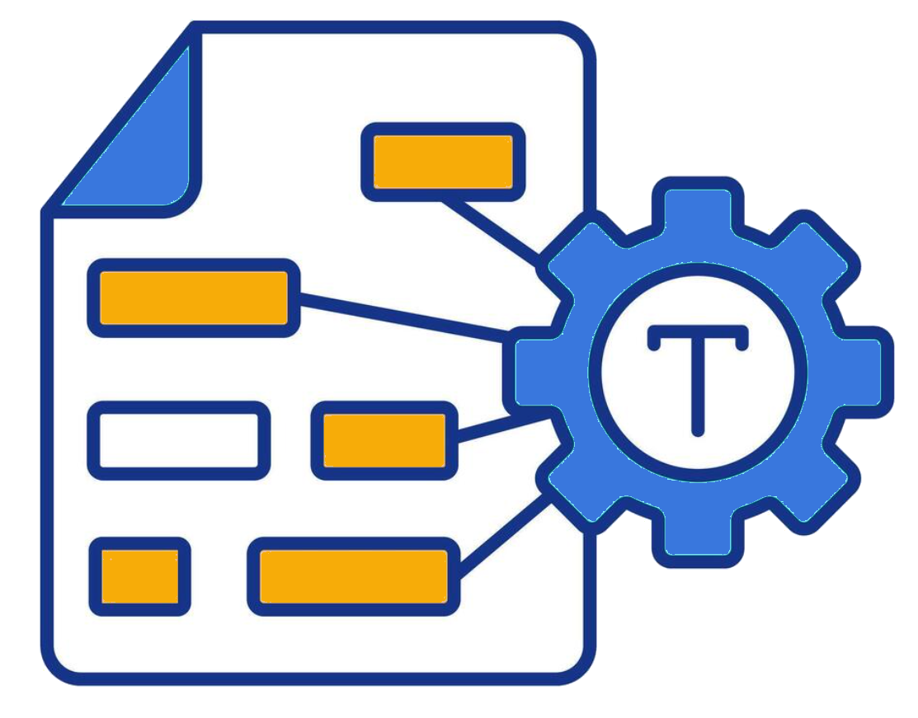
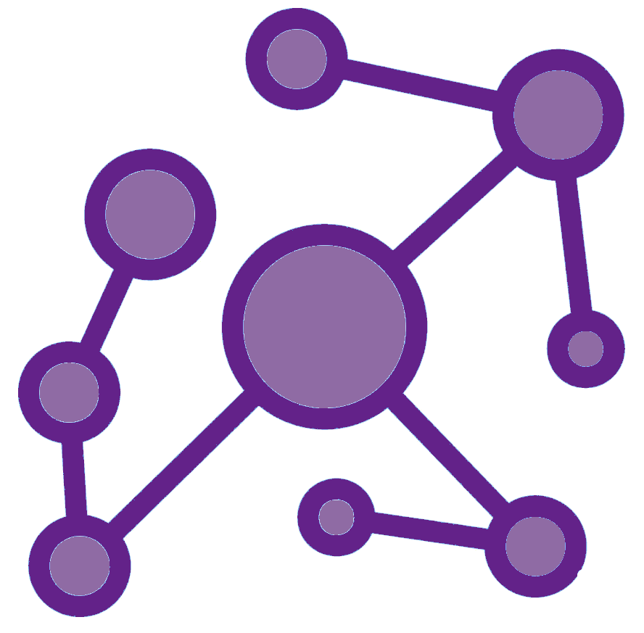
Patient Graph with Diagnosis, etc.
train
MIMIC
test
Vector Embeddings
Patient Similarity Graph
Graph Neural Network
RAG System

