Slide 1
Measuring Pay-per-Install: The Commoditization of Malware Distribution
Juan Caballero, Chris Grier, Christian Kreibich, Vern Paxson
...and presented by Razvan Brinzea
Notes:
Hi everyone.
As you probably know already, I’m Razvan and today I’ll be covering a very interesting paper: Measuring PPI:…
The title sounds a bit scary, so I’m going to start with a gentle introduction on malware development and distribution. After that, we’ll look at Pay-per-Install (or PPI) services and explore why exactly the authors were motivated to do this research. Then, we’ll look at how the authors infiltrated several PPI services and finally I’ll discuss some of the most interesting results that they found.

Slide 2
PART 1: Let’s make malware!
(no, not really)
Notes:
So, first, let’s talk about malware for a bit.

Slide 3
What is malware?
Malware (malicious software) is any software intentionally designed to cause damage to a computer, server, client, or computer network. ^{[1]}
Characteristics of malware:
malicious intent
(usually) hidden from the user
(usually) installed without the user’s consent
Notes:
There are plenty of definitions of malware and most of them seem to be quite similar. I chose a definition that Microsoft has made available in some of their security documentation and that I found quite concise. Malware is any software intentionally designed to cause damage to a computer, server, client or computer network.
It’s interesting to take a look at some of the key characteristics of malware.
First of all, malware must have malicious intent. It is possible that some piece of software, through an unknown bug or vulnerability, causes some damage to a system or network (or otherwise exposes it to attackers). In cases like that we’re not really talking about malware, because it was not intentionally developed to cause farm.
Next, malware is usually hidden from the user and usually installed without the user’s consent, either bundled with software which has been tampered, or through some other means. The reason I said “usually” is because there are also families of malware hidden in plain sight, for example fake antivirus software, which the user knowingly installs. The user might think that this is a legitimate antivirus, while in the background it might be stealing his/her private information and generally compromising his computer.

Slide 4
Types of malware
spyware
adware
virus
MALWARE
Trojan
cryptominer
keylogger
ransomware
rootkit
… and more!
Notes:
This is a list of some of the more well-known classes of malware. It’s not exhaustive but it should cover most of the important categories that are out there.
Is this list familiar to everyone? Is there any particular category of malware which you’d want to hear more about, or something important that you think I missed?
A lot of recent attention has been given to ransomware, malware that encrypts your files and then asks for a ransom in order to decrypt them. And recently hidden cryptominers are popular, which use your computational resources to mine cryptocurrency for their creators.
Adware is unwanted software designed to throw advertisements up on your screen, most often within a web browser.
Spyware is malware that secretly observes the computer user’s activities without permission and reports it to the software’s author.
A virus is malware that attaches to another program and, when executed—usually inadvertently by the user—replicates itself by modifying other computer programs and infecting them with its own bits of code.
A Trojan, or Trojan horse, usually represents itself as something useful in order to trick you. Once it’s on your system, the attackers behind the Trojan gain unauthorized access to the affected computer.
Ransomware is a form of malware that locks you out of your device and/or encrypts your files, then forces you to pay a ransom to get them back.
Rootkit is a form of malware that provides the attacker with administrator privileges on the infected system.
A keylogger is malware that records all the user’s keystrokes on the keyboard,
Malicious cryptomining, also sometimes called drive-by mining or cryptojacking, is an increasingly prevalent malware usually installed by a Trojan.

Slide 5
Development cycle of malware
code the malware
install the malware on target computers
collect the data, update the malware
obscure it from AV (see: packing)
use or sell the data
Every step is becoming more and more complex, requiring highly developed skills and resources.
Clear trend toward specialization -> do one thing, do it well, and buy the rest as services!
Notes:
Now let’s take a very high level look on how exactly you produce and profit off of malware.
First step: code the malware. Make it do what you want it to: encrypt files, steal credit card information, exploit whatever vulnerability, etc.
Then, you need to obscure it from antiviruses. They’re becoming smarter so this task is increasingly more difficult. A bit later I’ll talk about packers, which help you do that.
Then, install your malware on some computers. Spread it via file-sharing networks, perform social engineering, send spam e-mails, whatever it takes.
Now, collect your data and maybe update your malware (again, to try and prevent detection from antiviruses).
Finally, use or sell the data that you obtained: this is also not very straightforward, as you can’t really take the stolen credit cards and go do grocery shopping. There are special forums in shady places on the internet where you should buy and sell this kind of info.
Now, the bottom line really is: there’s a lot of work to do, and it’s really hard. And with modern security, it only gets more and more complicated. So the current trend is SPECIALIZATION: various actors have appeared in the malware scene, highly specialized in some parts of this development cycle and selling their expertise as a service. Which leads us to…

Slide 6
PART 2: The business of malware distribution
Notes:
… part 2, in which I’ll talk about the business model of malware distribution. Arguably, infecting victim computers lies at the heart of the entire malware ecosystem. Any malware developer needs to have his binaries installed on as many computers as possible to maximize his potential profits.
There are some who figured out this problem, and found a way to turn it into a business opportunity.

Slide 7
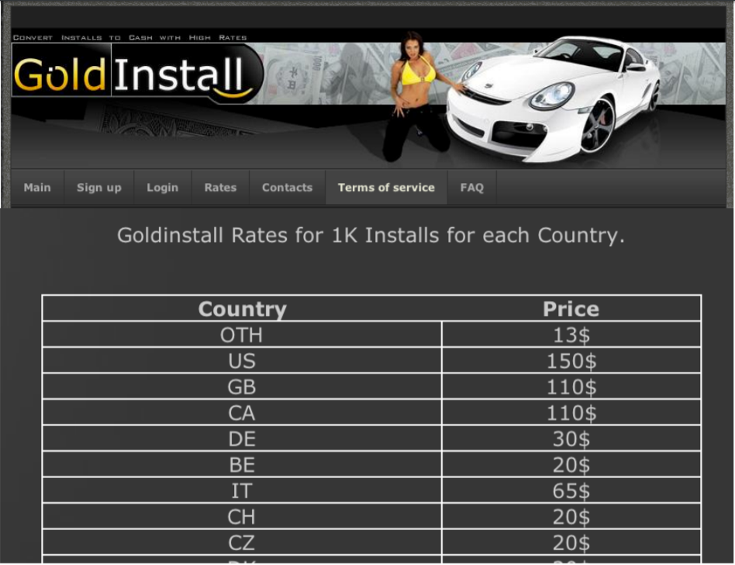


The PPI market
PPI = pay-per-install
PPI providers specialize in the infection of victim computers
Malware developers just choose their victims (number and even geographical location) and pay a small sum
The PPI provider takes care of the rest
Notes:
And that’s how the PPI (or pay-per-install) market appeared. PPI providers perform only one task, and they do it really well: they install your malware on target computers. They will do it quickly, they will target a certain geographical region and charge you a REALLY low price for this, sometimes even less than 10 cents per each confirmed installation. And there are a lot of services like this…

Slide 8





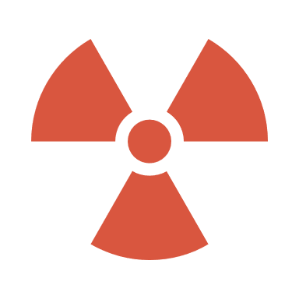
The PPI business model (direct PPI)
PPI clients
Clients want to deploy their malware
PPI providers install the client’s malware on compromised systems (usually using a downloader)
Client pays for each successful installation
PPI providers
Victim systems
Notes:
To understand how this all works, let’s start with the simplest possible PPI model.
From now on, I’ll refer to malware developers as clients. Simply put, these clients want to deploy their malware. All they have to do is contact a PPI provider, send them the binary and pay for a number of installs.
The PPI provider has a small malware of his own, which is called a downloader. He installs his downloader on as many systems as possible, and then the downloader will retrieve and run client executables from a remote server. We call this kind of service a direct PPI service, because the PPI provider is the one actually performing the installations.

Slide 9

The PPI business model (affiliate PPI)
PPI clients
PPI providers
Affiliates are usually specialized in certain distribution methods
PPI providers act as middlemen between the clients and the affiliates
Affiliate
Victim systems
Notes:
Now, there also exists a slightly more complex model, called affiliate PPI. In an affiliate PPI service, the PPI provider outsources the distribution of client executables to some third parties, called affiliates. These affiliates are usually specialized in certain distribution methods and are paid by the provider to install the PPI downloader on infected machines. So, in this case, the PPI provider acts simply as a middleman. By contacting one provider, the client can potentially access a large network of affiliates which will distribute his executable in a wide variety of ways.
INTERESTING: One interesting thing about this entire business model is that there is a fundamental conflict-of-interest inside it: the more you install, the more money you earn from clients. However, the more you install, the worse your services become, because computers where you have installed a large amount of malware are more likely to be detected.

Slide 10
Key roles in the PPI market
Clients:
only have to develop stealthy malware
profit directly from the activities enabled by their malware
PPI providers:
develop and deploy their own downloader, which then downloads clients’ malware
profit from the installation fees paid by the clients
Affiliates:
specialize in certain distribution methods
profit from the installation fees paid by the PPI providers
often work with more than one provider (more on this later!)
Notes:
Now I’ve already mentioned the three key roles in the PPI market, but I’m just going to go through them once again.
The client only has to develop stealthy malware. His source of revenue is from the malware he distributes, be it from cryptomining, or from stealing credit card or personal information, or whatever else he does.
The PPI providers need to develop their own downloader. Their source of revenue is from clients, which pay for each installation. They can either perform the installations directly, or through an affiliate.
And finally, affiliates are often specialized in certain distribution methods: social engineering, spam email, file sharing sites, botnets. They get paid for each successful installation of a PPI downloader, and it turns out that they often work with multiple providers.

Slide 11
Evading detection
Antivirus software may detect and block these programs at any point!
Both PPI providers and clients must produce stealthy executables.
Packer programs:
usually sold by third parties
change the program content so that it’s MD5 hash differs
(sometimes) change the program size
(sometimes) add detection for debuggers and virtual machines
Notes:
There’s one more piece of the puzzle here, and it’s evading detection. Both PPI providers and clients must produce executables which are not detected by antivirus software. It turns out that there are also players selling this as a service, under the form of packer programs. These programs offer different features to try and avoid detection. Most often, people use them for repacking, which is changing the program content just so that its MD5 hash differs, but without altering any of the functionality.
Sometimes, these packer programs can also have additional features. Most interesting is the detection for debuggers and virtual machines. Because these tools are often used in malware analysis, there are some smart pieces of malware out there that can detect when they’re in such an environment, and refrain from injecting code or generating network traffic, so as to be harder to analyze.

Slide 12
PART 3: Infiltrating the PPI Infrastructure
Notes:
Now, let’s dig deeper into the authors’ work. What they did was infiltrate four PPI services, download a huge number of infected binaries from them, and then perform some interesting analysis on everything.

Slide 13
Why?
Analyze malware availability
Measure differences in geographical preferences
Analyze rate of repacking
Analyze interactions between PPI services and affiliates
=> gain new insight into the PPI market and improve anti-malware efforts
Notes:
Why did they do this?
Well, for one, they looked at malware availability. For example, some malware binaries might be distributed constantly, while others only in short bursts.
Then, they also looked at differences in geographical preferences, to see which malware families are most likely to be distributed in which parts of the world (because we’ve already seen that targeted distribution is possible).
Then, they also tried to measure the rate of repacking and analyze interactions between PPI services and affiliates.
All of this has the purpose of understanding the PPI market better to improve anti-malware and takedown efforts.

Slide 14
How?
Build “milkers”
Ensure anonymity and geographical diversity
Run and classify downloaded malware
Notes:
Here are the major steps that they undertook in their analysis. I’ll go through each of these in more detail in the following slides, but I just wanted you to know what to expect.
First, for each PPI service that they infiltrated, they built a “milker”, which is sort of like a downloader. They made this milker appear like it runs from different parts of the globe and then they let it download all the malware it could, finally analyzing and classifying all of the nice surprises that it received.

Slide 15



Milking PPI services
1. Download client programs
PPI service
PPI milker
PPI downloader
Each PPI service uses at least one downloader program => reverse engineer and imitate downloader programs.
Sample rate of infection: 12 binaries downloaded in <5 minutes.
Total binaries: 1,060,895 over 6 months
2. Execute
3. Communicate success
Notes:
As I mentioned earlier, each PPI service uses at least one downloader program. This downloader has three main purposes. First, it downloads client programs. Then, it executes the client programs. Finally, it communicates back to the PPI service each successful installation that it managed to do.
Without going into many technical details, the authors reverse engineered these downloaders then created their “milker” programs. Simply put (CLICK), these milker programs pretend to be real PPI downloaders, so they connect to the service and then download a lot of binaries. However, they don’t execute them directly, and they don’t communicate successful installations to the service. So, their purpose really is just to milk as many binaries as possible. And they’ve managed to do that well, over one million in around 6 months.
INTERESTING: It is also interesting to mention here that while building such a milker, it is very important to minimize the amount of traffic that it exchanges with the PPI service. One of the computers that the authors’ developed on was actually banned from one of the services because their traffic was detected!

Slide 16

Anonimity and geographical diversity
Some malware families prefer certain geographical regions
Ensure geographical diversity by using 15 Tor circuits, as per the different price points offered by the PPI services
Notes:
Now, we’ve also seen that PPI services offer different rates depending on the country where clients would like to deploy their malware.
To gather results on what malware is distributed in what countries, the milker’s outgoing traffic was redirected through Tor circuits in 15 countries where the PPI services offered different rates. This way, it would become clear what families of malware prefer which geographical regions. And I’ll come back to this when I talk about the results.

Slide 17
Running malware executables
Analysis of modern malware relies on executing and observing its behavior
But: must contain the resulting network activity
Solution: GQ malware farm, a platform for malware-driven-research
Key ideas:
Intercept and block all network traffic
Allow DNS: let it attempt to communicate to the control server
Mimic a valid HTTP/SMTP session
Account for possible anti-virtualization capabilities
Notes:
Now, you don’t just run 1 million malware binaries very lightly. The authors used a controlled environment, a so-called “GQ malware farm” (which I honestly don’t know a lot of details about).
To prevent any kind of unwanted infection, most network traffic from the binaries was intercepted and blocked.
However, these binaries don’t give up that easily. They will only communicate with their control servers when certain conditions are met, so when they “feel” that they’re running on a compromised computer with network access. For this reason, DNS traffic was allowed, and also valid HTTP/SMTP sessions were created when requested by the binaries.
And one more important thing, as I mentioned before some malware might have anti-virtualization capabilities. Any binaries that seemed to do absolutely nothing on the virtual machine were also run on physical machines.

Slide 18
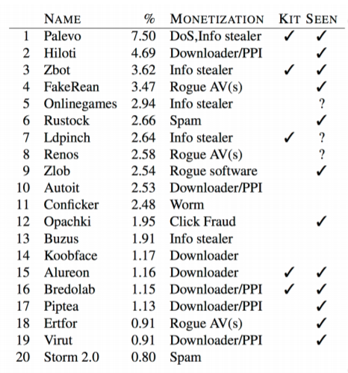
Classifying malware executables
Based on the network traffic that they produce
Use features such as protocols, endpoints, destination TCP/UDP ports, content
Try to match with known malware signatures
12 out of top 20 malware families were milked
Notes:
Having run all those evil binaries, the authors then tried to classify them based on the network traffic that was produced. They defined various features such as which protocols the malware tries to use, or which destination ports it tries to communicate with, and then based on the features performed a clustering that helped illustrate the various malware families.
Then, they went through databases of known signatures and tried to match those with the malware that they had milked. Interestingly, they found that 12 of the top 20 most widespread families of malware were indeed distributed by these PPI providers, some by more than one provider!

Slide 19
PART 4: Insights into the PPI business
Notes:
We’ve already seen a few results on the previous slides, but now let’s take a look on the rest of the analyses that the authors made.

Slide 20
Family classification
57 different malware families milked
Relevance of signatures decays over time: 92% of August downloads classified, 86% of September downloads, 77% of October downloads. Not surprising!
Some malware families (7 out of top 20) are distributed by more than one PPI service => clients do not feel tied to a single PPI provider.
Notes:
So, a few interesting observations on the classification that the authors made.
For the most popular families of malware that they milked, they manually extracted a set of classification signatures. This set was quite comprehensive, classifying over 90% of the downloads that they made in the first month. However, in the second month, it could only classify 86% of downloads, then 77%, and the percentage kept dropping. This is to be expected, because new clients always sign up to these services, and old clients sometimes update their malware (for example after repacking it to avoid detection!).
Also, many binaries seem to be distributed by more than one provider. It seems that clients will do this in order to ensure a wider spread of their malware and thus increase their profits.

Slide 21
Repacking rate
Typically repacked by the clients themselves
On average, at least once every 11 days
Top malware families are repacked more often (average every 6.5 days)
Rate varies: between twice a day and only once a month
Exception: Zlob performs automatic repacking of their downloader. This could be extended to client executables too!
Notes:
So, I’ve talked about packers before. It turns out that the average rate of repacking is once every 11 days, but the rate varies greatly: some repack their binaries twice a day, while others seemed to only do so once a month.
An interesting trend that might develop is PPI providers which offer automatic repacking. Zlob, one of the providers that was infiltrated already offers this for their downloader: every time an affiliate requests a downloader, it will receive one that was automatically repacked. It’s possible that this could one day be extended to client executables too.

Slide 22
Geographic breakdown
Most malware families have clear geographical preferences
Some families exclusively target Europe or the US (e.g. Ertfor, Securitysuite)
Some families exclusively target one or two countries (e.g. Gleishug – Germany)
Some families have no geographical preferences (e.g. Rustock)
Why is this happening?
prices vary between target countries (for 1K installations: from $7-8 to $180)
the class of activity has an influence: a spambot only requires a unique IP, whereas a fake antivirus requires localization
value of stolen information varies
Notes:
The authors also discovered that most malware has geographical preferences. Some exclusively target the US, some target Europe, some only target one or two countries, and some families have no preferences at all.
It’s interesting to think about why this happens. First, the malware’s class of activity has an influence: a spambot only requires a unique IP, so it will usually be distributed worldwide, while a fake antivirus often requires translations in the target country’s language and maybe even the possibility of payment processing. Also, because the prices vary quite a bit between target countries, there’s always a cost/benefit analysis involved, depending on the potential value of the stolen information (such as the amount of money that could be potentially found on credit cards).

Slide 23
Affiliate-PPI interactions
PPI clients
Surprising interaction: downloaders frequently download other downloaders!
Affiliates from one PPI service sometimes act as clients for another PPI service: e.g. affiliate buys 1k installs from PPI2 for $40, and sells them to PPI1 for $60.
PPI providers
Affiliate
Victim systems
Notes:
Now, I also promised I’d talk a bit about affiliate-PPI interactions. It was interesting to discover that affiliates sometimes subscribe to PPI services too, and use them to distribute downloaders for other PPI providers! So downloaders sometimes download other downloaders, which is quite a funny thing to say out loud… This happens because there are often price differences among PPI providers even for the same region, so one provider might charge less for client installations than another provider might pay for affiliate installations.

Slide 24
Lessons learned
Should separate the exploitation mechanism compromising a system from the malware itself!
It’s harder to analyze malware distributed via PPI in isolation.
PPI services have implications for takedown efforts: take down the people running them!
Notes:
Now, before I wrap this up, some general lessons about information security.
We’ve seen that there is a hugely prolific market of installation services, so really there is not a strong connection anymore between the mechanism that was used to compromise a system and the malware that it hosts afterwards. Classification should only really on malware behavior from now on.
However, because malware often comes bundled with downloaders and other malware, it’s harder to analyze it in isolation!
Another important lesson is that installations are really, really cheap. So taking down a botnet or some specific malware network might not be very helpful, because it’s easy to rebuild that. What should be targeted are the PPI services themselves, and even the people that are behind them!

Slide 25
Thank you! Questions?

