Slide 1



Internship on “Skill Enhancement Courses & Implementation on Interactive Chart Generator” Subject Code : 21INT82
Rupam Bhattacharyya (1EP21CS089)
Under the Guidance of
Mrs. Manimegalai A
Assistant Professor
Department of CSE, EPCET

Slide 2
Contents
Introduction to Skill Enhancement Courses
Objectives/Future Implications of the Internship
Technical Skills Gained
Project Overview
Hardware and Software Requirements
Internship Implementation
Learning Outcome
Challenges Faced
References

Slide 3
INTRODUCTION TO SKILL ENHANCEMENT COURSES
Practical Knowledge: These courses emphasize hands-on training in key areas such as programming, data science, web development, and mobile app development, enhancing technical proficiency.
Industry Readiness: By simulating real-world challenges through projects and assignments, students gain the confidence and skills required for professional roles.
Flexibility: Offered as an alternative to internships, these courses provide a structured learning experience within a flexible timeframe.
Enhanced Employability: Completing these courses adds value to students' resumes, making them more attractive to potential employers.
Skill Development: Students acquire both foundational and advanced technical skills, improving their problem-solving abilities and innovation potential.

Slide 4
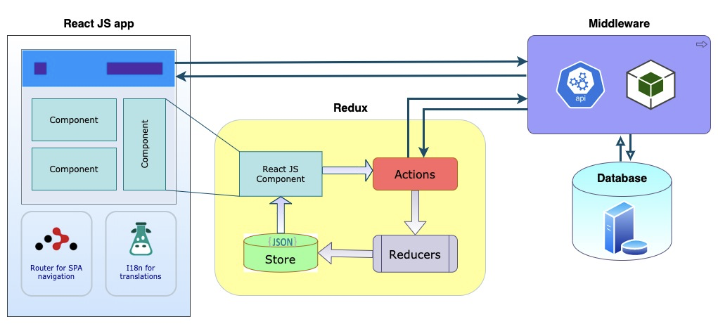
React in Web Development
Features:
Component-Based Architecture
UI is broken down into reusable components.
Encourages code reusability and modularity.
Virtual DOM
Efficiently updates and renders components.
Minimizes direct DOM manipulation for better performance.
3. Declarative Syntax
Developers describe what the UI should look like.
React handles the underlying rendering.
4. One-Way Data Binding
Ensures better control over data flow.
Simplifies debugging and state management

Slide 5
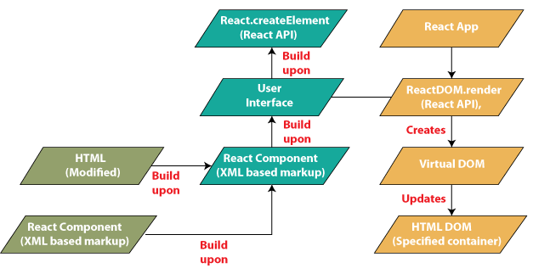
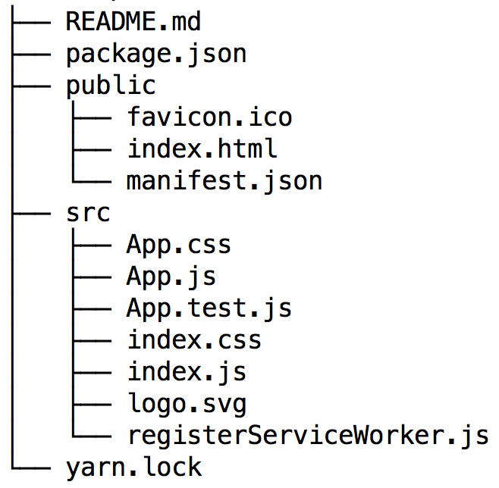
React in Web Development
React Workflow
Define components in JSX.
Use state and props for data management.
Interact with APIs to fetch or send data.
Apply lifecycle methods (e.g., useEffect) for dynamic behaviors.
Tools and Libraries
React Router: For navigation and routing in single-page applications.
Redux/Context API: For state management.
Material-UI/Chakra UI: For pre-built UI components.
Axios/Fetch: For API calls.

Slide 6
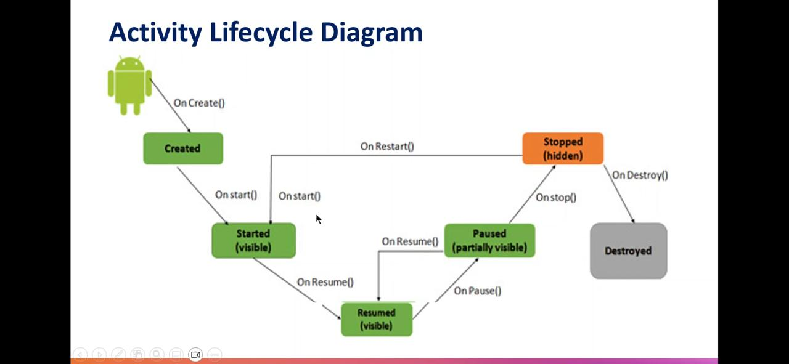
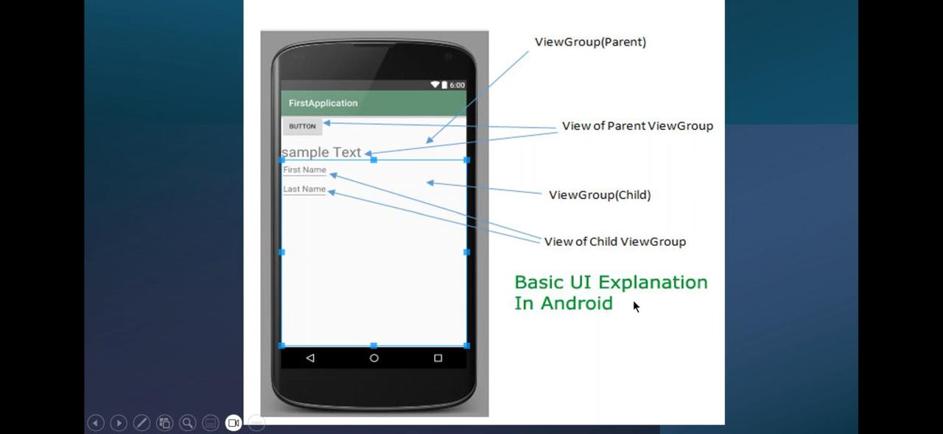
Kotlin in App Development
Key Features of Kotlin
Concise Syntax
Reduces boilerplate code compared to Java.
Easier to write and maintain.
Interoperability
Fully compatible with Java.
Can call Java code within Kotlin and vice versa.
Null Safety
Built-in support to eliminate NullPointerException.
Ensures safer code execution.
Extension Functions
Add new functionality to existing classes without altering their source.
Coroutines for Asynchronous Programming
Simplifies handling asynchronous tasks.
Reduces complexity in multi-threaded programming.

Slide 7
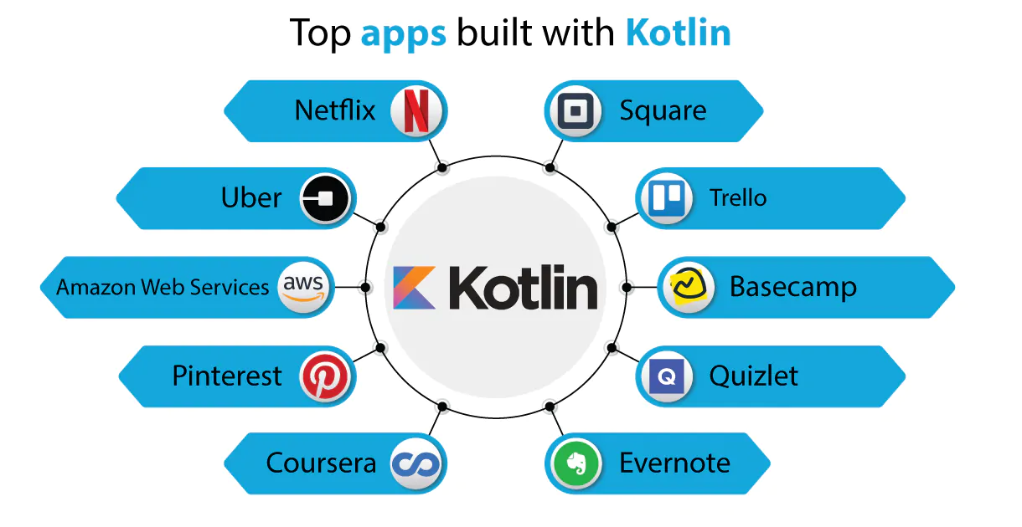
Kotlin in App Development
Tools and Libraries
Ktor: Framework for building web applications.
Kotlinx Serialization: For data serialization.
Anko: Simplifies Android development.
Kotlin Multiplatform Mobile (KMM): Write shared code for Android and iOS.
Kotlin Workflow
Write concise and expressive code in the IDE (e.g., IntelliJ IDEA, Android Studio).
Leverage Java libraries and frameworks seamlessly.
Use coroutines for asynchronous programming.
Test code using Kotlin’s built-in testing tools.

Slide 8
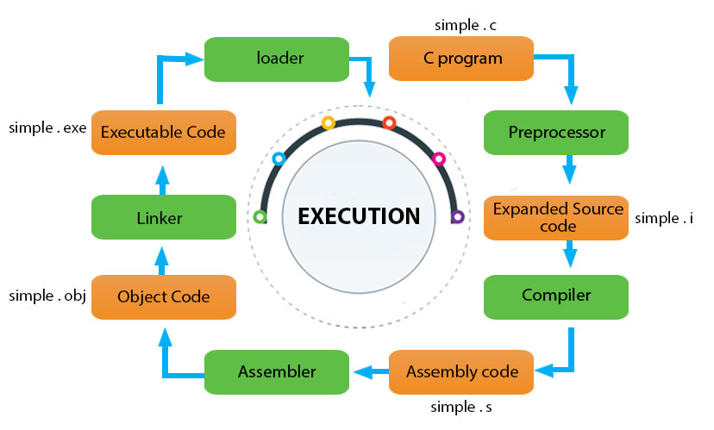
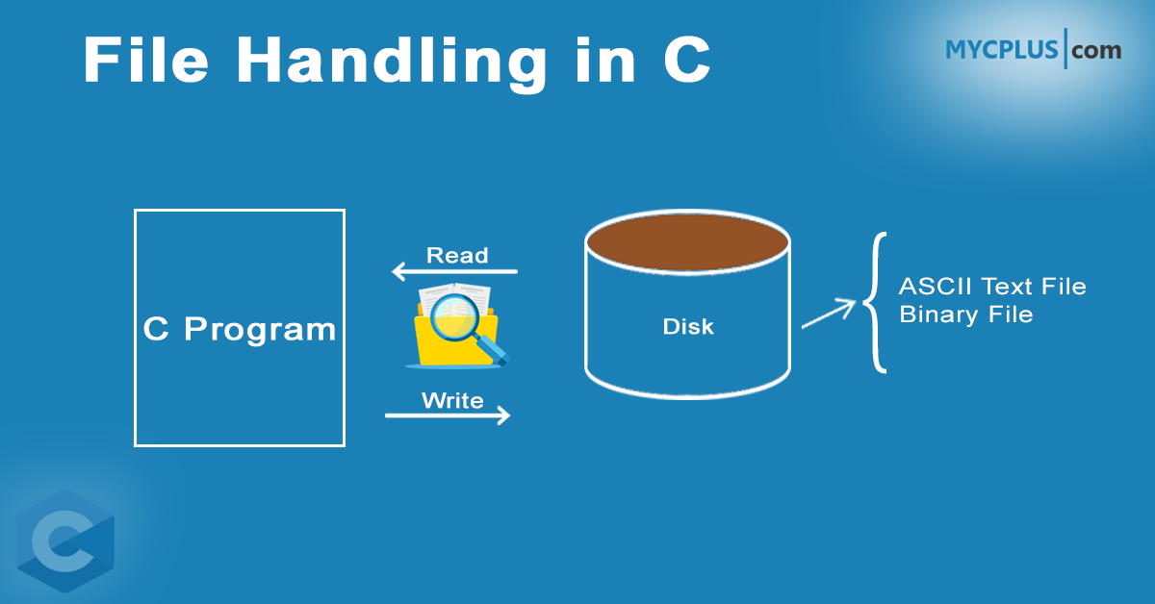
C Programming Language
Features of C Language
Simplicity: Easy to understand and implement.
Portability: Code can be executed on different machines with minimal changes.
Structured Language: Programs can be divided into functions, improving readability.
Efficiency: Offers fast and efficient execution.
File Handling in C
File handling in C is a mechanism that allows programs to read from and write to files stored on a storage device. It provides a way to persist data beyond the runtime of a program and is essential for tasks such as data logging, configuration management, and structured data processing.

Slide 9
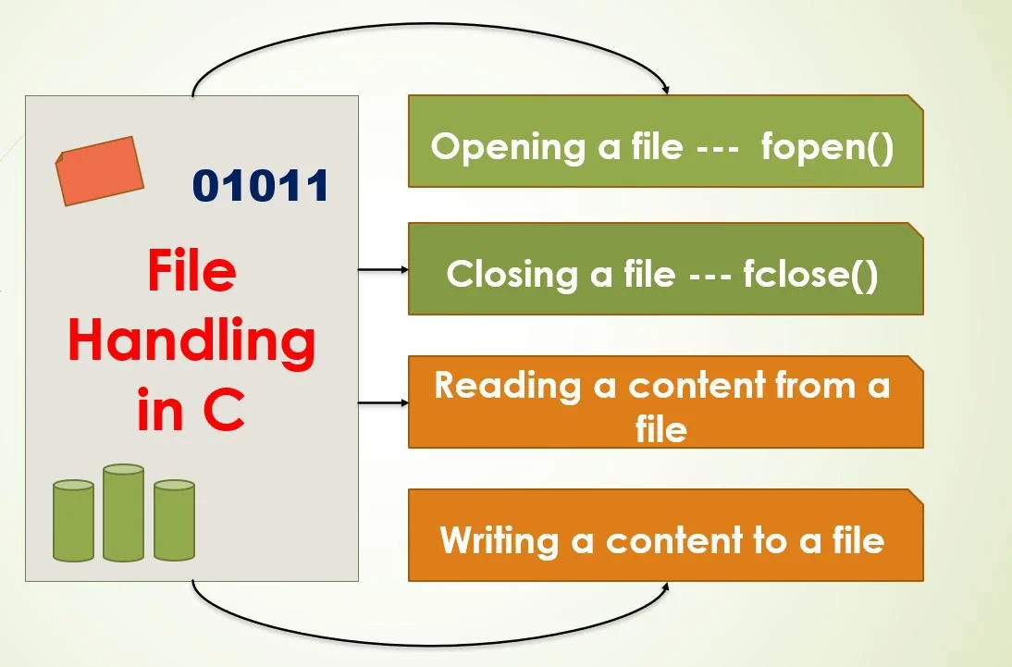
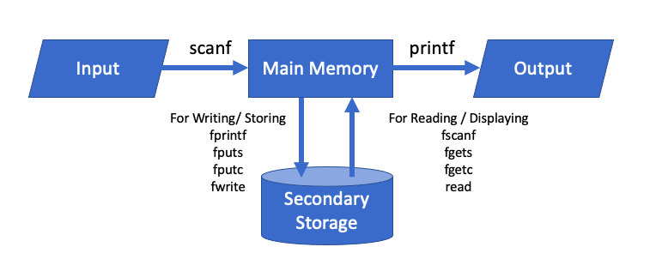
C Programming Language
File Operations
C supports the following basic file operations:
Creating a file: Creating a new file for storing data.
Opening a file: Associating a file with a stream.
Reading from a file: Extracting data from a file.
Writing to a file: Storing data into a file.
Closing a file: Releasing resources associated with the file.

Slide 10
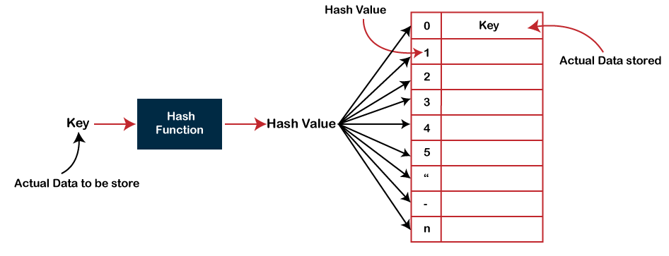
Data Structure using C
Types of Data Structures
Primitive Data Structures
Basic data types: integers, floats, characters, and pointers.
Linear Data Structures
Arrays: Fixed-size, sequential memory allocation.
Linked Lists: Nodes connected by pointers for dynamic memory usage.
Stacks: Last In, First Out (LIFO) operations (e.g., undo functionality).
Queues: First In, First Out (FIFO) operations (e.g., task scheduling).
Non-Linear Data Structures
Trees: Hierarchical structures (e.g., binary trees, AVL trees).
Graphs: Nodes (vertices) connected by edges (e.g., social networks).
Heaps: Specialized trees for priority-based operations.
Hash-Based Data Structures
Hash Tables: Key-value pairs for quick lookups.
Common in database indexing and caching.

Slide 11
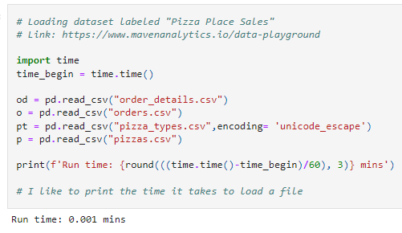
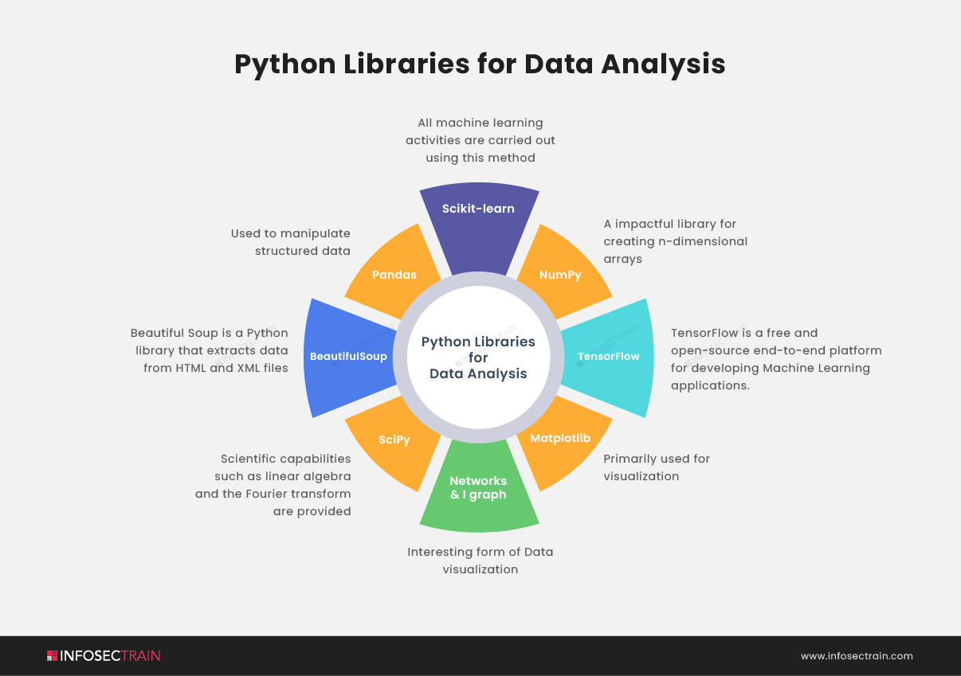
Python for Data Science
Python Libraries for Data Science
Data Manipulation and Analysis
Pandas: Handling structured data with DataFrames.
NumPy: Efficient array computations.
Data Visualization
Matplotlib: Basic plotting capabilities.
Seaborn: Advanced statistical visualizations.
Plotly/Dash: Interactive and dynamic plots.
Machine Learning and AI
Scikit-learn: For classical machine learning algorithms.
TensorFlow/PyTorch: For deep learning applications.
Big Data and Distributed Computing
Dask: For parallel computing and large datasets.
PySpark: For big data processing.
Natural Language Processing (NLP)
NLTK/Spacy: For text preprocessing and sentiment analysis.

Slide 12
Objectives of the Internship
Develop a user-friendly interface using React.js.
Enable dynamic chart generation in multiple formats (bar, pie, line, scatter).
Build a secure backend with Django for data processing and chart generation.
Allow users to download charts as image files.
Ensure cross-browser compatibility and responsive design.
Incorporate secure data handling practices.
Design the system for future extensibility and integration with external data sources.

Slide 13
Future Implications:
Enhanced Data Accessibility:
Simplify data representation for diverse users.
Skill Development:
Practical experience with React.js, Django, and Matplotlib.
Scalable Solutions:
Foundation for advanced tools like real-time analytics.
Professional Applications:
Usable in industries like education, finance, and healthcare.
Innovation:
Basis for interactive dashboards and machine learning insights.

Slide 14
Technical Skills Gained
Programming Proficiency
Mastery of multiple programming languages (e.g., Python, C, Kotlin, React) for diverse applications like web development, data science, and system-level programming.
Problem-Solving and Algorithm Design
Strong understanding of data structures and algorithms to efficiently solve computational problems and optimize software performance.
Application Development
Hands-on experience in building robust applications, including Android apps with Kotlin, React-based web apps, and AI-powered tools like resume builders and vehicle detection systems.
Data Analysis and Visualization
Expertise in processing, analyzing, and visualizing data using Python libraries (e.g., Pandas, Matplotlib) and integrating them into interactive systems.
Advanced Technology Integration
Skills in integrating cutting-edge tools and frameworks (e.g.,TensorFlow) into projects for real-world applications like object detection, speed tracking, and predictive modeling.

Slide 15
Project Overview
The "Interactive Chart Generator Using React and Python" is a web-based application designed to simplify the visualization of data through customizable charts. This tool enables users to input data manually, specify categories and values, and dynamically generate various chart types, including bar, pie, line, and scatter plots. Leveraging a user-friendly interface, the application allows for seamless data entry and editing, with options to add or remove rows as needed.
The generated charts are displayed in real-time, and users can download them in high-quality image format for offline use. The application utilizes React.js for its responsive front-end and Axios for secure API communication with the server. It also incorporates CSRF token-based protection to ensure data security during user interactions. Designed for researchers, educators, and professionals, this tool eliminates the complexities of traditional chart creation, offering an efficient and intuitive solution for data visualization needs.

Slide 16
Hardware and Software Requirements
Hardware Requirements
Processor: A modern multi-core processor (e.g., Intel i5/i7 or AMD Ryzen 5/7) is recommended to handle data processing and model training efficiently.
Memory: At least 8 GB of RAM is ideal to manage large datasets and perform computations smoothly.
Graphics Processing Unit (GPU): A dedicated GPU (e.g., NVIDIA GTX 1060 or higher) is beneficial for accelerating deep learning model training.
Software Requirements
Operating System: Windows 10 or later, macOS, or a modern Linux distribution (e.g., Ubuntu) for compatibility with development tools and libraries.
Python: Version 3.7 or later, which is essential for running the Python scripts and libraries used in the project.
IDE: VS Code or any other preferred IDE for efficient coding and debugging.
Node Js: The latest version of node js to run the frontend react.

Slide 17
Internship Implementation
Title: Interactive Chart Generator
Update settings.py: Define MEDIA_URL and MEDIA_ROOT to handle media files.
Update urls.py: Add static URL patterns to serve media files during development.
Modify Chart Saving Path: Use MEDIA_ROOT in manual_data_view to save charts in the media/charts directory.
Return Chart URL: Construct the chart URL using MEDIA_URL in the JSON response.
Support Multiple Chart Types: Add a chart_type field in the request and handle various chart types (e.g., bar, pie, line, scatter) in the view.
Frontend Dropdown: Add a dropdown in React to let users select a chart type.
Send Chart Type: Include the selected chart type in the POST request from React.
Test Changes: Verify the functionality by generating different chart types and ensuring they appear correctly in the frontend.
Check Media Serving: Confirm that the Django server serves the media files properly in development mode.

Slide 18
Frontend Set Up:
Add State for Chart Type: Add a chartType state in React to store the selected chart type.
Create Dropdown Menu: Add a dropdown in the form to let users choose the chart type (e.g., Bar, Pie, Line, Scatter, etc.).
Update Form Submission: Include the selected chartType along with the data in the POST request body.
Handle Dynamic Inputs: Adjust the input fields dynamically based on the chart type (e.g., x and y fields for scatter plots).
Modify Request Headers: Ensure the CSRF token is sent with the POST request for security.
Enhance Visualization Logic: Update the logic to fetch and display the generated chart dynamically based on the returned URL.

Slide 19
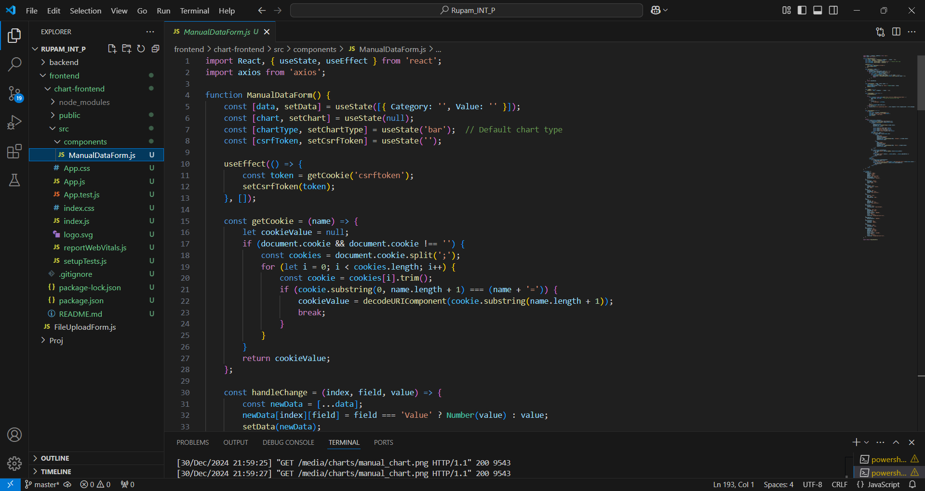
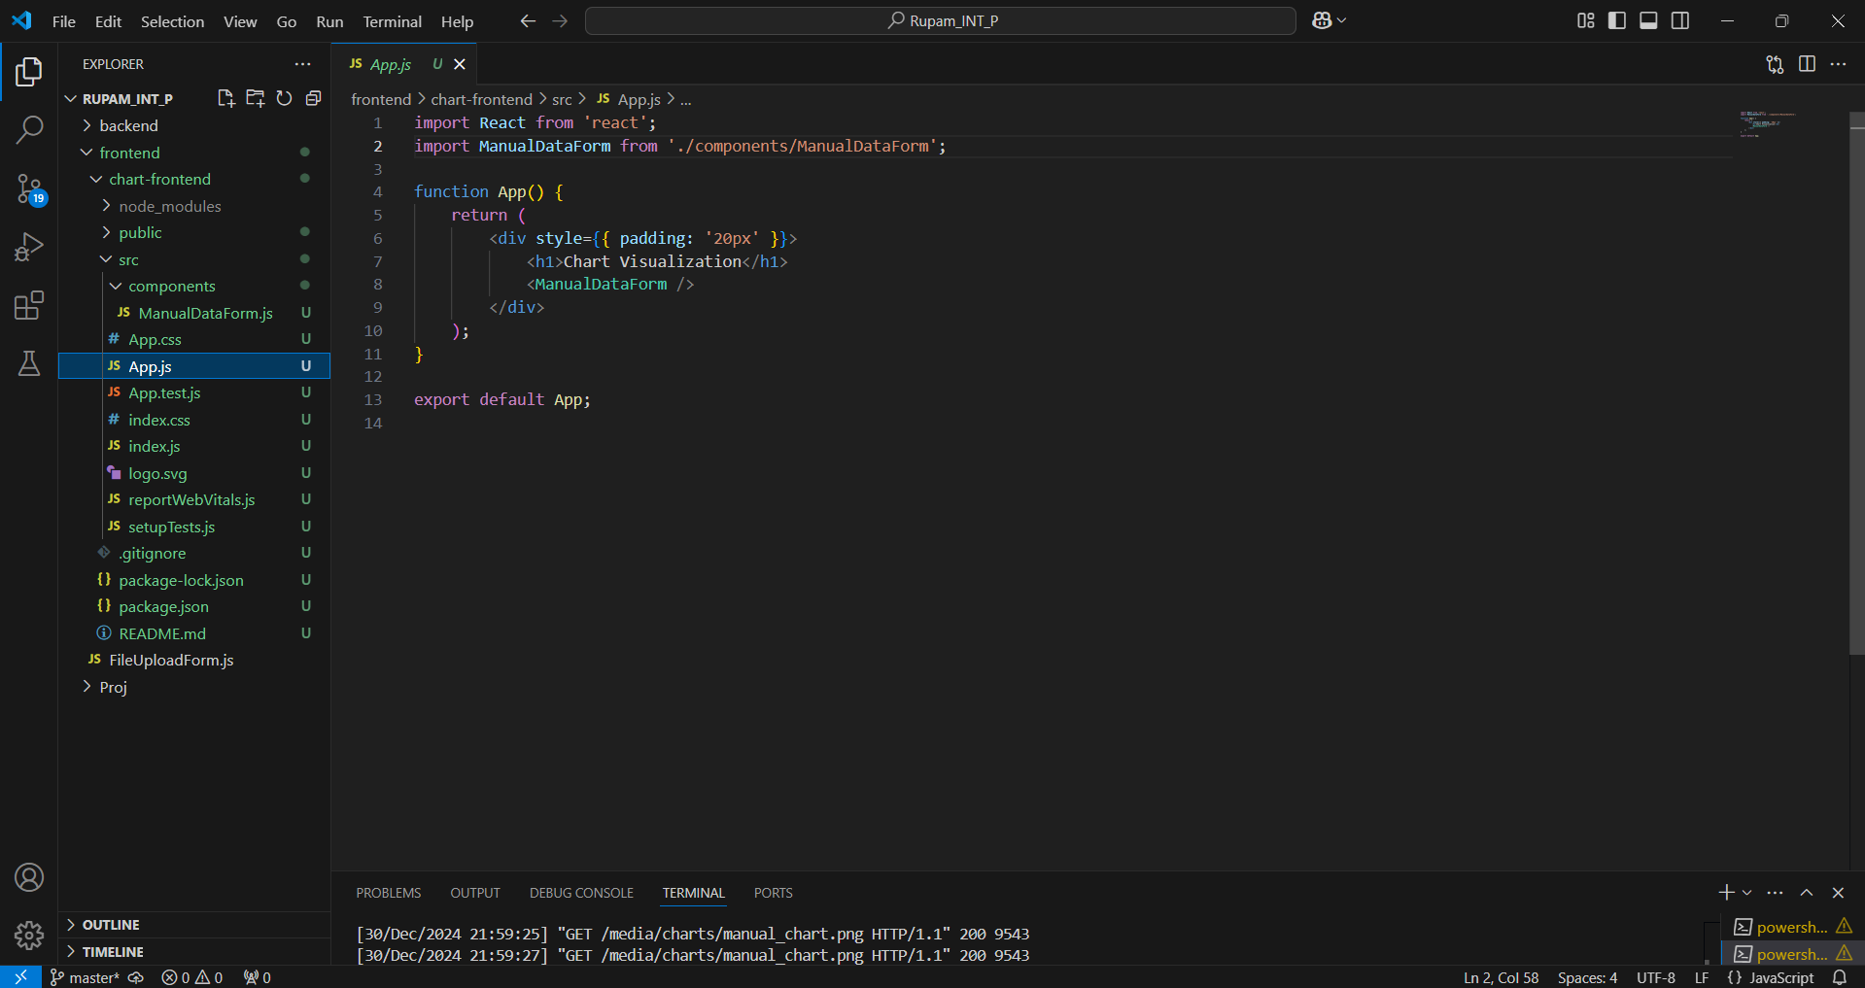

Slide 20
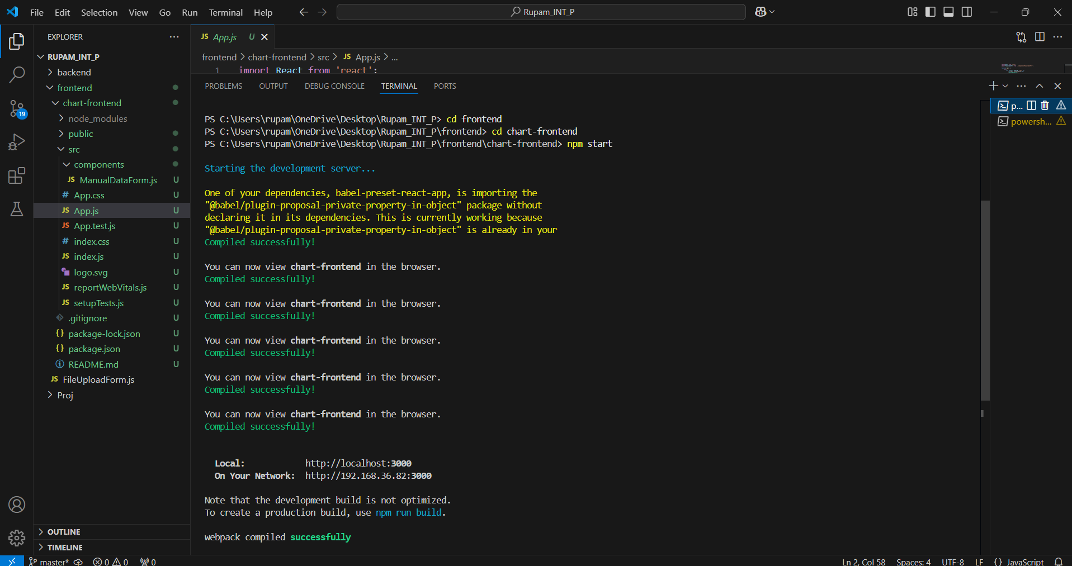
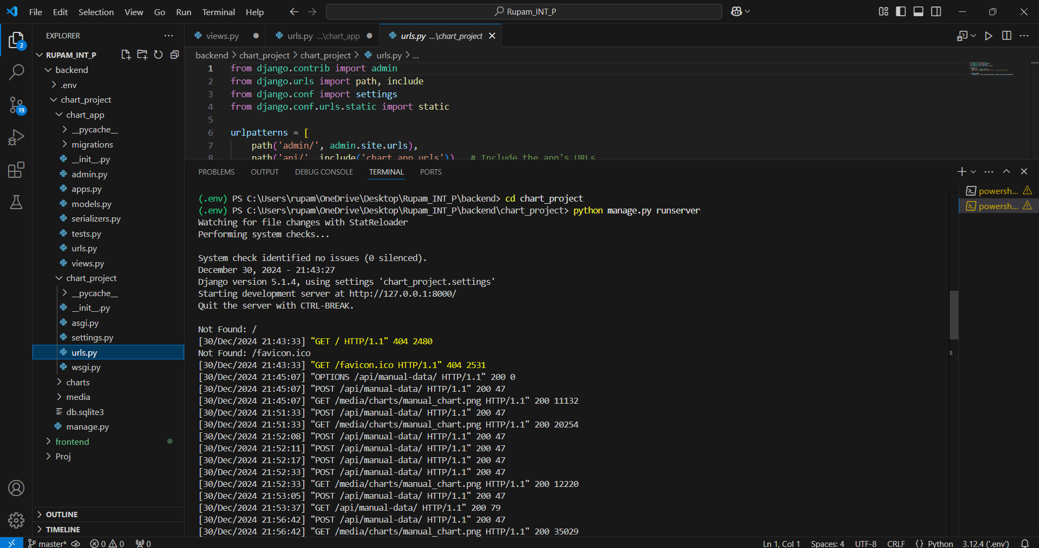

Slide 21
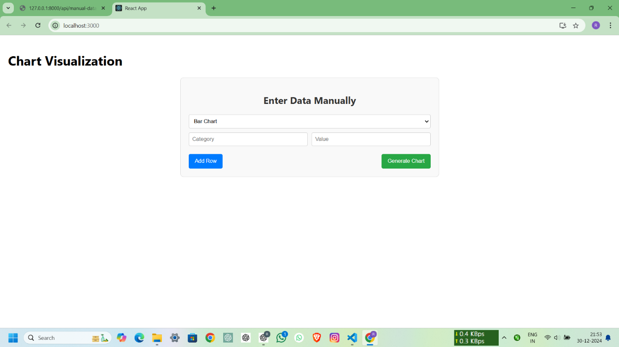
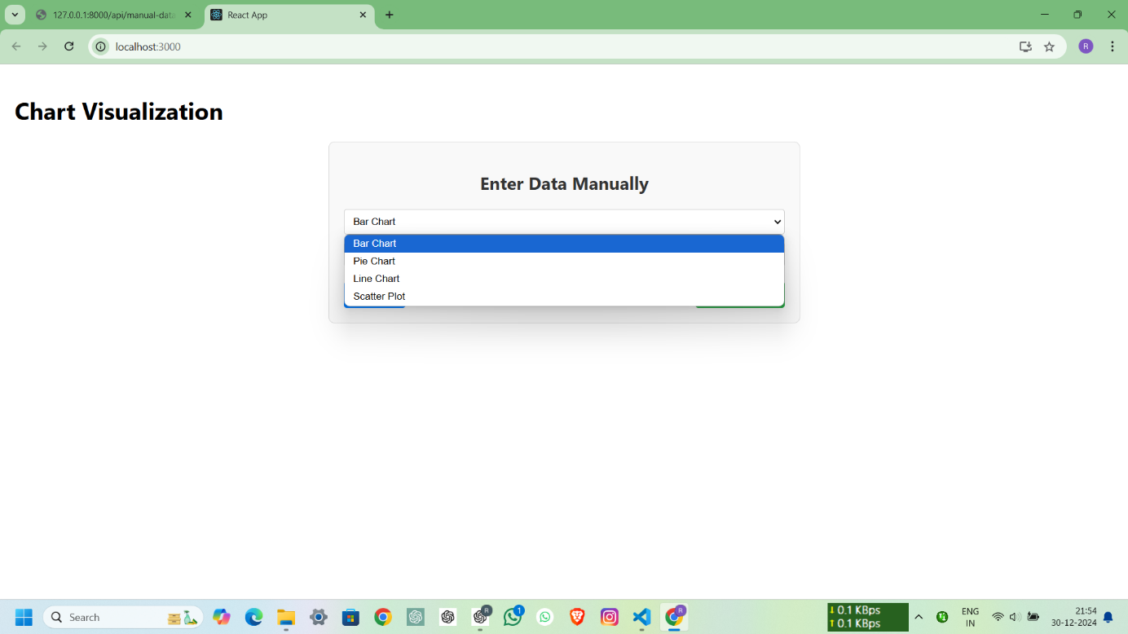

Slide 22
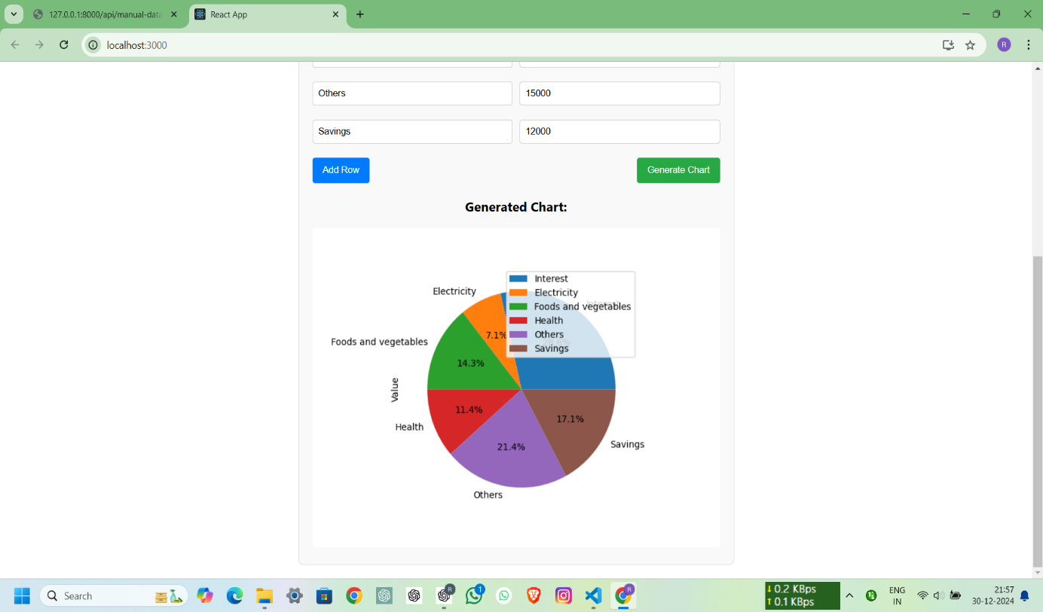
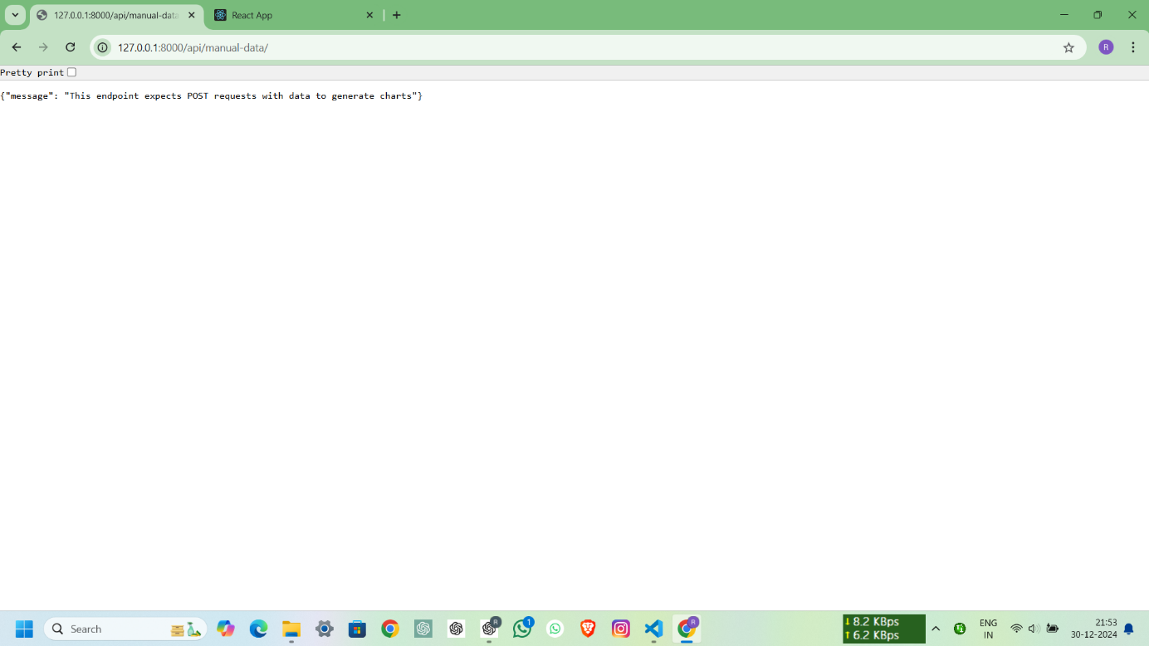

Slide 23
Challenges Faced
Dynamic Input Handling: Managing form inputs dynamically for different chart types without cluttering the UI can be complex.
Data Validation: Ensuring the user inputs match the requirements for each chart type (e.g., numeric data for bar charts, paired data for scatter plots).
Backend Coordination: Synchronizing frontend changes with the backend to handle multiple chart types seamlessly.
Error Handling: Providing meaningful feedback to users when they input invalid data or if the backend fails to process their request.
Chart Rendering: Displaying different chart images dynamically without caching issues, especially when the same file name is reused.

Slide 24
References
React Documentation: https://react.dev/ Official documentation for building user interfaces with React.
Django Documentation: https://docs.djangoproject.com/ Comprehensive documentation for Django, including views, routing, and handling APIs.
Matplotlib Documentation: https://matplotlib.org/stable/contents.html Guide on generating different chart types using Matplotlib.
Pandas Documentation: https://pandas.pydata.org/docs/ Instructions for handling and transforming data in Python.

Slide 25
THANK YOU

