Slide 1

Intelligent Traffic Violation Detection and Notification System Using Deep Learning
Presented By, | Under the guidance of, Mrs. Manimegalai A Asst. Professor Department of CSE, EPCET
Pritish Ali(1EP21CS076)
Rupam Bhattacharyya(1EP21CS089)
HD Kishore(1EP22CS405) Vinay Kumar(1EP21CS122)

Slide 2
INTRODUCTION
Purpose of Vehicle Detection and Tracking
Essential for traffic monitoring, autonomous driving, and security surveillance.
Involves identifying, locating, and monitoring vehicles in images or video streams over time.
YOLO (You Only Look Once) for Object Detection
Fast, efficient single-stage object detection algorithm.
Detects multiple objects in an image in a single pass.
Deep SORT for Multiple Object Tracking
Utilizes Kalman filters and Hungarian matching for robust tracking.
Accurately tracks vehicles even in challenging conditions like occlusions.

Slide 3
Speed Estimation for Traffic Monitoring
Integrated to measure vehicle speeds, adding another layer to the monitoring system.
EasyOCR for Automatic Number Plate Recognition (ANPR)
Detects and reads number plates automatically.
Identifies traffic violators and streamlines the process of issuing fines.
Comprehensive Real-Time Traffic Monitoring System
Combines vehicle detection, speed estimation, and ANPR.
Provides an efficient solution for real-time traffic monitoring and rule enforcement

Slide 4
PROBLEM STATEMENT
The increasing traffic violations and inefficiencies in manual enforcement necessitate an automated and adaptable traffic monitoring system. Leveraging advanced technologies, the system aims to detect vehicles, estimate speeds, recognize license plates, and identify violations in real-time. The implementation using YOLOv8 for vehicle detection, Deep SORT for object tracking, EasyOCR for license plate recognition, and speed estimation introduces challenges in maintaining high accuracy, real-time responsiveness, and computational efficiency while adapting to diverse and dynamic traffic scenarios.
Objective:
Develop a comprehensive real-time traffic monitoring and enforcement system using YOLOv8, Deep SORT, EasyOCR, and speed estimation to detect vehicle speeds, recognize license plates, and automatically alert owners of violations.
Challenges:
Accuracy in detecting and identifying violations.
Real-time performance and responsiveness.
Computational efficiency for processing live traffic footage.

Slide 5
EXISTING SYSTEM
Existing vehicle detection and tracking systems often use traditional object detection methods like Viola-Jones or HOG (Histogram of Oriented Gradients) combined with tracking algorithms such as Kalman filters or particle filters. While these methods are effective to some extent, they face several limitations:
Limitations:
Limited detection accuracy, especially in complex environments.
Real-time performance challenges, making them unsuitable for high-speed traffic monitoring.
Susceptibility to occlusions and background clutter, reducing reliability.
Limited adaptability to varied traffic conditions.
Higher computational requirements for achieving acceptable accuracy.

Slide 6
PROPOSED SYSTEM
The proposed system utilizes a combination of YOLO (You Only Look Once) for object detection, DeepSORT for multiple object tracking and EasyOCR to number plate recognition to achieve accurate and efficient vehicle detection, tracking and number plate recognition.
ADVANTAGES:
Improved Detection Accuracy
Real-time Performance
Robust Tracking
Adaptability
Computational Efficiency

Slide 7
AIM OF THE PROJECT
The proposed project aims to develop a comprehensive and efficient real-time traffic monitoring and enforcement system. Utilizing YOLOv8 for precise vehicle detection, Deep SORT for reliable object tracking, and EasyOCR for accurate license plate recognition, the system will also incorporate speed estimation to identify traffic violations such as speeding and helmet non-compliance. The ultimate goal is to create a robust and adaptable solution that enhances traffic surveillance and enforcement capabilities, contributing to safer roads and more efficient traffic management through the integration of advanced computer vision techniques.

Slide 8
OBJECTIVES
To develop a traffic violation detection system with integrated modules for license plate recognition and vehicle speed monitoring.
To enable real-time detection and reporting of hit-and-run cases using vehicle tracking and centralized data systems.
To automate fine notification through seamless integration with government databases and messaging platforms.
To design a scalable and cost-effective solution tailored to regional traffic challenges, ensuring high accuracy under diverse environmental conditions.

Slide 9
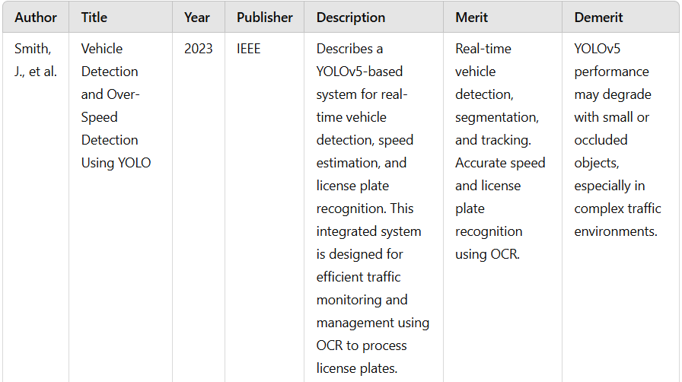
LITERATURE SURVEY

Slide 10
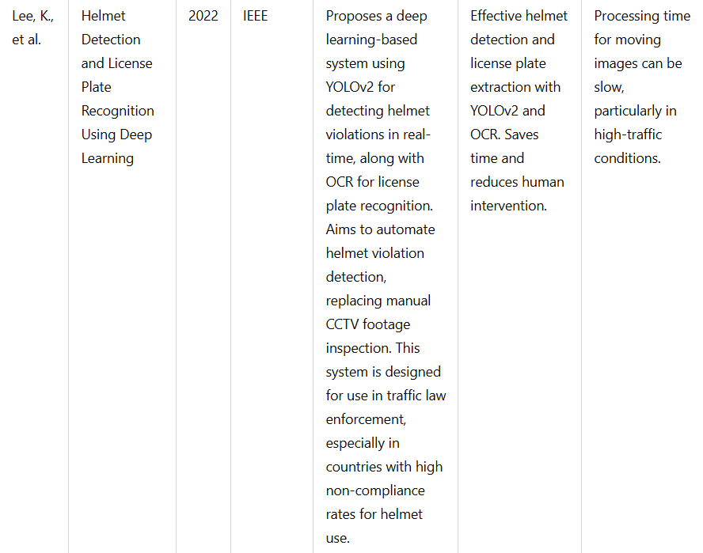

Slide 11
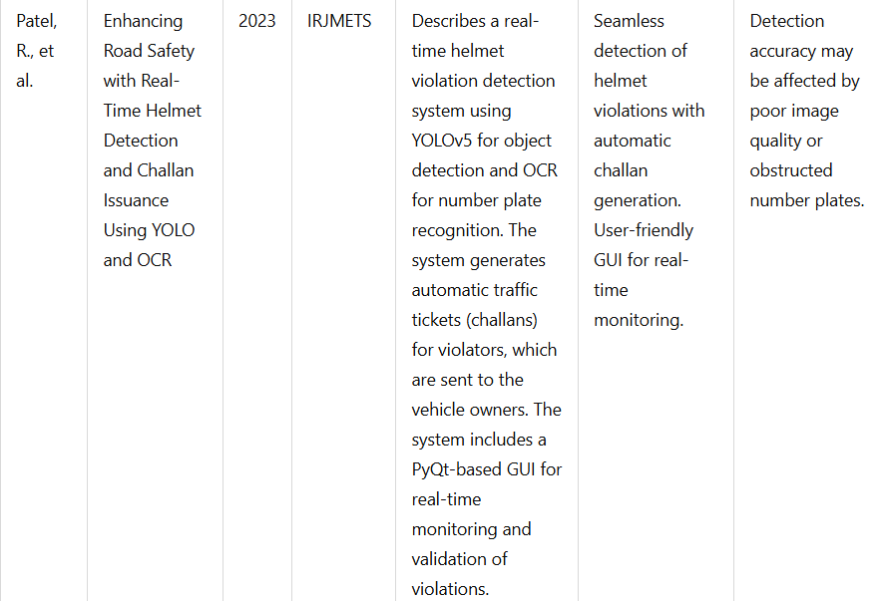

Slide 12
HARDWARE REQUIREMENT
Processor : AMD Ryzen 5 3450U with Radeon Vega Mobile Gfx 2.10 GHz
Memory : 4GB
Disk : 10GB
Display : 15-inch color
RAM: At least 8 GB

Slide 13
SOFTWARE REQUIREMENTS
Coding : Python
Operating System : Windows 11
Platform : Python 3.12
Tool : Visual Studio Code
Libraries : NumPy, Ultralytics, PyTorch , OpenCV, Matplotlib

Slide 14
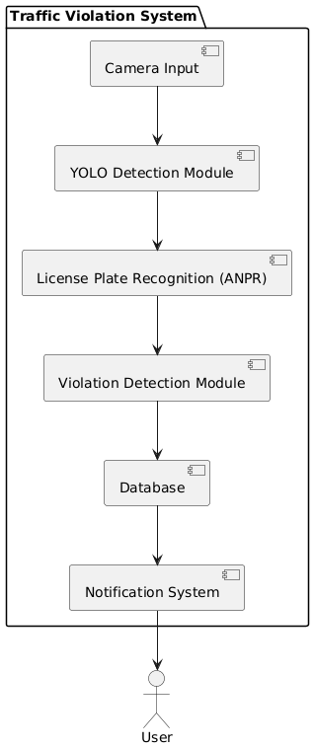
SYSTEM ARCHITECTURE

Slide 15
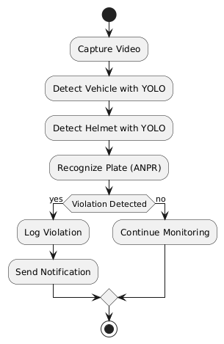
ACTIVITY DIAGRAM

Slide 16
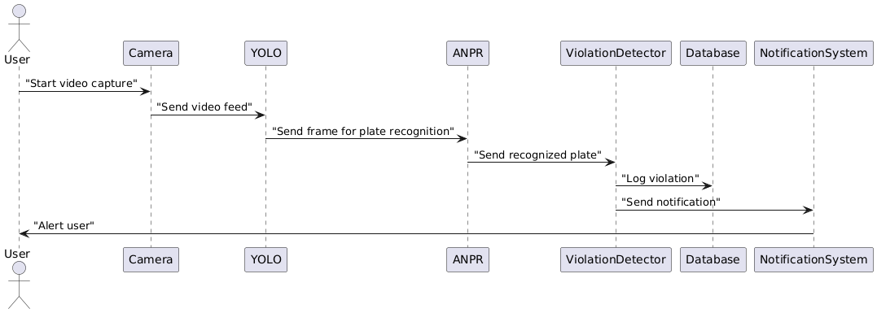
SEQUENCE DIAGRAM

Slide 17
SYSTEM MODULE
Input Acquisition Module
Captures live or recorded video feed for processing.
2. Vehicle Detection Module
Detects vehicles using object detection techniques.
3. Object Tracking Module
Tracks detected vehicles across frames for consistent identification.
4. Speed Estimation Module
Calculates vehicle speed using frame displacement and real-world scaling.

Slide 18
5. Violation Detection
Logic: Rule-based thresholds for speed, helmet usage, etc.
6. Database Management
Tool: SQLite/MySQL for storing vehicle and violation data.
7. Notification and Reporting
Tool: SMTP for emails; third-party APIs for SMS integration.

Slide 19
INPUT AND OUTPUT
Inputs Required : The system requires video feeds from traffic cameras, either live streams or pre-recorded footage in formats like MP4 or RTSP. Calibration data, such as the pixels-to-meters scaling factor and camera frame rate, is essential for accurate speed estimation. Threshold parameters, including speed limits and helmet compliance rules, are provided to detect violations. Additionally, a database of registered vehicles containing license plate numbers and owner details (name, email, contact) is used for identification and reporting.
Expected Outputs : The system outputs detected vehicles with their bounding boxes, calculated speeds, and classifications (e.g., car, bike). Violations, such as over speeding are flagged and logged. License plate numbers of violating vehicles are extracted and cross-referenced with the database. The final output includes violation reports and automated notifications, such as emails or SMS, sent to offenders.

Slide 20
SYSTEM IMPLEMENTATION
Environment Setup.
Download YOLO Model.
Configuration.
Code Implementation.
Database design
Run the code.

Slide 21
UNIT TESTING
Definition: Unit testing involves testing individual units or components of the software independently.
Tools Used: Python's unit test framework or pytest for writing and running unit tests.
Test Coverage: Ensure each function/method is tested with various input scenarios (e.g., different types of vehicle images).
Example: Test YOLOv8 detection functions with mock input data to validate expected outputs.

Slide 22
INTEGRATED TESTING
Definition: Integrated testing checks the combined behavior of components working together as a system.
Scope: Test interactions between YOLOv8 (vehicle detection) and Deep SORT (tracking) modules.
Mocking: Use mock objects or stubs to simulate dependencies during integration testing.
Example: Test YOLOv8 outputs as inputs to Deep SORT to ensure proper tracking initiation.

Slide 23
SYSTEM TESTING
Definition: System testing evaluates the overall behavior of the system as a whole.
Test Scenarios: Define test scenarios (e.g., detecting vehicles in different weather conditions, tracking vehicles in crowded scenes).
Performance Metrics: Measure system performance (e.g., accuracy, real-time processing speed).
Example: Run the entire pipeline on a diverse dataset and assess detection and tracking accuracy.

Slide 24
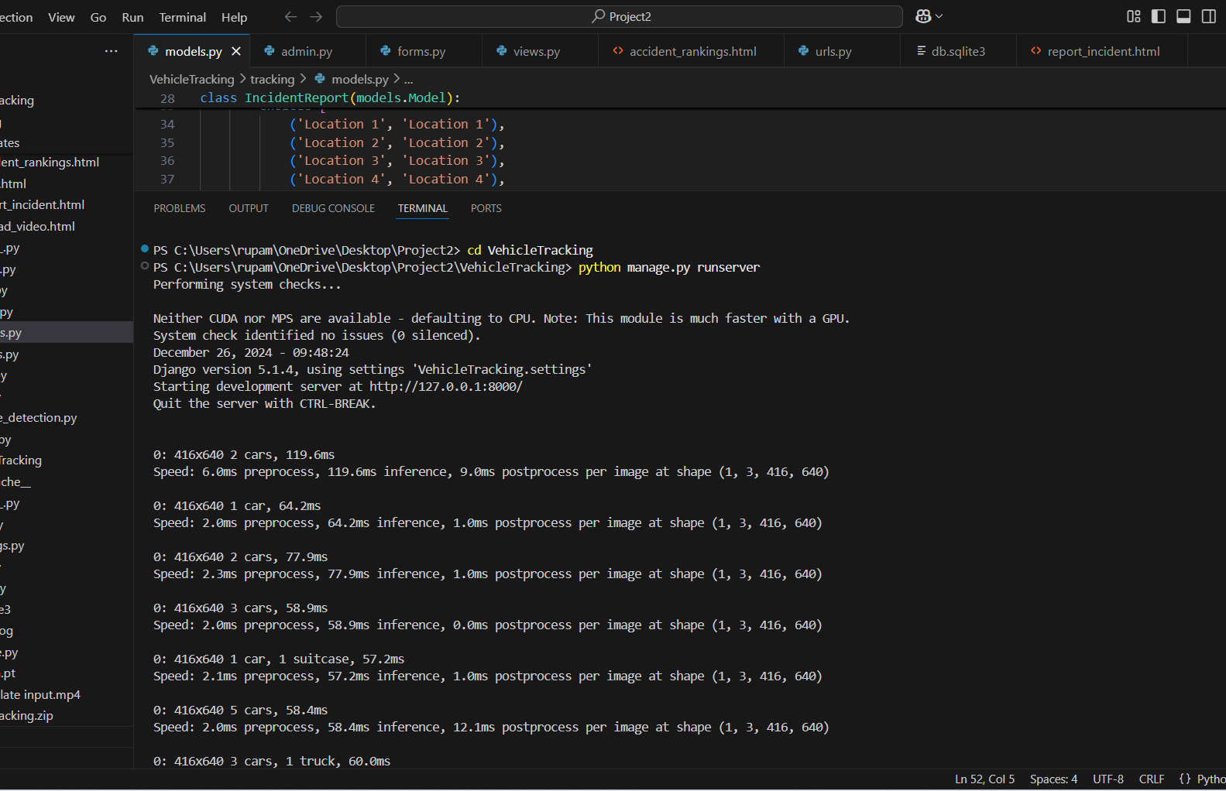
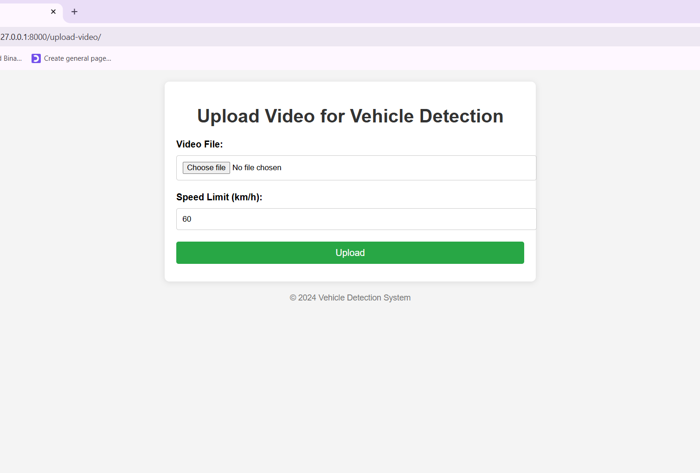
RESULT AND RESULT ANALYSIS

Slide 25
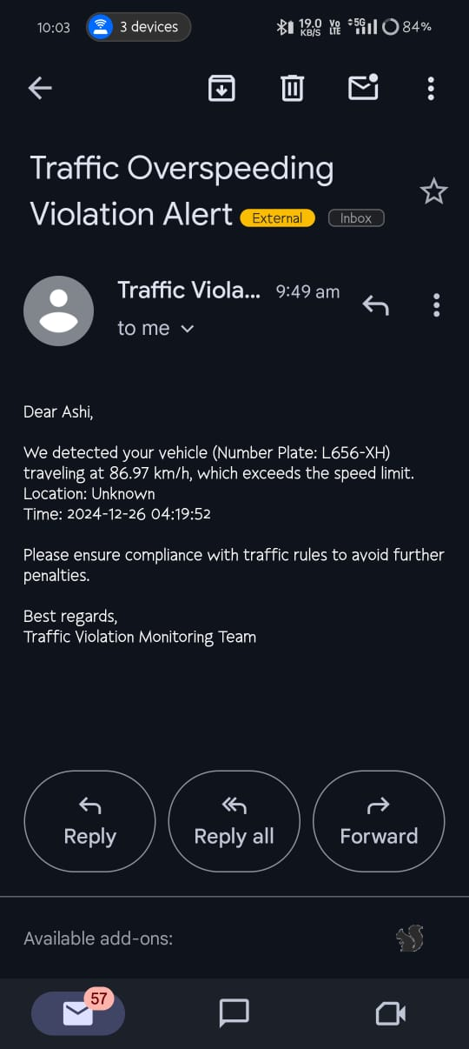
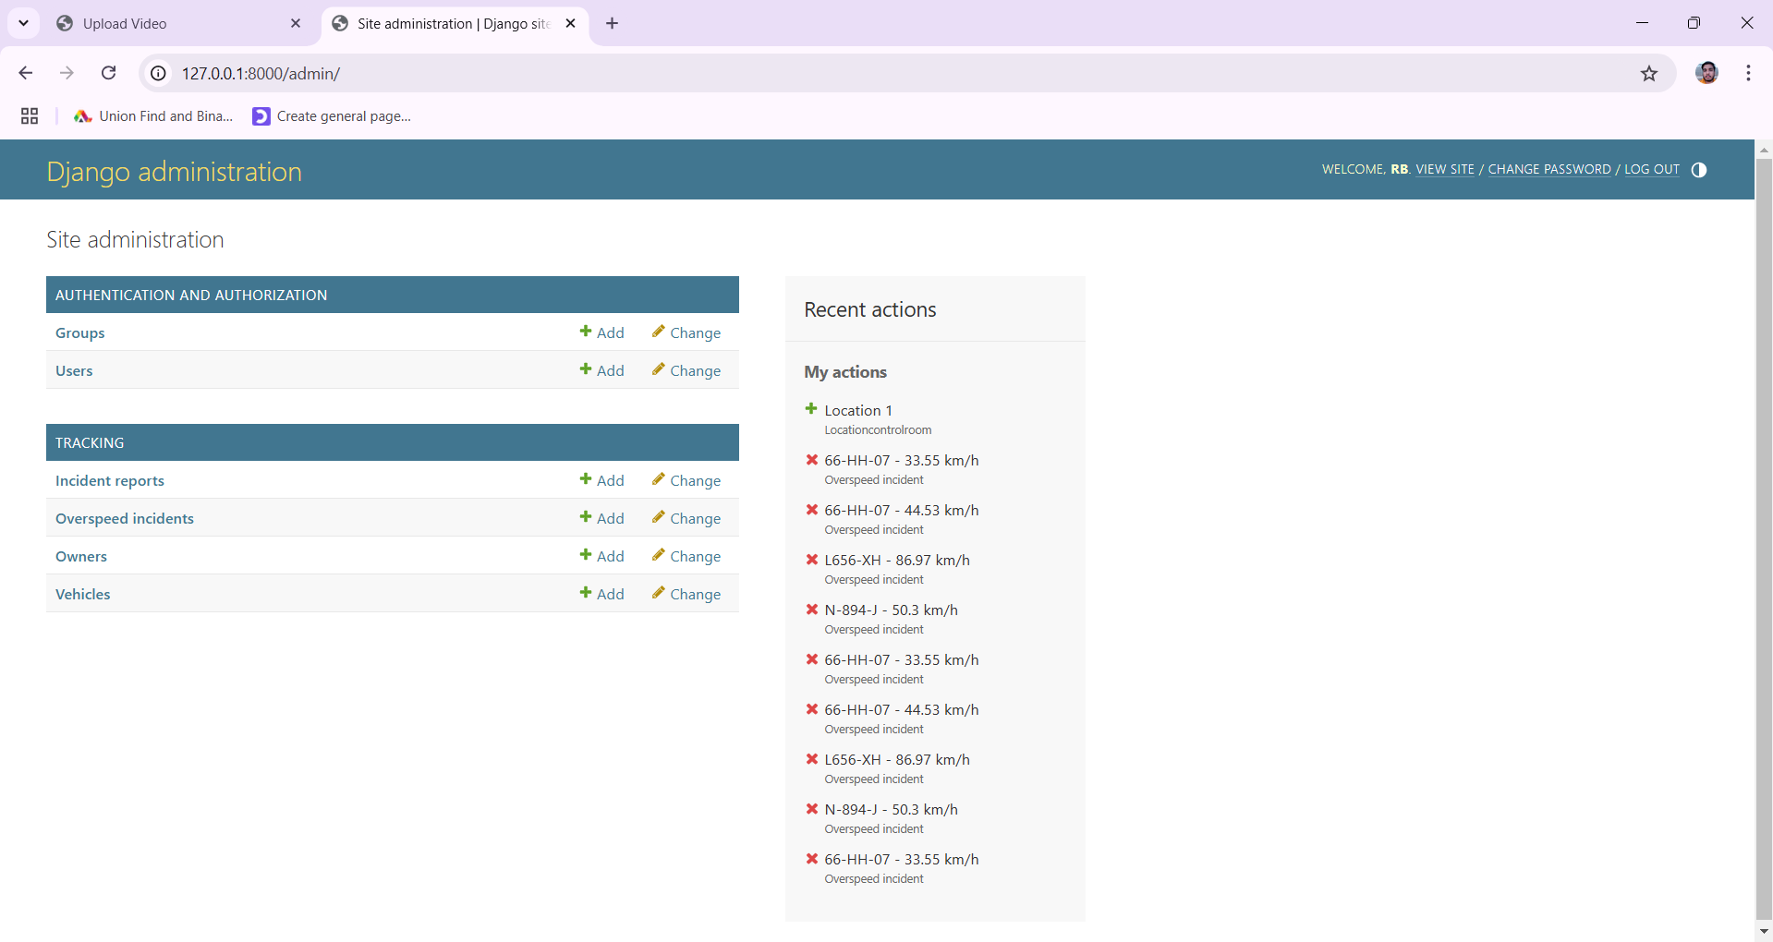
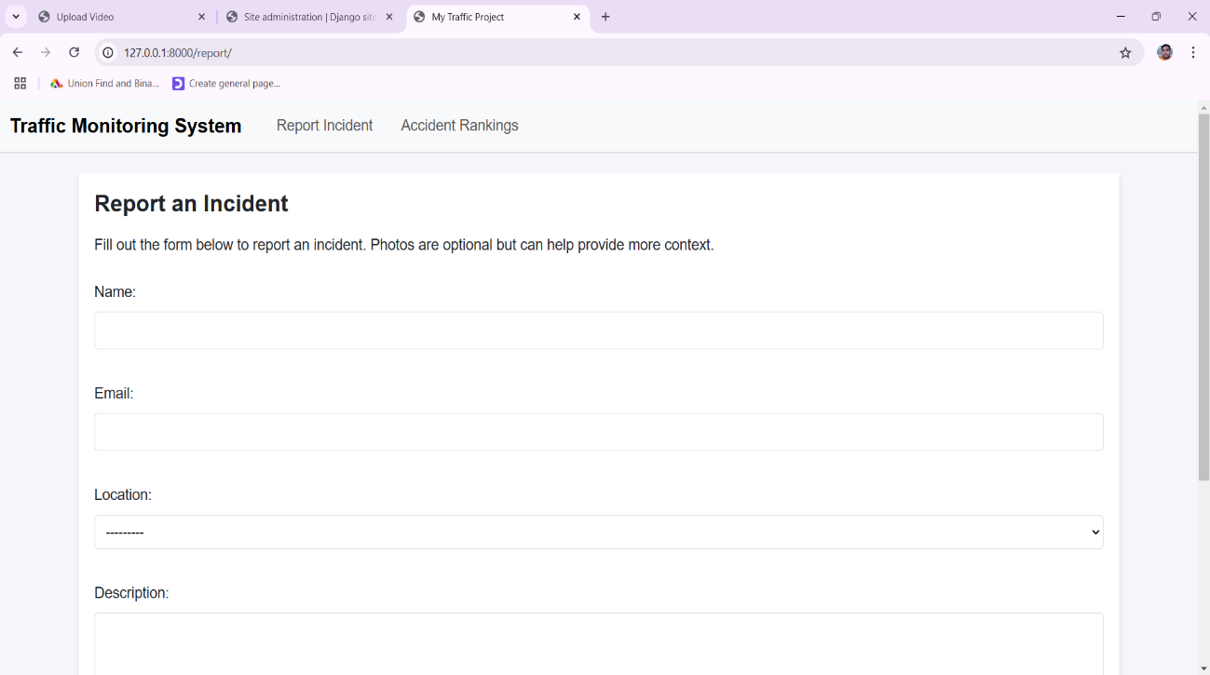
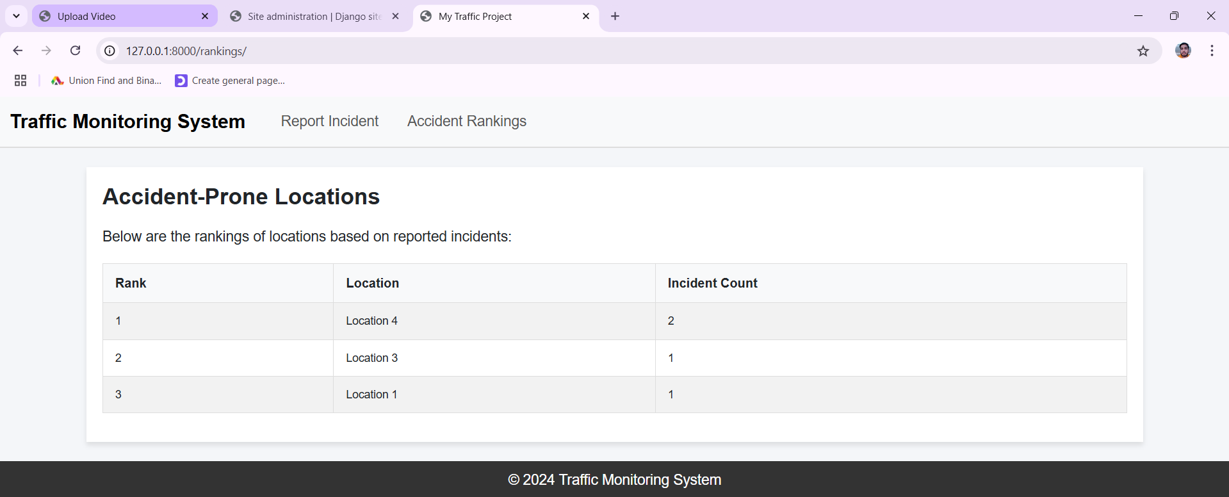

Slide 26
PROJECT SCHEDULE
Tasks | Oct | Nov |  |  | Jan |  | Feb | April
Requirement Analysis
Designing
Test Cases
Coding with unit testing
Testing
Documentation

Slide 27
PUBLICATION PLAN
KARNATAKA STATE COUNCIL FOR SCIENCE AND TECHNOLOGY on 30th November, 2024

Slide 28
CONCLUSION
The integration of YOLOv8, Deep SORT, and EasyOCR has demonstrated significant potential for real-time traffic monitoring and enforcement. By combining advanced vehicle detection, reliable tracking, speed estimation, and license plate recognition, the system effectively addresses key traffic violations such as speeding and helmet non-compliance. Its ability to operate under diverse environmental conditions and seamlessly integrate with government databases for automated fine notification enhances its value as a modern traffic management tool.
Additionally, the system's scalability and adaptability make it suitable for deployment across varied traffic scenarios, contributing to improved road safety and regulatory compliance. As further advancements in AI and computer vision techniques emerge, the system is poised to achieve greater accuracy, computational efficiency, and robustness, ensuring its continued effectiveness in real-world applications.

Slide 29
FUTURE ENHANCEMENT
Enhanced Accuracy - Improve OCR precision using advanced models.
Real-Time Optimization - Enable faster detection with optimized algorithms.
Multi-Object Tracking - Detect and track multiple vehicles simultaneously.
Adaptive Learning - Incorporate machine learning for dynamic adaptation to variations.
Deployment and Integration - Integrate with traffic systems and deploy on scalable platforms.
Privacy and Ethical Considerations - Ensure data protection compliance and ethical use of data.

Slide 30
REFERENCES
[1] Anthony Lim, “Vehicles Registrations in Malaysia - 31.2 mil as of 2019,” Paultan.org, Apr. 02, 2020.
[2] T. Afrin and N. Yodo, “A survey of road traffic congestion measures towards a sustainable and resilient transportation system,” Sustain., vol. 12, no. 11, pp. 1–23, 2020, doi: 10.3390/su12114660.
[3] M. D. Chow, “Alibaba and Sena to develop smart traffic solution to ease congestion,” May24,2019 12:02 AM.
[4] J. Redmon, S. Divvala, R. Girshick, and A. Farhadi, “You only look once: Unified, real-time object detection,” Proc. IEEE Comput. Soc. Conf. Comput. Vis. Pattern Recognit., vol. 2016-Decem, pp. 779– 788, 2016, doi: 10.1109/CVPR.2016.91. A. Bochkovskiy, C. Y. Wang, and H. Y. M. Liao, “YOLOv4: Optimal Speed and Accuracy of Object Detection,” arXiv, 2020. [6] J. Xiong, W. Cui, W. Zhang, and X. Zhang, “YOLOv3-Darknet with Adaptive Clustering Anchor Box for Intelligent Dry and Wet Garbage Identification and Classification,” Proc. - 2019 11th Int. Conf. Intell. Human-Machine Syst. Cybern. IHMSC 2019, vol. 2, no. 99, pp. 80–84, 2019, doi: 10.1109/IHMSC.2019.10114.

Slide 31
QUERIES?

Slide 32
THANK YOU

