Slide 1
Raft Consensus Algorithm
Distributed Systems Project
Marco Balossini
Roberto Basla
A. Y. 2021/2022

Slide 2
The Raft Algorithm
Raft is a consensus algorithm for managing a replicated log with the primary goal of understandability.
Raft implements consensus by first electing a distinguished leader, then giving the leader complete responsibility for managing the replicated log; the leader accepts log entries from clients, replicates them on other servers, and tells servers when it is safe to apply log entries to their state machines.
Given the leader approach, Raft decomposes the consensus problem into three relatively independent subproblems:
Leader election: a new leader must be chosen when an existing leader fails
Log replication: the leader must accept log entries from clients and replicate them across the cluster, forcing the other logs to agree with its own
Safety: if any server has applied a particular log entry to its state machine, then no other server may apply a different command for the same log index.

Slide 3
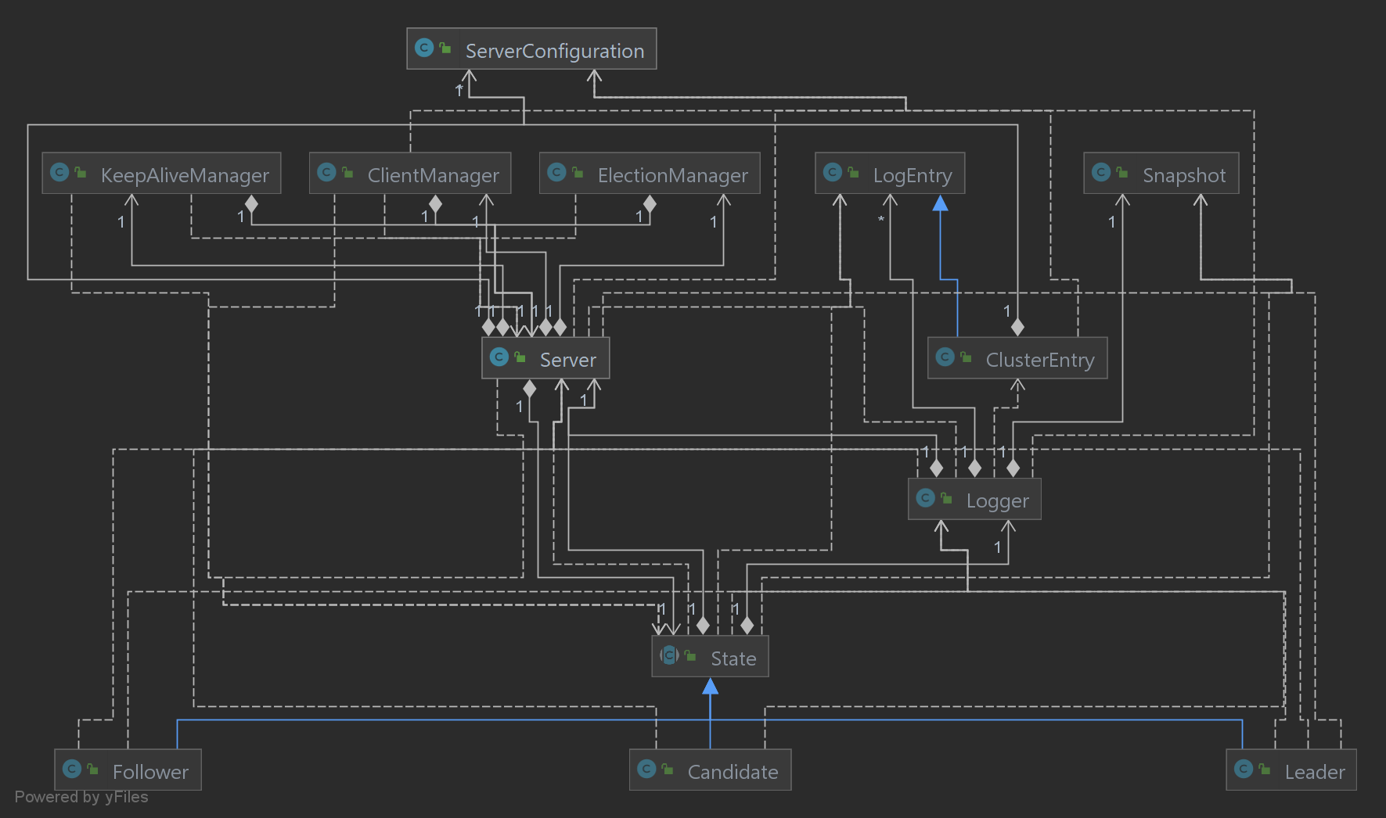
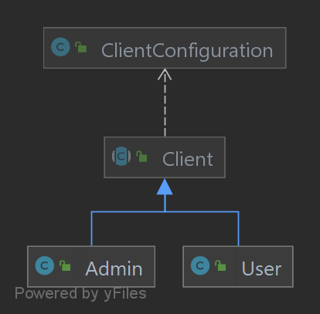
Project Structure
Server structure
Client structure

Slide 4
Server Architecture
Server 2
Queue
RMI thread
Main loop thread
Timer thread
Election thread
Keepalive thread
Request/
Result
Enqueue message
Server start
On change to Follower or Candidate
On change to Candidate
On change to Leader
Start timeout
Start threads
Start threads
ACK(id)
Read from queue
Y
Interrupt?
Append
…
Append
N
Req
…
Req
Res
…
Res
Execute command
Emit state change
Res
…
Res
End
…
End
Result(id)
Respond
Modify state
End
End

Slide 5
Cluster Architecture
client1
{ "name": "admin1", "clusterConfiguration": { "server1": { "name":"server1", "serverIP":"192.168.1.101", "port":4242 }, "server2": { "name":"server2", "serverIP":"192.168.1.101", "port":4243, "registryPort":1099 }, "server3": { "name":"server3", "serverIP":"192.168.1.92", "port":4244, "registryPort":1099 }, "server4": { "name":"server4", "serverIP":"192.168.1.92", "port":4245 } }, "isAdmin": true }
{ "name": "server1", "serverIP": "192.168.1.101", "port": 4242, "cluster": { "server2": { "name": "server2", "serverIP": "192.168.1.101", "port": 4243, "registryPort": 1099 }, "server3": { "name": "server3", "serverIP": "192.168.1.92", "port": 4244, "registryPort": 1099 }, "server4": { "name": "server4", "serverIP": "192.168.1.92", "port":4245 } }, "maxLogLength":20 }
192.168.1.101
192.168.1.92
server1
server3
server2
server4
RMI registry
RMI registry
admin1

Slide 6
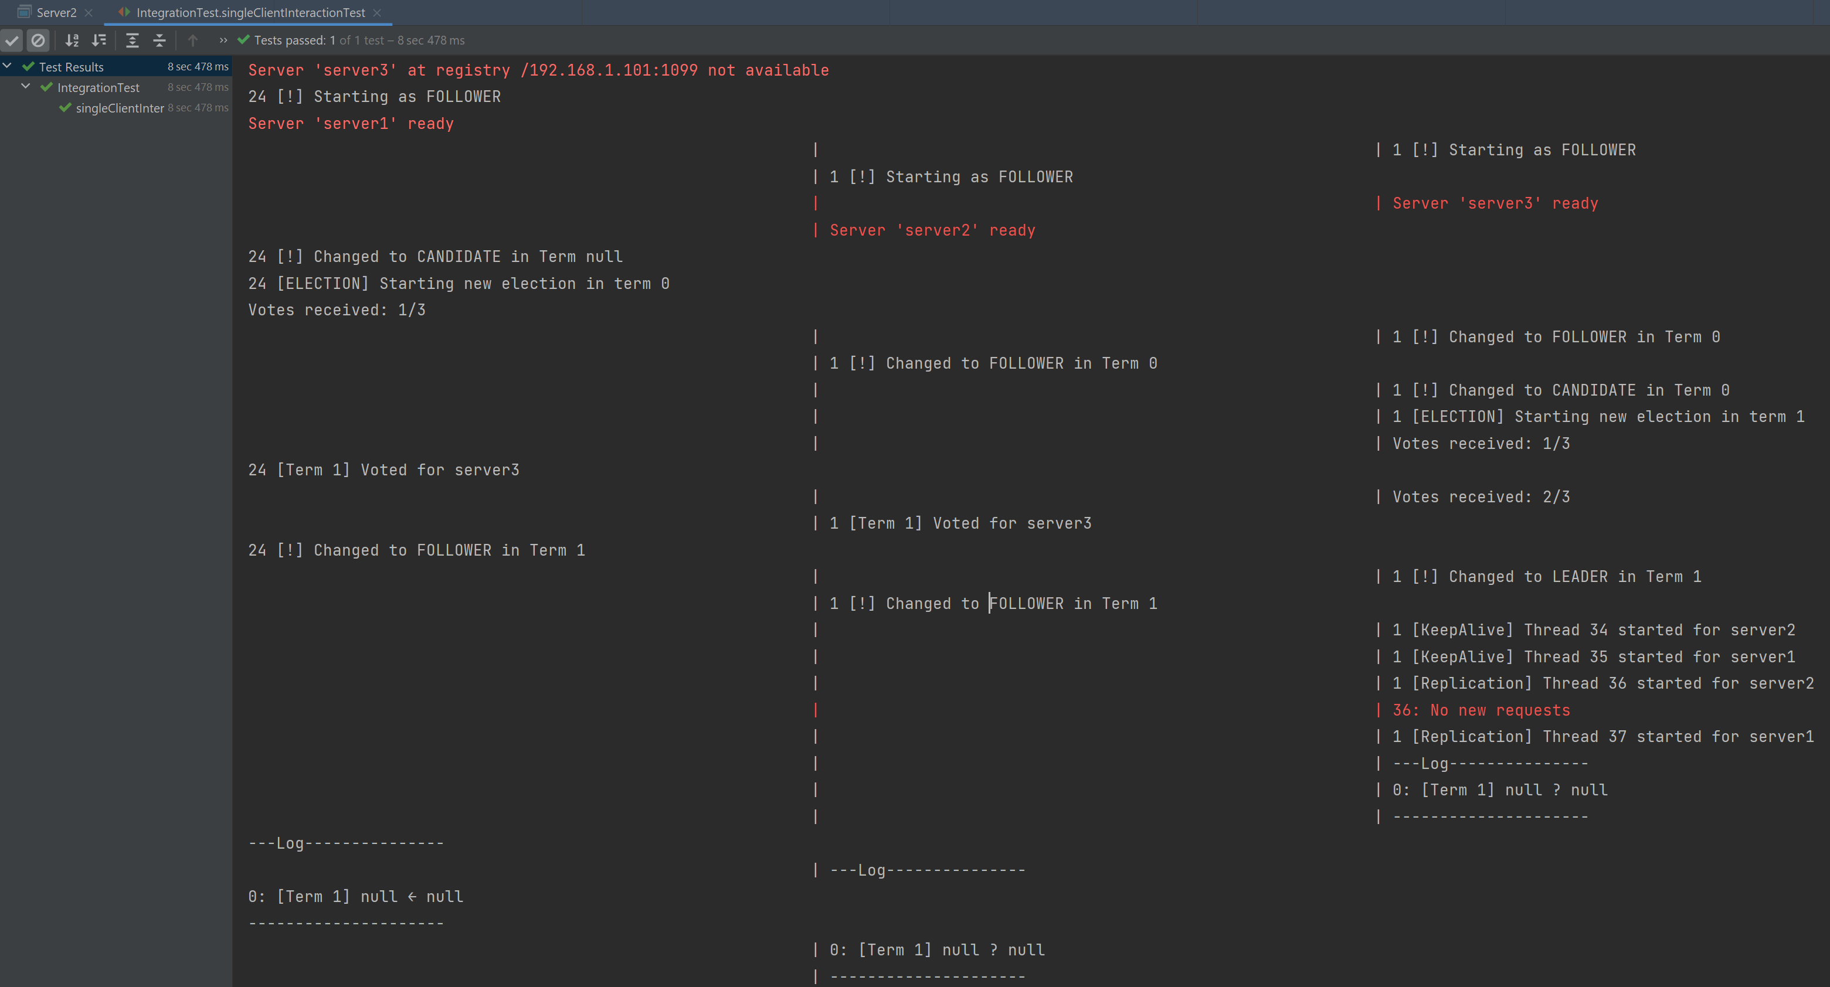
Testing
Unit testing of most critical server methods
Automated multi-server testing (on single and multiple machines)
Manual corner-case testing on server interactions

