Slide 1
Quarkus – cis demo

Slide 2
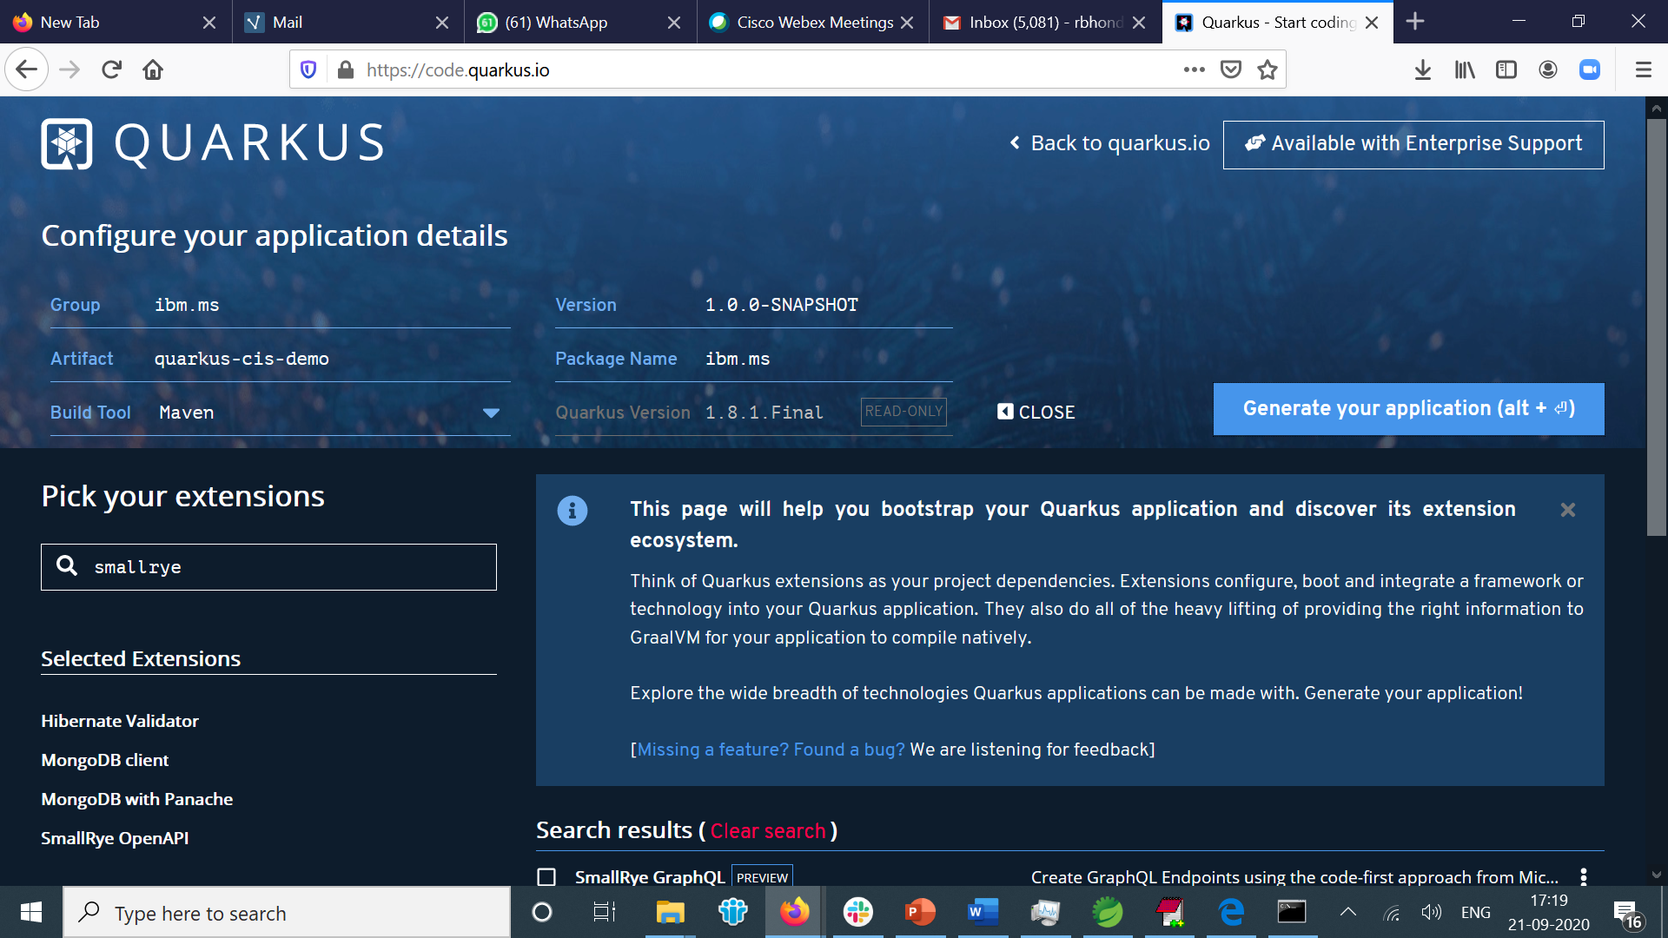

Slide 3
https://w3.ibm.com/services/lighthouse/documents/159643 by Pankaj Ravekar Samrajya

