Slide 1






LeaRn
Leen Salaheddin 400003496
Rova Badavi 761002045
ISTE.240.602

Slide 2

What is LeaRn?
LeaRn is an interactive learning platform that helps users improve their knowledge and productivity through videos, quizzes, practice questions, and progress tracking, built mainly using Java Spring and MySQL.

Slide 3

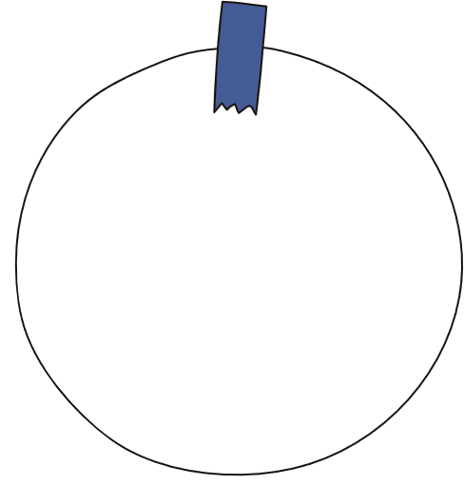






Features & User Scenario
Login System
AI Chat System
Username and password for every user to ensure security and privacy.
Practice Questions
Support users while studying by answering questions and practice.
Different level questions that will be given for users to learn.
Quizzes!
Testing the progress level after studying the resources given.
Donation Link
Donations to improve our website and users’ academic journey.
Academic level Test
Users will be tested on specific courses to see their level and getresources accordingly.
Leaderboard
Competition between users on common courses.

Slide 4



Other Components
Implementation Details
  Front-end: Bootstrap, CSS
  Back-end: Java Spring
  Database: MySQL
Scope & Timeline
  We will implement a login system, video-based content, quizzes and practice questions, Leaderboard.
  Week 1-2: Research and Planning
  Week 3-5: Back-end Development
  Week 6-8: Front-end Development
Anticipated Challenges
  Differentiate with unique features beyond competitors (Khan Academy, Pearson, Chegg).
  Implement a leaderboard that supports many users
  Database Integration.
  Accurately place users into levels based on initial test scores
  Make everything work hand in hand.

