Slide 1
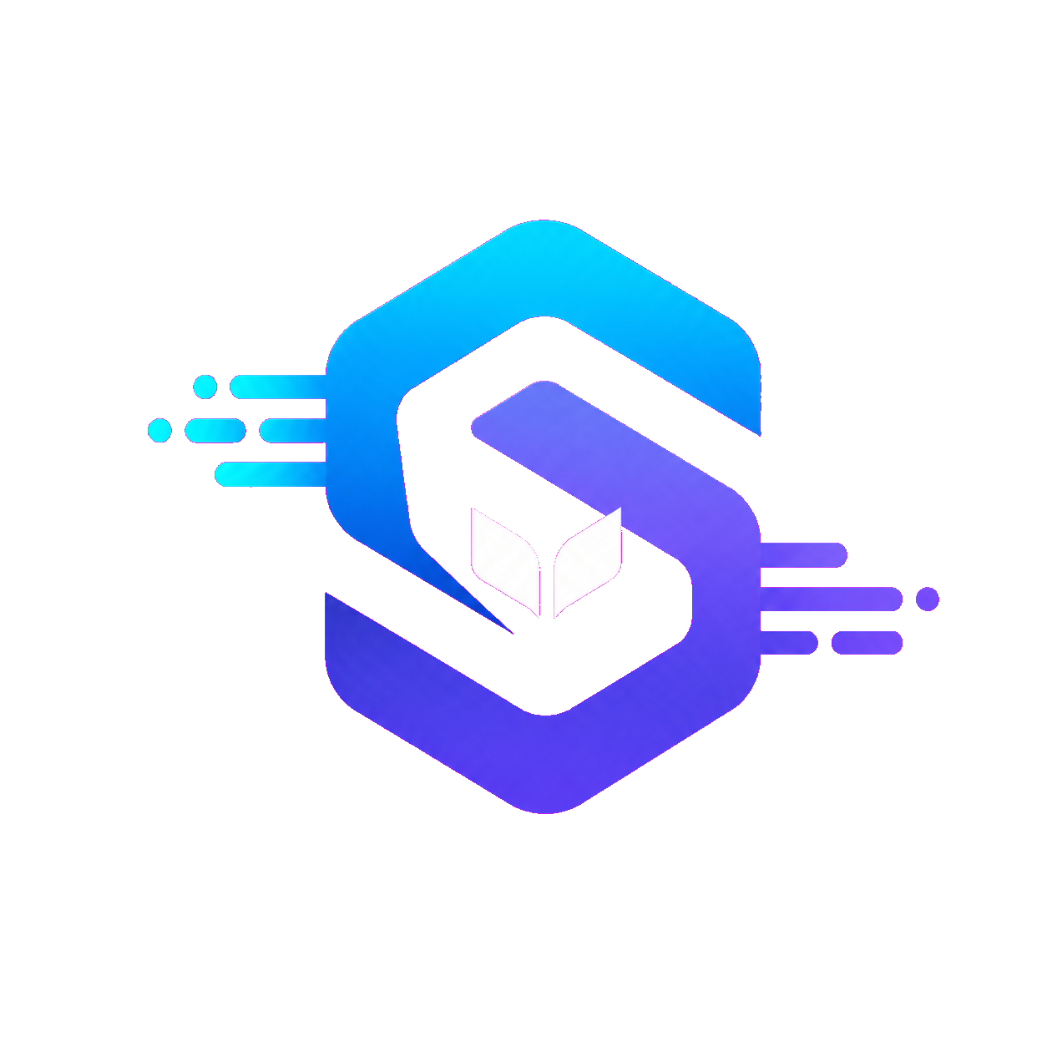
BUILDING REAL UNDERSTANDING
01 / 05
Skill
Sync
Practice that turns questions into knowledge.
By ChatGPT Codex + Oli

Slide 2
WHAT SKILLSYNC DOES
02 / 05
Practice reveals what students
truly understand.
Designed for elementary and middle school students, SkillSync reinforces classroom topics through questions and problems students answer themselves.
01
02
03
Review
Respond
Understand
Return to the ideas that matter most—not a generic list of answers.
Students work through questions and problems using their own thinking.
Feedback shows what is secure, what needs review, and what to try next.

Slide 3
WHY NOT JUST ASK AI?
03 / 05
Answers finish a problem.
Learning builds capability.
Answer-first AI
SkillSync
A student asks, receives an answer, and may never discover whether they can solve the next problem independently.
AI works quietly behind the experience—reviewing responses, checking understanding, and tailoring school-focused practice.
ASK
ANSWER
DONE
TRY
CHECK
REVIEW
GROW

Slide 4
FUTURE IMPROVEMENTS
04 / 05
The next step is a stronger
learning experience.
SkillSync is still early. Its future depends on making every interaction clearer, smarter, and more useful to young learners.
DESIGN
INTELLIGENCE
PROGRESS
Polish the UI
Deepen review
Show growth
Improve navigation, accessibility, animation, and classroom-friendly clarity.
Make feedback more precise and practice more responsive to knowledge gaps.
Help students see what they know, what improved, and where to focus next.

Slide 5
THE SKILLSYNC PROMISE
05 / 05
AI should not replace thinking.
It should help students think better.
SkillSync turns review into understanding—so students can answer with confidence because they know why.

