Slide 1
Relating compound toxicity to molecular structure using machine learning
Robin Bosshard

Slide 2


Slide 3
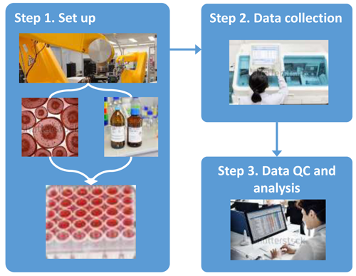
Data from high-throughput screening (HTS) assays

Slide 4
invitroDB
tcpl: processing package (language: R) pipelining raw assay data
Curve-fitting of concentration-response series
Hit-calling (labelling) and metadata
Computing points of departure (POD)
e.g. AC50 = concentration at 50% of maximal activity

Slide 5
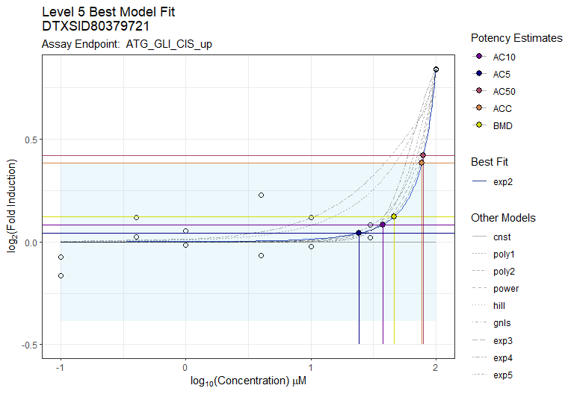
Data labelling (new version with more models)

Slide 6
Given: Many chemical/bioassay endpoint pairs
Is it reasonable to predict bioactivity of new untested compounds in water samples?
Mechanistic hypothesis: The expression of bioactivity of a chemical with a toxicological endpoint is implicit in its molecular structure.
-> Use molecular fingerprints

Slide 7
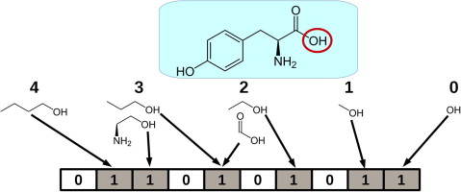
Structure-based molecular fingerprints
Bit-array: each bit = absence/presence of pre-defined molecular substructures
There are many fingerprint representations available with different bit-lengths.
At inference time: Input the molecular fingerprint from a suspected compound into the model of associated toxicological endpoint and get the predicted bioactivity information

Slide 8
ML (challenges)
Train separate models for each molecular toxicity endpoint (grouping)
Feature-selection
Class-imbalance
Binary classification?
Uncertainty quantification
Validation with real-life spectral data
Extract mechanistic explanation and correlation of outcome
What endpoints/mechanistic targets can be modeled successfully?
What supervised classification ML models/MolFps perform best?

Slide 9
Next steps
Rewrite tcpl v3 main functionality into a Python package (ongoing)
Extend this new package for data uncertainty quantification using bootstrap methods (if applicable)
Pipeline invitroDB v3.5 data with new methods to get continuous hit-calls
Start with ML with new data (similar to the not yet published invitroDB v4.0)

Slide 12
Data
assay source
assay
assay component
assay component endpoint
Hierarchical Structure,
one-to-many relationship

