Slide 1
Relating compound toxicity to molecular structure using machine learning
Robin Bosshard

Slide 2
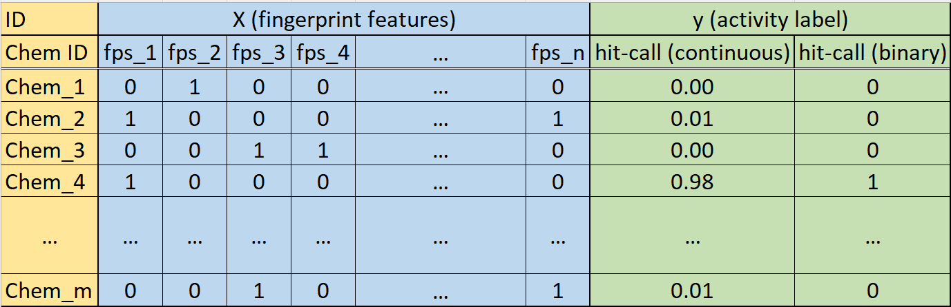
Data processing for ML input
For each assay endpoint:

Slide 3
Data processing for ML input
For each assay endpoint:

Slide 4
Data processing for ML input
For each assay endpoint:

Slide 5
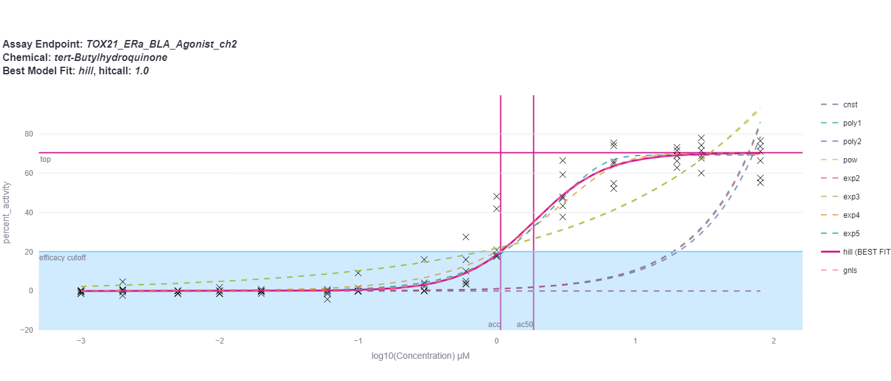
Curve Fitting, Maximum Likelihood Estimation
∑ [ t-distribution((resp – pred) / err, df = 4, log = TRUE) - log(err) ]

Slide 6
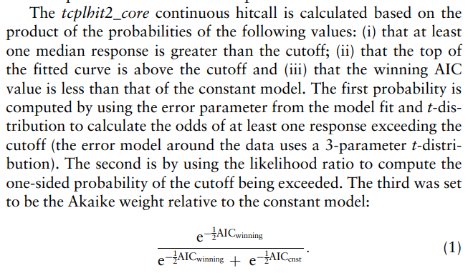
Continous hitcall
https://doi.org/10.1093/bioinformatics/btab779

Slide 7
More computing resources - Euler cluster?
“Dear Robin Bosshard, Thank you for contacting us with this question. While you could, in principle, install mysql locally in your home directory. However, it would be difficult to run the mysql server persistently, connect to it using batch jobs, and so on. In addition, you have no place to store more than 15 GB of data as a guest user on the cluster. I suggest you look for another solution. For example, ETH offers solutions for a hosted mysql service: https://ethz.ch/staffnet/de/it-services/katalog/datenbanken/mysql.html. With kind regards, Urban Borstnik Your Cluster Support Team”

Slide 8
Next steps:
Add missing data curation steps (MLinvitroTox paper)
Feature Selection/Importance
Remove no-variance & highly correlated features
Check out non-negative matrix factorization
Threshold moving for model comparison and minimizing false negatives
Concatenate endpoints based on mechanistic targets
Start with endpoints families: nuclear receptors and genotoxicity

Slide 11
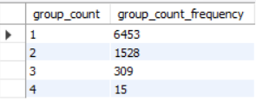
Mc5 table contains per assay duplicated chemicals under different sample ids. Data leak?
subset chemicals and use consensus hit (mean)

