Slide 1
Master Thesis
Improve MLinvitroTox

Slide 2
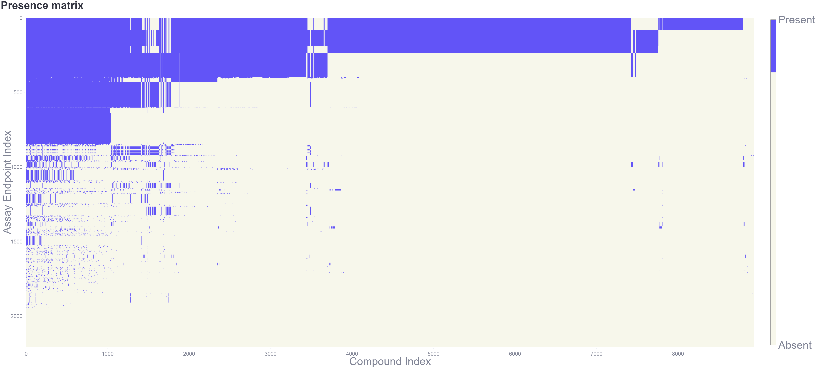
InvitroDB v3.5: Presence Matrix

Slide 3
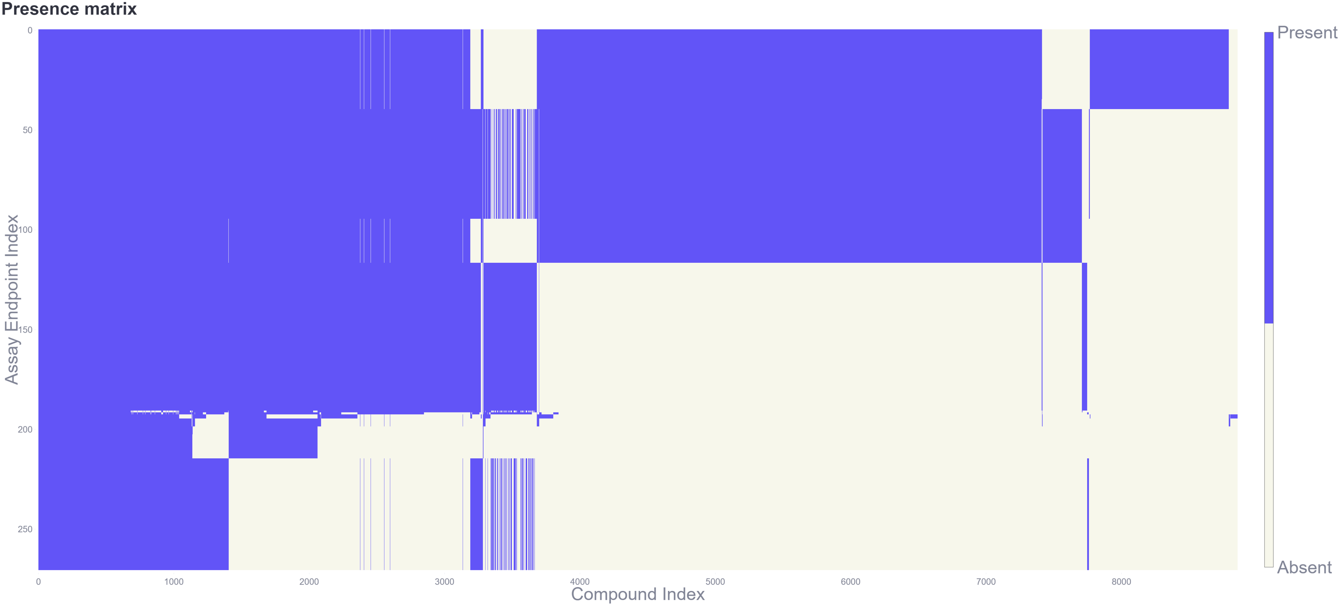
InvitroDB v3.5: Presence Matrix (filtered)

Slide 4

Assay
Endpoint 1
Assay
Endpoint 2
…
Assay
Endpoint m
Compound 1
Compound 1
…
Compound 1
Compound 2
Compound 2
…
Compound 2
…
…
…
…
Compound n₁
Compound n₂
…
Compound n_{m}

Slide 5

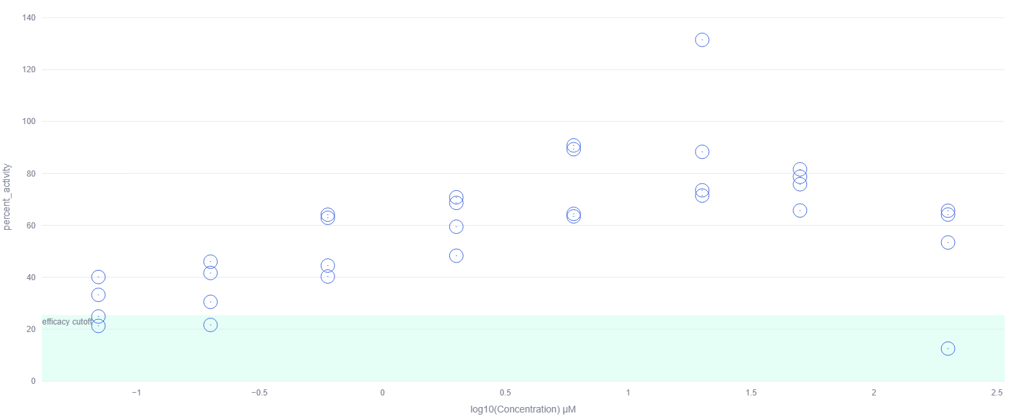
Assay
Endpoint 1
Assay
Endpoint 2
…
Assay
Endpoint m
Compound 1
Compound 1
…
Compound 1
Compound 2
Compound 2
…
Compound 2
…
…
…
…
Compound n₁
Compound n₂
…
Compound n_{m}

Slide 6
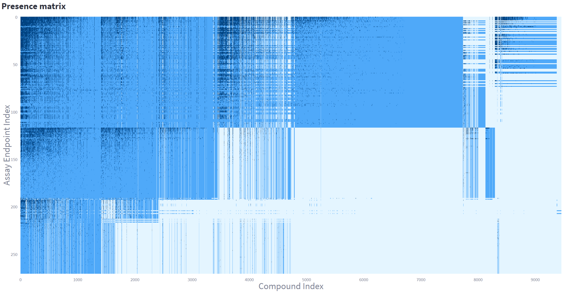

Slide 7
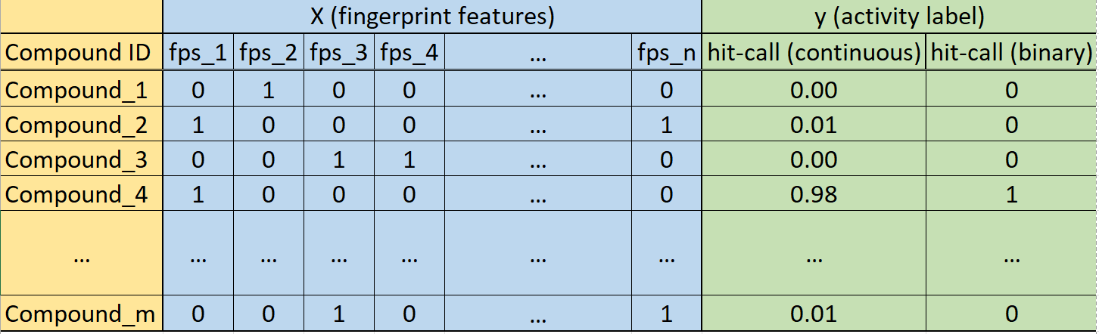
For each assay endpoint build ML model with:
Structural fingerprints from CompTox Chemicals Dashboard
pytcpl

Slide 8
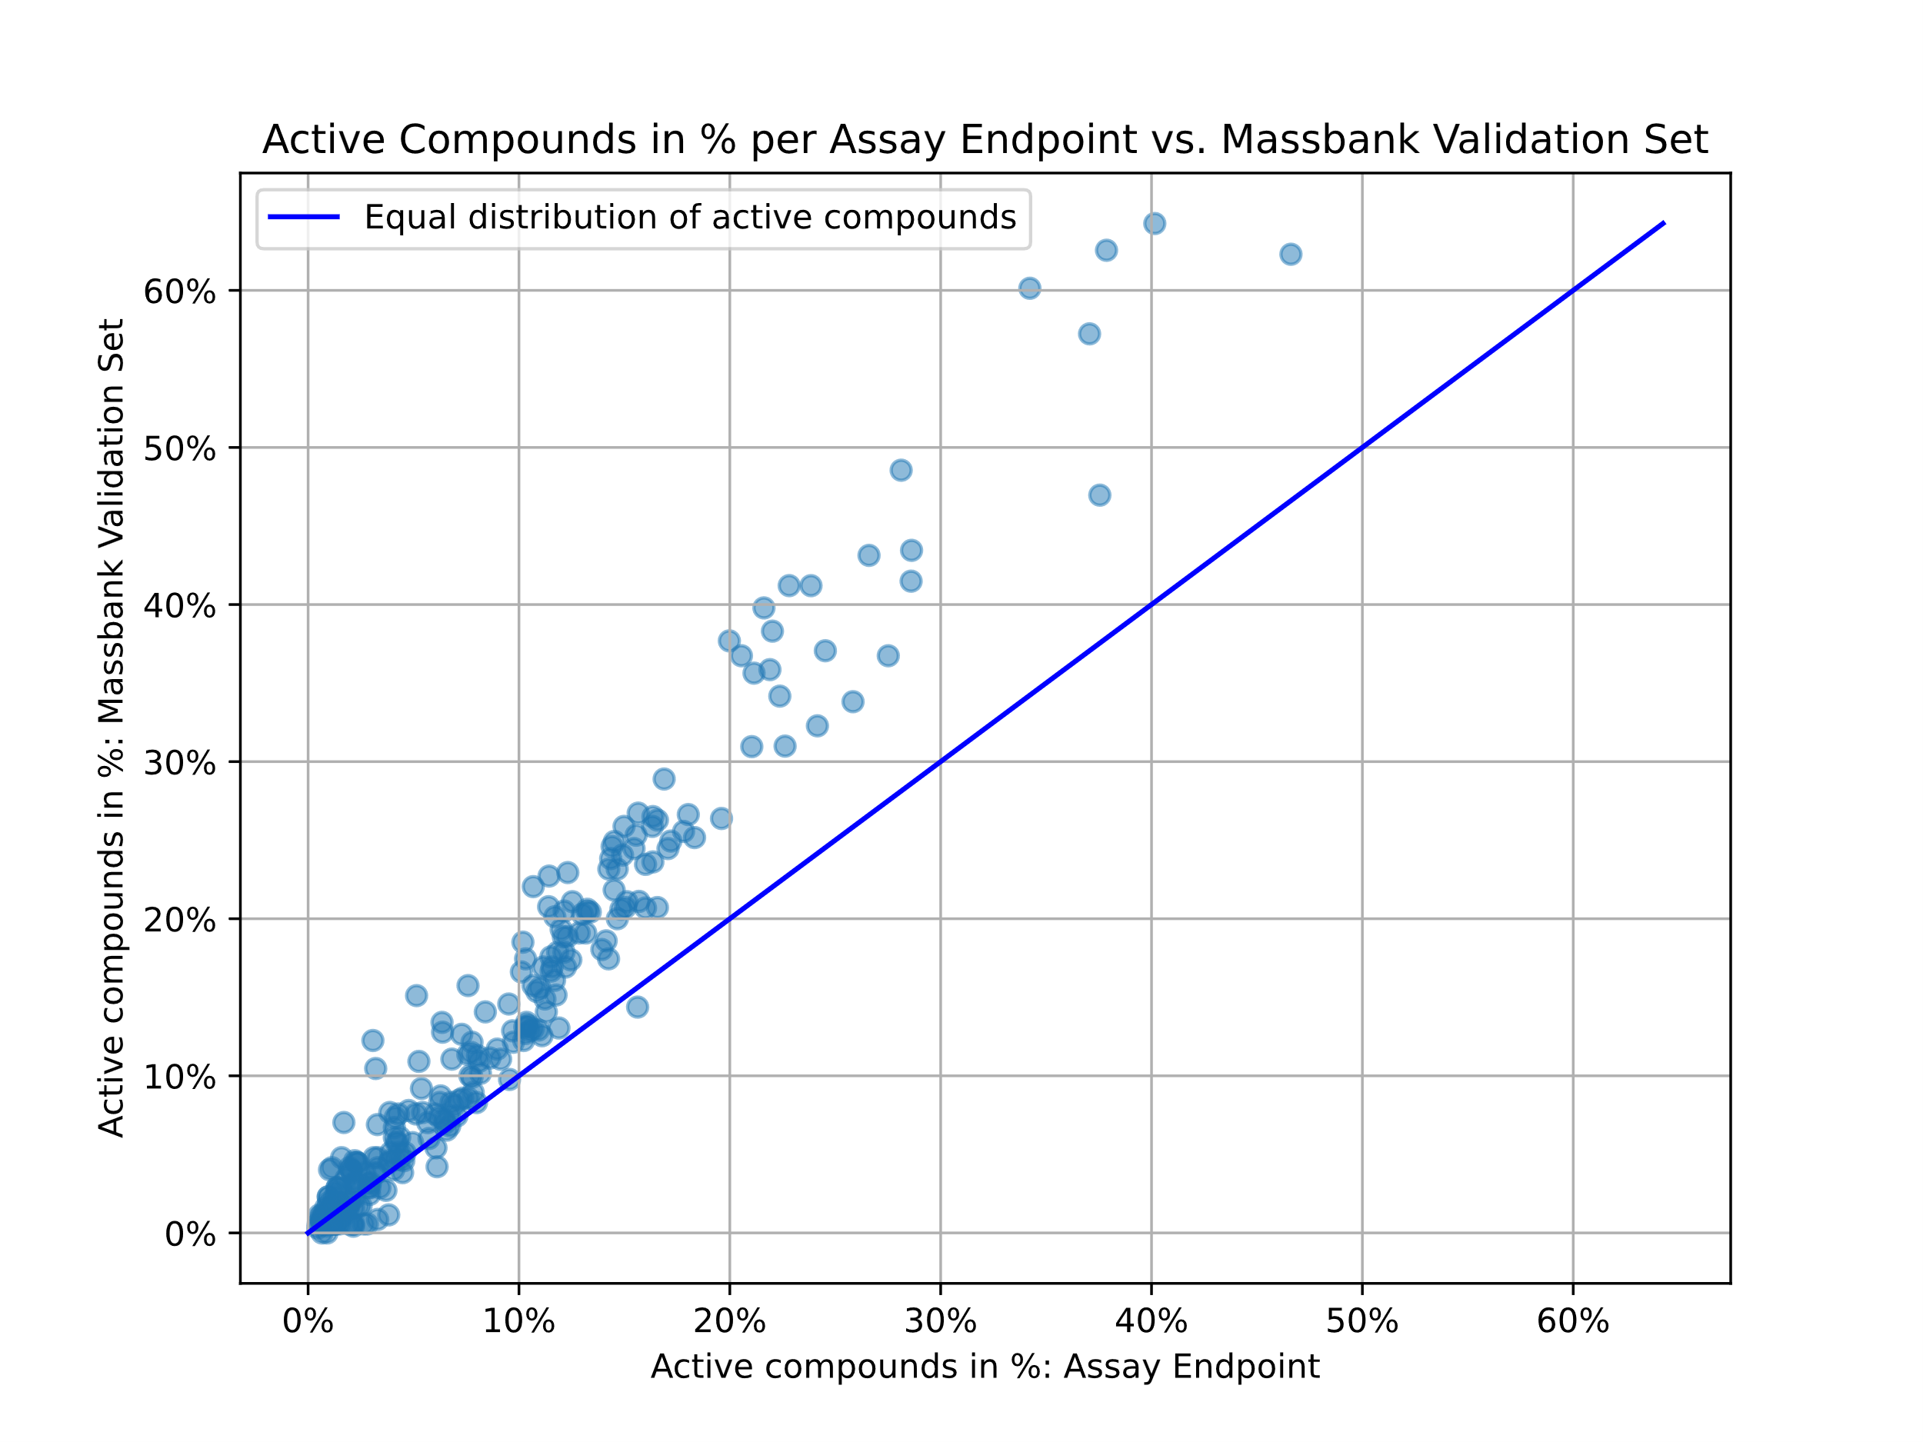
Representativeness of Massbank Validation Set

Slide 9
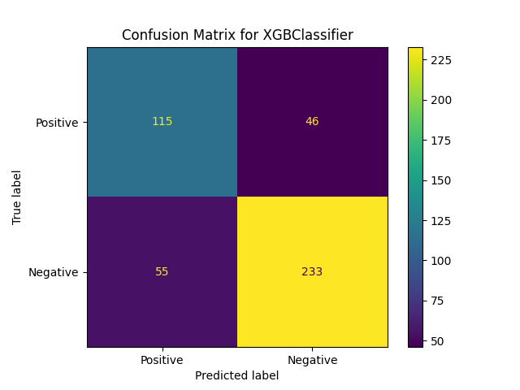
Binary Classification on single assay endpoint Massbank validation with true fingerprints
XGB Classifier
Dimensionality reduction:
Feature Selection:
Variance Threshold
Non-negative matrix factorization
PCA/Sparse Coding

Slide 10
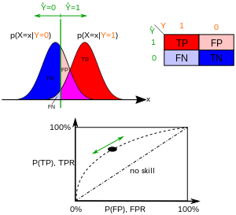
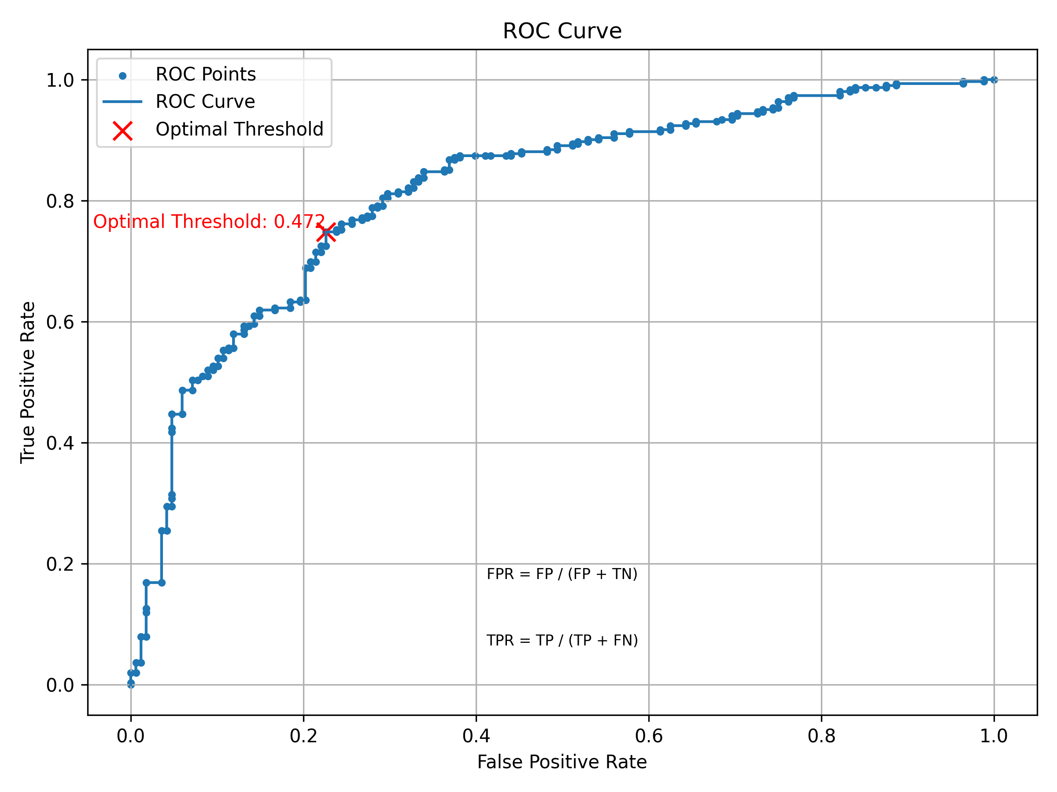
ROC Curve
https://en.wikipedia.org/wiki/Receiver_operating_characteristic

Slide 11
Ongoing/Further work
Run ML for all assay endpoints (m independent models)
Do Massbank validation
Group classifiers by e.g. Mechanistic Targets and do voting
Regression

Slide 13
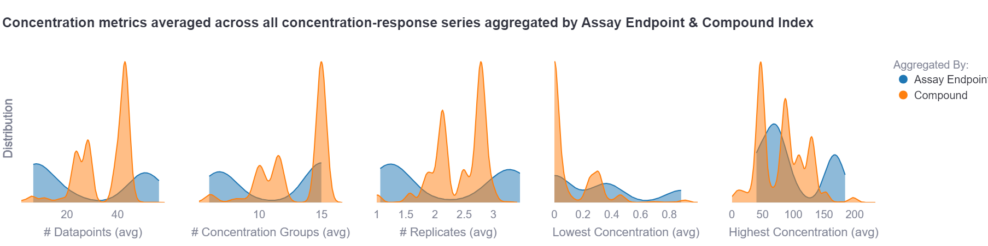
Metrics on tested concentrations

