Slide 1
Line Following Sensor: An Overview
Team 6
Jake Cook, Ryan Baas

Slide 2
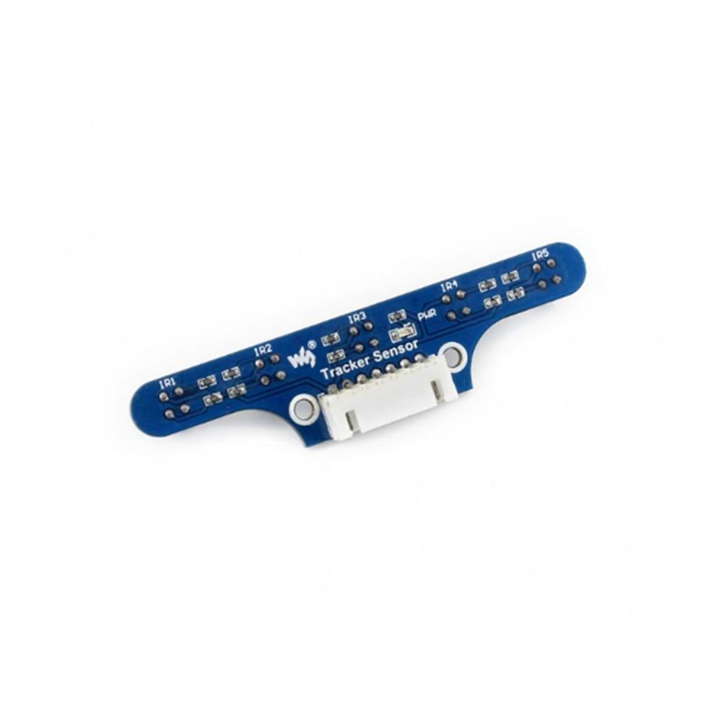
Sensor Specification
Power: 3.3V to 5V
Weight: 0.007 kg
Dimension: 78mm * 18mm
Detector spacing: 16mm
Mounting holes size: 3mm
Detection range: 1cm to 5cm
5x ITR20001/T Infrared Detectors
Five analog outputs (one per sensor)
XH2.54 7PIN wire connector for interface

Slide 3
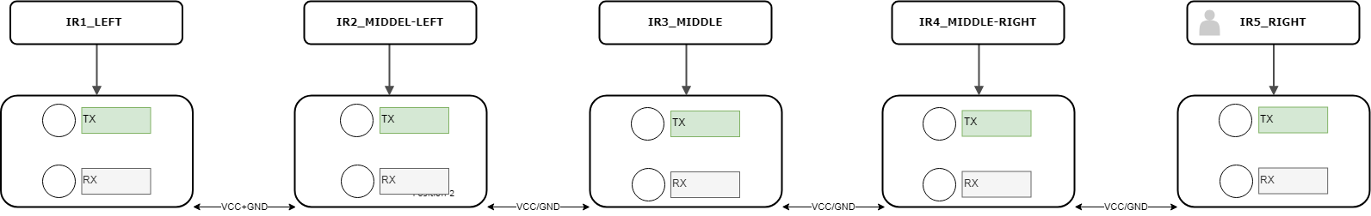
Theory of Operation
Signal outputs of the sensor vary depending on the color and distance of desired object.
A detected white surface increases the analog output voltage
A detected black surface decreases the analog output voltage
Seen below is the layout of the sensors.

Slide 4
Purchasing Options
Sensor:
https://www.amazon.com/Tracking-Tracker-Infrared-ITR20001-Detector/dp/B073VH14SP/ref=sr_1_12?keywords=line+follower+sensor&qid=1556857415&s=gateway&sr=8-12
OR:
https://www.ebay.com/itm/Tracker-Sensor-Module-5-ch-ITR20001-T-Robot-Infrared-Line-Tracking-Range-1cm-5cm/252646977876?hash=item3ad2eef154:g:F~cAAOSwiDFYM8H1&frcectupt=true
Cable: https://www.ebay.com/itm/323744976812?ul_noapp=true

