Slide 1
A few search related ideas

Slide 2
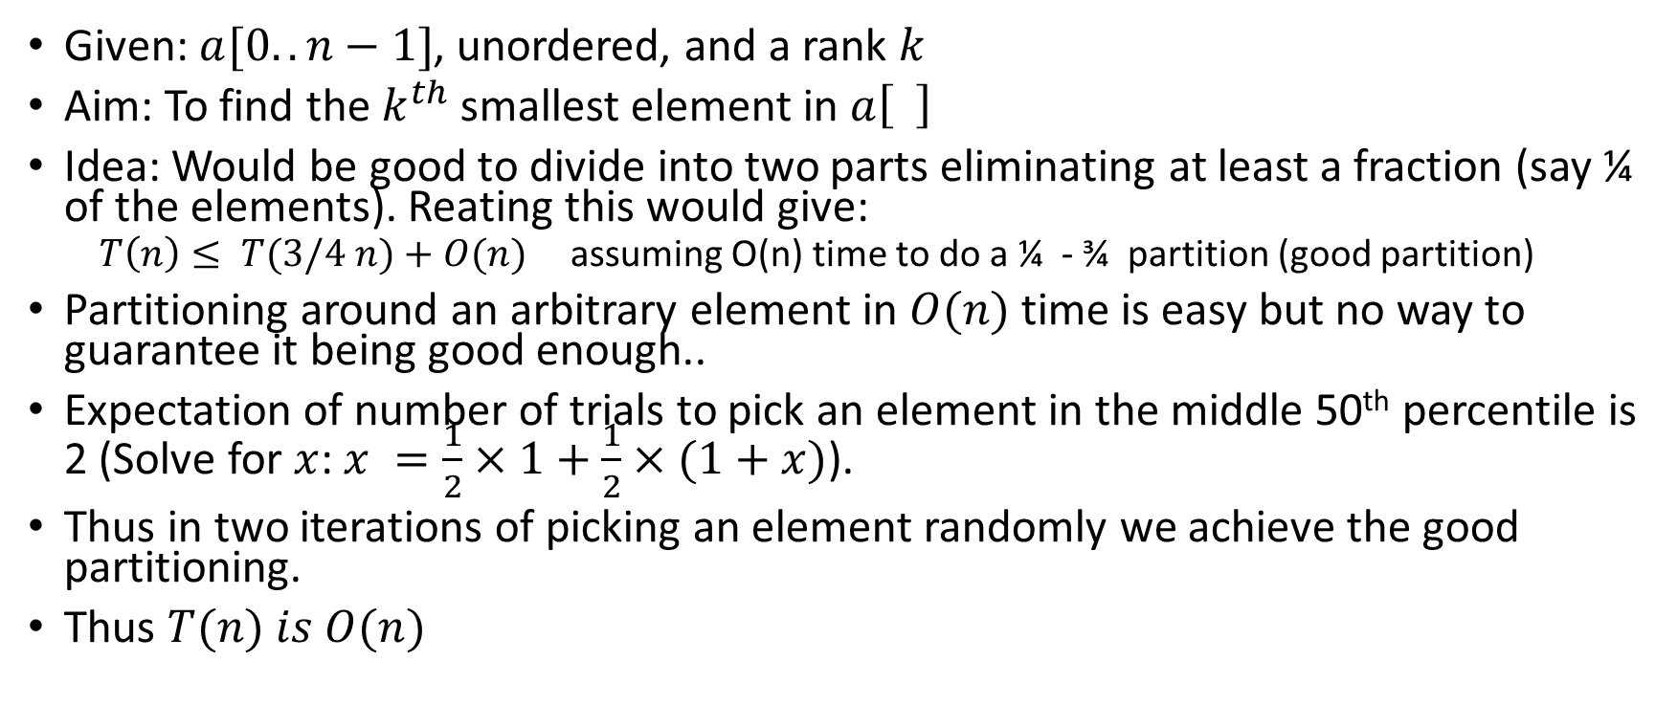

Finding the $k^{th}$ ranked element
Given: $a[0..n−1]$, unordered, and a rank $k$
Aim: To find the $k^{th}$ smallest element in $a\left[ \right]$
Idea: Would be good to divide into two parts eliminating at least a fraction (say ¼ of the elements). Reating this would give:
$T\left(n\right)≤ T(3/4 n)+O(n)$assuming O(n) time to do a ¼ - ¾ partition (good partition)
Partitioning around an arbitrary element in $O(n)$ time is easy but no way to guarantee it being good enough..
Expectation of number of trials to pick an element in the middle 50th percentile is 2 (Solve for $x$: $x =\frac{1}{2}×1+\frac{1}{2}×(1+x)$).
Thus in two iterations of picking an element randomly we achieve the good partitioning.
Thus $T(n) is O(n)$

Slide 3
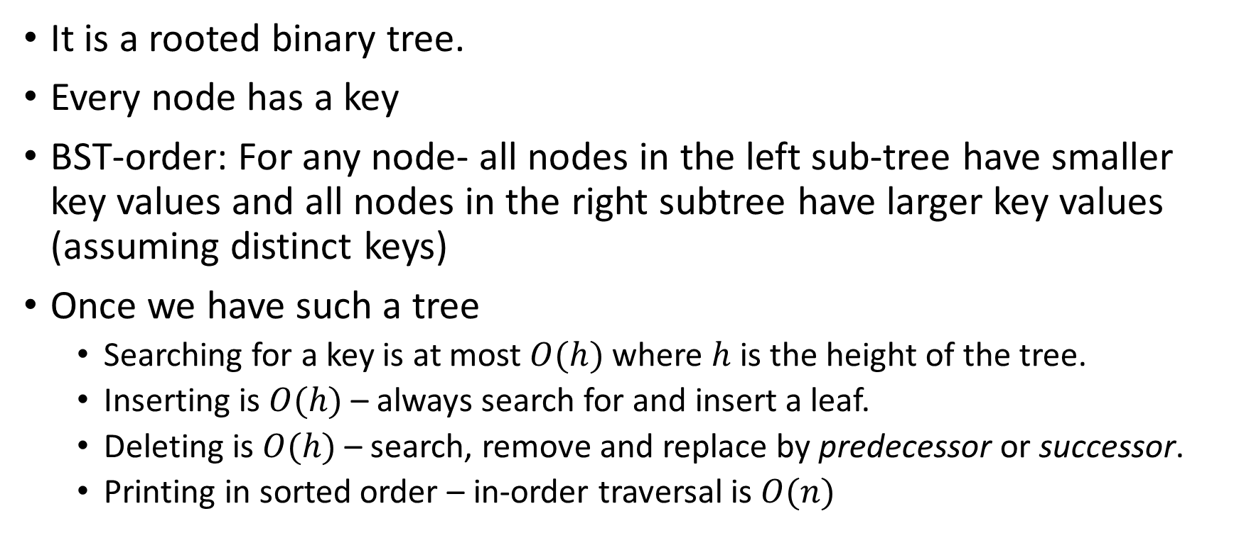
BST – a tree data structure to assist search
It is a rooted binary tree.
Every node has a key
BST-order: For any node- all nodes in the left sub-tree have smaller key values and all nodes in the right subtree have larger key values (assuming distinct keys)
Once we have such a tree
Searching for a key is at most $O(h)$where $h$ is the height of the tree.
Inserting is $O(h)$– always search for and insert a leaf.
Deleting is $O(h)$– search, remove and replace by predecessor or successor.
Printing in sorted order – in-order traversal is $O(n)$

Slide 4



BST in order traversal
$$a$$
L < a < R
If a has a Right child, successor of a is in R
If a has a Left child, predecessor of a is in L
Otherwise where is successor or predecessor?
$$<a$$
$$>a$$
L
R

Slide 5

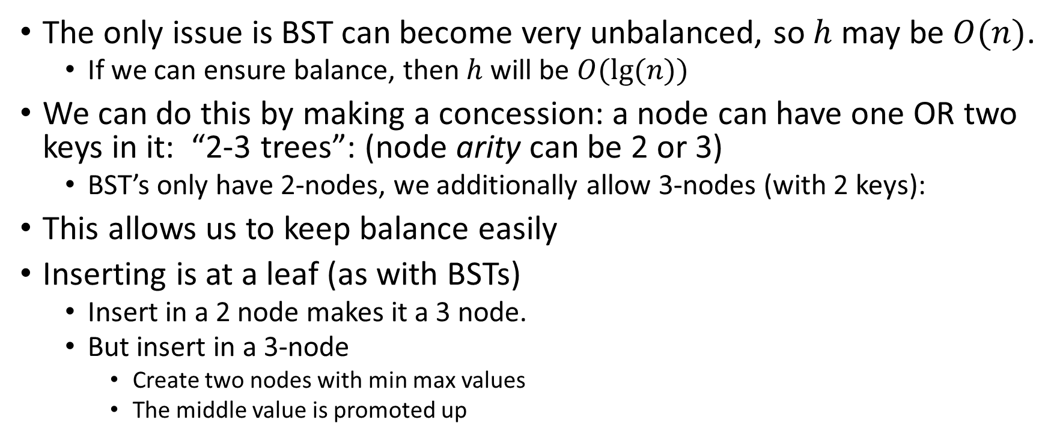
BST-problem – Enter 2-3 tree
The only issue is BST can become very unbalanced, so $h$ may be$O(n)$.
If we can ensure balance, then $h$ will be $O(lg⁡(n))$
We can do this by making a concession: a node can have one OR two keys in it: “2-3 trees”: (node arity can be 2 or 3)
BST’s only have 2-nodes, we additionally allow 3-nodes (with 2 keys):
This allows us to keep balance easily
Inserting is at a leaf (as with BSTs)
Insert in a 2 node makes it a 3 node.
But insert in a 3-node
Create two nodes with min max values
The middle value is promoted up
$$a b$$
L
M
R

Slide 6

$$⋯$$
Repeat this with 50
50
The promoted up node sits with its parent
If the parent was full (already 3-ary), then the promotion continues.
Tree height increases only when root is split
30
60
20
40
M
R
Leaf overflow, split & promote up
the middle
Merge 30 in (50 60), split & promote up the new middle
50 60
50 60
30
30 40
M
R
20
40
M
R
To insert at leaf New value 20

Slide 7

Thus a 2-3 tree is always balanced.
Since each node has 2 or three children, its height is $O(lg⁡(n))$
Thus we have a search tree which is balanced.

Slide 8
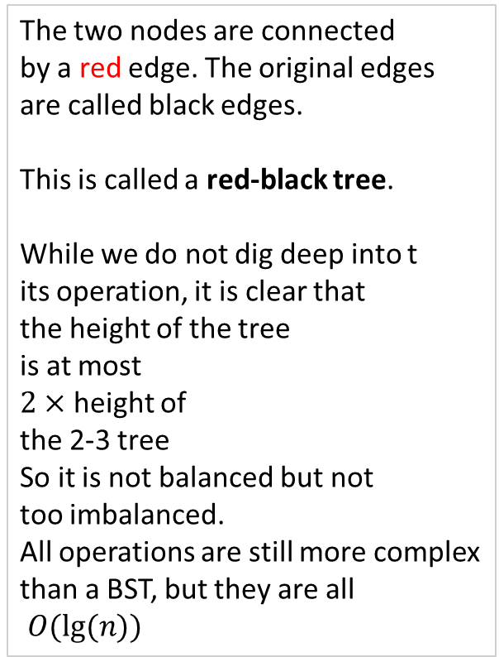
Red-Black trees
BST’s are typically easier to handle than 2-3 trees.
There is a simple mapping of 2-3 trees to BSTs:
A 2-ary node stays a 2-ary node.
A 3-ary node is broke as follows into two 2-ary nodes:
The two nodes are connected by a red edge. The original edges
are called black edges. This is called a red-black tree.
While we do not dig deep into t its operation, it is clear that the height of the tree is at most $2×$ height of
the 2-3 tree So it is not balanced but not too imbalanced. All operations are still more complex than a BST, but they are all
$O(lg⁡(n))$
a b
a
b
L
M
R
L
M
R

Slide 9
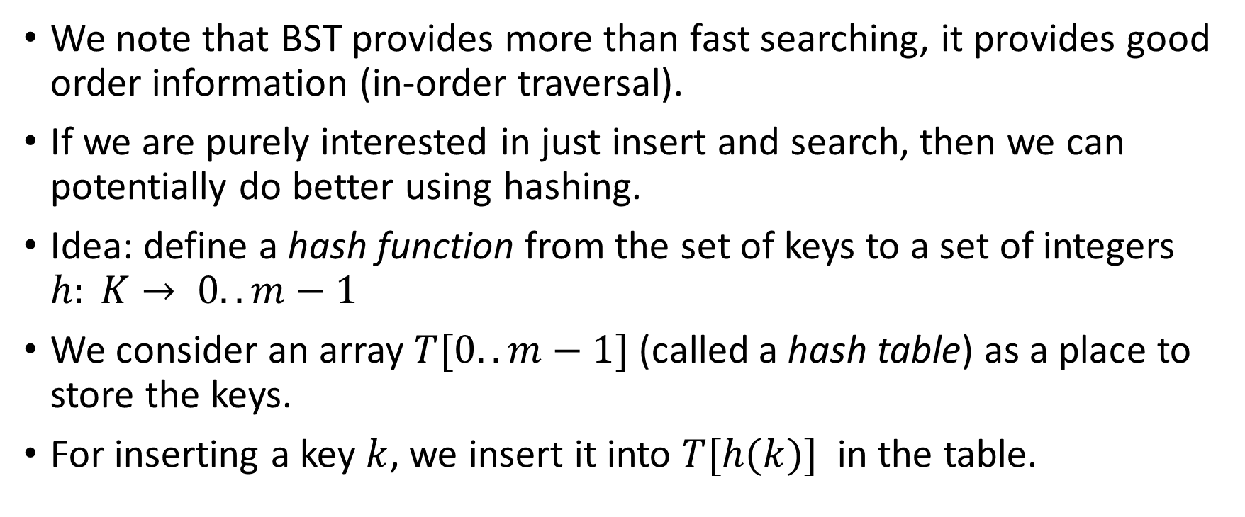
Hashing
We note that BST provides more than fast searching, it provides good order information (in-order traversal).
If we are purely interested in just insert and search, then we can potentially do better using hashing.
Idea: define a hash function from the set of keys to a set of integers $h: K→ 0..m−1$
We consider an array $T[0..m−1]$ (called a hash table) as a place to store the keys.
For inserting a key $k$, we insert it into $T[h(k)]$ in the table.

Slide 10
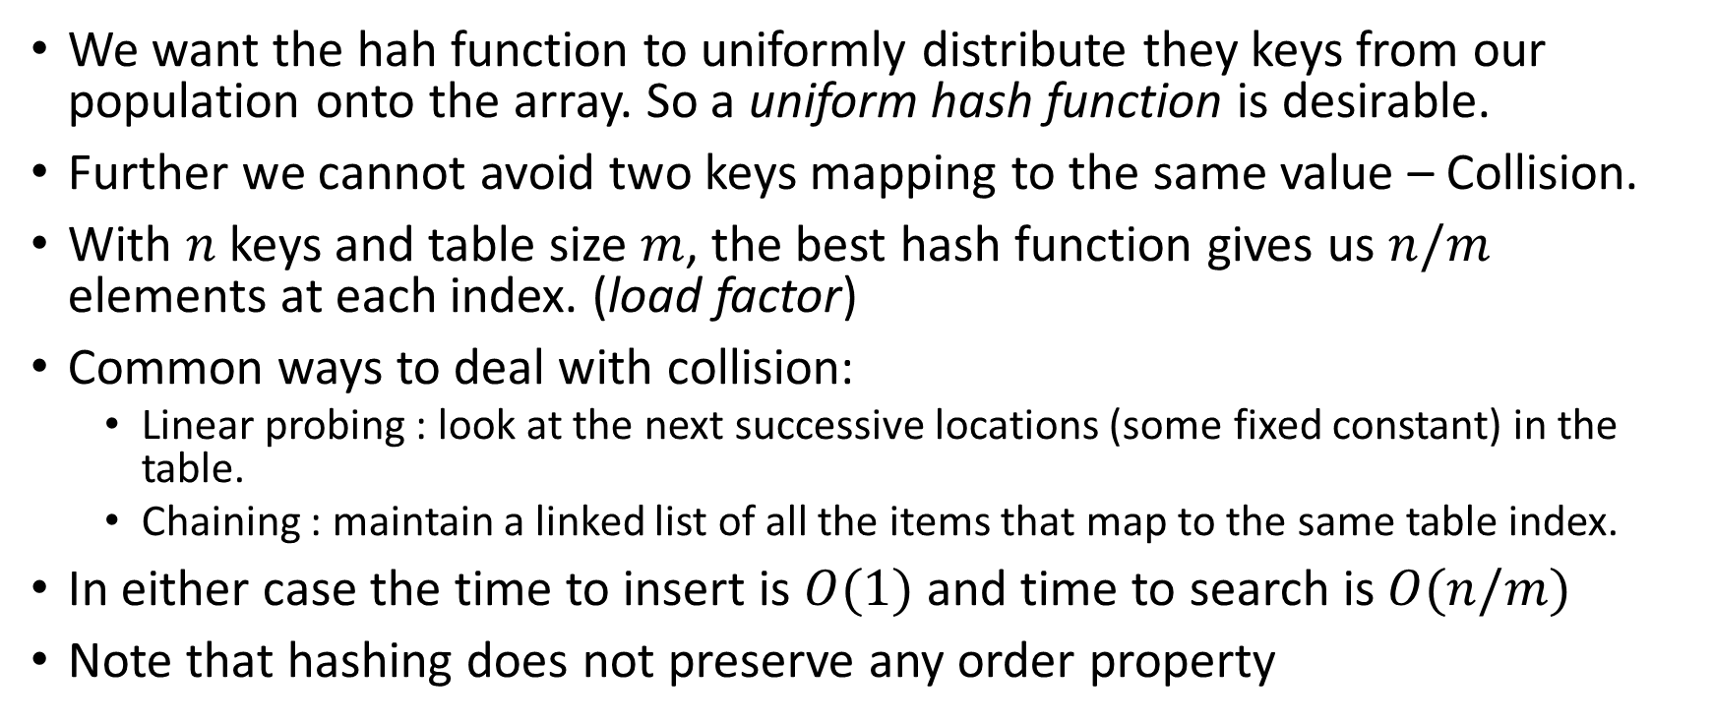
Challenges
We want the hah function to uniformly distribute they keys from our population onto the array. So a uniform hash function is desirable.
Further we cannot avoid two keys mapping to the same value – Collision.
With $n$ keys and table size $m$, the best hash function gives us $n/m$ elements at each index. (load factor)
Common ways to deal with collision:
Linear probing : look at the next successive locations (some fixed constant) in the table.
Chaining : maintain a linked list of all the items that map to the same table index.
In either case the time to insert is $O(1)$and time to search is $O(n/m)$
Note that hashing does not preserve any order property

