Slide 1
Introduction to the analysis of algorithms through examples

Slide 2
Given an algorithm, we wish to analyze
We wish to analyze the resources that an algorithm consumes
Time
Space
Often done by instruction execution or space(# items stored) count:
Relevant for practice, though independent of technology
To do that we still need the algorithm itself to be sufficiently explicit
A few examples of (mostly known) algorithms and their analysis follow

Slide 3
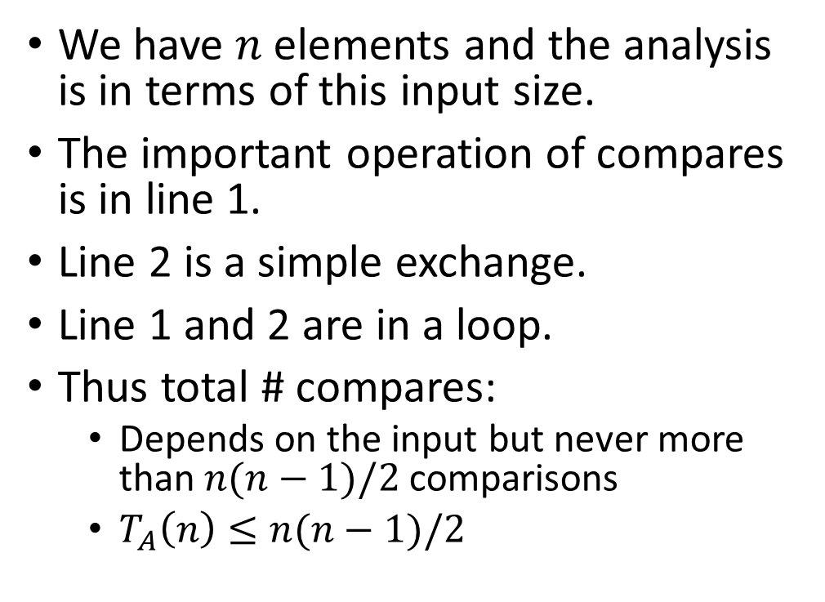
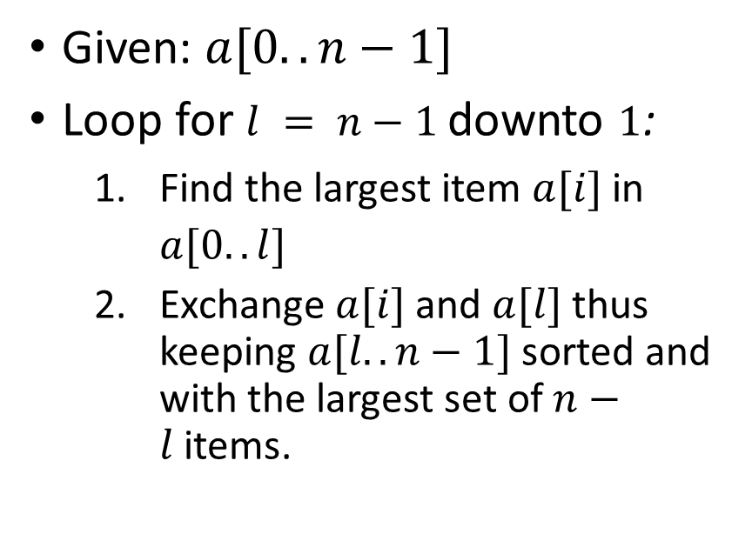
Simple sorting
Selection Sort
Analysis
Given: $a[0..n−1]$
Loop for $l = n−1$downto $1$:
Find the largest item $a[i]$in $a[0..l]$
Exchange $a[i]$and $a[l]$thus keeping $a[l..n−1]$sorted and with the largest set of $n−l$items.
We have $n$elements and the analysis is in terms of this input size.
The important operation of compares is in line 1.
Line 2 is a simple exchange.
Line 1 and 2 are in a loop.
Thus total # compares:
Depends on the input but never more than $n(n−1)/2$comparisons
$T_{A}\left(n\right)≤n(n−1)/2$

Slide 4
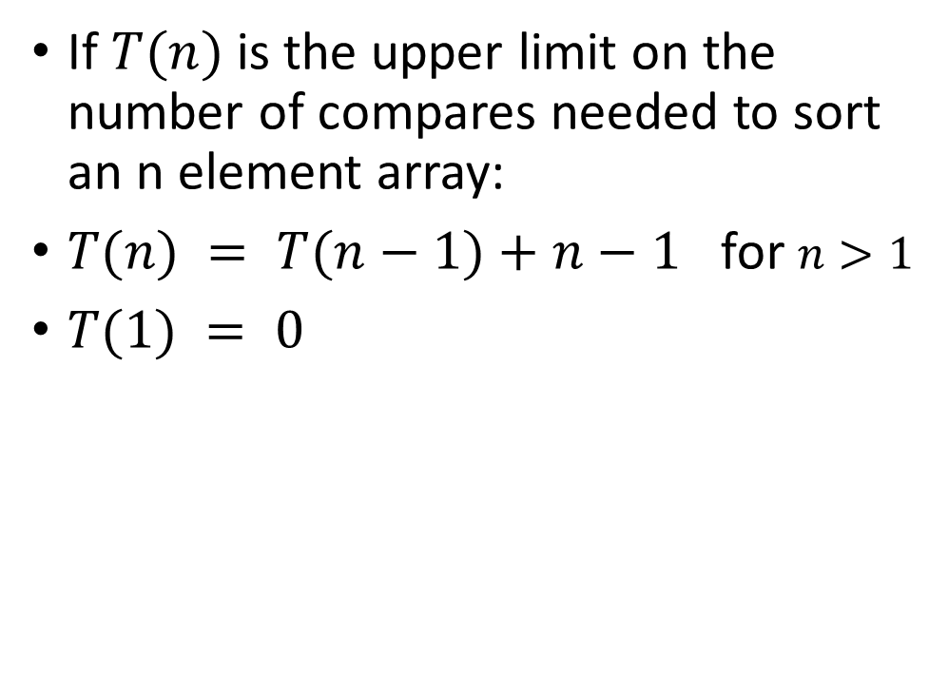
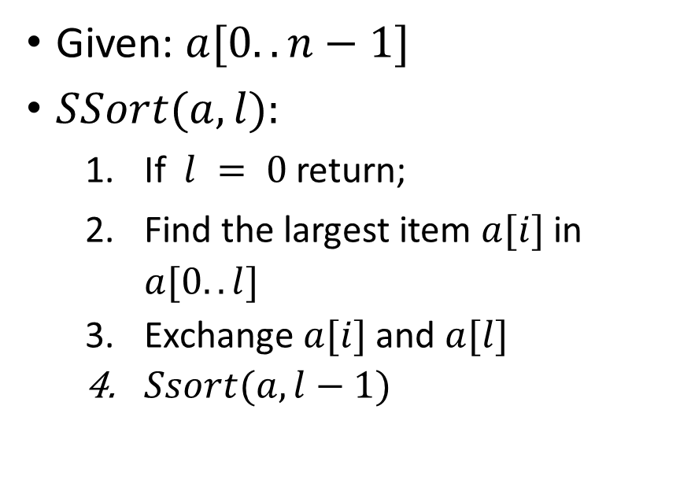
Simple sorting
Selection Sort - recursive
Analysis
Given: $a[0..n−1]$
$SSort(a,l):$
If $l = 0$return;
Find the largest item $a[i]$in $a[0..l]$
Exchange $a[i]$and $a[l]$
$Ssort(a,l−1)$
If $T(n)$is the upper limit on the number of compares needed to sort an n element array:
$T(n) = T(n−1)+n−1$ for $n>1$
$T(1) = 0$

Slide 5
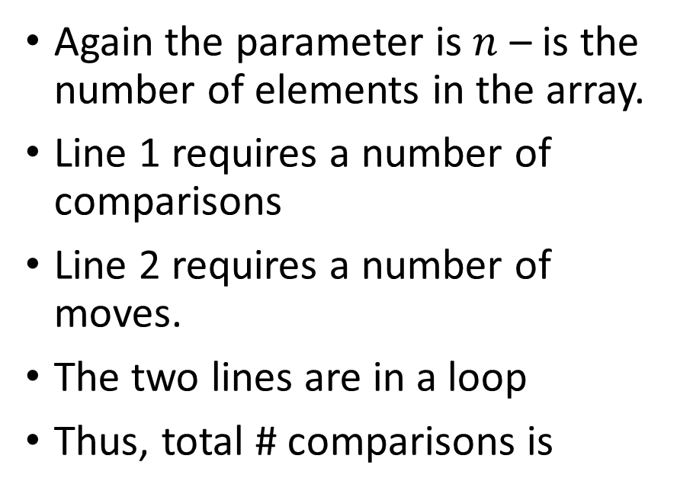
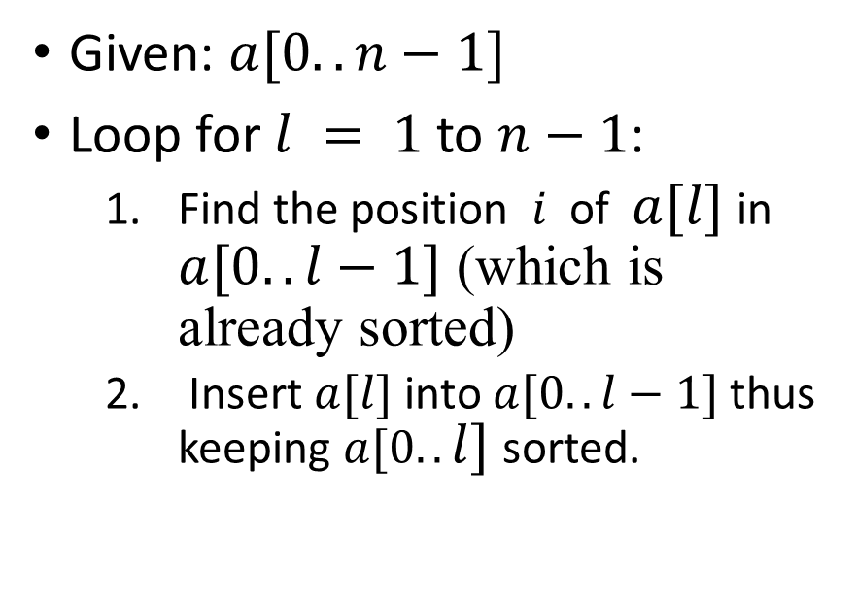
Simple sorting
Insertion Sort
Analysis
Given: $a[0..n−1]$
Loop for $l = 1$to $n−1$:
Find the position $i$of $a[l]$in $a[0..l−1]$ (which is already sorted)
Insert $a[l]$ into $a[0..l−1]$thus keeping $a[0..l]$sorted.
Again the parameter is $n$ – is the number of elements in the array.
Line 1 requires a number of comparisons
Line 2 requires a number of moves.
The two lines are in a loop
Thus, total # comparisons is
Note that we are analyzing the given algorithm. The problem itself may different algorithms that find a solution!

Slide 6
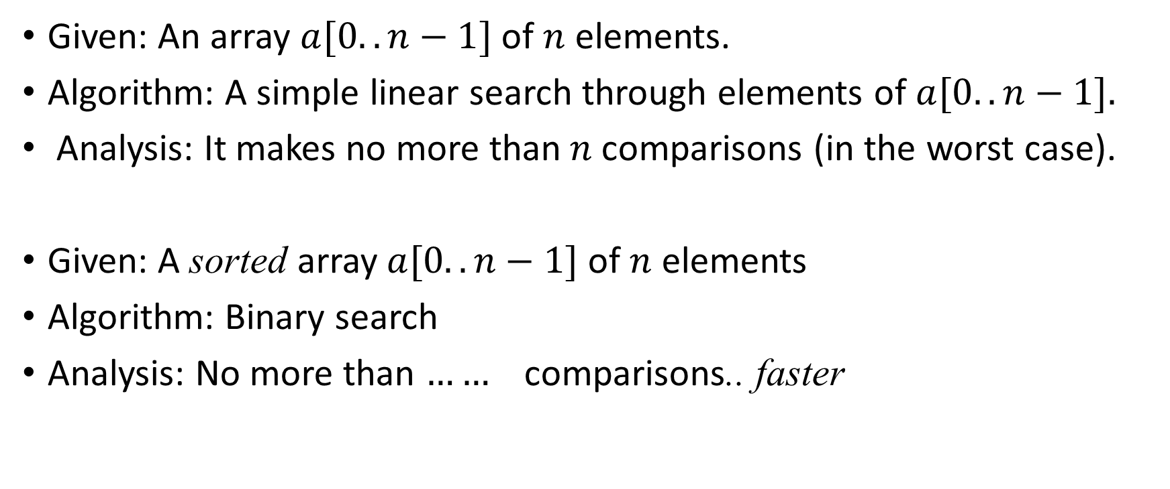
Searching on an array
Given: An array $a[0..n−1]$ of $n$ elements.
Algorithm: A simple linear search through elements of $a[0..n−1].$
Analysis: It makes no more than$n$comparisons (in the worst case).
Given: A sorted array $a[0..n−1]$ of $n$ elements
Algorithm: Binary search
Analysis: No more than $……$comparisons.. faster

Slide 7
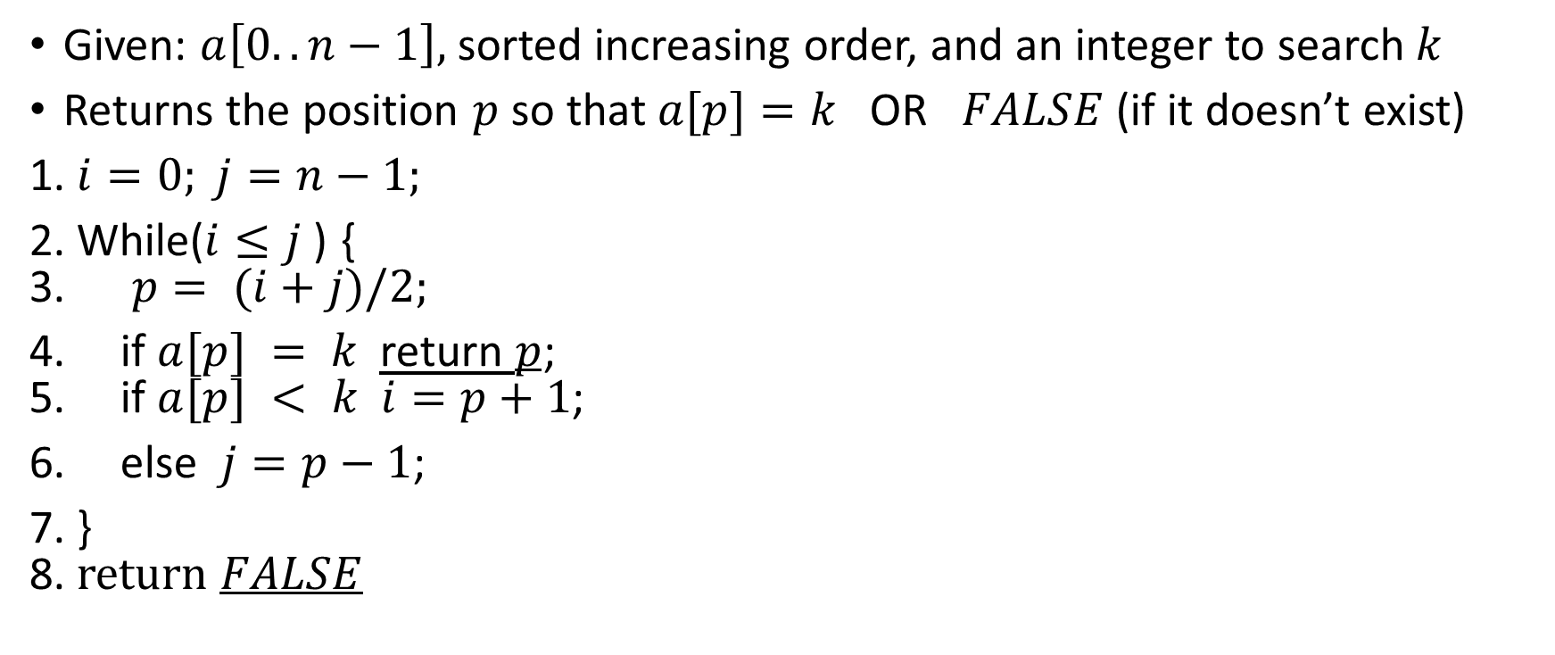

Binary Search Algorithm
$$i=0 j=n−1$$
▪ ▪
Given: $a\left[0..n−1\right],$sorted increasing order, and an integer to search $k$
Returns the position $p$ so that $a[p]=k$OR $FALSE$(if it doesn’t exist)
1. $i=0; j=n−1;$
2. While($i≤j$) { 3. $p= (i+j)/2;$
4. if $a[p] = k$return $p$; 5. if $a[p] < k i=p+1$;
6. else $j=p−1$;
7. } 8. return $FALSE$
Analysis: - Lines 4 and 5 make two compares - Line 5 and 6 change $i$or $j$ and ensure that the range $i..j$is at most half of its previous range -So the condition on line 2 is satisfied at most … - Thus the number of compares depends on the input values, but is at most …

Slide 8
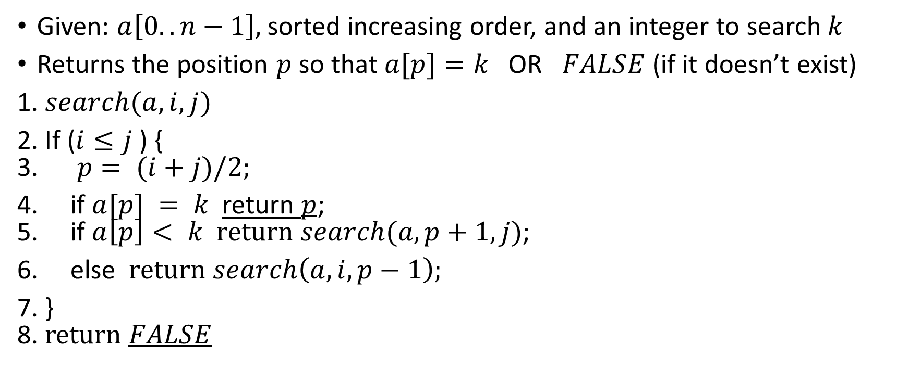

A recursive formulation
Given: $a\left[0..n−1\right],$sorted increasing order, and an integer to search $k$
Returns the position $p$ so that $a[p]=k$OR $FALSE$(if it doesn’t exist)
1. $search(a,i,j)$
2. If ($i≤j$) { 3. $p= (i+j)/2;$
4. if $a[p] = k$return $p$; 5. if $a\left[p\right]< k return search(a,p+1,j)$;
6. else $return search\left(a,i,p−1\right);$
7. } 8. return $FALSE$
Analysis: A recurrence relation for the number of comparisons $T(n)$:
$T\left(0\right)=0$
$T\left(n\right)≤T(n/2) + 2$ for $n > 0$

Slide 9

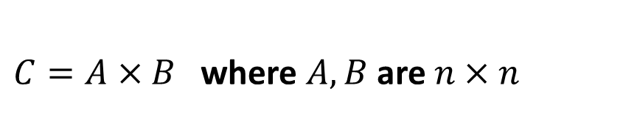
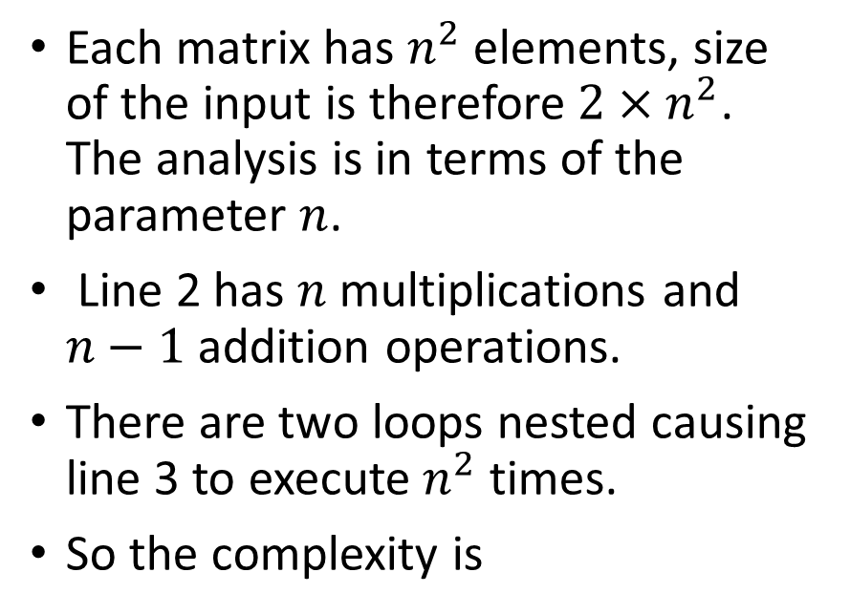
Simple Matrix Multiply
$C=A×B$where $A,B$ are $n×n$
Analysis
1. for $i=0..n−1$: 2. for $j=0..n−1$: 3. $c[i][j]=Σ_{k=0}^{n−1} a[i][k].b[k][j]$
Each matrix has $n^{2}$ elements, size of the input is therefore$2×n^{2}$. The analysis is in terms of the parameter $n$.
Line 2 has $n$ multiplications and $n−1$ addition operations.
There are two loops nested causing line 3 to execute $n^{2}$ times.
So the complexity is

Slide 10
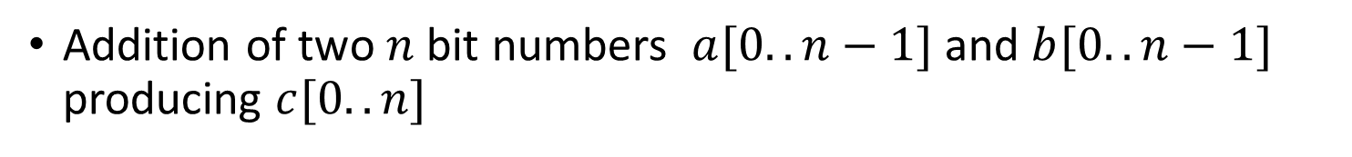
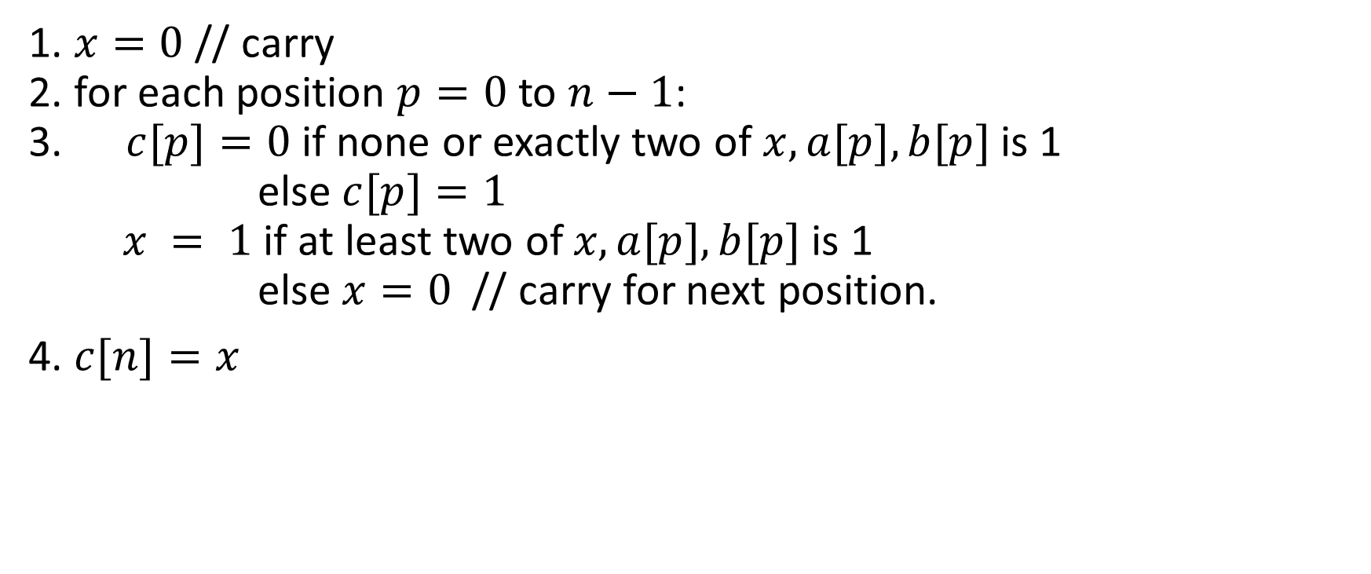
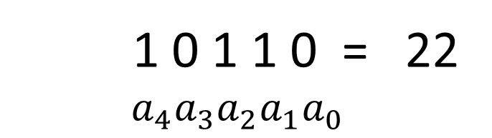
Binary Addition
1 0 1 1 0 = 22 $$a_{4}a_{3}a_{2}a_{1}a_{0}$$
Addition of two $n$ bit numbers $a[0..n−1]$and $b[0..n−1]$ producing $c[0..n]$
1. $x=0$ // carry 2. for each position $p=0$ to $n−1$: 3. $c[p]=0$if none or exactly two of $x,a[p],b[p]$is 1 else $c[p]=1$ $x = 1$if at least two of $x,a[p],b[p]$is 1 else $x=0$// carry for next position.
4. $c[n]=x$
3 bit addition
Complexity: Line 3 is a #3-bit addition .
Line 2 is a loop … Complexity is

Slide 11

Binary Multiplication
Multiply two $n$ bit integers, giving a $2n$bit integer.
The primary school algorithm works just fine.
Complexity

Slide 12
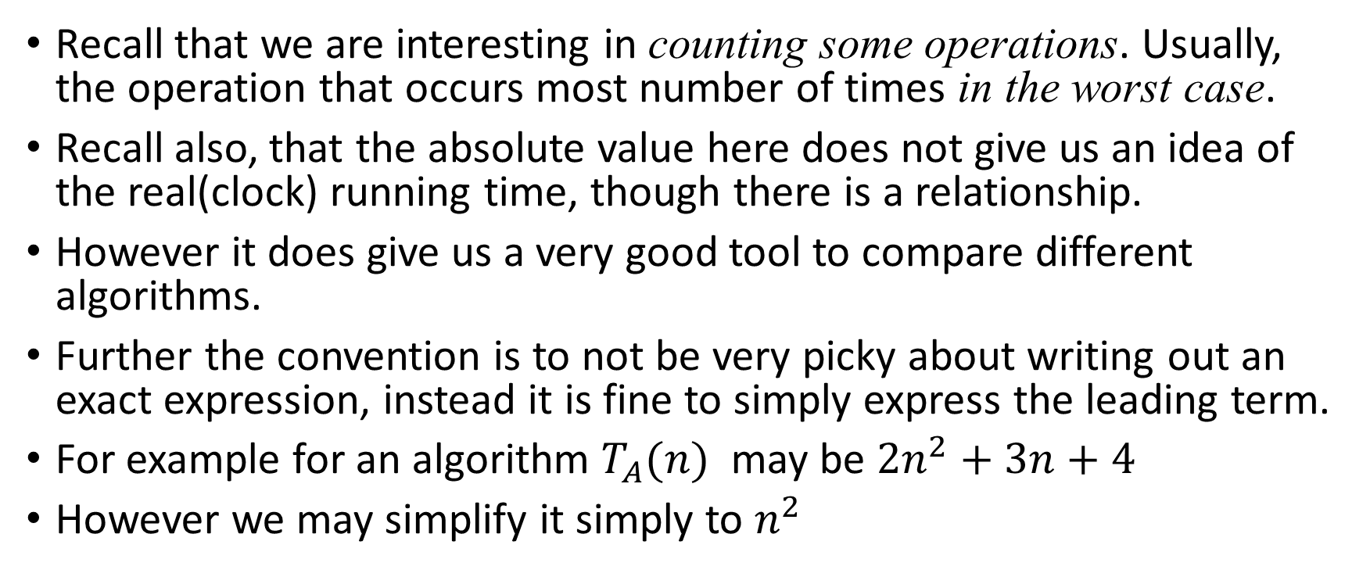
Formally.. complexity
Recall that we are interesting in counting some operations. Usually, the operation that occurs most number of times in the worst case.
Recall also, that the absolute value here does not give us an idea of the real(clock) running time, though there is a relationship.
However it does give us a very good tool to compare different algorithms.
Further the convention is to not be very picky about writing out an exact expression, instead it is fine to simply express the leading term.
For example for an algorithm $T_{A}(n)$ may be $2n^{2}+3n+4$
However we may simplify it simply to $n^{2}$

Slide 13
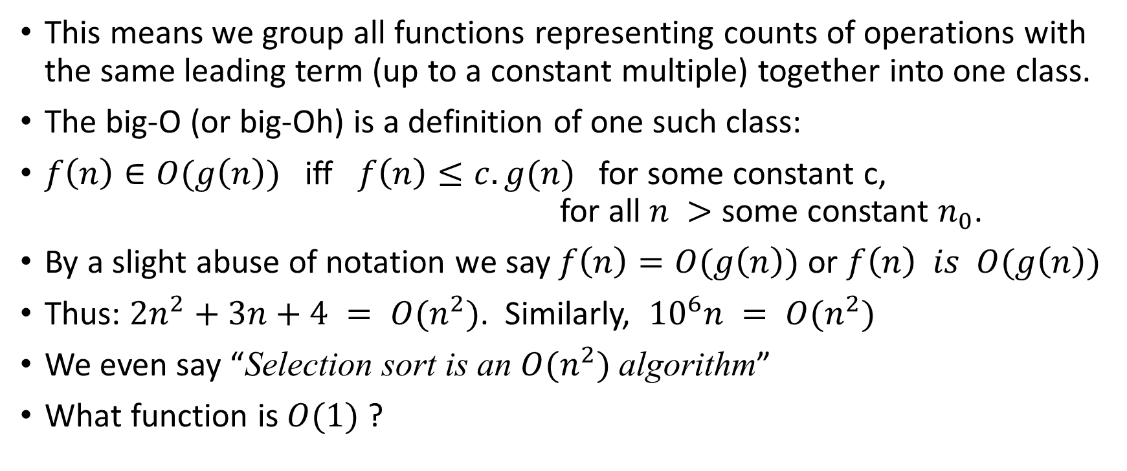
Formally…
This means we group all functions representing counts of operations with the same leading term (up to a constant multiple) together into one class.
The big-O (or big-Oh) is a definition of one such class:
$f\left(n\right)∈O(g\left(n\right))$ iff $f\left(n\right)≤c.g(n)$for some constant c, for all $n >$some constant $n_{0}$.
By a slight abuse of notation we say $f\left(n\right)=O(g\left(n\right))$ or $f\left(n\right) is O(g\left(n\right))$
Thus: $2n^{2}+3n+4 = O(n^{2})$. Similarly, ${10}^{6}n = O(n^{2})$
We even say “Selection sort is an $O(n^{2})$ algorithm”
What function is $O(1)$?

Slide 14

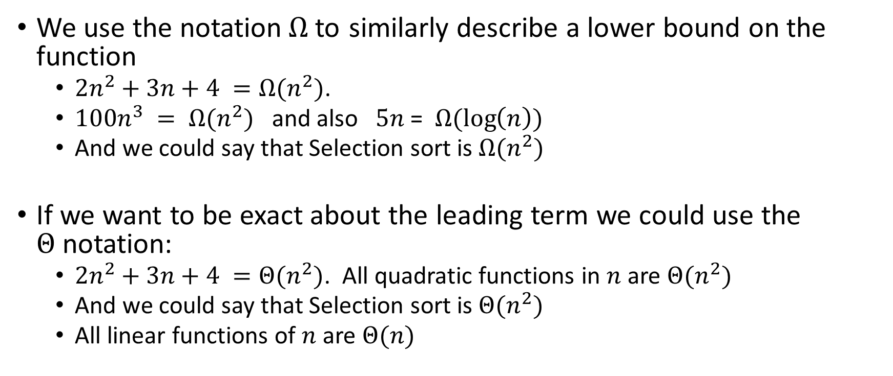
Some other notations$Ω$and $Θ$
We use the notation$Ω$to similarly describe a lower bound on the function
$2n^{2}+3n+4 =Ω(n^{2})$.
$100n^{3} = Ω(n^{2})$ and also $5n$ = $Ω(log\left(n\right))$
And we could say that Selection sort is $Ω(n^{2})$
If we want to be exact about the leading term we could use the $Θ$notation:
$2n^{2}+3n+4 =Θ(n^{2})$. All quadratic functions in $n$ are $Θ(n^{2})$
And we could say that Selection sort is $Θ(n^{2})$
All linear functions of $n$ are $Θ(n)$

Slide 15
More examples

Slide 16


Searching for a Target-Sum in a sorted array
Problem: Given sorted array $a[0..n−1]$ and an integer$T$find $i,j$so that $a[i]+a[j]=T$ (assume increasing order sorted)
Algorithm-1:
for$i=0..n−1$
for $j=0..n−1$
If $a[i]+a[j]=T$Return $\left(i,j\right)$
Return False
Analysis: $T_{1}=O(n^{2})$
Algorithm-2:
$i=0, j=n−1$
Loop:
If $i>=j$return $False$
If $a[i]+a[j]=T$Return $(i,j)$
If $a\left[i\right]+a\left[j\right]>T j−−$
Else $i++$
Analysis: $T_{2}=$

Slide 17
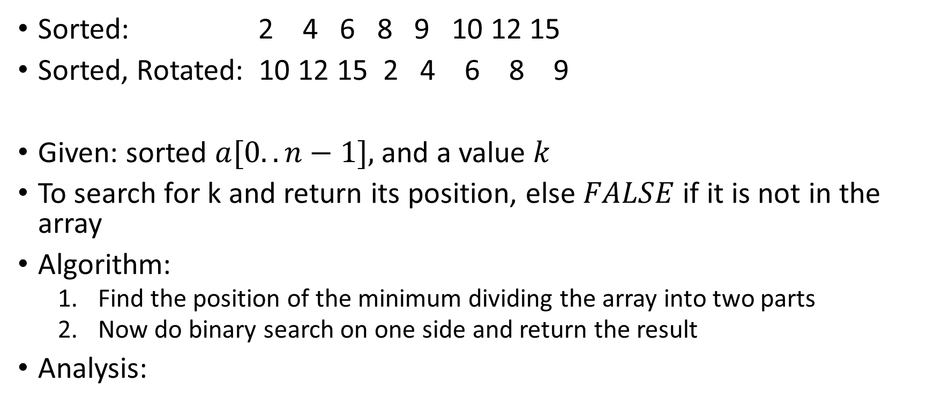
Searching in a Sorted, Rotated Array
Sorted: 2 4 6 8 9 10 12 15
Sorted, Rotated: 10 12 15 2 4 6 8 9
Given: sorted $a[0..n−1],$and a value $k$
To search for k and return its position, else $FALSE$ if it is not in the array
Algorithm:
Find the position of the minimum dividing the array into two parts
Now do binary search on one side and return the result
Analysis:

Slide 18
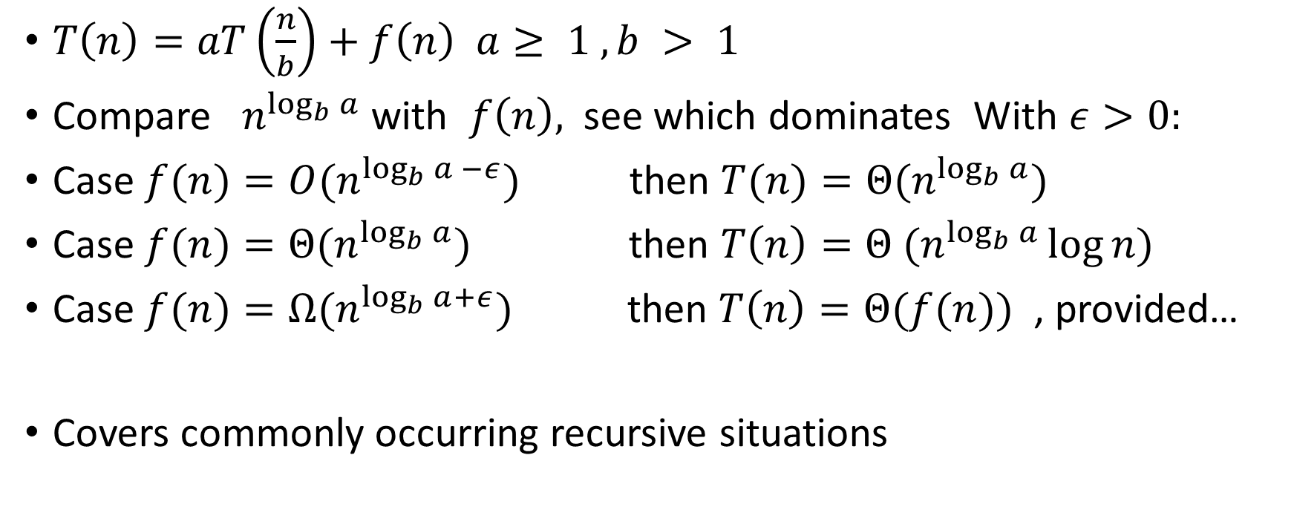
‘Master Theorem’ for complexity computation for commonly occurring recurrence relations
$T\left(n\right)=aT\left(\frac{n}{b}\right)+f\left(n\right) a≥ 1 , b > 1$
Compare $n^{\log_{b}{a}}$with $f\left(n\right),$ see which dominates With $ε>0:$
Case $f(n)={O(n}^{\log_{b}{a} −ε})$ then $T(n)=Θ{(n}^{\log_{b}{a}})$
Case $f(n)={Θ(n}^{\log_{b}{a}})$ then $T\left(n\right)={Θ (n}^{\log_{b}{a}}\log{n)}$
Case $f(n)={Ω(n}^{\log_{b}{a}+ε})$then $T\left(n\right)=Θ(f(n))$ , provided…
Covers commonly occurring recursive situations

Slide 19
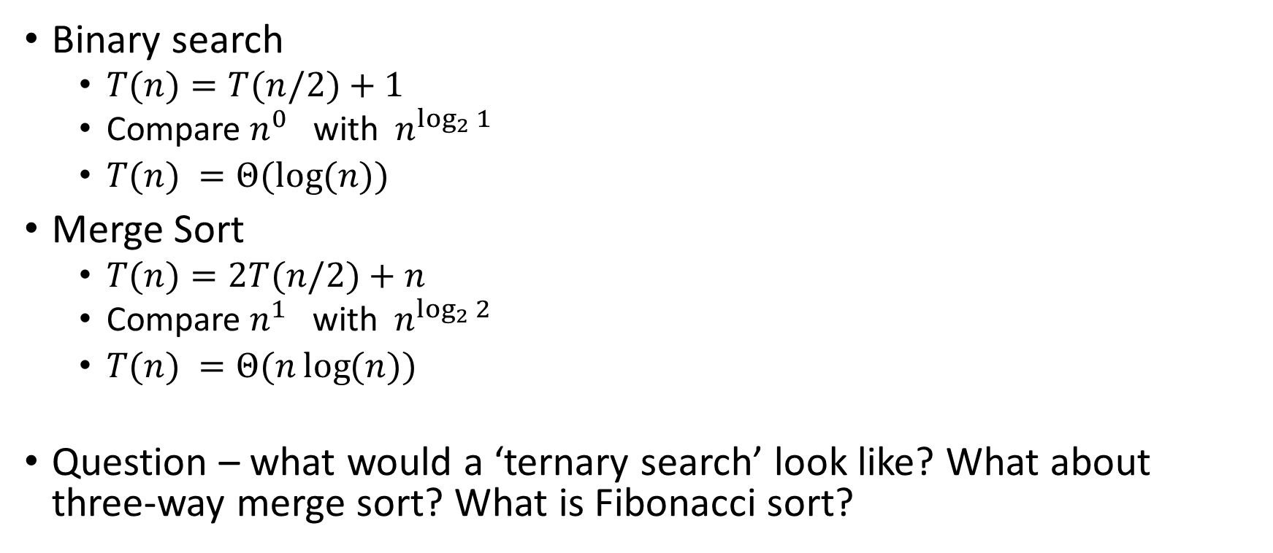
Examples of the master theorem
Binary search
$T(n)=T(n/2)+1$
Compare $n^{0}$ with $n^{\log_{2}{1}}$
$T(n) =Θ(\log{(n)})$
Merge Sort
$T(n)=2T(n/2)+n$
Compare $n^{1}$ with $n^{\log_{2}{2}}$
$T(n) =Θ(n\log{(n)})$
Question – what would a ‘ternary search’ look like? What about three-way merge sort? What is Fibonacci sort?

Slide 20
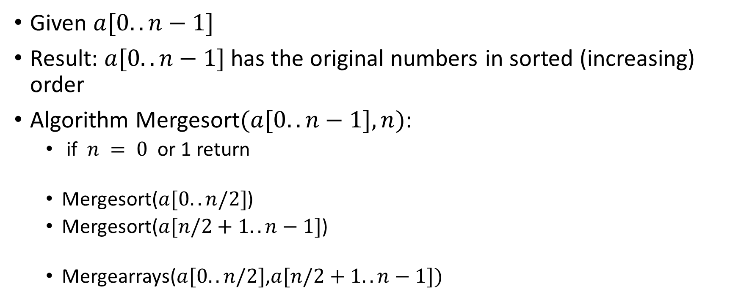
Merge Sort
Given $a[0..n−1]$
Result: $a[0..n−1]$has the original numbers in sorted (increasing) order
Algorithm Mergesort$(a[0..n−1],n)$:
if $n = 0$ or 1 return
Mergesort($a[0..n/2]$)
Mergesort($a[n/2+1..n−1]$)
Mergearrays($a[0..n/2]$,$a[n/2+1..n−1])$

Slide 21
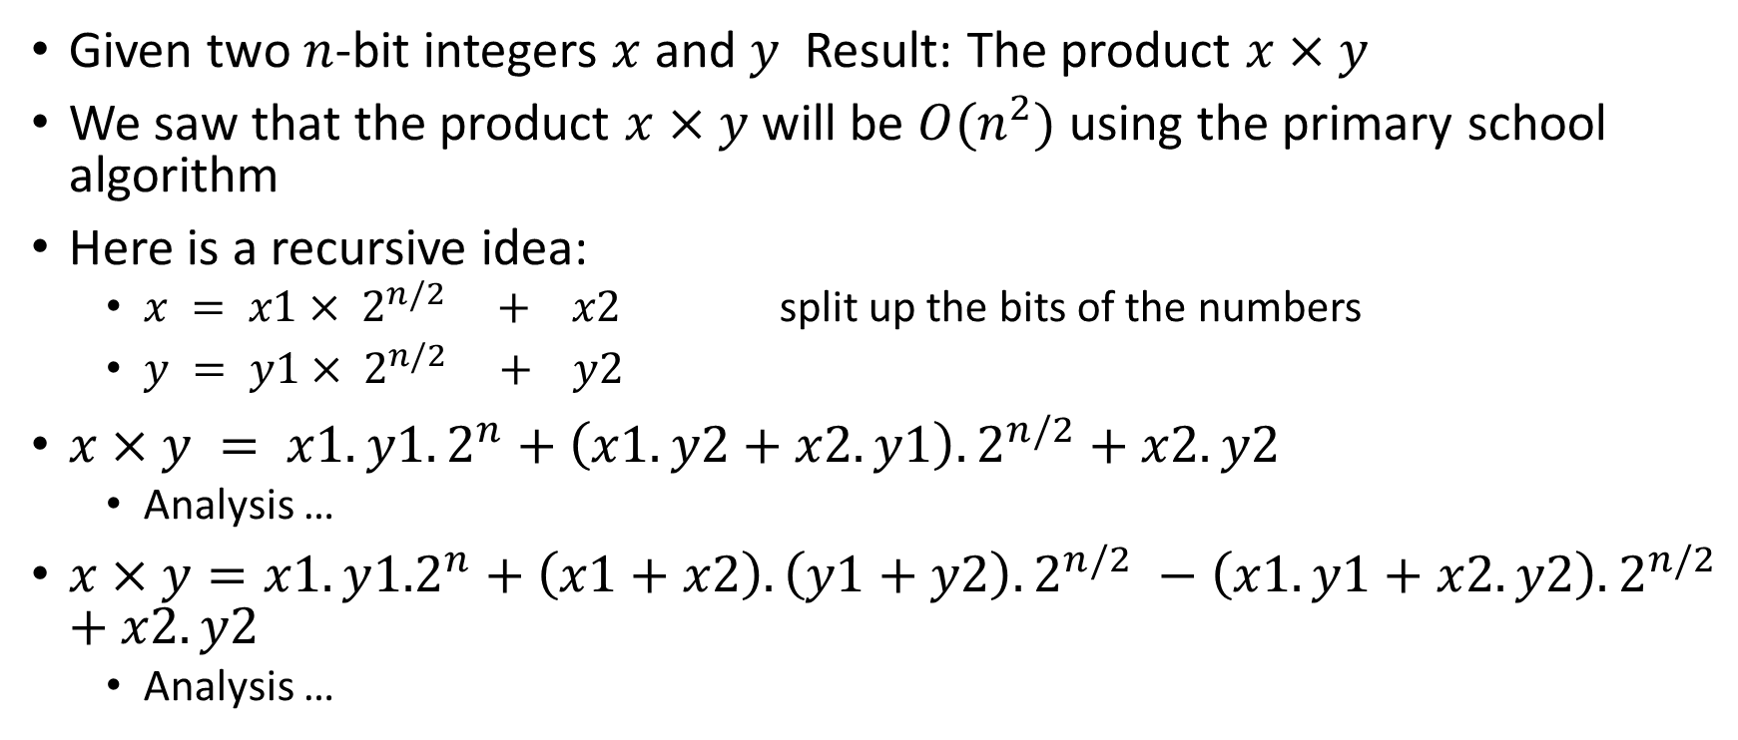
Faster integer multiplication
Given two $n$-bit integers $x$ and $y$ Result: The product $x×y$
We saw that the product $x×y$will be $O(n^{2})$using the primary school algorithm
Here is a recursive idea:
$x = x1× 2^{n/2} + x2$ split up the bits of the numbers
$y = y1× 2^{n/2} + y2$
$x×y = x1.y1.2^{n}+\left(x1.y2+x2.y1\right).2^{n/2}+x2.y2$
Analysis …
$x×y=x1.y{1.2}^{n}+\left(x1+x2\right).\left(y1+y2\right).2^{n/2} −\left(x1.y1+x2.y2\right).2^{n/2}$ $+x2.y2$
Analysis …

