Slide 1
The Constraint Satisfaction Problem formulation for search

Slide 2
Constraint Satisfaction Problems
As seen before in several problems where we used for example local search, SA, GA, beam search etc. The path to the solution was not important.
There is another technique to deal with such problems.
Configuration solution search

Slide 3
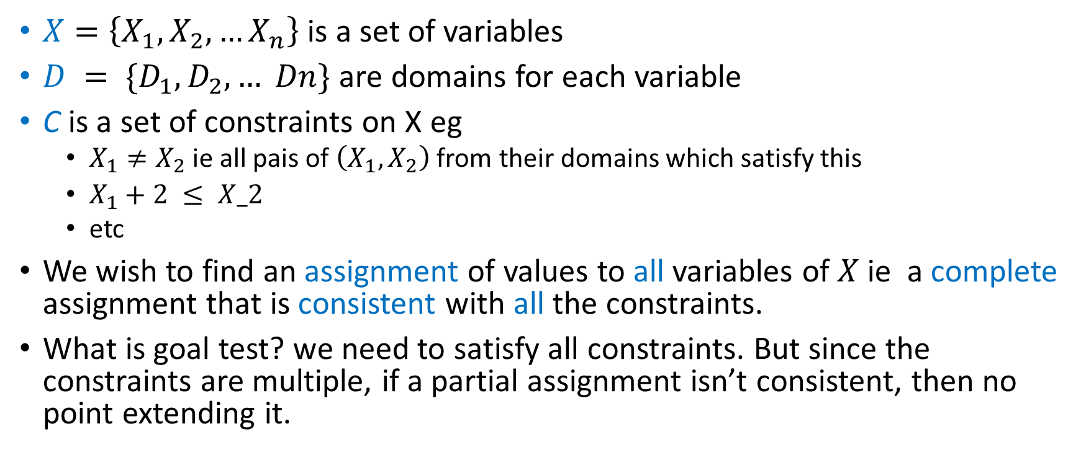
Modeling the problem and the solution
$X=\left\{X_{1},X_{2},…X_{n}\right\}$is a set of variables
$D = \{D_{1},D_{2}, … Dn\}$ are domains for each variable
C is a set of constraints on X eg
$X_{1}≠X_{2}$ ie all pais of $\left(X_{1},X_{2}\right)$ from their domains which satisfy this
$X_{1}+2 ≤ X_2$
etc
We wish to find an assignment of values to all variables of $X$ie a complete assignment that is consistent with all the constraints.
What is goal test? we need to satisfy all constraints. But since the constraints are multiple, if a partial assignment isn’t consistent, then no point extending it.

Slide 4
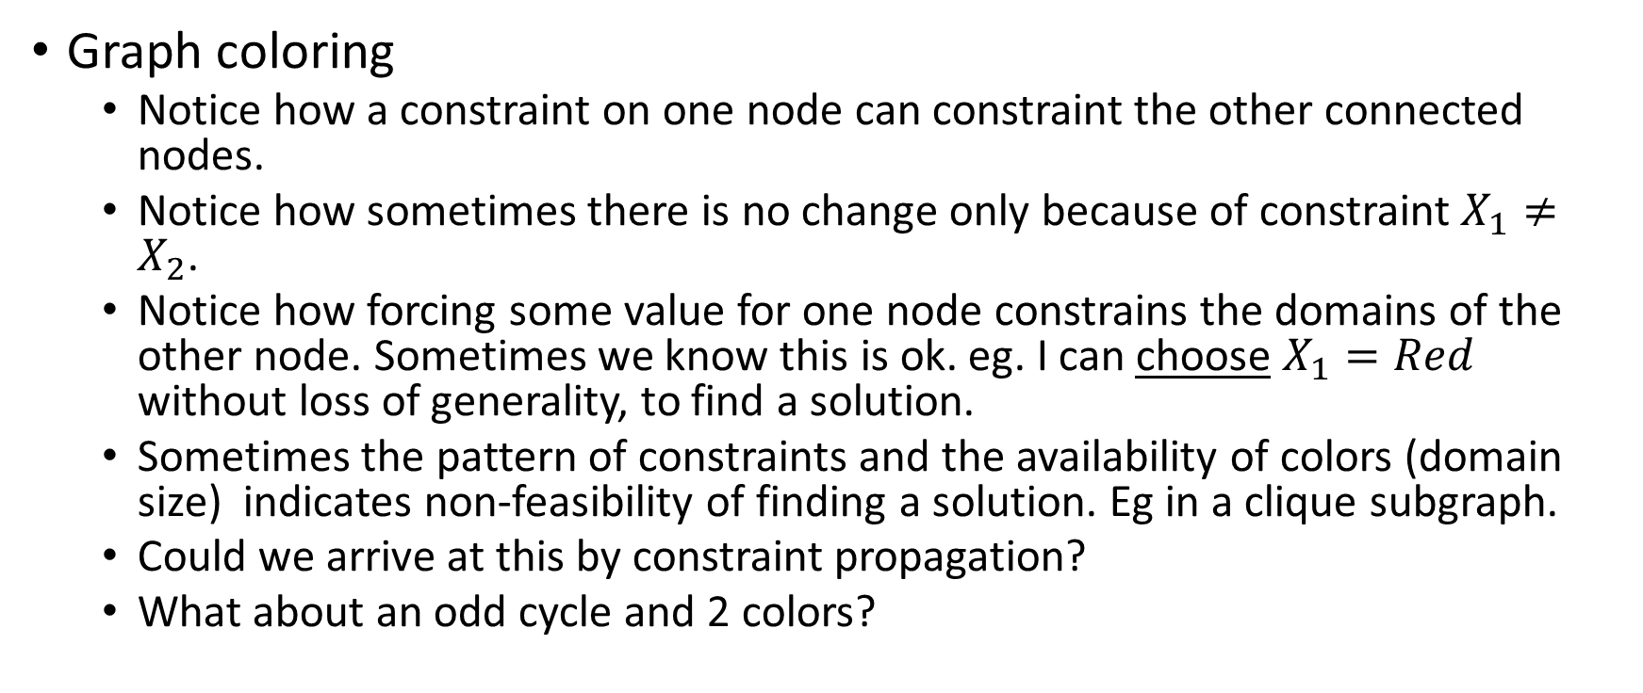
An Example
Graph coloring
Notice how a constraint on one node can constraint the other connected nodes.
Notice how sometimes there is no change only because of constraint $X_{1}≠X_{2}$.
Notice how forcing some value for one node constrains the domains of the other node. Sometimes we know this is ok. eg. I can choose $X_{1}=Red$ without loss of generality, to find a solution.
Sometimes the pattern of constraints and the availability of colors (domain size) indicates non-feasibility of finding a solution. Eg in a clique subgraph.
Could we arrive at this by constraint propagation?
What about an odd cycle and 2 colors?

Slide 5
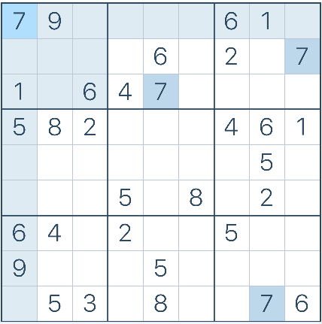
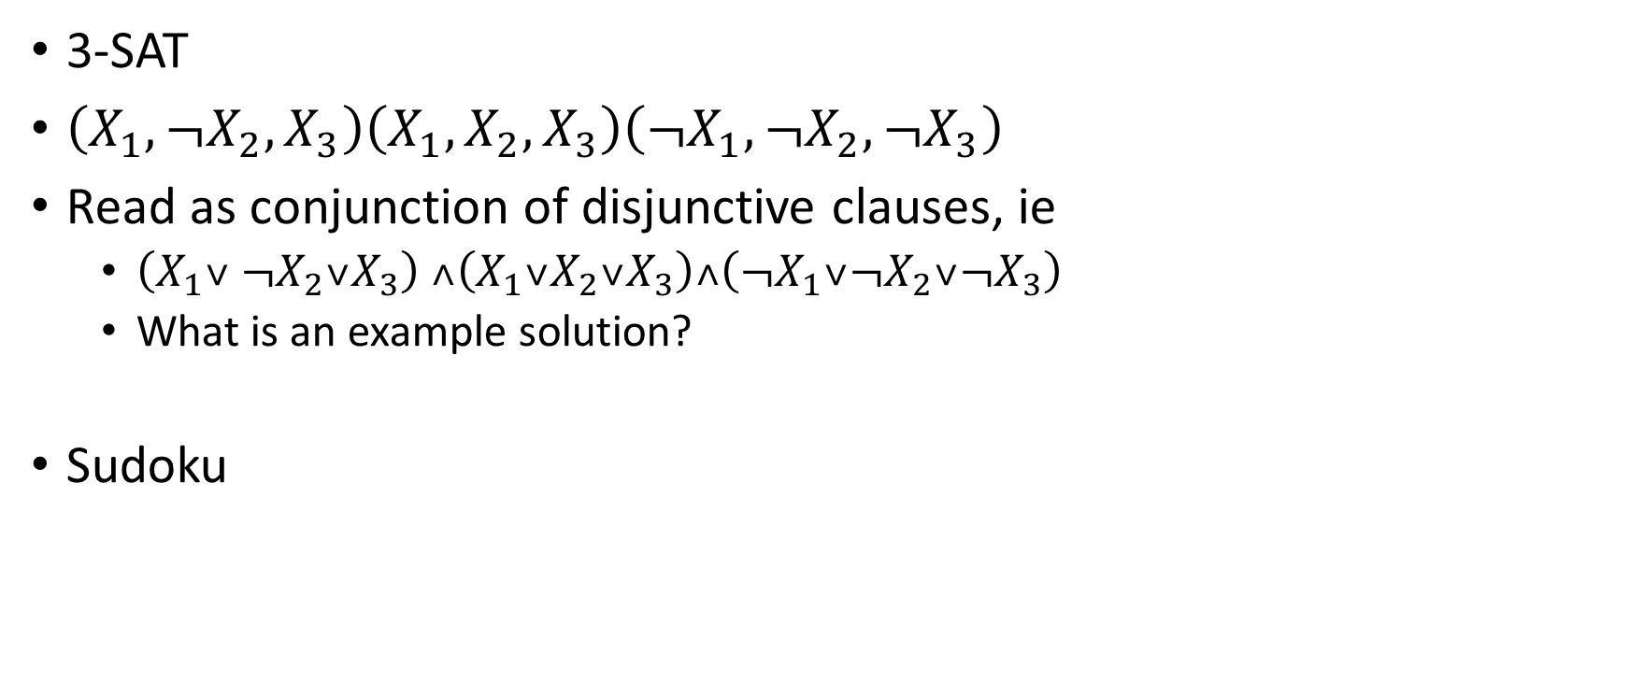
More examples
3-SAT
$\left(X_{1},{¬X}_{2},X_{3}\right)\left(X_{1},X_{2},X_{3}\right)\left({¬X}_{1},¬X_{2},¬X_{3}\right)$
Read as conjunction of disjunctive clauses, ie
$\left(X_{1}˅ {¬X}_{2}˅X_{3}\right) ˄\left(X_{1}˅X_{2}˅X_{3}\right)˄\left({¬X}_{1}˅¬X_{2}˅¬X_{3}\right)$
What is an example solution?
Sudoku

Slide 6
Variations
Discrete finite domains
8-queens configuration – what are X_{i} and D_{i} ?
SAT problem
Job-shop scheduling with job delays
D consists of
finite number of discrete values
infinite discrete values
continuous values
Constraints are usually described like in our example, instead of enumeration
Linear constraints
Non-linear constraints
Unary, binary or mluti-variable/ Global constraints

Slide 7
Constraint satisfaction vs optimization
Strict constraints (satisfy this sat expression) vs
Preference constraints… find an assignment with minimum unsatisfied clauses

Slide 8
Inference or Constrain-Propagation in CSP
Notion of Local consistency. Using this to iteratively shrink the valid values for each variable. We can have many notions of “local”.
Node consistency
Arc consistency. For a constraint on X₁, X₂, shrink D₁ → D₁‘ so that all values of D₁’ have a satisfying value in D₂. ie remove useless values of D₁
We want to shrink all Domains minimally so that every domain is consistent with every other.
AC-3 algorithm
Note it doesn’t find a solution, just reduces domain size. Then we still need to search.

Slide 9

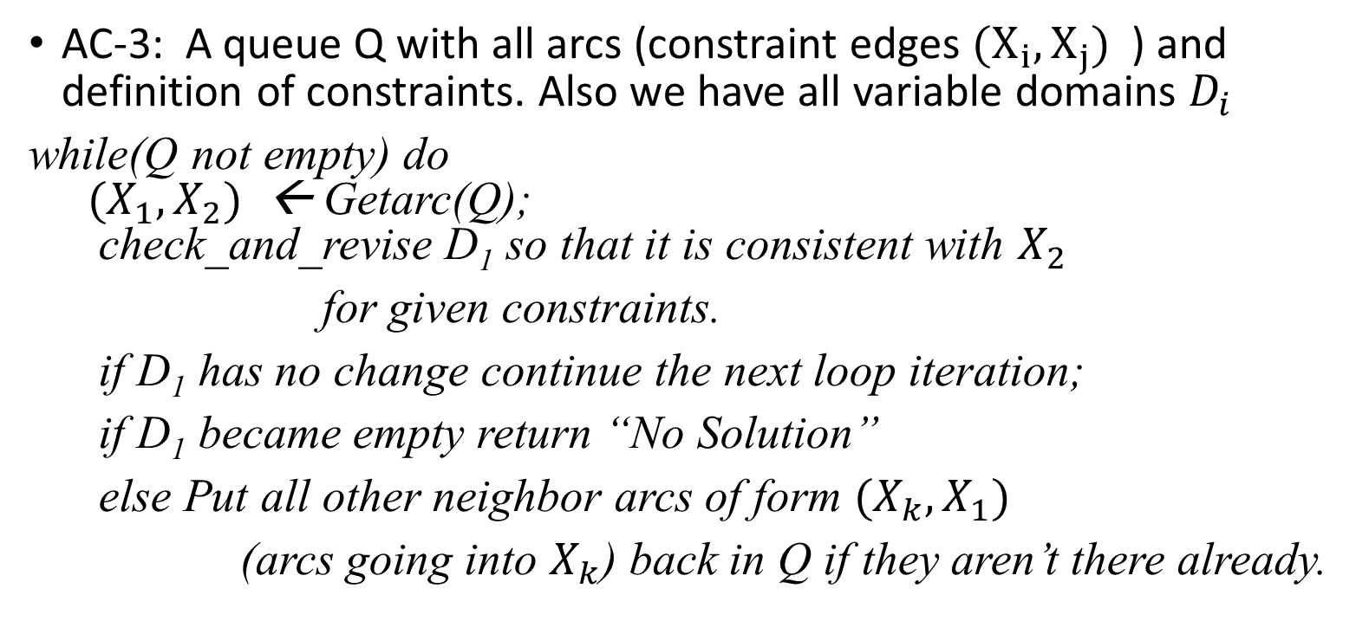


An arc consistency (2-consistency) algorithm
$$X_{2}$$
AC-3: A queue Q with all arcs (constraint edges ${(X}_{i},X_{j})$ ) and definition of constraints. Also we have all variable domains $D_{i}$
while(Q not empty) do ${(X}_{1},X_{2})$ ← Getarc(Q); check_and_revise D₁ so that it is consistent with $X_{2}$
for given constraints.
if D₁ has no change continue the next loop iteration;
if D₁ became empty return “No Solution”
else Put all other neighbor arcs of form ${(X}_{k},X_{1})$
(arcs going into $X_{k}$) back in Q if they aren’t there already.
$$X_{1}$$
$$X_{k}$$
... …
complexity?
#arcs.domainsize
domainsize*domainsize

Slide 10


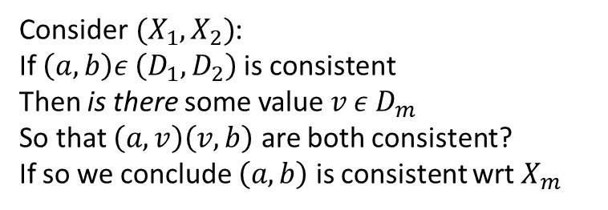

Path consistency (3-consistency)
Arc-consistency is looking too local
For every (X1,X2) that is arc-consistent change D₁,D₂ so that:
for each X_{m} ensure that all consistent X₁,X₂ assignments have some value from X_{m} which makes arcs (X₁, X_{m}) and (X_{m},X₂) arc consistent.
To achieve this reduce the valid pairs from the two domains.
$$X_{2}$$
$$X_{m}$$
$$X_{1}$$
Consider${ (X}_{1},X_{2})$:
If $\left(a,b\right)ε \left(D_{1},D_{2}\right)$ is consistent
Then is there some value ${v ε D}_{m}$
So that $\left(a,v\right)\left(v,b\right)$ are both consistent?
If so we conclude $\left(a,b\right)$ is consistent wrt $X_{m}$

Slide 11
Beyond path consistency
We could similarly think of k-consistency as helping us eliminate more possible combinations
And of course a combination of 1-2-3..k-consistency
Special purpose multi-valued(global) constraints can be useful.
All this is to reduce the number of possibilities to consider.
However it does not reduce it altogether or find a solution.
We still need to do some search.
In practice we stop with arc or path-consistency (ie 2- or 3- consistency)
Can you write code for 2 and 3 consistency to solve a Sudoku automatically? Does it work?

Slide 12

Using search on top of constraint propagation(C-P) to arrive at a solution
Combine it with some backtracking based method like DFS
Explore all tuples in the space ($D_{1},D_{2},…D_{n}$) derived after C-P.
Candidate node is some tuple (a₁,a₂,…a_{n}) and we systematically evaluate all.
Combine it with a local search method like beam search, stochastic gradient, SA, GA etc.

Slide 13
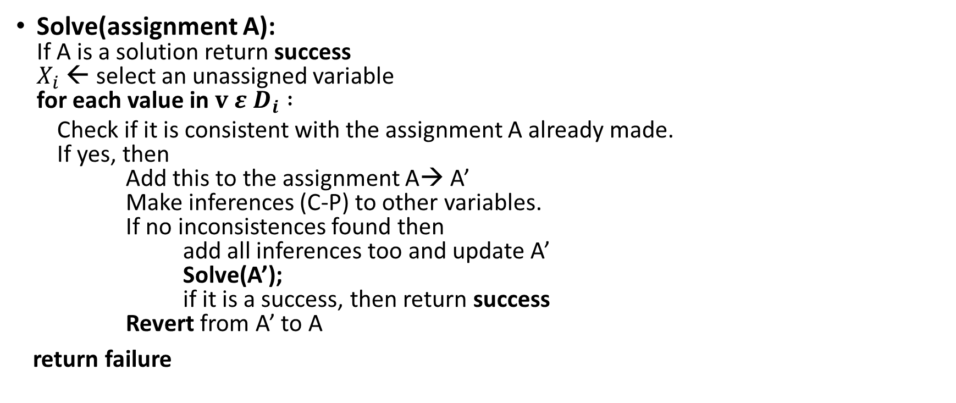
Backtracking (dfs-like) Solver revisited
Solve(assignment A): If A is a solution return success $X_{i}$ ← select an unassigned variable for each value in $v ε D_{i} :$
Check if it is consistent with the assignment A already made. If yes, then Add this to the assignment A→ A’ Make inferences (C-P) to other variables. If no inconsistences found then add all inferences too and update A’ Solve(A’); if it is a success, then return success Revert from A’ to A
return failure

Slide 14
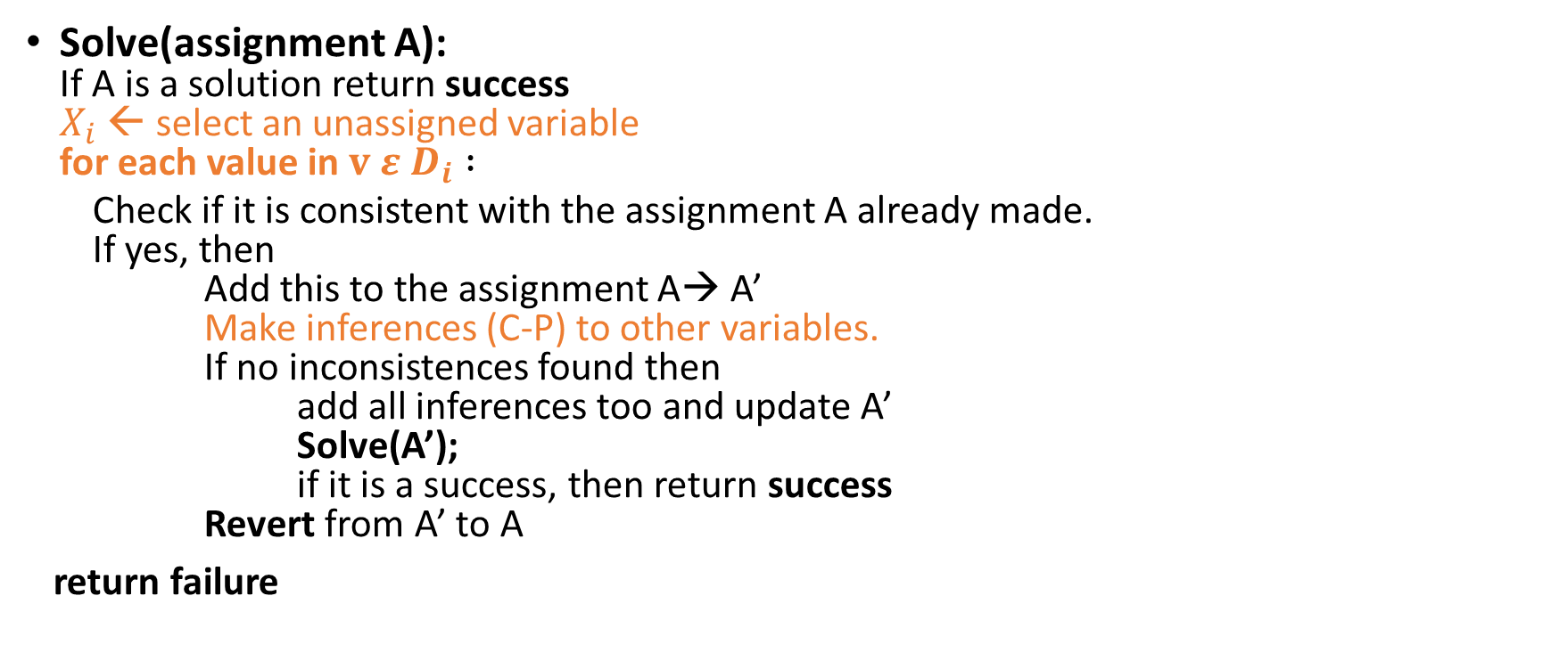
Backtracking (dfs-like) Solver revisited
Solve(assignment A): If A is a solution return success $X_{i}$ ← select an unassigned variable for each value in $v ε D_{i} :$
Check if it is consistent with the assignment A already made. If yes, then Add this to the assignment A→ A’ Make inferences (C-P) to other variables. If no inconsistences found then add all inferences too and update A’ Solve(A’); if it is a success, then return success Revert from A’ to A
return failure

Slide 15
The three places we can try something
Choosing the variables in order:
Choose that which is already most constrained (min remaining values-MRV)
If there is a tie, choose the one that has highest degree(maximum constraints)
Choosing the value order:
To quickly arrive at one solution, create pick the one that has most flexibility, ie value that causes least constraining (LCV) of other variables.
Choose to do inferencing:
Choose arc-consistency, AC-3 or any other C-P to do consistency propagation and quickly hit dead ends. Maintaining arc consistency (MAC)
However, backtracking is still needed

Slide 16
Improving backtracking efficiency
Not just chronological backtracking
Figure out a good point to backtrack to
See an example from graphs
Can we do backjumping? (Jump over useless backtrack phases)
What are some useless backtracking and how do we detect them?
The concept of a conflict set – when a node fails, we can ask why it failed
There may be a certain set of other assignments
We jump over other variables and go back to the most recent among those assignments
We can propagate the conflict set back until we see an alternate assignment is possible for a variable
During the process we do not make other tries

Slide 17
g
b
B
C
{r,g,b}
r
r
A
D
F
Case-1
A-r B-g C-b
D-r
E-g
T-b
F ?
Case-2
A-r D-r B-g
C-b
F ?
E
T

Slide 18
Local search to the aid
While DFS is useful, we can certainly also take help from that fact that it is a configuration finding problem, so local search also helps.
Here we go from one (or one set of) configuration(s) to another.
We need to prefer a next configuration to go to (neighbor?)
We can do that by finding a minimum-conflict neighbor as a good heuristic.
8-queens example.

Slide 19
Lastly, using problem structure..
How would you color a tree?
How would you color a cycle?
Connected components and divide and conquer.
etc

Slide 20
To do
We need to implement a few of these techniques for CSP perhaps with local search in order to really understand them and see them work.

