Slide 1
Knowledge based agents – Using logic and inference

Slide 2
Logic:
An alternative to search and CSP: Knowledge representation and reasoning
Representation – represent what?
Reasoning – make decisions
Domain independent
Declarative approach (vs procedural approach)
More like human reasoning

Slide 3
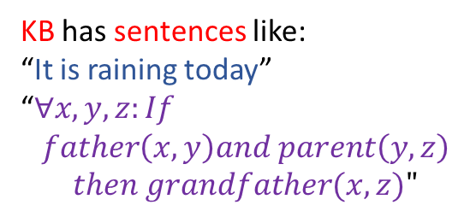
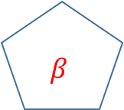
Knowledge contains “sentences” – an abstraction of the real world situation
KB
$$β$$
Inference
The agent
KB has sentences like: “It is raining today” “$∀x,y,z:If$ $father\left(x,y\right)and parent\left(y,z\right)$
$$then grandfather(x,z)"$$
Real world
“follows”

Slide 4
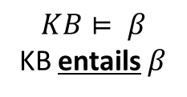
Reasoning helps derive new information / action / decision from available KB
Reasoning Process
KB
$$β$$
Inference
1
The agent
Prior / Expert / Knowledge
$$KB⊨ β$$
KB entails $β$
How the entailment is done
Depends on the derivation or inferencing process used
2
Percept
The language used to represent the knowledge constrains what can be represented in the KB

Slide 5

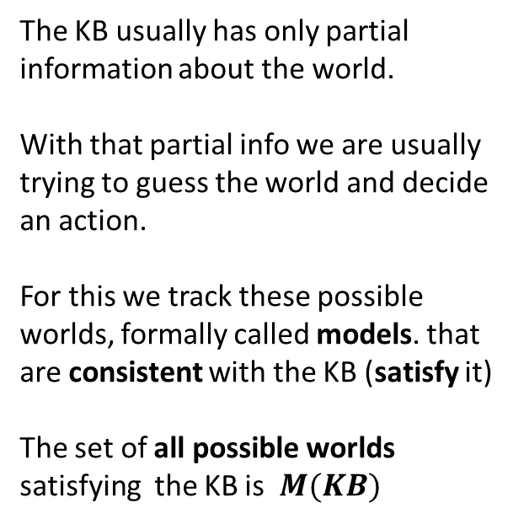




Model and Entailment
Reasoning Process
KB
$$β$$
Inference
1
The agent
Prior / Expert / Knowledge
$$KB⊨ β$$
KB entails $β$
The KB usually has only partial information about the world. With that partial info we are usually trying to guess the world and decide an action.
For this we track these possible worlds, formally called models. that are consistent with the KB (satisfy it) The set of all possible worlds satisfying the KB is $M(KB)$
2
Percept
M₁
M₃
$$M(α)$$
M_{i} satisfies $α$
M₂
$$α$$
$$°°°°°°$$
$$if KB⊨ β , then M\left(KB\right)⊆M(β)$$

Slide 6
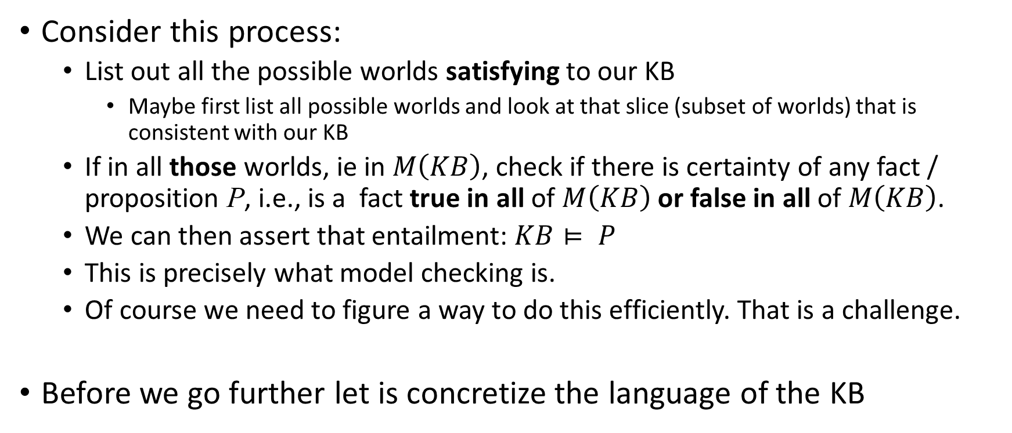
Model Checking
Consider this process:
List out all the possible worlds satisfying to our KB
Maybe first list all possible worlds and look at that slice (subset of worlds) that is consistent with our KB
If in all those worlds, ie in $M\left(KB\right)$, check if there is certainty of any fact / proposition P, i.e., is a fact true in all of $M\left(KB\right)$ or false in all of $M\left(KB\right)$.
We can then assert that entailment: $KB⊨ P$
This is precisely what model checking is.
Of course we need to figure a way to do this efficiently. That is a challenge.
Before we go further let is concretize the language of the KB

Slide 7
Knowledge representation
If we can have a language that is sufficiently powerful to succinctly represent the world, that is good.
If we can have a inferencing (reasoning) process for that language which derives only and all conclusions we want (ie it is sound and complete) that is good.
Lastly, we wish it to be efficient.
We take as a first example of a logic language – Propositional Logic
We look at an inferencing process for that language.

Slide 8
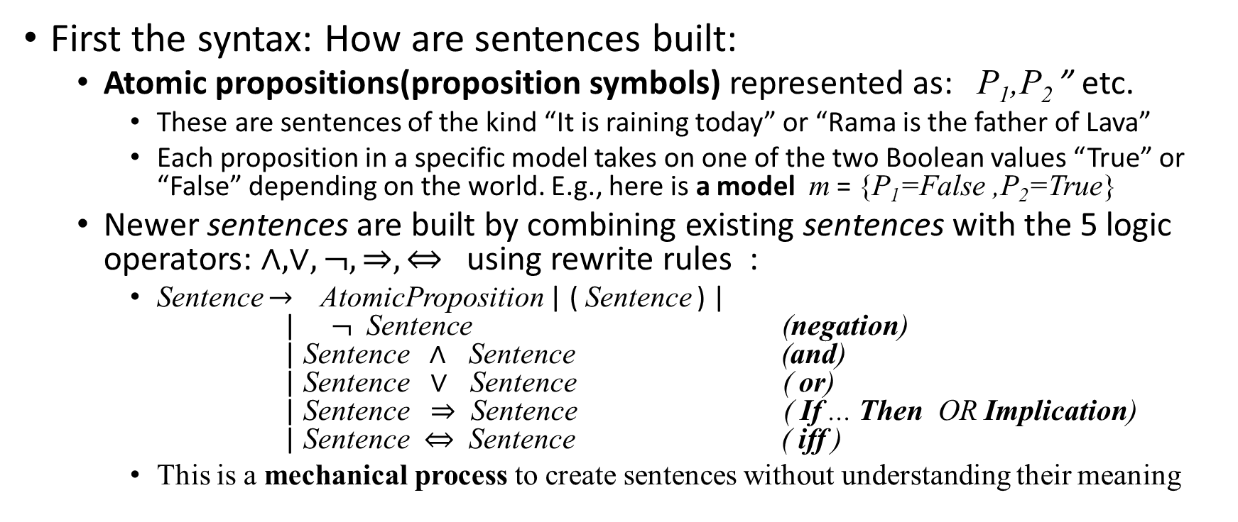
Propositional Logic – The Language
First the syntax: How are sentences built:
Atomic propositions(proposition symbols) represented as: P₁,P₂ ” etc.
These are sentences of the kind “It is raining today” or “Rama is the father of Lava”
Each proposition in a specific model takes on one of the two Boolean values “True” or “False” depending on the world. E.g., here is a model m = {P₁=False ,P₂=True}
Newer sentences are built by combining existing sentences with the 5 logic operators: $∧,∨, ¬, ⇒, ⇔$using rewrite rules :
Sentence $→$ AtomicProposition | ( Sentence ) | | $¬$ Sentence (negation) | Sentence $∧$ Sentence (and) | Sentence $∨$ Sentence ( or) | Sentence $⇒$ Sentence ( If ... Then OR Implication) | Sentence $⇔$ Sentence ( iff )
This is a mechanical process to create sentences without understanding their meaning

Slide 9
Meaning of sentences : Semantics
Each Atomic Proposition is true or false in a world.
For every other sentence, its meaning is defined by deriving a truth value to it from our usual knowledge of (well codified in) the truth table of the logic operators.
We’ll admit two propositions “True” and “False” as propositions that are respectively True and False in all worlds.
Lets understand propositional logic further by creating a concrete example.

Slide 10
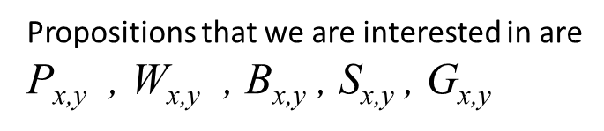
Wumpus world
Agent A needs to get the gold and come back to the starting position
The Wumpus emits a stink that can be sensed in 4 adjacent squares.
The pit causes a breeze in the 4 adjacent squares
A
Propositions that we are interested in are
P_{x,y} , W_{x,y} , B_{x,y} , S_{x,y} , G_{x,y}

Slide 11
Wumpus world
KB after sensing at (1,1)
4
3
2
1
OK
A
A
OK
OK
1 2 3 4

Slide 12
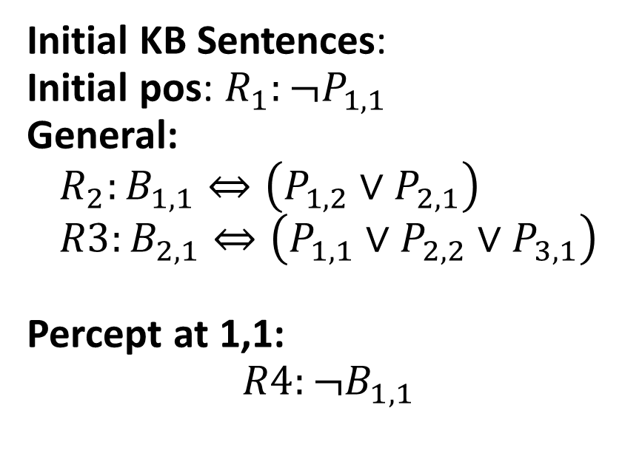
Wumpus world
KB after sensing at (1,1)
4
3
2
1
Initial KB Sentences: Initial pos: $R_{1}:¬P_{1,1}$ General: $$R_{2}:B_{1,1}⇔\left(P_{1,2}∨P_{2,1}\right) \\ R3:B_{2,1}⇔\left({P_{1,1}∨P}_{2,2}∨P_{3,1}\right)$$ Percept at 1,1:
$$R4:¬B_{1,1}$$
OK
A
OK
OK
1 2 3 4
We want to use reasoning to conclude: $¬P_{1,2} , ¬P_{2,1}$

Slide 13
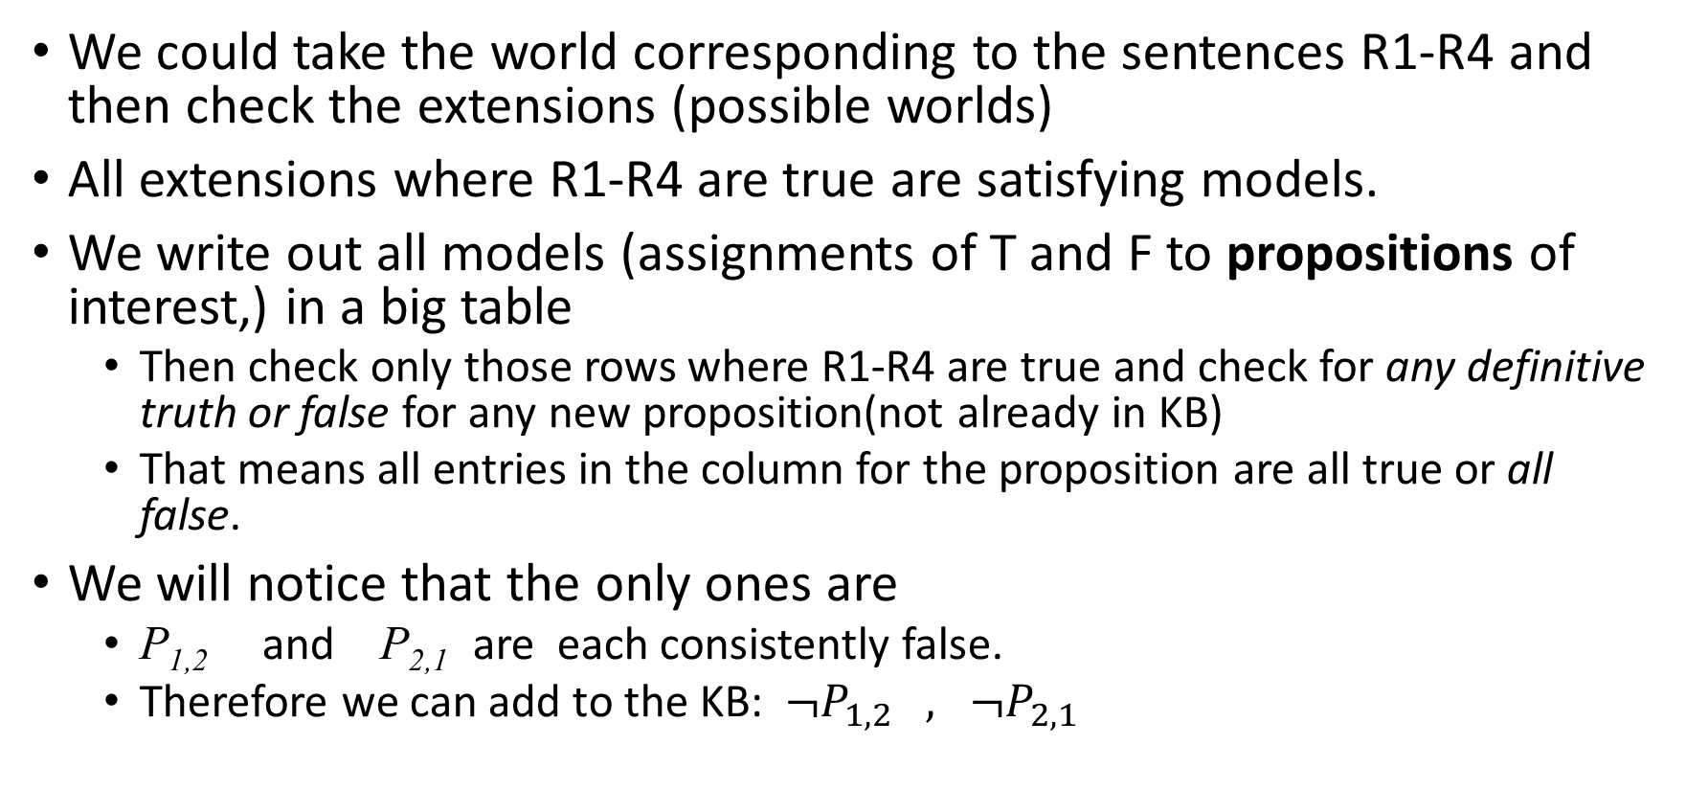
Using model checking to Reason
We could take the world corresponding to the sentences R1-R4 and then check the extensions (possible worlds)
All extensions where R1-R4 are true are satisfying models.
We write out all models (assignments of T and F to propositions of interest,) in a big table
Then check only those rows where R1-R4 are true and check for any definitive truth or false for any new proposition(not already in KB)
That means all entries in the column for the proposition are all true or all false.
We will notice that the only ones are
P_{1,2} and P_{2,1} are each consistently false.
Therefore we can add to the KB: $¬P_{1,2} , ¬P_{2,1}$

Slide 14
Model checking can be time consuming
Table is large and grows quickly with the number of propositions and info in the knowledge base.
This is an area of research
Model checking in general is very useful and widely used to make decisions
We will however spend more time now on using logic reasoning to make decisions.

Slide 15
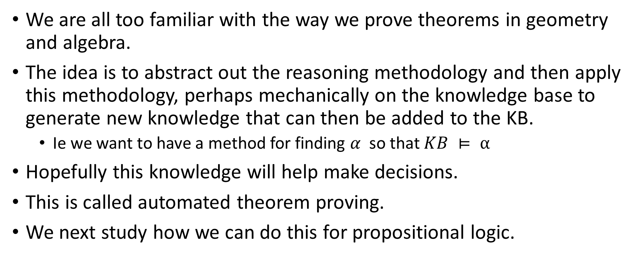
Theorem Proving as a method to make decisions
We are all too familiar with the way we prove theorems in geometry and algebra.
The idea is to abstract out the reasoning methodology and then apply this methodology, perhaps mechanically on the knowledge base to generate new knowledge that can then be added to the KB.
Ie we want to have a method for finding $α$ so that $KB ⊨ α$
Hopefully this knowledge will help make decisions.
This is called automated theorem proving.
We next study how we can do this for propositional logic.

Slide 16
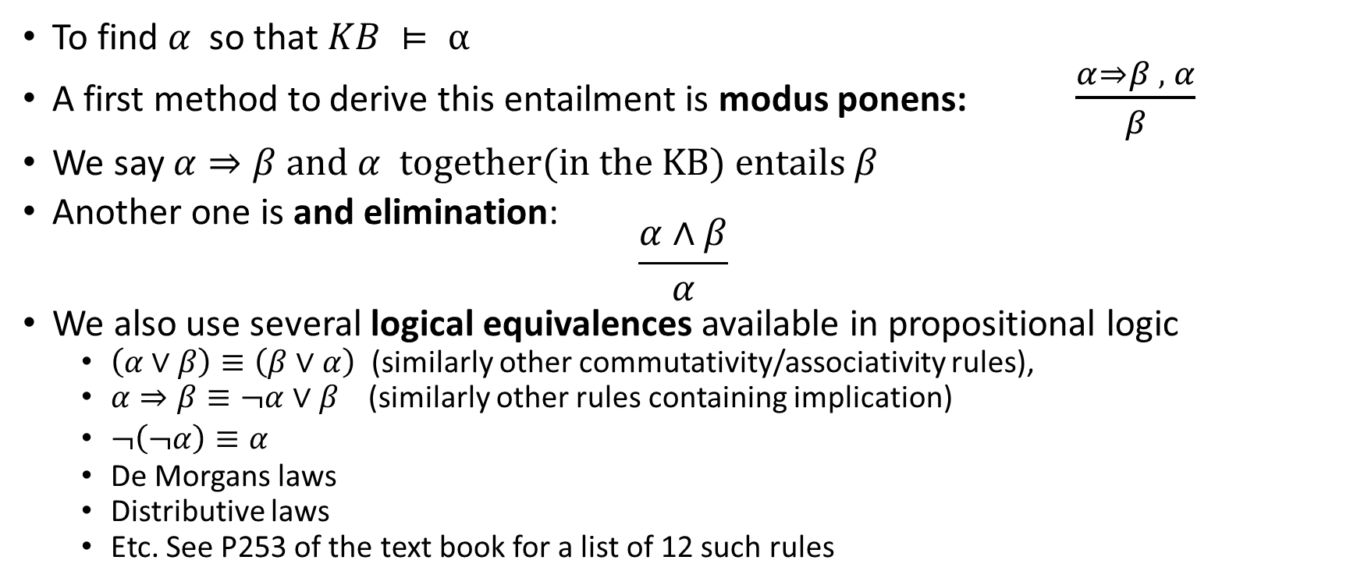
Entailment in propositional logic
To find $α$ so that $KB ⊨ α$
A first method to derive this entailment is modus ponens: $\frac{α⇒β , α}{β}$
We say $α⇒β \text{and} α \text{together}\text{(}\text{in} \text{the} \text{KB}\text{) }\text{entails} β$
Another one is and elimination: $\frac{α∧β}{α}$
We also use several logical equivalences available in propositional logic
$\left(α∨β\right)≡\left(β∨α\right)$ (similarly other commutativity/associativity rules),
$α⇒β≡¬α∨β$(similarly other rules containing implication)
$¬\left(¬α\right)≡α$
De Morgans laws
Distributive laws
Etc. See P253 of the text book for a list of 12 such rules

Slide 17
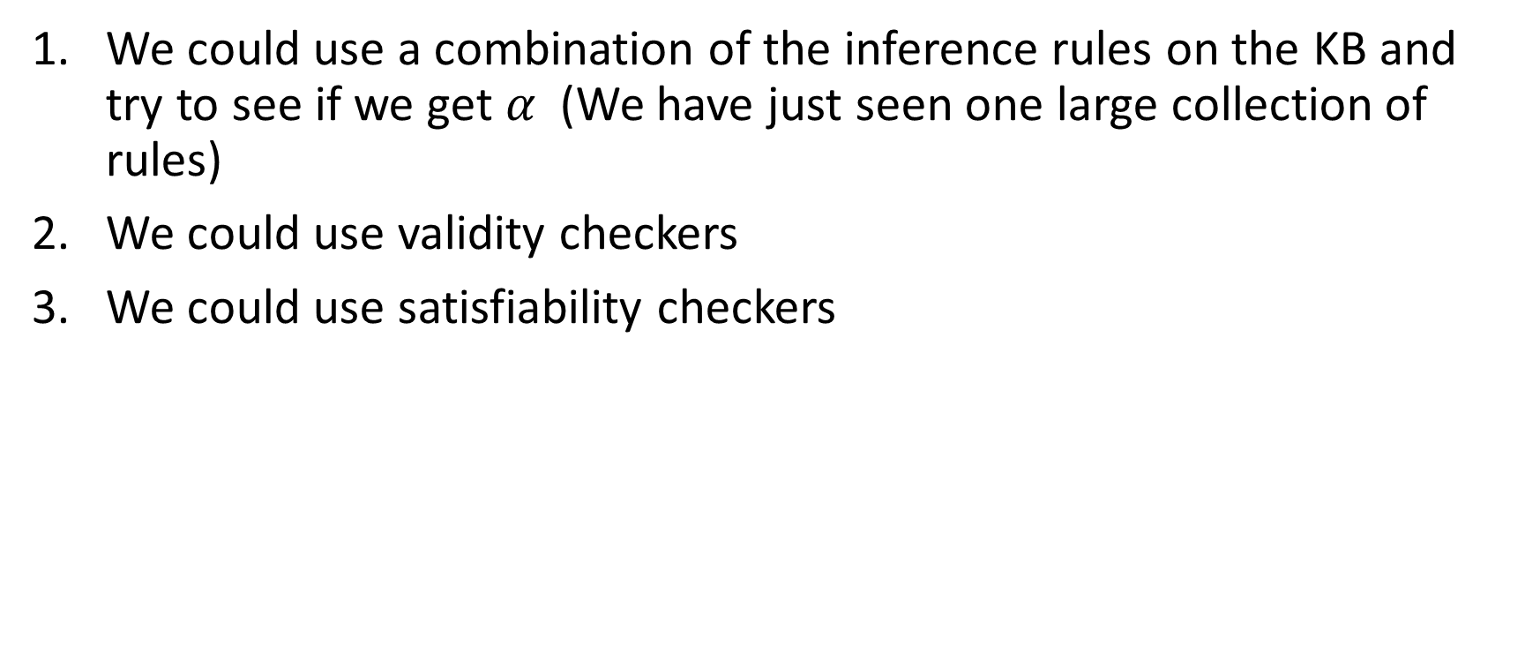

Deciding $KB ⊨α \text{for} \text{a} \text{given} α$
We could use a combination of the inference rules on the KB and try to see if we get $α$(We have just seen one large collection of rules)
We could use validity checkers
We could use satisfiability checkers

Slide 18
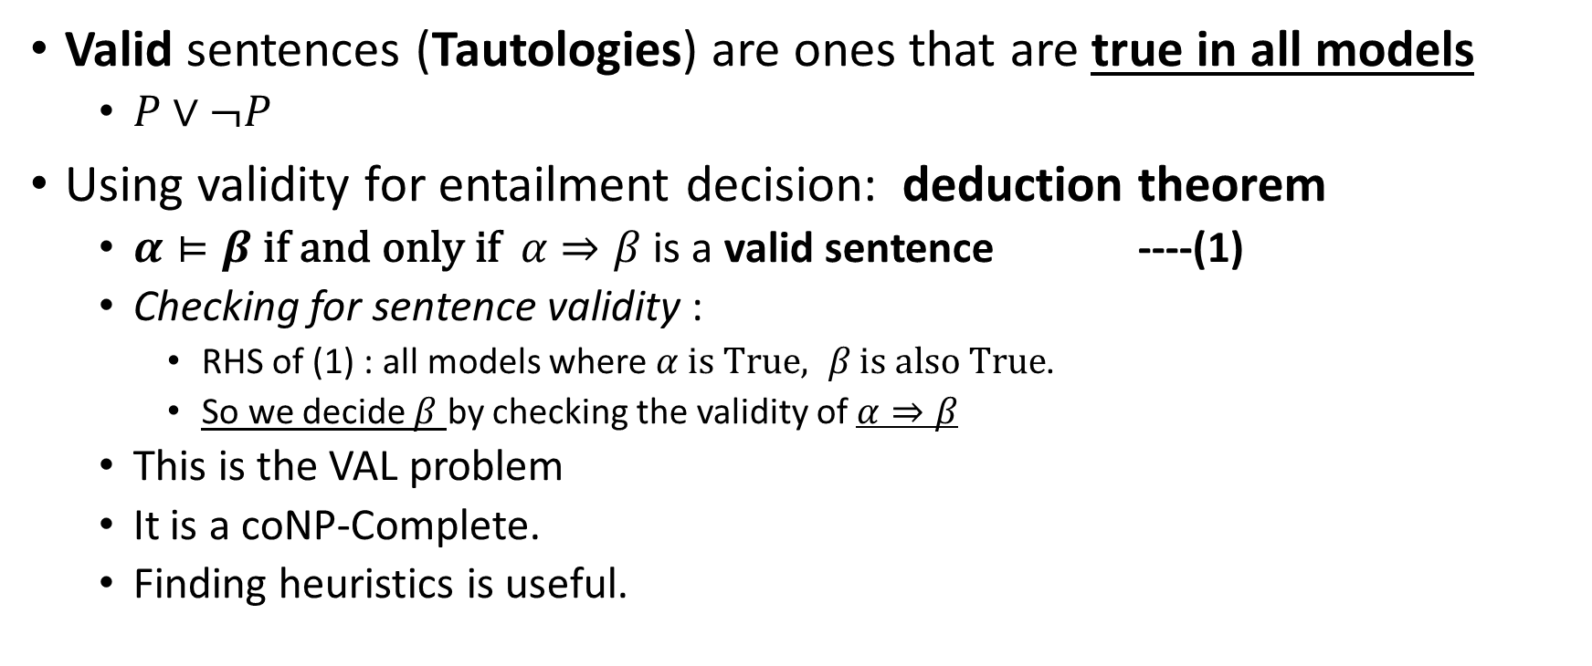
Validity
Valid sentences (Tautologies) are ones that are true in all models
$P∨¬P$
Using validity for entailment decision: deduction theorem
$α⊨β \text{if} \text{and} \text{only} \text{if} α⇒β$ is a valid sentence ----(1)
Checking for sentence validity :
RHS of (1) : all models where $α \text{is} True, β \text{is} \text{also} \text{True}$.
So we decide $β$ by checking the validity of $α⇒β$
This is the VAL problem
It is a coNP-Complete.
Finding heuristics is useful.

Slide 19
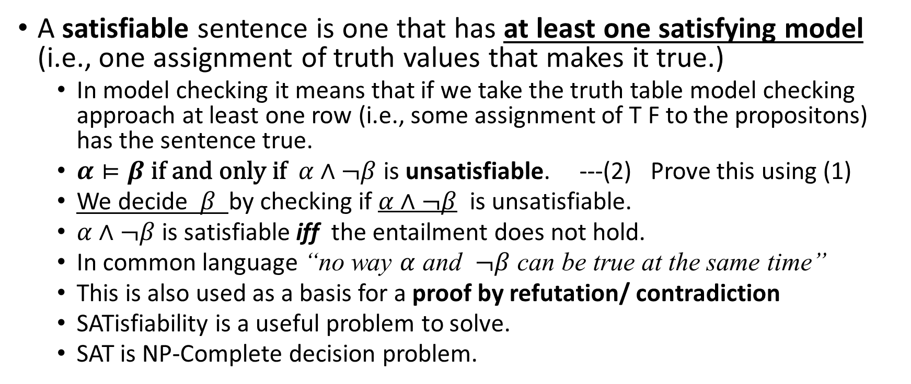
Satisfiability
A satisfiable sentence is one that has at least one satisfying model (i.e., one assignment of truth values that makes it true.)
In model checking it means that if we take the truth table model checking approach at least one row (i.e., some assignment of T F to the propositons) has the sentence true.
$α⊨β \text{if} \text{and} \text{only} \text{if} α∧¬β$ is unsatisfiable. ---(2) Prove this using (1)
We decide $β$ by checking if $α∧¬β$ is unsatisfiable.
$α∧¬β$ is satisfiable iff the entailment does not hold.
In common language “no way $α$ and $¬β$ can be true at the same time”
This is also used as a basis for a proof by refutation/ contradiction
SATisfiability is a useful problem to solve.
SAT is NP-Complete decision problem.

Slide 20
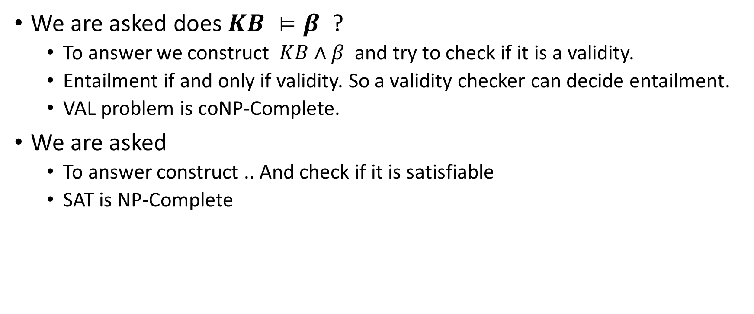
VAL and SAT are both useful in deciding entailment of a given statement from the KB
We are asked does $KB ⊨β$ ?
To answer we construct $KB∧β$ and try to check if it is a validity.
Entailment if and only if validity. So a validity checker can decide entailment.
VAL problem is coNP-Complete.
We are asked
To answer construct .. And check if it is satisfiable
SAT is NP-Complete

Slide 21
The process of deriving entailments
How to enlarge a given KB:.
Repeatedly use inference to derive new facts
Find a matching inference rule ‘top half’
Add the ‘bottom half’ to the KB
This process itself is like a search.
Actions – one of the inference rules and the corresponding match
Result – add the bottom half of the inference rule to the KB
Repeat this until goal is reached or no new sentences are added.
For Wumpus world at each time step we wish to do a search (DFS)
We do that by simply adding the percept to the KB, enlarging the KB, choosing the next action for the DFS.
We do this until the goal is reached.

Slide 22
Exercise
Back to Wumpus world. Now we have a technique to make new sentences. Each time we make a new sentence that a cell has no Wumpus and no Pit, it becomes “OK”, ie a valid cell to move to. So now we can tell our search method, like DFS that it can explore that cell.
So the Agent in the Wumpus world move around and try to build its KB as it moves around using the 12 equivalences and Modus ponens, until it finds the gold. After that it needs to retrace its way back to the starting square to complete its mission.
There are two challenges. One is a computations challenge – how do we write programs to make these inferences.
Another challenge that we face where we do this exercise is to decide which of the entailment methods to use to find the next new sentence.
You will notice that we are assuming that ach time we add a percept to the KB, it keeps the KB consistent all conclusions so far drawn. This is called monotonicity.
For example if the world change in some ways over time, it is no longer monotonic e.g., in a game a new Wumpus appearing or disappearing may change our conclusions.

Slide 23
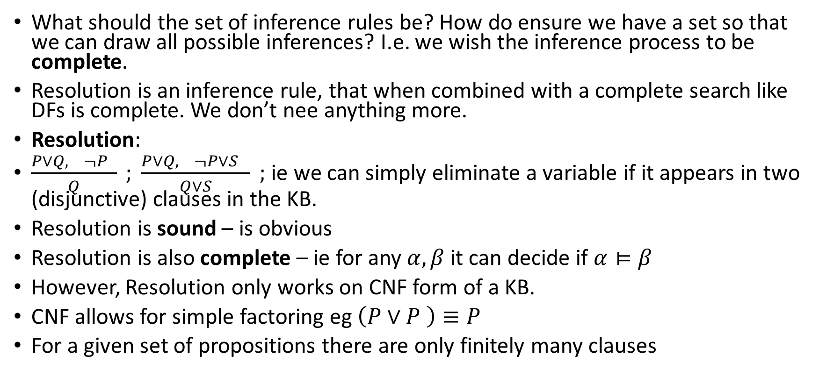
Reasoning and the resolution rule
What should the set of inference rules be? How do ensure we have a set so that we can draw all possible inferences? I.e. we wish the inference process to be complete.
Resolution is an inference rule, that when combined with a complete search like DFs is complete. We don’t nee anything more.
Resolution:
$\frac{P∨Q, ¬P }{Q} ; \frac{P∨Q, ¬P∨S }{Q∨S} ;$ie we can simply eliminate a variable if it appears in two (disjunctive) clauses in the KB.
Resolution is sound – is obvious
Resolution is also complete – ie for any $α, β$ it can decide if $α⊨β$
However, Resolution only works on CNF form of a KB.
CNF allows for simple factoring eg $\left(P∨P \right)≡P$
For a given set of propositions there are only finitely many clauses

Slide 24
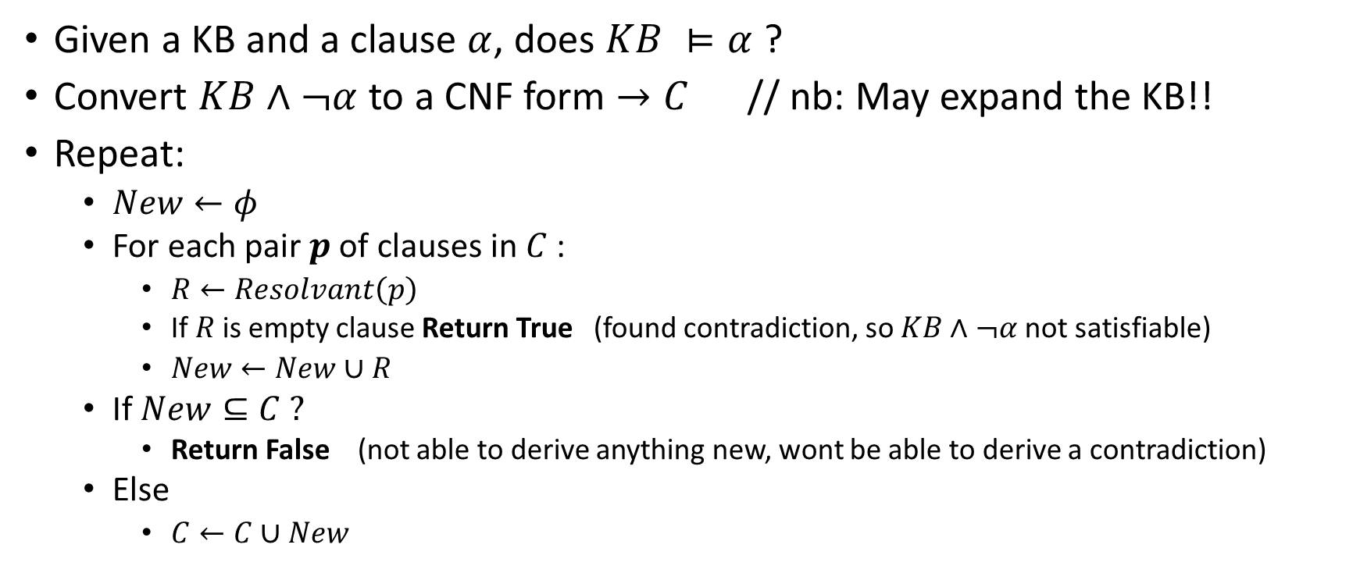
The Resolution Algorithm
Given a KB and a clause $α$, does $KB ⊨α$ ?
Convert $KB∧¬α$to a CNF form $→C$ // nb: May expand the KB!!
Repeat:
$New←φ$
For each pair $p$ of clauses in $C$ :
$R←Resolvant\left(p\right)$
If $R$ is empty clause Return True (found contradiction, so $KB∧¬α$ not satisfiable)
$New←New∪R$
If $New⊆C ?$
Return False (not able to derive anything new, wont be able to derive a contradiction)
Else
$C←C∪New$

Slide 25

This is useful because we often want to ask a question like (in the Wumpus world) is it true (from what we know in the KB) that $P_{1,2}$?

Slide 26
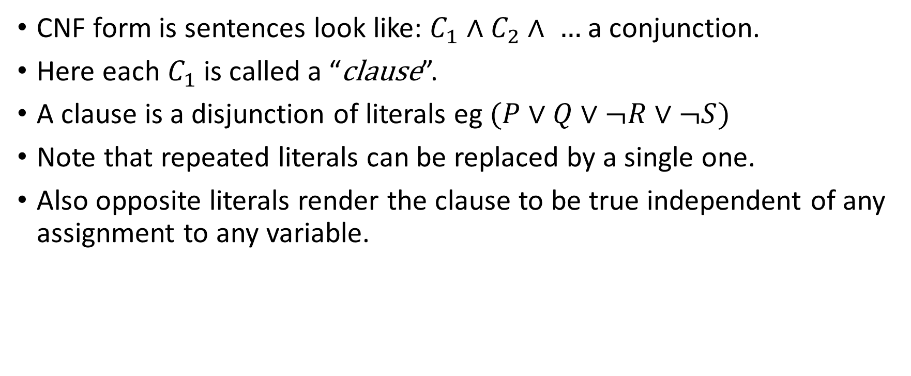
Getting the KB into CNF form: What is CNF
CNF form is sentences look like: $C_{1}∧C_{2}∧ …$ a conjunction.
Here each $C_{1}$ is called a “clause”.
A clause is a disjunction of literals eg $(P∨Q∨¬R∨¬S)$
Note that repeated literals can be replaced by a single one.
Also opposite literals render the clause to be true independent of any assignment to any variable.

Slide 27
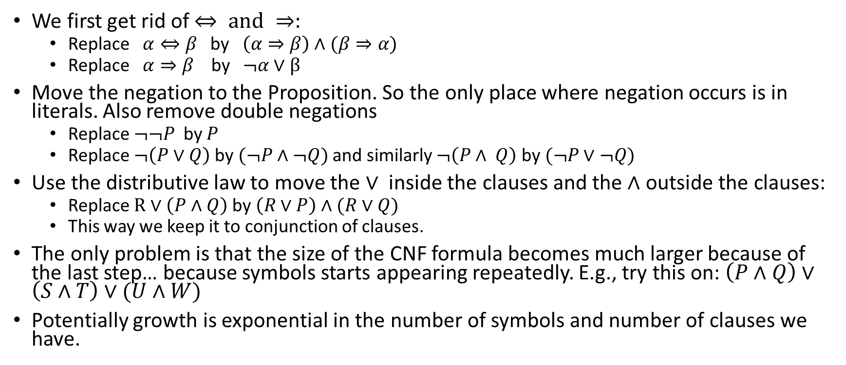
Getting the KB into CNF form: The algorithm
We first get rid of $⇔ \text{and} ⇒:$
Replace $α⇔β$ by $\left(α⇒β\right)∧(β⇒α)$
Replace $α⇒β$ by $¬α∨β$
Move the negation to the Proposition. So the only place where negation occurs is in literals. Also remove double negations
Replace $¬¬P$ by $P$
Replace $¬\left(P∨Q\right)$ by$(¬P∧¬Q)$ and similarly $¬\left(P∧ Q\right)$ by$(¬P∨¬Q)$
Use the distributive law to move the $∨$ inside the clauses and the $∧$ outside the clauses:
Replace $R∨\left(P∧Q\right)$ by$\left(R∨P\right)∧(R∨Q)$
This way we keep it to conjunction of clauses.
The only problem is that the size of the CNF formula becomes much larger because of the last step… because symbols starts appearing repeatedly. E.g., try this on: $\left(P∧Q\right)∨\left(S∧T\right)∨(U∧W)$
Potentially growth is exponential in the number of symbols and number of clauses we have.

Slide 28
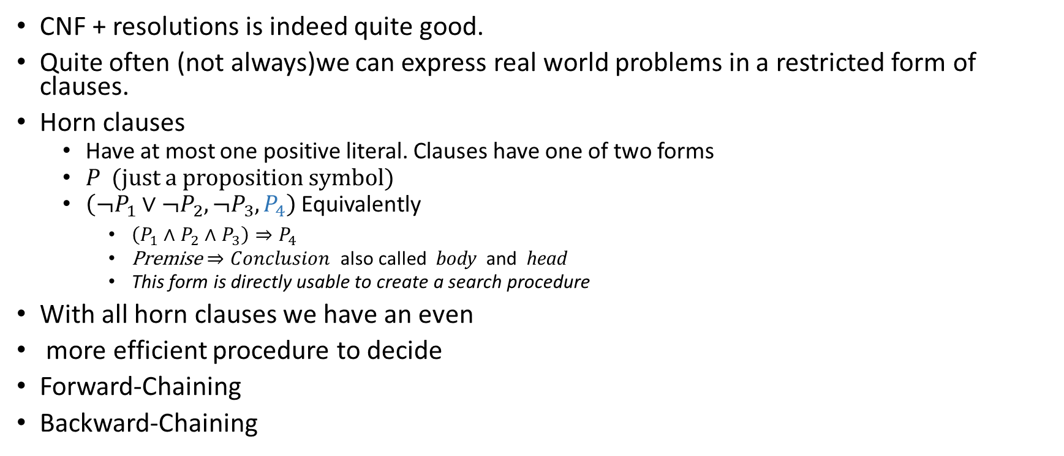
Horn Clauses and Logic programming
CNF + resolutions is indeed quite good.
Quite often (not always)we can express real world problems in a restricted form of clauses.
Horn clauses
Have at most one positive literal. Clauses have one of two forms
$P$ (just a proposition symbol)
$\left(¬P_{1}∨¬P_{2}, ¬P_{3}, P_{4}\right)$Equivalently
$\left(P_{1}∧P_{2}∧P_{3}\right)⇒P_{4}$
Premise $⇒Conclusion$ also called body and head
This form is directly usable to create a search procedure
With all horn clauses we have an even
more efficient procedure to decide
Forward-Chaining
Backward-Chaining

Slide 29
Forward chaining
Given KB and a query q we want to know if: KB entails q ?
S = { all propositions known true in KB }, keep a count of unsatisfied premises of each clause in KB
While S not empty do p := Pop(S) if (p == q) return true if (! Inferred(p) ) then inferred(p):= true for each clause in KB that has p in premise decrement count_of_unsatisfied_premise(c) if the count became zero put conclusion of c into S
return false

Slide 30
Backward chaining
Forward chaining can create many conclusions that are not useful.
We could do even better by simply going back from the required conclusion.
This is done in an AND-OR Tree fashion.

Slide 31
An algorithm for SAT (DPLL)
Model checking can be made efficient using some ideas (heuristics).. These eliminate clauses or force assignments ( reminiscent of constraint propagation)
Early termination/ truncation of search – false clause assignment, short circuit for ‘true’ facts
Pure symbols – these give freedom to choose the truth value without affecting others.
Unit clauses (as in forward chaining)
The idea is to recursively descend the search tree(degree 3), while doing the above.

Slide 32
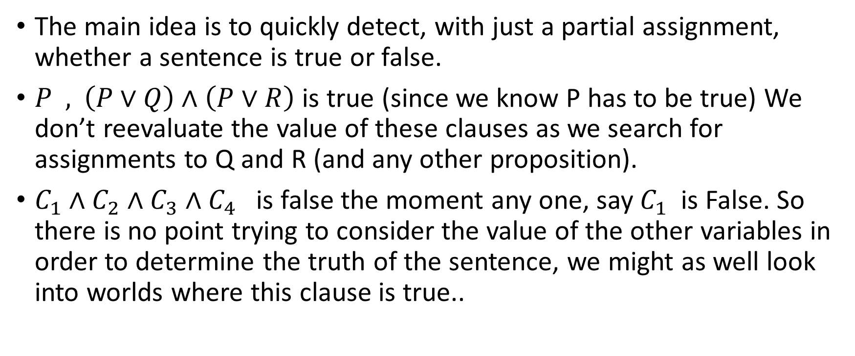
Early termination detection for SAT
The main idea is to quickly detect, with just a partial assignment, whether a sentence is true or false.
$P \text{ , }\left(P∨Q\right)∧\left(P∨R\right)$ is true (since we know P has to be true) We don’t reevaluate the value of these clauses as we search for assignments to Q and R (and any other proposition).
$C_{1}∧C_{2}∧C_{3}∧C_{4}$ is false the moment any one, say $C_{1}$ is False. So there is no point trying to consider the value of the other variables in order to determine the truth of the sentence, we might as well look into worlds where this clause is true..

Slide 33
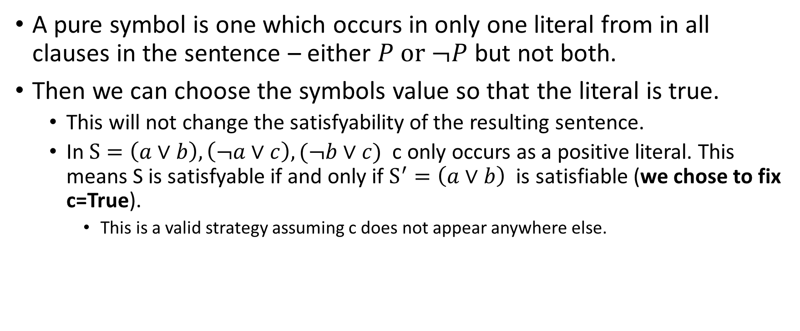
Pure symbols heuristic for SAT
A pure symbol is one which occurs in only one literal from in all clauses in the sentence – either $P \text{or} ¬P$ but not both.
Then we can choose the symbols value so that the literal is true.
This will not change the satisfyability of the resulting sentence.
In $S=\left(a∨b\right), \left(¬a∨c\right), (¬b∨c)$ c only occurs as a positive literal. This means S is satisfyable if and only if $S^{′}=\left(a∨b\right)$is satisfiable (we chose to fix c=True).
This is a valid strategy assuming c does not appear anywhere else.

Slide 34
Unit clauses heuristic for SAT
A clause that is just one literal is a special case. We must take the symbol to be the value which makes the literal True.
This is like constraint propagation.
Or like resolution on Horn clauses in forward chaining.

Slide 35

The behavior of $CNF_{k}(m,n)$
The ratio r=m/n seems to have some threshold. (m clauses, n vars)
For small values (ie fewer clauses and more variables) a randomly generated formula is very likely satisfiable.
For large values (ie more clauses) a randomly generated clause is not satisfiable.
The change also seems to happen drastically (ie there is a marked threshold.
This suggests also that a random assignment may possibly work well.

Slide 36
A rough graph of how satisfiability varies with m/n

Slide 37
A local search algorithm for SAT (Walksat)
Start with a random assignment of truth values to all variables.
for(i=0;i<TimeLimit;i++) {
if ( model satisfies all clauses ) return the model else Choose a random false clause F and do one of: 1. Randomly choose a variable in F and flip-it OR 2. Choose a variable in F so that flipping it minimizes number of false clauses, then flip it.
}
return {}

Slide 38
Back to constructing an agent for Wumpus world – An agent algorithm
The strategy we discussed so far was:
Repeat for a given initial KB( ie initial location, facts, “rules” etc): Get percepts Convert them to assertions add them to the KB
Ask KB for conclusion about each possible adjacent safe squares of interest. Use an algorithm like DFS / A* to explore the next action
Take the action
// The algorithm may give up after some time. Or if the exploration step // finds nothing new
// note that the world is static. All percepts and assertions once made are true. The only thing that changes is the agents location.

Slide 39
Assumptions
One assumption we made was the world does not change, even for actions taken by the agent.
Lets try to model time, even of things don’t change.
So that we can see if we can derive a sequence of steps (offline plan) directly from SAT satisfiability given an initial state

Slide 40
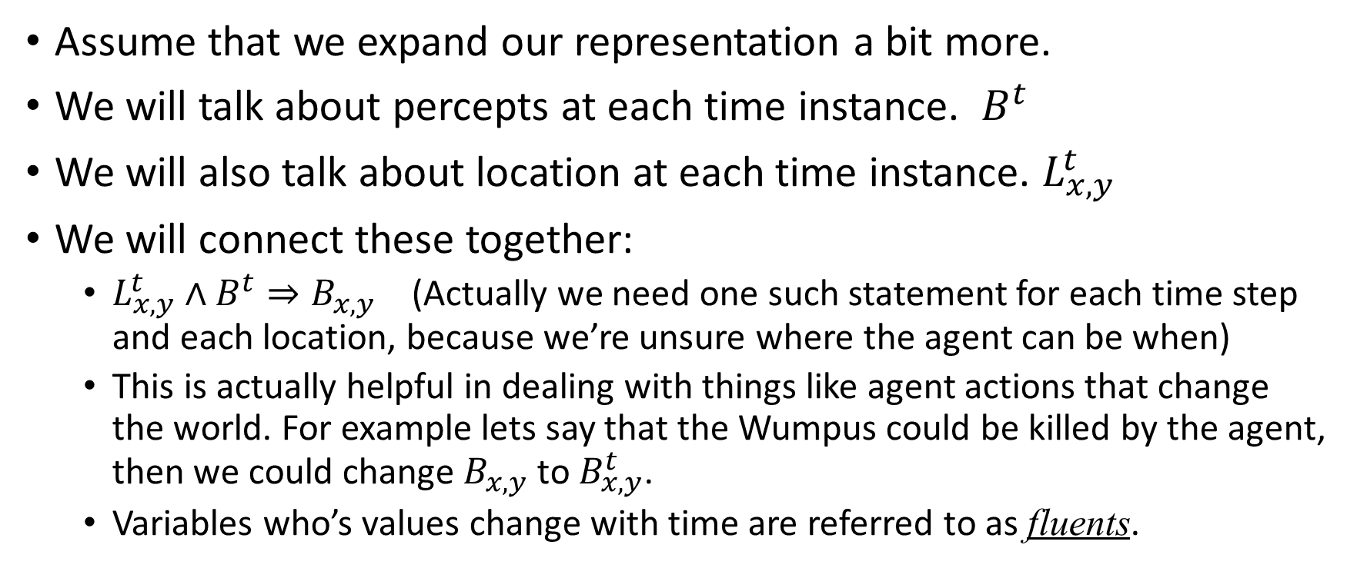
Using SatPlan to plan (offline)
Assume that we expand our representation a bit more.
We will talk about percepts at each time instance. $B^{t}$
We will also talk about location at each time instance. $L_{x,y}^{t}$
We will connect these together:
$L_{x,y}^{t}$ $∧B^{t}⇒B_{x,y}$ (Actually we need one such statement for each time step and each location, because we’re unsure where the agent can be when)
This is actually helpful in dealing with things like agent actions that change the world. For example lets say that the Wumpus could be killed by the agent, then we could change $B_{x,y}$ to $B_{x,y}^{t}$.
Variables who’s values change with time are referred to as fluents.

Slide 41
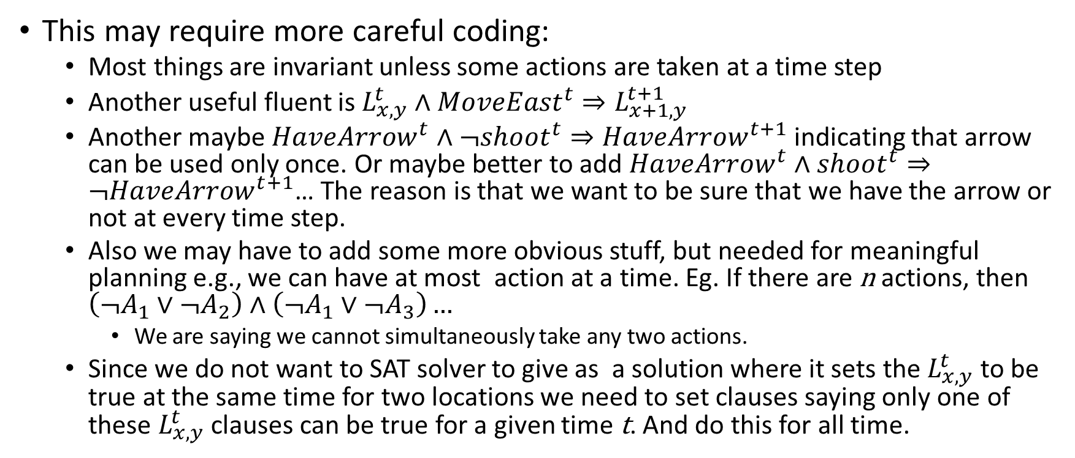
Working with SatPlan
This may require more careful coding:
Most things are invariant unless some actions are taken at a time step
Another useful fluent is $L_{x,y}^{t}$ $∧{MoveEast}^{t}⇒L_{x+1,y}^{t+1}$
Another maybe $HaveArrow^{t}∧¬shoot^{t}⇒HaveArrow^{t+1}$indicating that arrow can be used only once. Or maybe better to add $HaveArrow^{t}∧shoot^{t}⇒¬HaveArrow^{t+1}$… The reason is that we want to be sure that we have the arrow or not at every time step.
Also we may have to add some more obvious stuff, but needed for meaningful planning e.g., we can have at most action at a time. Eg. If there are n actions, then $\left(¬A_{1}∨¬A_{2}\right)∧\left(¬A_{1}∨{¬A}_{3}\right)…$
We are saying we cannot simultaneously take any two actions.
Since we do not want to SAT solver to give as a solution where it sets the $L_{x,y}^{t}$ to be true at the same time for two locations we need to set clauses saying only one of these $L_{x,y}^{t}$ clauses can be true for a given time t. And do this for all time.

Slide 42
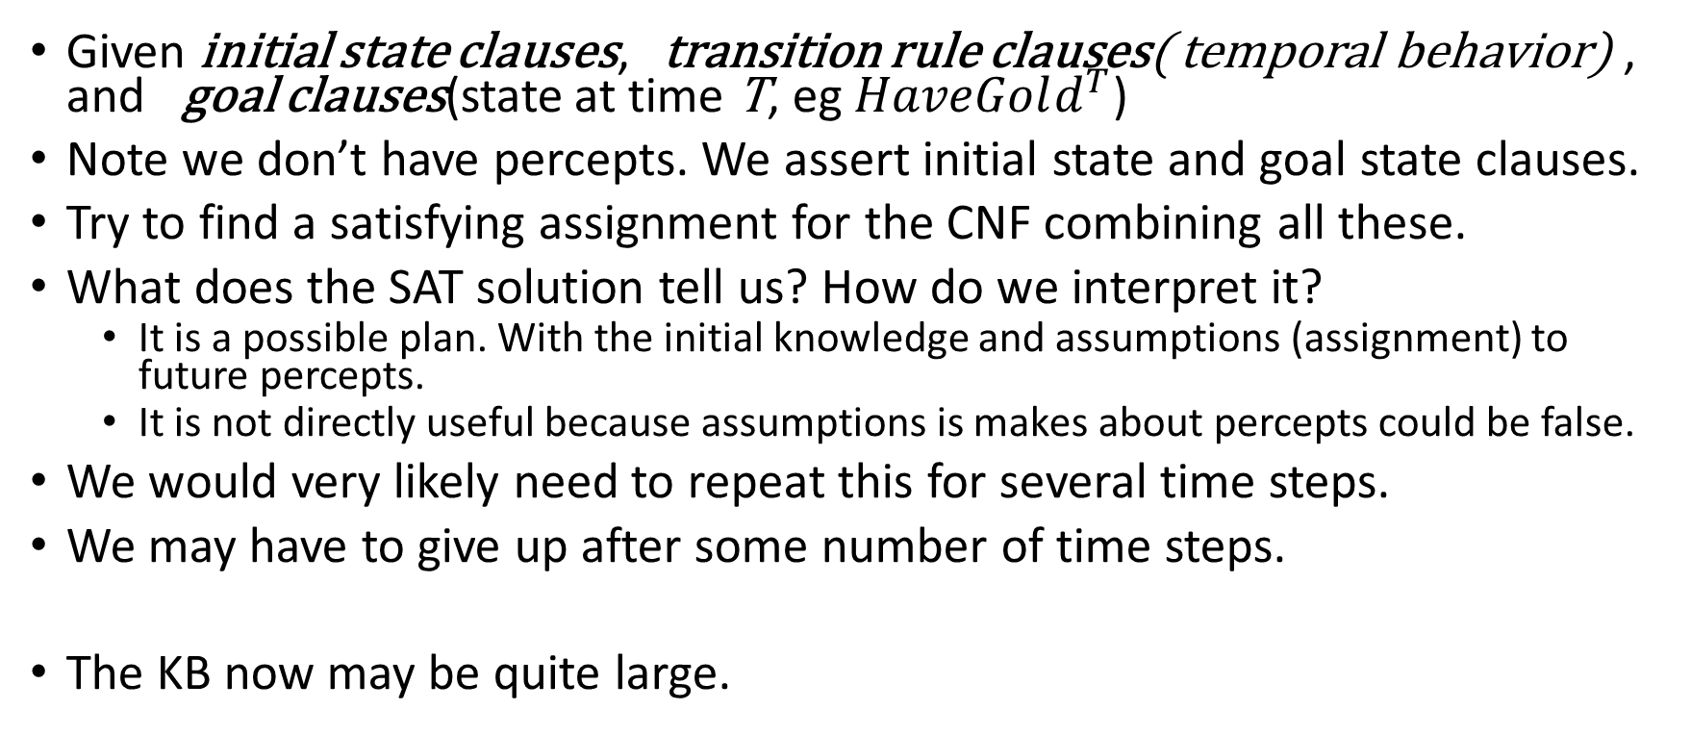
The SatPlan (offline) algorithm
Given initial state clauses, transition rule clauses( temporal behavior) , and goal clauses(state at time T, eg $HaveGold^{T}$)
Note we don’t have percepts. We assert initial state and goal state clauses.
Try to find a satisfying assignment for the CNF combining all these.
What does the SAT solution tell us? How do we interpret it?
It is a possible plan. With the initial knowledge and assumptions (assignment) to future percepts.
It is not directly useful because assumptions is makes about percepts could be false.
We would very likely need to repeat this for several time steps.
We may have to give up after some number of time steps.
The KB now may be quite large.

Slide 43
Two things
We can use the agent algorithm we saw earlier to build an agent even when things change over time. As an example we imagine in our Wumpus world, two changes:
The agent has an arrow that he can use exactly once.
The arrow can be thrown in any one of four directions at any time. It results in the Wumpus being killed if it is in any cell in that direction.
We’ll end up with a large KB. Perhaps we can survive if we take non-temporal facts (we know that the breeze fact does not change with time); and all temporal facts including conclusions at time t, to be enough to conclude whatever we want at time t+1.

Slide 44
Non-CNF SAT
As we know that our clause set can explode in size when converting an arbitrary SAT to CNF, we may wish to olve SAT directly for Non-CNF sentences.
This is a problem of resear

