Slide 1
Knowledge based agents – Using logic and inference

Slide 2
Logic:
An alternative to search and CSP: Knowledge representation and reasoning
Representation – represent what?
Reasoning – make decisions
Domain independent
Declarative approach (vs procedural approach)
More like human reasoning

Slide 3
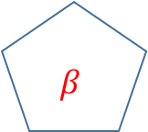
Knowledge contains statements – an abstraction of the real world situation
KB
$$β$$
Inference
The agent
Real world
“follows”

Slide 4
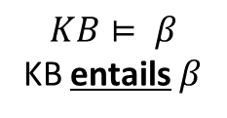
Reasoning helps derive new information / action / decision from available KB
Reasoning Process
KB
$$β$$
Inference
1
The agent
Prior / Expert / Knowledge
$$KB⊨ β$$
KB entails $β$
How the entailment is done
Depends on the derivation or inferencing process used
2
Percept
The language used to represent the knowledge constrains what can be represented in the KB

Slide 5




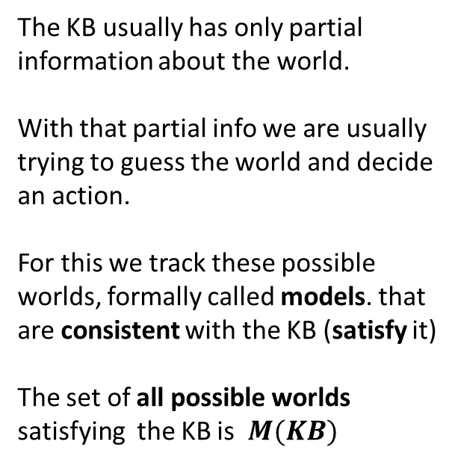

Model and Entailment
Reasoning Process
KB
$$β$$
Inference
1
The agent
Prior / Expert / Knowledge
$$KB⊨ β$$
KB entails $β$
The KB usually has only partial information about the world. With that partial info we are usually trying to guess the world and decide an action.
For this we track these possible worlds, formally called models. that are consistent with the KB (satisfy it) The set of all possible worlds satisfying the KB is $M(KB)$
2
Percept
M₁
M₃
$$M(α)$$
M_{i} satisfies $α$
M₂
$$α$$
$$°°°°°°$$
$$if KB⊨ β , then M\left(KB\right)⊆M(β)$$

Slide 6
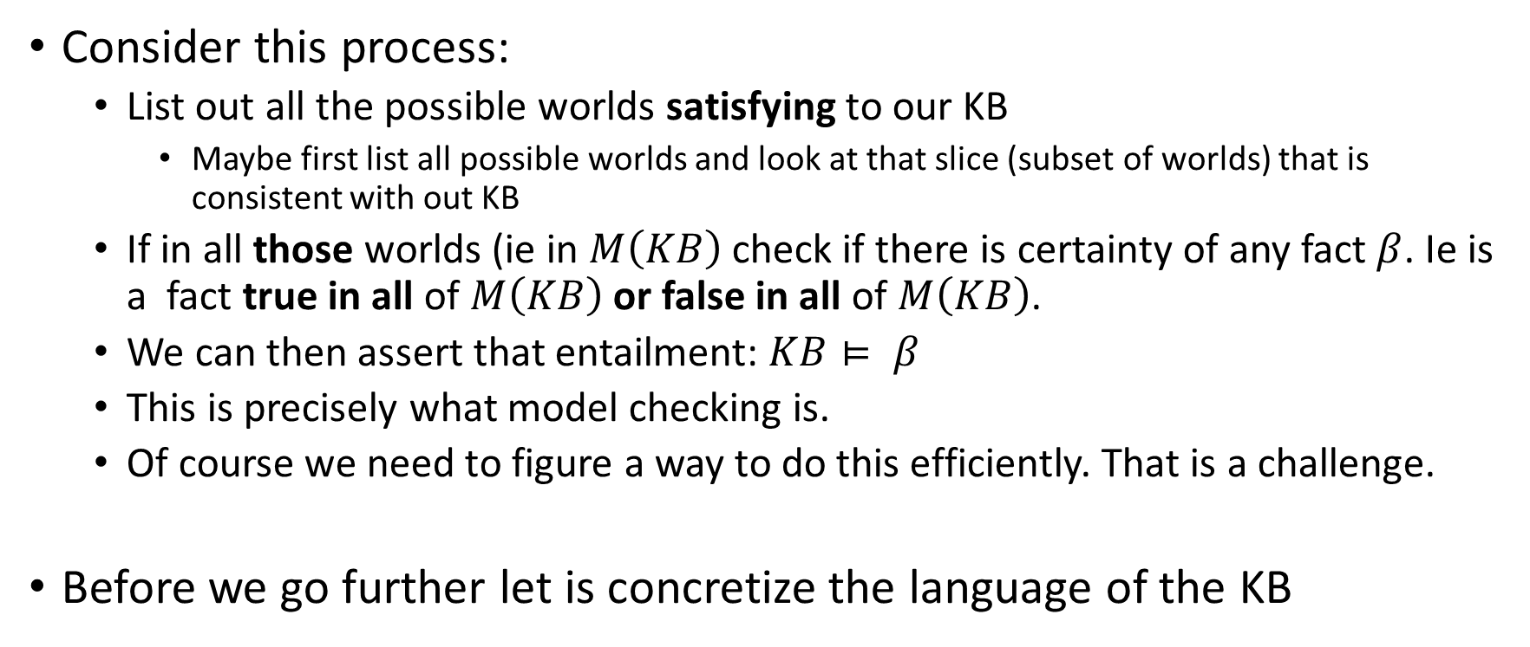
Model Checking
Consider this process:
List out all the possible worlds satisfying to our KB
Maybe first list all possible worlds and look at that slice (subset of worlds) that is consistent with out KB
If in all those worlds (ie in $M\left(KB\right)$ check if there is certainty of any fact $β$. Ie is a fact true in all of $M\left(KB\right)$ or false in all of $M\left(KB\right)$.
We can then assert that entailment: $KB⊨ β$
This is precisely what model checking is.
Of course we need to figure a way to do this efficiently. That is a challenge.
Before we go further let is concretize the language of the KB

Slide 7
Knowledge representation
If we can have a language that is sufficiently powerful to succinctly represent the world, that is good.
If we can have a reasoning process for that language which derives only and all conclusions we want (ie it is sound and complete) that is good.
Lastly, we wish it to be efficient.

Slide 8
KB
$$β$$
Inference
The agent
Real world
“follows”

