Slide 1
More about SAT Solvers and Knowledge based agent construction

Slide 2
A Model-checking approach to CNF-SAT (DPLL)
Note that so far our methods were based on logical entailment. Now we look at two non logical-entailment based approaches.
Model checking can be made efficient using some ideas (heuristics). These eliminate clauses or force assignments (reminiscent of constraint propagation)
Early termination/ truncation of search – false clause assignment, short circuit for ‘true’ facts
Pure symbols – these give freedom to choose the truth value without affecting others.
Unit clauses (as in forward chaining)
The idea is to recursively descend the search tree(degree 3), while doing the above.

Slide 3
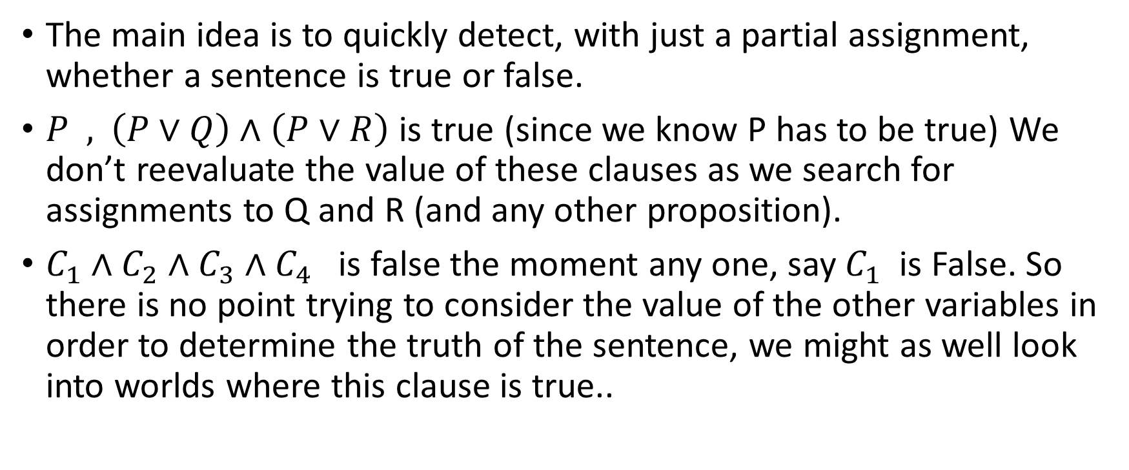
DPLL - Early termination detection for SAT
The main idea is to quickly detect, with just a partial assignment, whether a sentence is true or false.
$P \text{ , }\left(P∨Q\right)∧\left(P∨R\right)$ is true (since we know P has to be true) We don’t reevaluate the value of these clauses as we search for assignments to Q and R (and any other proposition).
$C_{1}∧C_{2}∧C_{3}∧C_{4}$ is false the moment any one, say $C_{1}$ is False. So there is no point trying to consider the value of the other variables in order to determine the truth of the sentence, we might as well look into worlds where this clause is true..

Slide 4
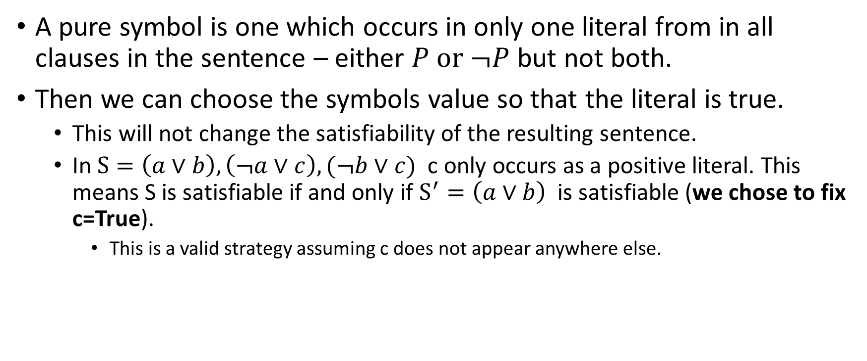
DPLL - Pure symbols heuristic for SAT
A pure symbol is one which occurs in only one literal from in all clauses in the sentence – either $P \text{or} ¬P$ but not both.
Then we can choose the symbols value so that the literal is true.
This will not change the satisfiability of the resulting sentence.
In $S=\left(a∨b\right), \left(¬a∨c\right), (¬b∨c)$ c only occurs as a positive literal. This means S is satisfiable if and only if $S^{′}=\left(a∨b\right)$is satisfiable (we chose to fix c=True).
This is a valid strategy assuming c does not appear anywhere else.

Slide 5
DPLL - Unit clauses heuristic for SAT
A clause that is just one literal is a special case. We must take the symbol to be the value which makes the literal True.
This is like constraint propagation.
Or like resolution on Horn clauses in forward chaining.

Slide 6
In real life DPLL based model checkers
These are enhanced with several of the techniques we learnt earlier for constraint propagation.

Slide 7
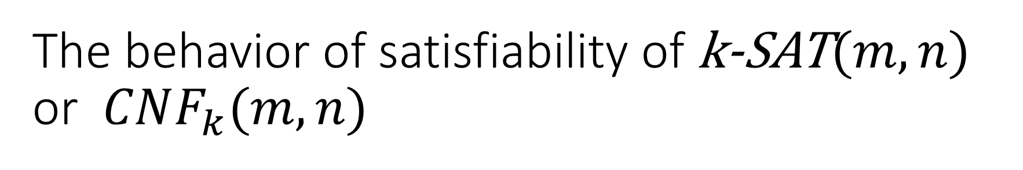
The behavior of satisfiability of k-SAT$(m,n)$ or $CNF_{k}(m,n)$
The ratio r=m/n seems to create a threshold. (m clauses, n vars)
For small values (ie fewer clauses and more variables) a randomly generated formula is very likely satisfiable.
For large values (ie more clauses) a randomly generated formula is not satisfiable.
The change also seems to happen drastically (i.e., there is a marked threshold).
This suggests also that a random assignment may possibly work well in real life.

Slide 8
A rough graph of how satisfiability varies with m/n
1 --
Exact graph depends on k, m and n
That a distinct threshold
exists is interesting
Probability of satisfiability
r=m/n

Slide 9
A local search algorithm for SAT (Walksat)
Start with a random assignment of truth values to all variables.
for(i=0;i<TimeLimit;i++) {
if ( model satisfies all clauses ) return the model else Choose a random false clause F and do one of: 1. Randomly choose a variable in F and flip-it OR 2. Choose a variable in F so that flipping it minimizes number of false clauses, then flip it.
}
return {}

Slide 10
Back to creating our KB based agent (Wumpus world)

Slide 11
Back to constructing an agent for Wumpus world – An agent algorithm
The strategy we discussed so far was:
Repeat for a given initial KB( ie initial location, facts, “rules” etc): Get percepts Convert them to assertions add them to the KB
Ask KB for conclusion about each possible adjacent safe squares of interest. Use an algorithm like DFS / A* to explore the next action
Take the action
// The algorithm may give up after some time. Or if the exploration step // finds nothing new
// note that the world is static. All percepts and assertions once made are true. The only thing that changes is the agents location.

Slide 12
Assumptions
One assumption we made was the world does not change, even for actions taken by the agent.
Lets try to model time, even of things don’t change.
So that we can see if we can derive a sequence of steps (offline plan) directly from SAT satisfiability given an initial state

Slide 13
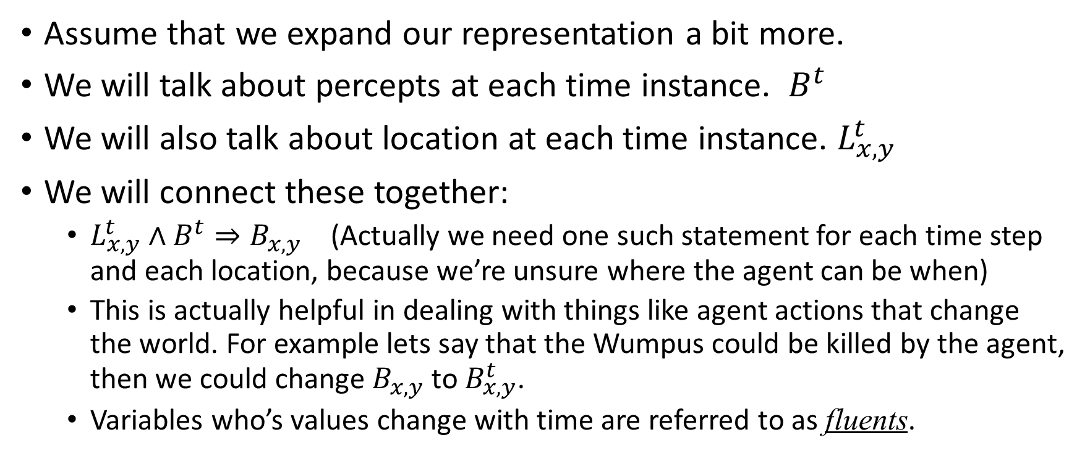
Using SatPlan to plan (offline)
Assume that we expand our representation a bit more.
We will talk about percepts at each time instance. $B^{t}$
We will also talk about location at each time instance. $L_{x,y}^{t}$
We will connect these together:
$L_{x,y}^{t}$ $∧B^{t}⇒B_{x,y}$ (Actually we need one such statement for each time step and each location, because we’re unsure where the agent can be when)
This is actually helpful in dealing with things like agent actions that change the world. For example lets say that the Wumpus could be killed by the agent, then we could change $B_{x,y}$ to $B_{x,y}^{t}$.
Variables who’s values change with time are referred to as fluents.

Slide 14
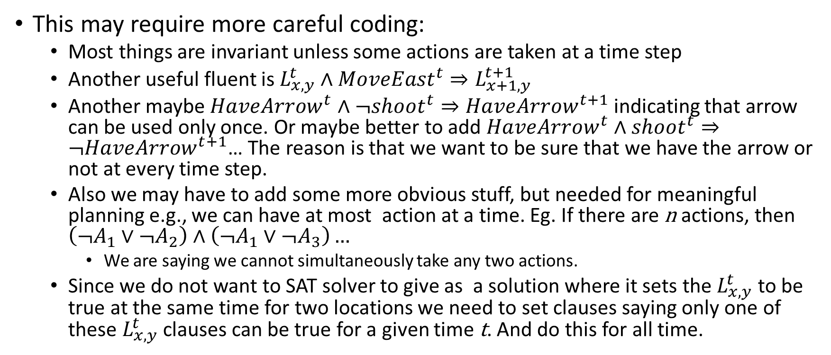
Working with SatPlan
This may require more careful coding:
Most things are invariant unless some actions are taken at a time step
Another useful fluent is $L_{x,y}^{t}$ $∧{MoveEast}^{t}⇒L_{x+1,y}^{t+1}$
Another maybe $HaveArrow^{t}∧¬shoot^{t}⇒HaveArrow^{t+1}$indicating that arrow can be used only once. Or maybe better to add $HaveArrow^{t}∧shoot^{t}⇒¬HaveArrow^{t+1}$… The reason is that we want to be sure that we have the arrow or not at every time step.
Also we may have to add some more obvious stuff, but needed for meaningful planning e.g., we can have at most action at a time. Eg. If there are n actions, then $\left(¬A_{1}∨¬A_{2}\right)∧\left(¬A_{1}∨{¬A}_{3}\right)…$
We are saying we cannot simultaneously take any two actions.
Since we do not want to SAT solver to give as a solution where it sets the $L_{x,y}^{t}$ to be true at the same time for two locations we need to set clauses saying only one of these $L_{x,y}^{t}$ clauses can be true for a given time t. And do this for all time.

Slide 15
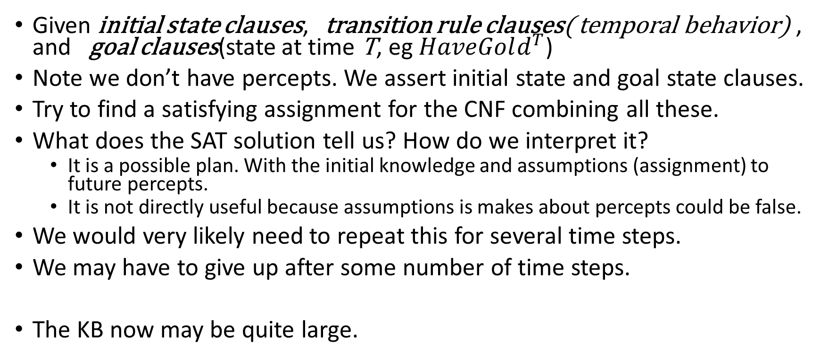
The SatPlan (offline) algorithm
Given initial state clauses, transition rule clauses( temporal behavior) , and goal clauses(state at time T, eg $HaveGold^{T}$)
Note we don’t have percepts. We assert initial state and goal state clauses.
Try to find a satisfying assignment for the CNF combining all these.
What does the SAT solution tell us? How do we interpret it?
It is a possible plan. With the initial knowledge and assumptions (assignment) to future percepts.
It is not directly useful because assumptions is makes about percepts could be false.
We would very likely need to repeat this for several time steps.
We may have to give up after some number of time steps.
The KB now may be quite large.

Slide 16
Two things
We can use the agent algorithm we saw earlier to build an agent even when things change over time. As an example we imagine in our Wumpus world, two changes:
The agent has an arrow that he can use exactly once.
The arrow can be thrown in any one of four directions at any time. It results in the Wumpus being killed if it is in any cell in that direction.
We’ll end up with a large KB. Perhaps we can survive if we take non-temporal facts (we know that the breeze fact does not change with time); and all temporal facts including conclusions at time t, to be enough to conclude whatever we want at time t+1.

Slide 17
Non-CNF SAT
As we know that our clause set can explode in size when converting an arbitrary SAT to CNF
Most SAT solvers work on CNF-SAT, however
Sometimes we may wish to solve SAT directly for Non-CNF sentences.
This remains an area of active research
One approach is to look at a form that is less constraining than CNF, for example Negative Normal form (NNF) this has the only restriction that negatives only appear as part of a literal.
These often involve changes to DPLL based approaches

