Slide 1
First order Predicate Logic

Slide 2
Why first order logic
Clearly we saw a lot of difficulty in using propositional logic to express parts of the Wumpus problem ‘rules’ i.e., sentences that say the four neighbors of a Wumpus location has a stink. Similarly for breeze.
However we could easily (naturally specify in our minds) write out all those ‘repetitive’ rules.
First order (or predicate) logic is a formalist to succinctly express such sentences that would otherwise be quite difficult if not impossible in propositional logic.

Slide 3
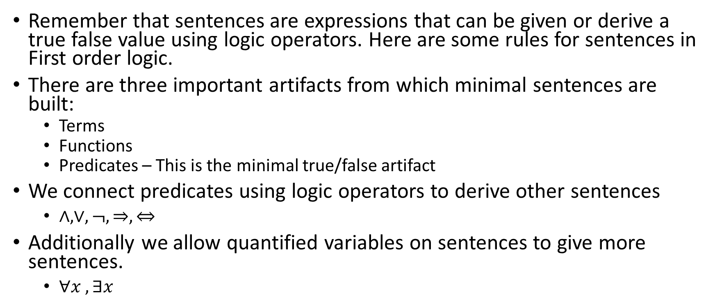
Sentences for Predicate logic
Remember that sentences are expressions that can be given or derive a true false value using logic operators. Here are some rules for sentences in First order logic.
There are three important artifacts from which minimal sentences are built:
Terms
Functions
Predicates – This is the minimal true/false artifact
We connect predicates using logic operators to derive other sentences
$∧,∨,¬,⇒, ⇔$
Additionally we allow quantified variables on sentences to give more sentences.
$∀x , ∃x$

Slide 4
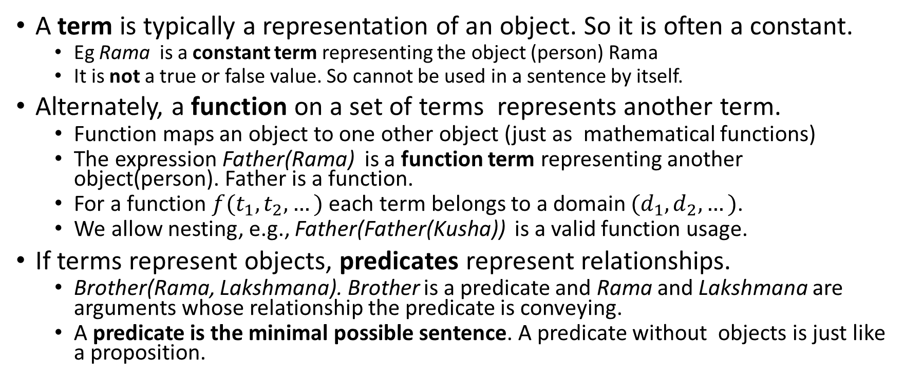
Terms, Functions and Predicates
A term is typically a representation of an object. So it is often a constant.
Eg Rama is a constant term representing the object (person) Rama
It is not a true or false value. So cannot be used in a sentence by itself.
Alternately, a function on a set of terms represents another term.
Function maps an object to one other object (just as mathematical functions)
The expression Father(Rama) is a function term representing another object(person). Father is a function.
For a function $f(t_{1},t_{2},…)$ each term belongs to a domain $(d_{1},d_{2},…)$.
We allow nesting, e.g., Father(Father(Kusha)) is a valid function usage.
If terms represent objects, predicates represent relationships.
Brother(Rama, Lakshmana). Brother is a predicate and Rama and Lakshmana are arguments whose relationship the predicate is conveying.
A predicate is the minimal possible sentence. A predicate without objects is just like a proposition.

Slide 5
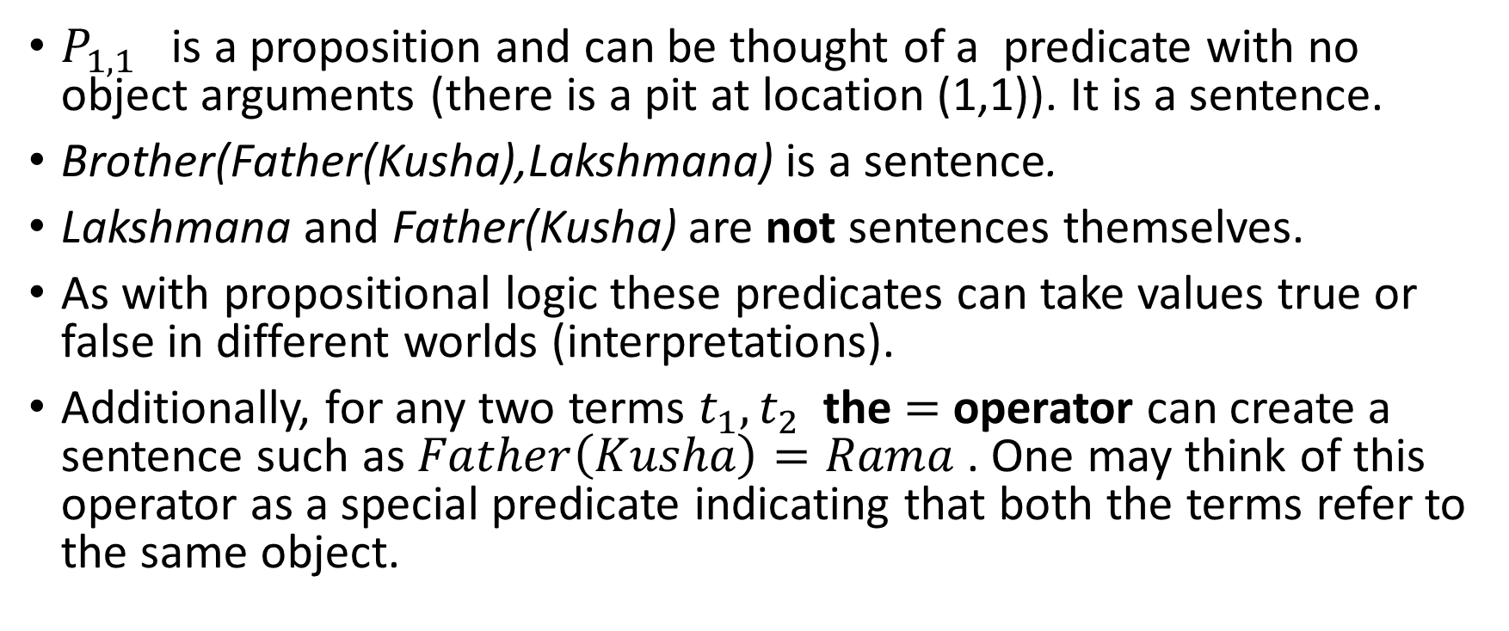
Atomic sentences
$P_{1,1}$ is a proposition and can be thought of a predicate with no object arguments (there is a pit at location (1,1)). It is a sentence.
Brother(Father(Kusha),Lakshmana) is a sentence.
Lakshmana and Father(Kusha) are not sentences themselves.
As with propositional logic these predicates can take values true or false in different worlds (interpretations).
Additionally, for any two terms $t_{1}, t_{2}$ the $=$ operator can create a sentence such as $Father\left(Kusha\right)=Rama$ . One may think of this operator as a special predicate indicating that both the terms refer to the same object.

Slide 6
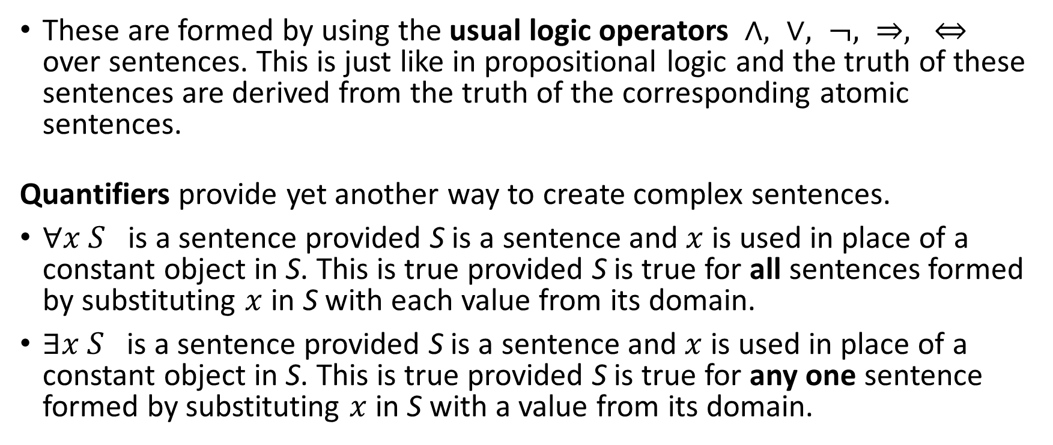
Complex sentences in FOL
These are formed by using the usual logic operators $∧, ∨, ¬, ⇒, ⇔$ over sentences. This is just like in propositional logic and the truth of these sentences are derived from the truth of the corresponding atomic sentences.
Quantifiers provide yet another way to create complex sentences.
$∀x S$ is a sentence provided S is a sentence and $x$ is used in place of a constant object in S. This is true provided S is true for all sentences formed by substituting $x$ in S with each value from its domain.
$∃x S$ is a sentence provided S is a sentence and $x$ is used in place of a constant object in S. This is true provided S is true for any one sentence formed by substituting $x$ in S with a value from its domain.

Slide 7
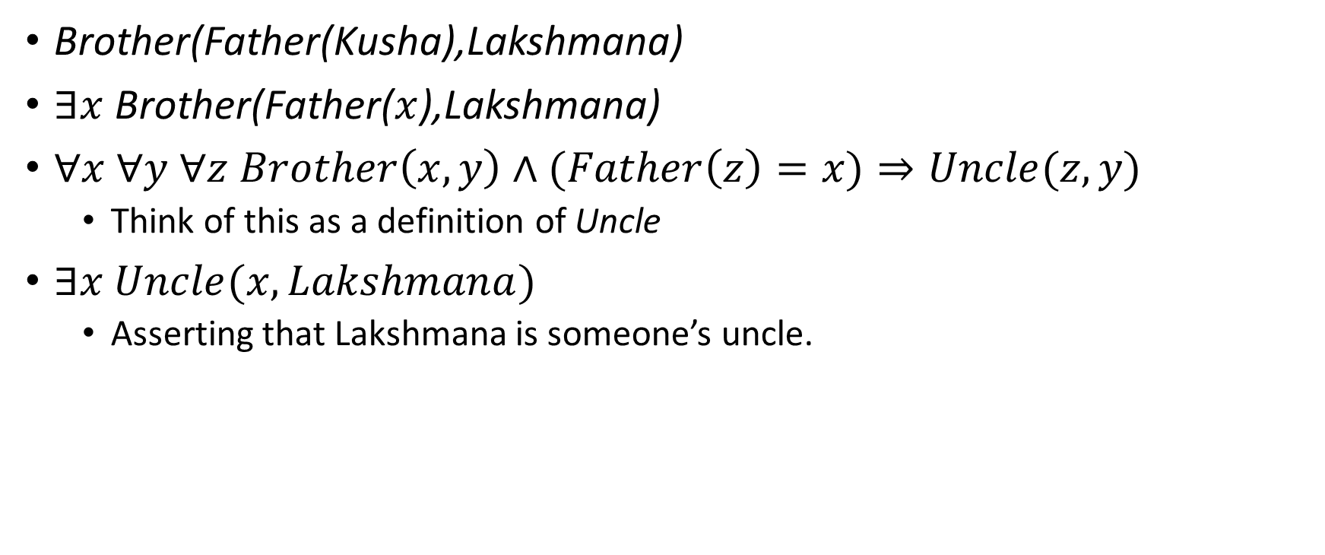
Sentence examples
Brother(Father(Kusha),Lakshmana)
$∃x$Brother(Father($x$),Lakshmana)
$∀x ∀y ∀z Brother\left(x,y\right)∧(Father\left(z\right)=x)⇒Uncle(z,y)$
Think of this as a definition of Uncle
$∃x Uncle(x,Lakshmana)$
Asserting that Lakshmana is someone’s uncle.

Slide 8
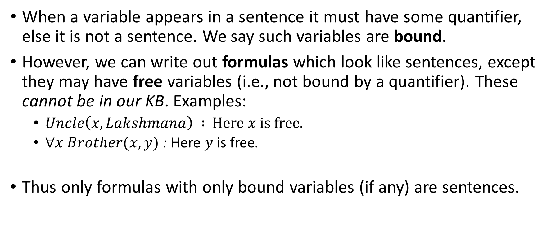
Formulas and free variables
When a variable appears in a sentence it must have some quantifier, else it is not a sentence. We say such variables are bound.
However, we can write out formulas which look like sentences, except they may have free variables (i.e., not bound by a quantifier). These cannot be in our KB. Examples:
$Uncle\left(x,Lakshmana\right) :$ Here $x$ is free.
$∀x Brother(x,y)$ : Here $y$is free.
Thus only formulas with only bound variables (if any) are sentences.

Slide 9
Semantics or Interpretations
To understand what a sentence means, we need to specify what in the world is meant by the constants, functions and predicates we use.
This mapping to a real world is needed for a model to be meaningful.
We call this the interpretation. In our example we can say that the constant Rama refers to the King of Ayodhya as in the Ramayana. The function Father is a mapping from a person to his/her father. The Brother predicate is the brotherhood relationship as in the world of people.
Note that a sentence may be true or false under different interpretations.

Slide 10
Using Predicate logic to model some worlds
The text book shows multiple examples of how to model the real world using predicate logic
We can even deal with a world with infinite objects. An example is the world of whole numbers. We may encode Peano’s axioms, for example.
Other examples are the world of sets and lists.
You are encouraged to go through those just to ground your understanding well.

Slide 11
Aside – Z3
We also looked at the tool Z3. https://en.wikipedia.org/wiki/Z3_Theorem_Prover
This is an example of a SAT solver for a class of predicate logic and includes mathematical theory. So it is called a solver for MT (SAT Modulo Theory).
It has been used quite a bit in practice.
It is open source, available on github.
It can also be tried out quickly using this interface https://jfmc.github.io/z3-play/
It is a good idea to try and get a feel of what is out there practically.

