Slide 1
Knowledge Representations and Inferencing
Concepts, practical tools and techniques

Slide 2
World
Representation in a KB, considerations:
Predicates?
A more natural representation?
Tractability of inference?
What concepts – general knowledge representation
Desirable language constructs
‘Linked data’ requirement
transferable and extendable information ?

Slide 3
KB so far
So far we saw three representations
PL – verbose, but decidable
FOL – concise, but semi-decidable
PDDL – partly concise, for actions only
Some learnings
Predicates/ relationships
Objects
Types and classes are common

Slide 4
Higher level concepts for a KB
Things/domain-objects
Classes
Relationships
Father(Rama, Kusha)
King(Rama)
Ontology captures these notions and helps build domain specific notion of classes.

Slide 5
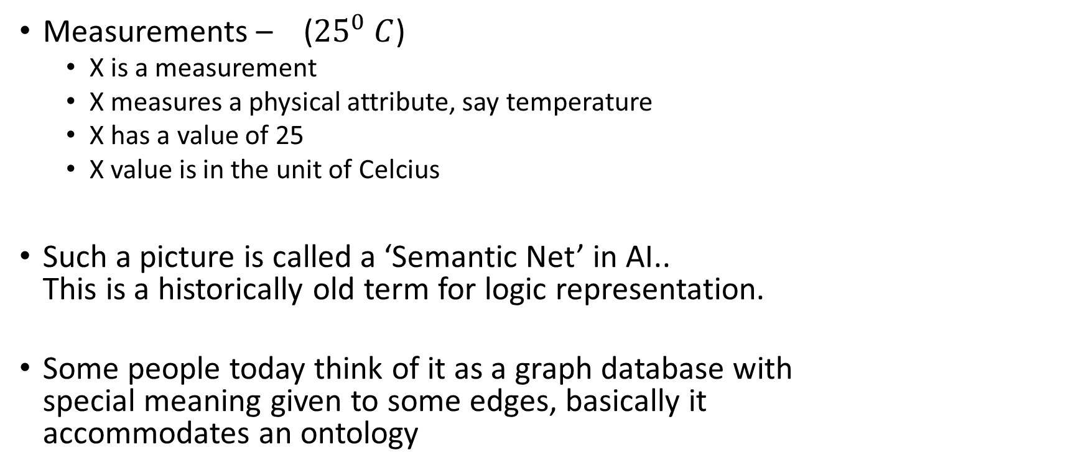
Some examples
measurement
Measurements – (${25}^{0} C$)
X is a measurement
X measures a physical attribute, say temperature
X has a value of 25
X value is in the unit of Celcius
Such a picture is called a ‘Semantic Net’ in AI.. This is a historically old term for logic representation.
Some people today think of it as a graph database with special meaning given to some edges, basically it accommodates an ontology
isa
Temperature
measures
X
hasValue
25
unit
Celcius

Slide 6
A bit about DLs : Logic behind semantic nets
DLs are intermediate (between PL and FoL) in terms of express-ability and tractability.
Individuals / things / resources / literals / Constants
Concept / Class / Unary Predicate
Role / Property / Binary predicate
Assumptions
no UNA (The Unique Name Assumption is that each thing is uniquely named)
open world assumption
TBox vs ABox
Decidable and tractable (mostly)
Inferencing methods – resolution, tableaux
Varieties to further balance expressiveness and tractability
DLs are the logical underpinning for ontology languages, especially those used in the WWW.

Slide 7
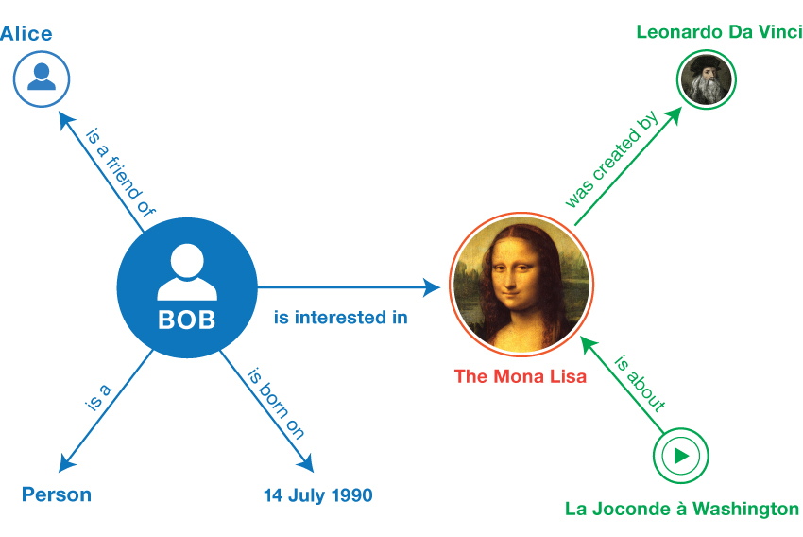
Putting it to Practice – Data Representation
Seeing the data differently:
The graph notion of data
Lets look at
Example RDF data
An ontology language (OWL) and some simple examples
A sample ontology for a specific domain

Slide 8
The data graph and the RDF language
S
P
O
Things
(binary) relationships as < subject predicate object >
Basic Things:
“Resources” – Literal(number/string etc), IRI
RDF statement
The goal to link independently created data/knowledge: * IRI * Semi-structured data model
Data is a collection of:
“triples” OR
“statements”
The ‘database’ is often called a ‘triple store’
Notes:
Jena, Stardog , Neo4J(LPG), Allegrograph, Marklogic, GraphDB

Slide 9
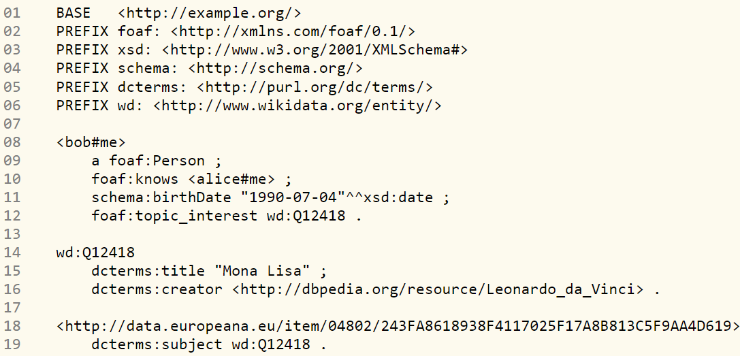
Sample RDF document
<wd:Q12418> <dc:terms:title> “Mona Lisa” .
<wd:Q12418> <dcterms:creator> http://dbpedia.org/resource/Lonardo_da_Vinci .
Source: https://www.w3.org/TR/rdf11-primer/#bib-RDF11-CONCEPTS

Slide 10
Specializations for some kinds of domains
Measurements
Discrete events
Processes
Desire: Create ontologies – vocabulary of semi-structured class hierarchy and relationships for reach domain.
Coincides with the notion of semantic web (TBL/W3C).
Practical languages to write out an ontology: RDFS, OWL (Ontology Meta Languages)

Slide 11
Terminology often seen in this context
XML: a data model and syntax – strict tree structure.
XML Schema: a schema for XML documents – specifies the tree structure and the valid elements.
RDF: a data model one may use XML (or other format) to represent RDF data, Support for IRI
RDFS (schema) a schema for RDF data – explicit class and property hierarchy
OWL another schema to define more things about classes and properties

Slide 12
Some online resources
https://www.w3.org/TR/rdf11-primer/ ,
https://www.w3.org/TeamSubmission/n3/ https://www.w3.org/RDF/Validator/
https://www.w3.org/TR/rdf-schema/
https://www.w3.org/TR/owl2-syntax/
https://www.w3.org/TR/rdf-sparql-query/
Description logics: https://en.wikipedia.org/wiki/Description_logic
Reasoners: RACER, Pellet, FACT for variations of OWL-DL

Slide 13
Knowledge Graph Projects
Many projects have tried to create the large KBs of general knowledge
CYC
DBPedia : See for example the SPARQL interface at https://dbpedia.org/sparql or the facet browser https://dbpedia.org/fct/
Wikidata
Schema.org

Slide 14
Domain Specific Ontologies
Geospatial ontology : https://www.w3.org/2005/Incubator/geo/XGR-geo-ont-20071023/
Gene ontology: http://geneontology.org/
Drug Target ontology: https://bioportal.bioontology.org/ontologies/DTO
IoT “Thing Description**”: https://www.w3.org/TR/wot-thing-description11/
SSN / SOSA https://ww.w3.org/TR/vocab-ssn/

Slide 15
Exercise – for yourself (not evaluated) – emphasizing interoperability, not logic inferencing
You have a bunch of iot devices you are connected to.
Assume you wish to collect in three tables information from those devices that give temperature, pressure and humidity values.
You are unsure which devices give which beforehand, but you do have a list of WoT description of the devices in a simple text file all in JSON-LD format
Browse the ontology called WoT: https://www.w3.org/TR/wot-thing-description11/
How would you create a program to achieve your task?
(You may need to make some assumptions about the ontology)
How would you extend this to class subsumption type inferencing – how would you use it and how would you implement it?

