Slide 1
AI Planning
Domain independent language and heuristics for planning
Making action specification a 1st class thing!

Slide 2
The language
The “KB” now has the following
Initial state : propositional
Goal state : propositional
Actions : based on an “action schema” which uses predicate representation
Action schema:
Action-Name ( <variables-list> L )
Precond – A conjunction of predicates over variables of L
Effect – A conjunction of predicates over variables of L

Slide 3
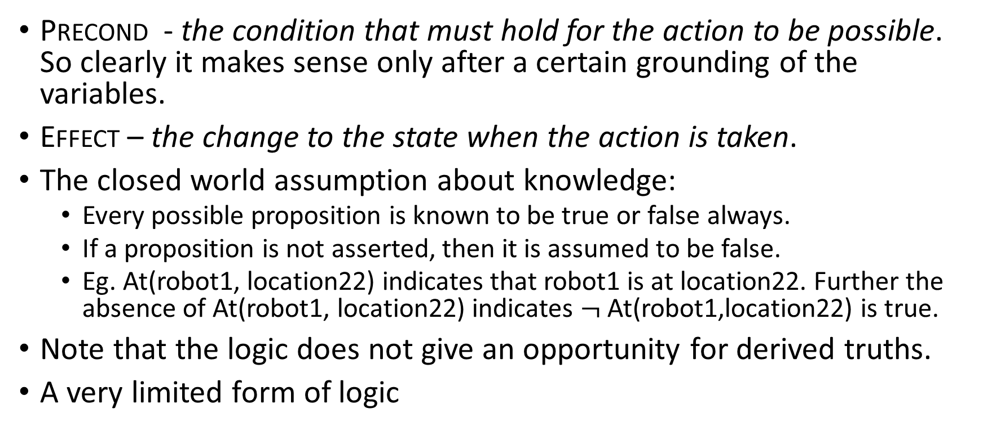
Semantics - 1
Precond - the condition that must hold for the action to be possible. So clearly it makes sense only after a certain grounding of the variables.
Effect – the change to the state when the action is taken.
The closed world assumption about knowledge:
Every possible proposition is known to be true or false always.
If a proposition is not asserted, then it is assumed to be false.
Eg. At(robot1, location22) indicates that robot1 is at location22. Further the absence of At(robot1, location22) indicates $¬$ At(robot1,location22) is true.
Note that the logic does not give an opportunity for derived truths.
A very limited form of logic

Slide 4
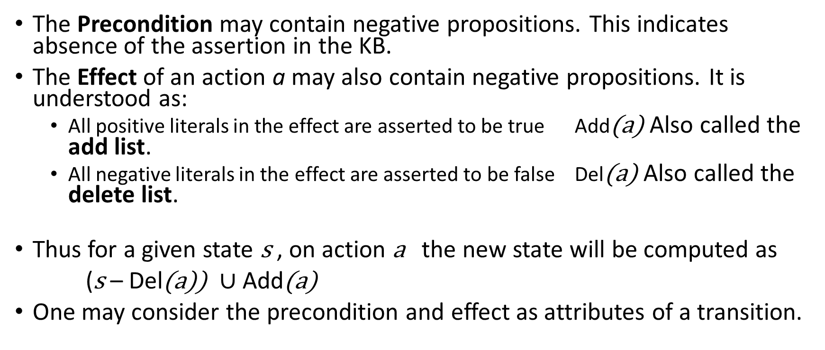
Semantics - 2
The Precondition may contain negative propositions. This indicates absence of the assertion in the KB.
The Effect of an action a may also contain negative propositions. It is understood as:
All positive literals in the effect are asserted to be true Add(a) Also called the add list.
All negative literals in the effect are asserted to be false Del(a) Also called the delete list.
Thus for a given state s , on action a the new state will be computed as
(s – Del(a)) $∪$Add(a)
One may consider the precondition and effect as attributes of a transition.

Slide 5
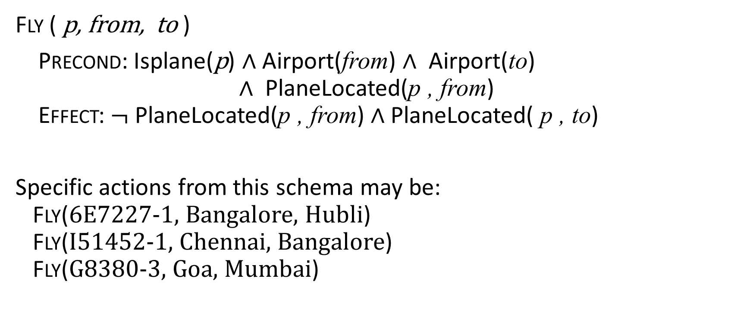
Example of the action schema fly for a certain plane
Fly ( p, from, to )
Precond: Isplane(p) $∧$ Airport(from) $∧$ Airport(to) $∧$ PlaneLocated(p , from) Effect: $¬$ PlaneLocated(p , from) $∧$ PlaneLocated( p , to)
Specific actions from this schema may be: Fly(6E7227-1, Bangalore, Hubli) Fly(I51452-1, Chennai, Bangalore) Fly(G8380-3, Goa, Mumbai)

Slide 6
Example Action in PDDL
PDDL (and its varieties) have been the standard specification language since about 2000. Here is an example for a robot move action schema.
(:action move
:parameters (?from ?to)
:precondition (and (room ?from) (room ?to) (at-robby ?from))
:effect (and (at-robby ?to) (not (at-robby ?from))))
See http://editor.planning.domains/

Slide 7
Now that our knowledge has a representation of both the states and the actions….. Solving the Planning Problem

Slide 8
Characteristics of “Classical Planning” with PDDL (Fully known, Deterministic, Offline)
Closed world assumption
Only “enabled” actions (not action schema) – those whose preconditions are satisfied – are possible at a given state.
The chosen action modifies the state according to its effect.
Solution strategy:
The strategy to create a plan is therefore to create a tree automatically from the problem statement (see how this makes it domain independent)
Then use any of the tree based search methods – BFS(?) , DFS, IDFS, A* etc to do an offline plan.

Slide 9
Tree-based search for planning with PDDL
Note that deriving action instances from a schema is creating a substitution, a limited sort of unification.
This way we can potentially create all possible actions for each given schema.
We could use forward search or backward search methods.
That will be quite a large set of actions
Note that the size also depends on the number of objects we have, not only the number of action schemas– Motivation for types in PDDL
Can we derive the heuristic in a domain independent fashion? For A* ?

Slide 10
Search for heuristics - creating a relaxed problem
What if we neglected all preconditions?
Admissible heuristic is the minimum set of actions that covers all literals of the goal is a heuristic.
However this (just computing the heuristic) is also NP Hard. (It is set cover)
What if we neglected negative effects (the delete list)?
Particularly useful if our goal and preconditions do not have negative clauses
Ignore delete list heuristic.
We make a version where we remove negative literals from all effects and then solve.
Actions just keep adding some goal clauses, however actions continue to be constrained by preconditions.
This is admissible too, however it is also NP Hard
Good news: domain independent way to create a heuristic. See eg. The FF planner. https://fai.cs.uni-saarland.de/hoffmann/ff.html

Slide 11
Approaches to solving the planning problem for PDDL
State space planning – we can deploy the forward and backward methods we learnt earlier and search for a path in the state space.
Challenge: we need a good heuristic
We can convert it into other problems
SAT
CSP
Etc
Partial order planning (or plan space planning)
The Planning Graph is a particular data structure that has been used a lot in building planner.
So we now take a look at the planning graph.

Slide 12
The Planning Graph – the problem
(:action eat :parameters (?c) :precondition (havecake ?c) :effect (and (eatencake ?c) (not (havecake ?c)) )
(:action bake :parameters (?c) :precondition (not (havecake ?c)) :effect (havecake ?c) )
(:objects cake1 )
(:init (havecake cake1) )
(:goal (and (havecake cake1) (eatencake cake1)))

Slide 13
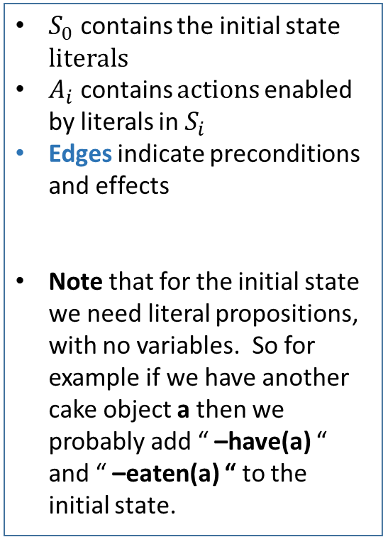
The Planning Graph – the graph (1)
$$S_{0} A_{0} S_{1} A_{1} S_{2}$$
have(c)
− eaten(c)
eat(c)
have(c)
− have(c)
eaten(c)
− eaten(c)
bake(c)
eat(c)
have(c)
− have(c)
eaten(c)
− eaten(c)
$S_{0}$ contains the initial state literals
$A_{i}$ contains actions enabled by literals in $S_{i}$
Edges indicate preconditions and effects
Note that for the initial state we need literal propositions, with no variables. So for example if we have another cake object a then we probably add “ –have(a) “ and “ –eaten(a) “ to the initial state.
!
Note that here c is a specific cake object, unlike the ?c parameter earlier!
!
▪▪▪Same holds for the action sets too: bake(c) and bake(a) are different actions

Slide 14
The Planning Graph – the graph (2)
$$S_{0} A_{0} S_{1} A_{1} S_{2}$$
have(c)
− eaten(c)
eat(c)
have(c)
− have(c)
eaten(c)
− eaten(c)
bake(c)
eat(c)
have(c)
− have(c)
eaten(c)
− eaten(c)
We introduce ‘persistence’/ ‘maintenance’ actions. To allow explicitly indicate retaining literals ..we did that implicitly so far.
Note that persistence actions always exist in all action sets.
Once a literal appears, it doesn’t go away because of persistence.

Slide 15
The Planning Graph – the graph (3)
$$S_{0} A_{0} S_{1} A_{1} S_{2}$$
There are missing conflict edges,
complete them
have(c)
− eaten(c)
eat(c)
have(c)
− have(c)
eaten(c)
− eaten(c)
bake(c)
eat(c)
have(c)
− have(c)
eaten(c)
− eaten(c)
Adding mutex edges is the S and A sets
We do this going left to right, layer by layer
Adding mutex action set edges: * Inconsistent lit effects * lit interference * Compteting needs (mutex prec lit)
Adding mutex literal set edges: * Negated literals * Inconsistent (action) support: ie. Every way (action pair) of creating the literals is mutex

Slide 16
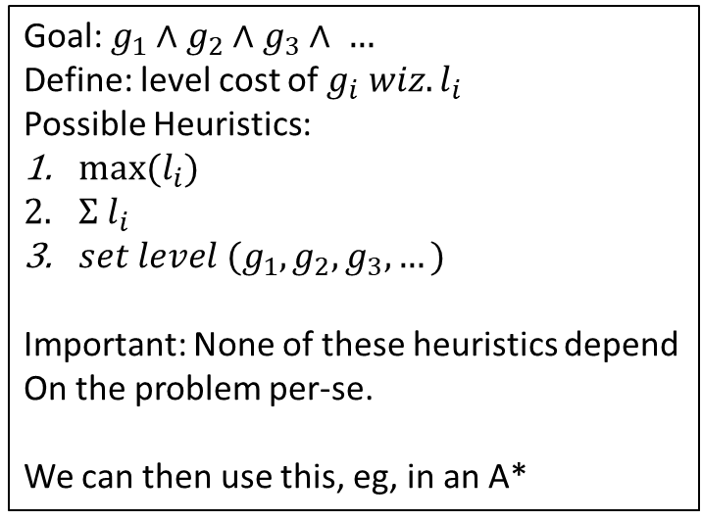
The Planning Graph – Deriving heuristics
$$S_{0} A_{0} S_{1} {A∗}_{1} {S∗}_{2}$$
have(c)
− eaten(c)
eat(c)
have(c)
− have(c)
eaten(c)
− eaten(c)
bake(c)
eat(c)
have(c)
− have(c)
eaten(c)
− eaten(c)
Goal: $g_{1}∧g_{2}∧g_{3}∧ …$
Define: level cost of $g_{i} wiz. l_{i}$
Possible Heuristics:
${max⁡(l}_{i})$
$Σ{ l}_{i}$
$set level (g_{1},g_{2},g_{3},…)$
Important: None of these heuristics depend
On the problem per-se.
We can then use this, eg, in an A*
Adding mutex action set edges: * Inconsistent lit effects * lit interference * Compteting needs (mutex prec lit)
Adding mutex literal set edges: * Negated literals * Inconsistent (action) support: ie. Every way (action pair) of creating the literals is mutex

Slide 17
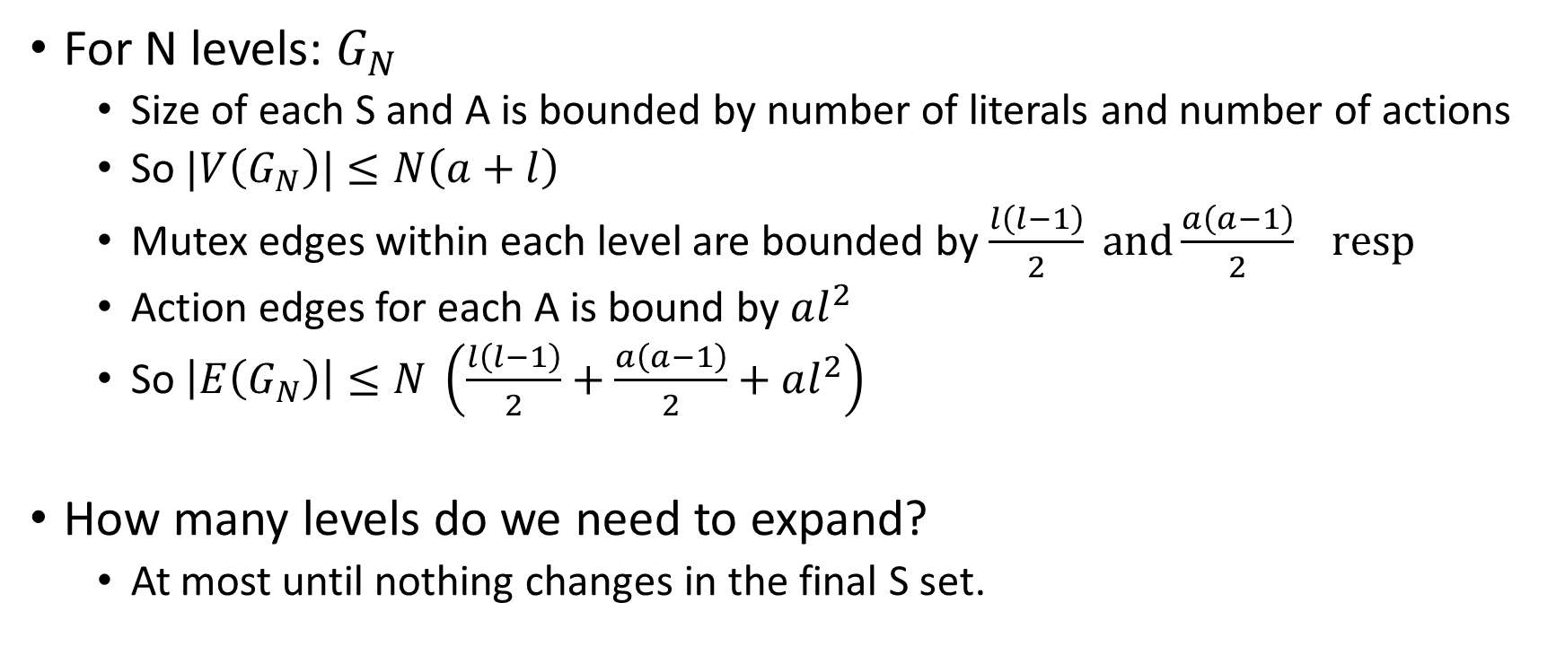
The Planning graph – size
For N levels: $G_{N}$
Size of each S and A is bounded by number of literals and number of actions
So $|V\left(G_{N}\right)|≤N\left(a+l\right)$
Mutex edges within each level are bounded by $\frac{l\left(l−1\right)}{2} and\frac{a\left(a−1\right)}{2} resp$
Action edges for each A is bound by $al^{2}$
So $\left|E\left(G_{N}\right)\right|≤N \left(\frac{l\left(l−1\right)}{2}+\frac{a\left(a−1\right)}{2}+al^{2}\right)$
How many levels do we need to expand?
At most until nothing changes in the final S set.

Slide 18
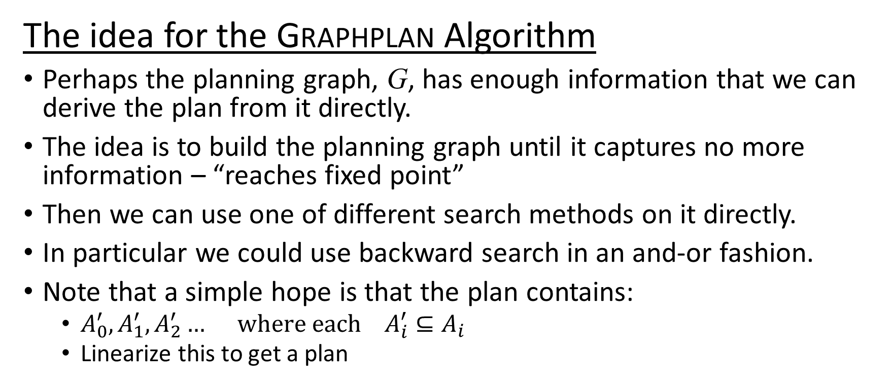
The Planning Graph – Deriving plans directly!
The idea for the Graphplan Algorithm
Perhaps the planning graph, G, has enough information that we can derive the plan from it directly.
The idea is to build the planning graph until it captures no more information – “reaches fixed point”
Then we can use one of different search methods on it directly.
In particular we could use backward search in an and-or fashion.
Note that a simple hope is that the plan contains:
$A_{0}^{′},A_{1}^{′},A_{2}^{′}… where each { A}_{i}^{′}⊆A_{i}$
Linearize this to get a plan

Slide 19
The Planning Graph – the Graphplan Algorithm
$$S_{0} A_{0} S_{1} {A∗}_{1} {S∗}_{2}$$
have(c)
− eaten(c)
eat(c)
have(c)
− have(c)
eaten(c)
− eaten(c)
bake(c)
eat(c)
have(c)
− have(c)
eaten(c)
− eaten(c)
* The final (fixed point) state must have all the required literals of the goal appear.
* Further they must non-mutex.
If not, clearly there is no plan.
Then use a search for a solution directly on this graph.
If a solution exists it occurs in this graph
The solution will give us the subsets of
successive action sets.
Example discussion with backward search.
Adding mutex action set edges: * Inconsistent lit effects * lit interference * Compteting needs (mutex precond lit)
Adding mutex literal set edges: * Negated literals * Inconsistent (action) support: ie. Every way (action pair) of creating the literals is mutex

Slide 20
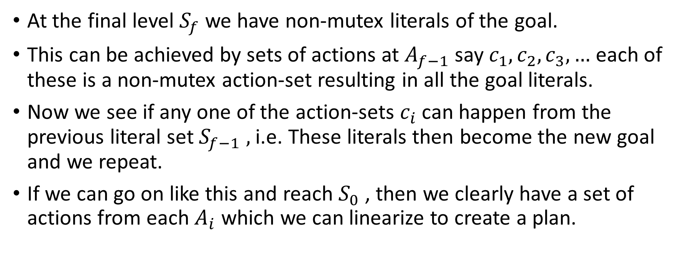
At the final level $S_{f}$we have non-mutex literals of the goal.
This can be achieved by sets of actions at $A_{f−1}$ say $c_{1},c_{2},c_{3},…$ each of these is a non-mutex action-set resulting in all the goal literals.
Now we see if any one of the action-sets $c_{i}$ can happen from the previous literal set $S_{f−1} ,$i.e. These literals then become the new goal and we repeat.
If we can go on like this and reach $S_{0}$ , then we clearly have a set of actions from each $A_{i}$ which we can linearize to create a plan.

Slide 21
Assignment- Implement Graphplan
Create a program to read in a PDDL specification as described in class. (No fancy stuff that you will find in the PDDL specification). Then it constructs a plan graph with all its edges and literal sets and action sets. Then it finally uses backtracking based method to extract a plan.
You can choose your input format to make it easy to read for the program. This means deviating a bit from PDDL specification, but input reading is not our goal here. So chose a representation closer to the internal representation that is useful for planning.
I found a json version useful and easy to read into a python code.

Slide 22
Conclusion
We just saw PDDL as giving us domain independent planning heuristics and techniques. It was completely offline planning and deterministic environments.
PDDL has been modified to deal with numeric fluents, metrics for the goal, durative actions, conditional effects (bounded non-determinism), processes, events etc., in an attempt to widen the scope of problems it can deal with.
A good starting point to understand more is in https://planning.wiki/ under the ‘Reference’ page. It is a source of further reading material.

