Slide 1
Ideas to algorithms to code
A flowchart approach

Slide 2
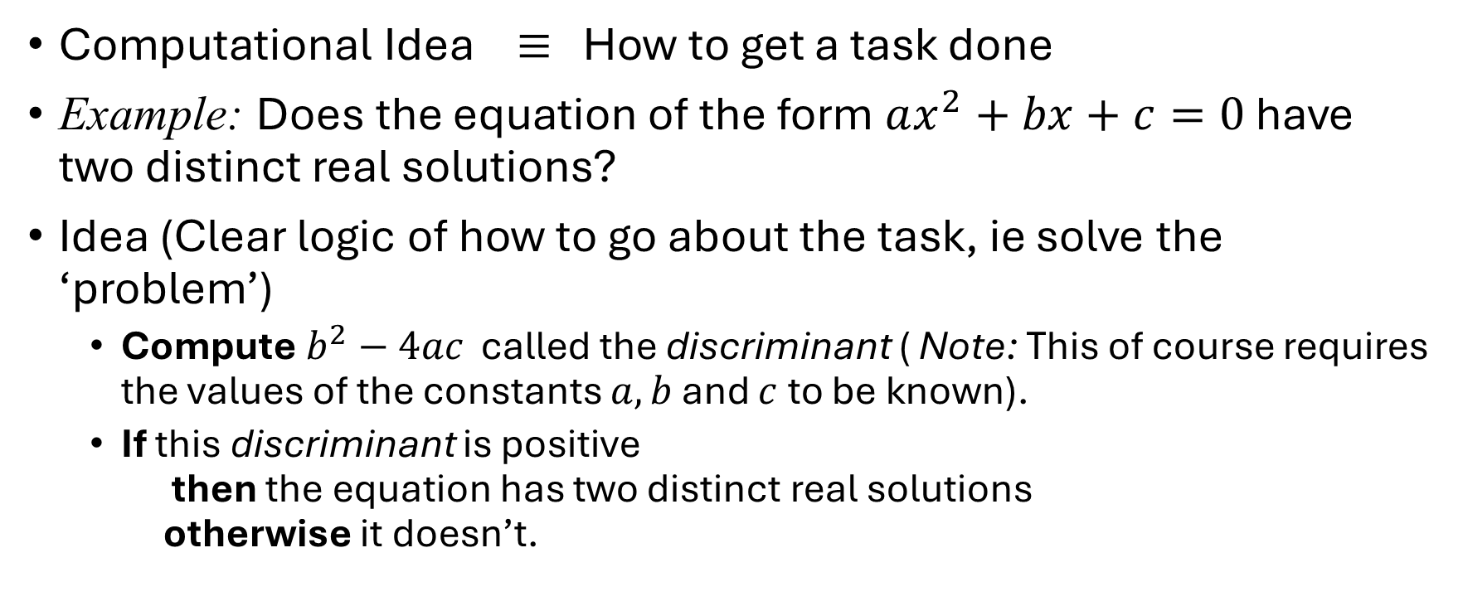
From computational ideas to code
Computational Idea $≡$ How to get a task done
Example: Does the equation of the form $ax^{2}+bx+c=0$ have two distinct real solutions?
Idea (Clear logic of how to go about the task, ie solve the ‘problem’)
Compute $b^{2}−4ac$ called the discriminant ( Note: This of course requires the values of the constants $a,b$ and $c$ to be known).
If this discriminant is positive then the equation has two distinct real solutions otherwise it doesn’t.

Slide 3
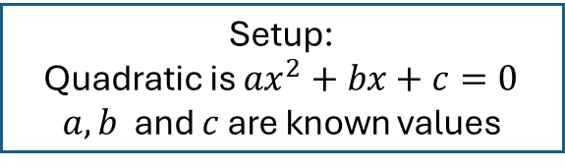
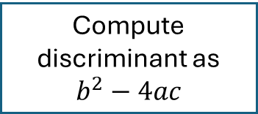
As a flowchart
Start
Setup:
Quadratic is $ax^{2}+bx+c=0$
$a,b$ and $c$ are known values
Compute discriminant as $b^{2}−4ac$
Conclusion: the quadratic does not have two distinct real roots
Is the discriminant > 0 ?
No
Yes
Conclusion: the quadratic has two distinct real roots
Stop

Slide 4
As a flowchart
Start
Setup:
Quadratic is $ax^{2}+bx+c=0$
$a,b$ and $c$ are known values
Compute discriminant as $b^{2}−4ac$
Conclusion: the quadratic does not have two distinct real roots
Is the discriminant > 0 ?
No
Yes
Conclusion: the quadratic has two distinct real roots
Stop

Slide 5
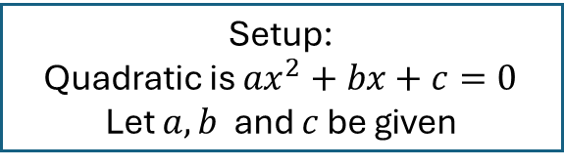
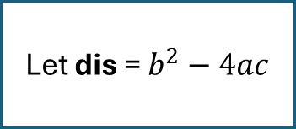
More symbolic
Start
Setup:
Quadratic is $ax^{2}+bx+c=0$
Let $a,b$ and $c$ be given
Let dis = $b^{2}−4ac$
Conclusion:
No two distinct real roots
dis > 0 ?
false
true
Conclusion:
Has two distinct real roots
Stop

Slide 6
More symbolic
Start
Setup:
Quadratic is $ax^{2}+bx+c=0$
Let $a,b$ and $c$ be given
Let dis = $b^{2}−4ac$
Conclusion:
No two distinct real roots
dis > 0 ?
false
true
Conclusion:
Has two distinct real roots
Stop

Slide 7
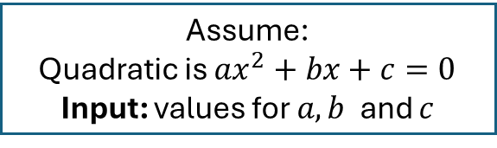
Program like
Start
Assume:
Quadratic is $ax^{2}+bx+c=0$
Input: values for $a,b$ and $c$
Let dis = $b^{2}−4ac$
Output:
“No two distinct real roots”
dis > 0 ?
false
true
Output:
“Has two distinct real roots”
Stop

Slide 8
Program like
Start
Assume:
Quadratic is $ax^{2}+bx+c=0$
Input: values for $a,b$ and $c$
Let dis = $b^{2}−4ac$
Output:
“Does not have two distinct real roots”
dis > 0 ?
false
true
Output:
“Has two distinct real roots”
Stop

Slide 9

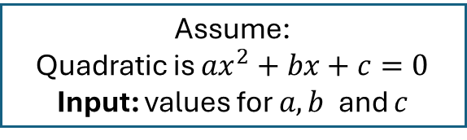
Program:
start
int main(){ // program starts here
// a,b,c are coefficients of the quadratic equation
float a,b,c;
// input the values of ‘a’,’b’,’c’
scanf(“%f %f %f”,&a,&b,&c);
// ‘dis’ is the discriminant
float dis;
dis = b*b – 4*a*c; // compute the value
// check if det > 0
if (dis > 0 )
printf(“Has two distinct real roots\n”);
else
printf(“Does not have two distinct real roots\n”);
} // program ends here
Assume:
Quadratic is $ax^{2}+bx+c=0$
Input: values for $a,b$ and $c$
This is an actual C Program
The idea is NOT: about a language like C
The idea IS: to show that the logic for programs is similar to the logic for flowcharts
Let dis = $b^{2}−4ac$
false
dis > 0 ?
true
stop

Slide 10
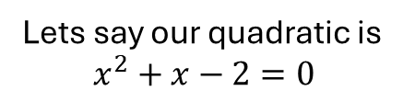
Program:
start
int main(){ // program starts here
// a,b,c are coefficients of the quadratic equation
float a,b,c;
// input the values of ‘a’,’b’,’c’
scanf(“%f %f %f”,&a,&b,&c);
// ‘dis’ is the discriminant
float dis;
dis = b*b – 4*a*c; // compute the value
// check if det > 0
if (dis > 0 )
printf(“Has two distinct real roots\n”);
else
printf(“Does not have two distinct real roots\n”);
} // program ends here
Lets say our quadratic is $$x^{2}+x−2=0$$
Assume:
Quadratic is $ax^{2}+bx+c=0$
Input: values for $a,b$ and $c$
1
1
2
a is now 1
b is now 1
c is now -2
Let dis = $b^{2}−4ac$
dis is now 9
false
dis > 0 ?
true
dis > 0 is true
Has two distinct real roots
stop
Checkout:flowgorithm

Slide 11
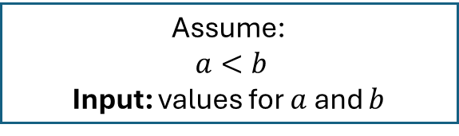


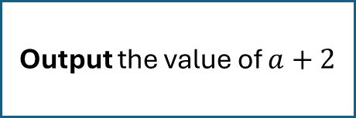
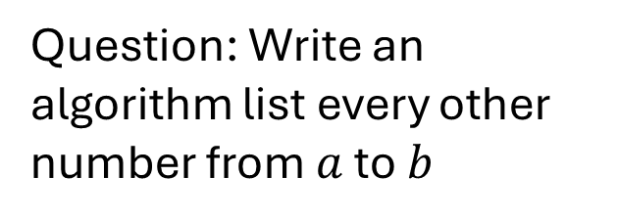
Loop: an additional flow chart construct
Start
Assume:
$a<b$
Input: values for $a$ and $b$
Output the value of $a$
Question: Write an algorithm list every other number from $a$ to $b$
Output the value of $a+2$
Repeatedly output as long as you are not yet done..
i.e. $a+k<b$
•••
Stop

Slide 12
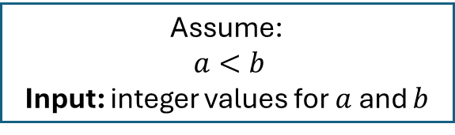

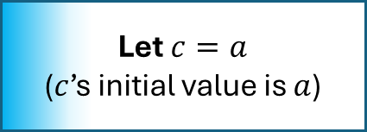


Loop: an additional flow chart construct
Start
Assume:
$a<b$
Input: integer values for $a$ and $b$
Let $c=a$
($c$’s initial value is $a$)
Question: Write an algorithm list every other number from $a$ to $b$
$c<b$ ?
true
Output the value of $c$
Let $c$ be incremented by 2
false
Stop

Slide 13
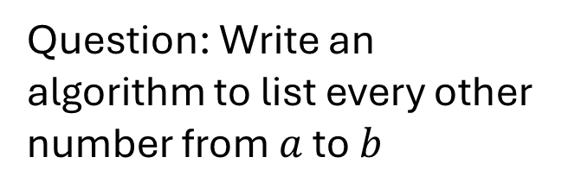
Loop: an additional flow chart construct
Start
Assume:
$a<b$
Input: integer values for $a$ and $b$
Let $c=a$
($c$’s initial value is $a$)
Question: Write an algorithm to list every other number from $a$ to $b$
$c<b$ ?
true
Output the value of $c$
int main(){
int a,b;
scanf(“%d %d”,&a,&b);
for(int c=a; c < b; c=c+2)
printf(“%d “,c);
}
Let $c$ be incremented by 2
false
Stop

Slide 14
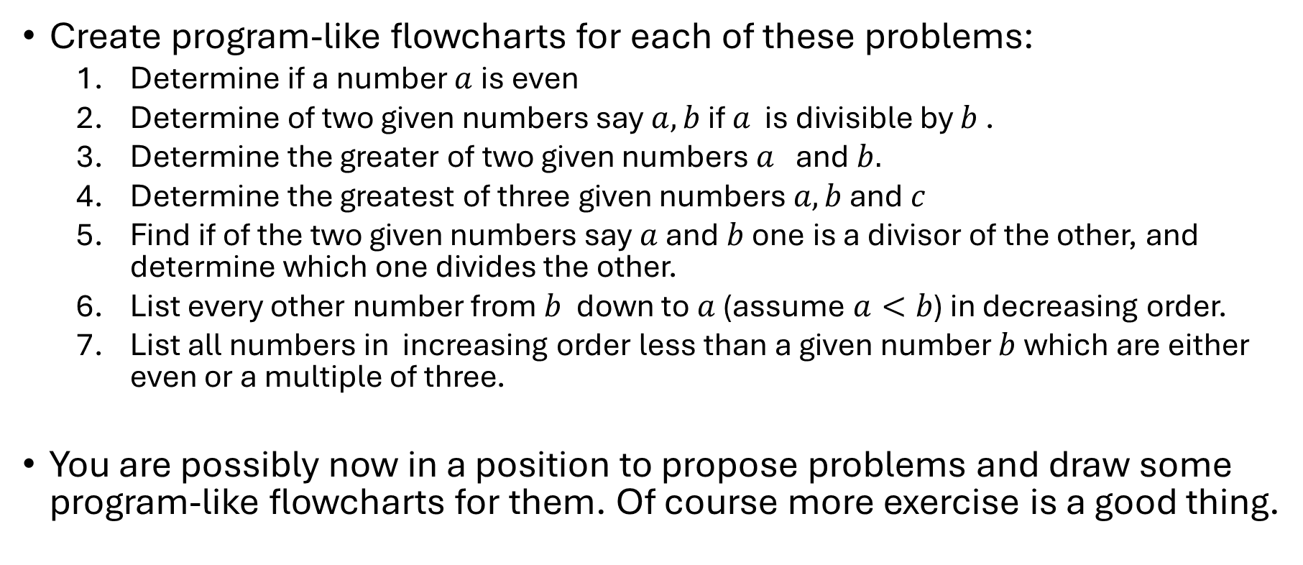
Exercises
Create program-like flowcharts for each of these problems:
Determine if a number $a$is even
Determine of two given numbers say $a,b$ if $a$ is divisible by $b$ .
Determine the greater of two given numbers $a$ and $b.$
Determine the greatest of three given numbers $a,b$ and $c$
Find if of the two given numbers say $a$ and $b$ one is a divisor of the other, and determine which one divides the other.
List every other number from $b$ down to $a$ (assume $a<b$) in decreasing order.
List all numbers in increasing order less than a given number $b$ which are either even or a multiple of three.
You are possibly now in a position to propose problems and draw some program-like flowcharts for them. Of course more exercise is a good thing.

