Slide 1
Concurrency, Coordination and Communication
Or
IPC

Slide 2
Sources of Concurrency

Slide 3
Sources of Concurrency in Operating Systems
Processes
Threads (sometimes called light weight processes)
Scheduling
All general purpose operating systems are preemptive!
Single CPU systems have concurrency too
Multiple CPUs add their own flavor to this
Sometimes we call threads and processes together as “tasks”
Note – Kernel has a lot of concurrent tasks!

Slide 4
The concept of ‘threads’ and an example with Linux pthreads library functions.
This is another way (in addition to processes) to create concurrency

Slide 5
Concurrency with Threads (as opposed to processes)
Threads share almost everything with each other
No parent-child relationship (in terms of PIDs etc)
Shared address space – watch out – this can be dangerous! However this means they can easily share data.
Except the call stack!
They are identified by different thread IDs (not different PIDs)
Linux calls them as light-weight processes(LWP) see ps -eLF
They are independently schedulable
Note – User threads vs Kernel threads

Slide 6
Processes and threads – creating and using threads in practice
P1
P1
T1
Stack_T1
fork()
Stack_T2
Thread_create()
P2
T2
wait()
join()
exit()
Thread_exit()
Lets see a practical example with linux pthreads – see pthreads/simple.c

Slide 7
pthread library functions create and join
int pthread_create(pthread_t *restrict thread, //returns the new threads id
const pthread_attr_t *restrict attr, //specify attributes (NULL)
void *(*start_routine)(void *), //specify the function to run
void *restrict arg); //specify args to the above function
Like most system calls pthread_create returns 0 if it succeeded
int pthread_join(pthread_t thread, //specify the thread to wait for termination void **retval); //The value from the “return” of the thread

Slide 8
A few notes about pthread_ calls we saw
Any thread calling exit() will cause all threads (i.e., the whole process) to terminate!
Any thread can terminate only itself by calling pthread_exit()
Simply returning from the thread function is also as good as pthread_exit() – i.e., causes only that thread to terminate, not the others
pthread_join() will wait for the given thread to terminate.
One thread can terminate another thread by calling pthread_cancel()
You can see how they are used in pthread/simple.c
Note that source needs #include <pthread.h> and compiling requires gcc -o simple -pthread simple.c

Slide 9
So concurrency can happen with processes or threads
… Now more about concurrency

Slide 10
Processes and threads working collaboratively and concurrently
Multiple processes or threads let us independently do different things “simultaneously”
We can also use multiple processes and multiple threads to distribute work among multiple entities.
Parallel / pipelined processing
Think of one thread doing compute when the other is doing IO
Threads are particularly useful in this context because they naturally share the data part of the work.
See example: pthreads/find_some_primes.c
This example was quite straightforward. However, note that each thread needed to be aware of the other.

Slide 11
Challenges in dealing with concurrency - Races and Deadlocks

Slide 12
Concurrency can create its own issues
Preemptive Scheduling
Concurrency
Problems
Parallel execution is great … get more things done ‘simultaneously’
Note that tasks often work collaboratively and share something
Sometimes it is natural, as in the kernel
Sometimes it is to speed up some task (divide and conquer)
…And sometimes this can cause an issue if we are not careful:
Here is a simple race example caused by concurrency + sharing
// shared variable
float balance=1000;
1. load ax, balance
2. add ax, 100 3. store ax, balance
T1 balance= balance + 100
T2 balance= balance + 100
T3 balance= balance − 100
Where is the problem that concurrency & preemption creates ?
See how this can happen: pthreads/update_balance.c

Slide 13
Another example of race
We could modify our find_some_primes.c example to have two read_items threads.
Now there is a possibility of a race condition:
Both the reader threads want to get an item from the rear
n = number[NEXT(rear)];
rear = NEXT(rear);
There is a problem because of possible concurrent execution
See pthread/find_some_primes_2r.c
Play with turning on nanosleep() to introduce more chance of a race.

Slide 14



The problems of concurrency – Races and Deadlocks
Races: As we saw in the previous example – data reading and writing concurrently to shared variables may lead to problems
Deadlocks: Sometimes simultaneously holding resources is needed to complete a task, that may lead to problems
A
C
B

Slide 15
Coordination of Concurrency … so as to avoid races and deadlocks

Slide 16
Notion of a Critical Section and Mutual Exclusion
Clearly in our example tasks T1 , T2 and T3 had each some code such that it would work perfectly fine provided they execute their code exclusively (no two at the same time).
Such piece of code is called a critical section. (Heard this before?)
Mutual exclusion (consisting of lock and unlock operations) is the mechanism used to protect critical sections.
Thought as a barrier, only one process allowed to pass at any time.
A thread does a lock operation to enter the critical section
and…
an unlock operation to signal exiting sectionfrom the ciritical
T1 may access like this:
lock_the_critical section
// This is the critical section code
balance= balance + 100
unlock
oversimplified lock implementation: simply turn off all interrupts and an unlock restores interrupts .. Works, ok for a small time! But…
not a good idea in general!
We never want two tasks simultaneously in any CS for this lock

Slide 17
Important
Mechanism vs Usage:
Lock and unlock are mechanisms to implement a critical section
Think of them as tools, instructions, syscalls etc.
In reality only proper use by the programmer ensures mutual exclusion
Right tool for the right job, used in the right way gives the desired effect
Lets take a look at how the lock and unlock operations may be implemented so that it can be used by the programmer to implement mutual exclusion to access critical sections.

Slide 18
Implementing the lock() and unclock() operations
Implementing the mechanism

Slide 19
A Proposed locking code – Aim is that at most one process is in the CS at any time
FAILED !
Implementation
Usage
struct lock { int flag=0; }L1 ;
lock( struct lock * l){
1. while (l->flag == 1 )
2. ; // keep looping if locked
3. lock->flag=1; // Got it, so // indicate
}
unlock( struct lock * l){
4. l->flag=0; // Declare free
}
Task T1 ( or T2, r T3, etc..)
lock(&L1) 5. // We are in the critical section
6. // so we can modify data
unlock(&L1)
(step, flag)
T1 T2
1 0
1 0
3 1
3 1
5
5
Can you say what could easily go wrong if this was the implementation?

Slide 20
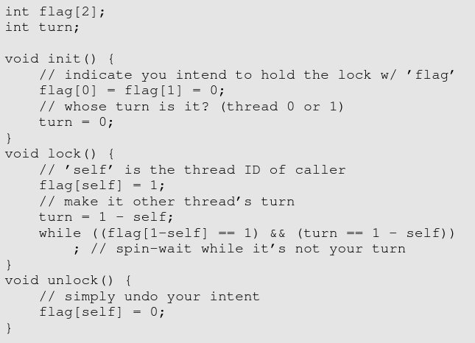
Peterson’s Algorithm
Ref: www.ostep.org chapter 28

Slide 21
Hardware support: Test and Set
What is an issue with this idea?
LOAD flag,ax STORE 1,flag
A special machine instruction:
TSL ax, flag
Copy original value of flag to ax, then set flag=1 in a single instruction
int test_and_set( int *flag){ TSL ax, flag RET // ax value is returned }
If original value was 0 then, we got the lock (returns 0) and others cant get it (flag=1).
unlock(int * flag) is simple:
STORE 0, flag
init(int * flag ) { *flag=0; }
lock(int * flag) { while( test_and_set(flag) == 1 )
;
// flag was 0, now is 1 }
int flag; // global shared T1::
lock(&flag)
// This is the critical section code
balance= balance + 100
unlock(&flag)
The implementations here are a model for understanding and
not intended to be compilable assembly/C code!

Slide 22
Avoiding the busy loop
Notice: Our solution has a busy loop!
Busy loop consumes too many CPU cycles.
Alternate:
A syscall to give up CPU “yield until a later time”
Goes back to the run queue
lock( int * flag) { while( test_and_set(flag) == 1 )
yield
// here flag was 0, now is 1 }
In Linux the closest yield is
sched_yield() or pthread_yeld() or sleep() or nanosleep()
What if multiple people are waiting for the lock
Possible starvation
Some process may not get a chance at all!
One solution
If yield could put waiters in a queue
and unlock wakes them up sequentially.
In FCFS order
These ideas are combined in the concept called a mutex
An extended idea is that of a semaphore.

Slide 23
A practical example in the pthreads library: Mutual Exclusion using a mutex.
We saw how to create threads using pthreads.
We can use the mutex provided by pthreads to prevent multiple threads from simultaneously entering the critical section:
Recall our example: T1:
lock_the_critical section
// This is the critical section code
balance= balance + 100
unlock
Three useful mutex related calls supported by pthreads:
pthread_mutex_lock()
pthread_mutex_unlock()
pthread_mutex_init()

Slide 24
Mutexes, Condition Variables, Semaphores

Slide 25
Typical usage
Define and initialize (Once)
Lock and unlock (Repeatedly in each thread)
// define a mutex variable
pthread_mutex_t mymutex;
…
// initialize before use
pthread_mutex_init(&mymutex, NULL); // NULL is attributes
// returns 0 if and only if success
// to enter the critical section
pthread_mutex_lock(&mymutex);
… critical section …
// to exit the critical section
pthread_mutex_unlock(&mymutex);
See how a mutex is used in pthreads/update_balance_mutex.c

Slide 26
Mutex ensures locking but sometimes we want conditional locking
Revisit the find_some_primes.c example with two readers.
See how there can be a race to deal with access to “front” and “rear”
Let’s see a solution using mutex to make sure only one thread accesses these variables at a time.
pthreads/find_some_primes_mutex.c
Notice how this still had a busy wait even though access was mutually exclusive!
We are waiting for a condition that can only come to be if another threads changes front or rear.
So we gave up the mutex
We would prefer to wait for some other process to tell us that perhaps the condition we are waiting for is met. (slot is free or slot is filled)
See : pthreads/find_some_primes_mutex.c

Slide 27
Condition Variables
They work in tandem with mutexes
You can wait for a condition and give up the mutex in one shot
You can also signal to other threads that a condition has occurred
Now the reader in our example
Does a lock_mutex
Waits for a condition for a filled slot
Once it wakes up it has the mutex lock
The main thread may signal the condition that the slot is filled.

Slide 28
Synchronization with mutexes and conditional variables – a template supported by pthreads
T1
T2
pthread_mutex_lock(&mutex)
while( desired condition1 not met) {
pthread_cond_wait(&desiredcv1, &mutex);
}
// do CS
pthread_cond_signal(&desiredcv2);
pthread_mutex_unlock(&mutex);
pthread_mutex_lock(&mutex)
while( desired condition2 not met) {
pthread_cond_wait(&desiredcv2, &mutex);
}
// do CS
pthread_cond_signal(&desiredcv1);
pthread_mutex_unlock(&mutex);
See: pthread/find_some_primes_cv.c

Slide 29
Semaphore – A more general solution:
Conceptually a semaphore is two things:
A counter (of allowed tasks) n ( 1 in our example)
A queue (of waiting tasks) wq
Often initially
n=MAX (MAX=1 in our example)
wq= empty list
counter
0
3375
4175
2100
FIFO Queue
Basically the semaphore is a barrier except it allows a MAX number of threads to pass the barrier (MAX possibly > 1)
It behaves like a mutex if MAX is 1

Slide 30
Implementing sem_wait and sem_post atomically
P
V
Edsger Dijkstra
sem_wait( S )
if (S.n > 0 ) S.n -- ;
else addq(self, S.wq)
blocked()
sem_post( S )
if ( S.wq is empty ) S.n ++ ;
else t = delq(S.wq)
movetoready(t)
ATOMIC !
Let others know.. On the way out
Try to get in
sem_post is also called sem_signal in literature.
Basically the semaphore is a barrier except it allows a MAX number of threads to pass the barrier (MAX possibly > 1)
It behaves like a mutex if MAX is 1 (Binary semaphore vs counting semaphore)

Slide 31
Example: The (multi) producer-consumer problem
Producers:
keep putting items to the buffer
Consumers:
keep getting items from the buffer
MAX number of array slots used circularly
put(val){
buffer[free]=val;
free=free+1 % MAX; }
get(){
tmp=buffer[used];
used=used+1 % MAX;
return tmp }
We only want as many producers to put() as there are free slots
We only want as many consumers to get() as there are filled slots
Also we want only one thread updating the index at any time!

Slide 32
A PC problem solution that combines Mutexes and POSIX Semaphores
Too many people accessing free and used, so we’ll guard them with locks ie mutex
Producer(){
… sem_wait(&empty_slot); //wait till empty_slot
lock(); put(x); unlock(); // we don’t want race for “free”;
sem_signal(&filled_slot) //signal anyone waiting for a filled slot
…
}
put(val){
buffer[free]=val;
free=free+1 % MAX; }
get(){
tmp=buffer[used];
used=used+1 % MAX;
return tmp }
init(&empty_slot) :: empty_slot.n=MAX init(&filled_slot) :: filled_slot.n = 0
Consumer(){ …
sem_wait(&filled_slot); //wait till filled slot
lock(); x=get(); unlock(); // we don’t want race for “used”;
sem_signal(&empty_slot); //signal anyone waiting for an empty slot
… }
See ipc/sem-posix/pc.c

Slide 33
Aside: Shared memory among processes
We will read soon about how processes, not just threads can share parts of their address spaces.
The exact techniqes is called “POSIX shared memory” and we come to that later.
However, this means all the stuff about mtexes etc are valid between processes too as long as they are located inside the shared memory.
P1
P2

Slide 34
Processes and semaphores and Linux
POSIX supports two types of semaphores
Unnamed: These are usually used between threads. However they can be used between processes if they are using shared memory.
When the processes exit, it is gone
Named sempahores: These semaphores have a name. In fact they are created in
/dev/shm
It is persistent (exist even after the processes are gone) and needs to be explicitly removed
Can also be used between threads
They can be used between processes to control access to shared memory data
They can be used between processes even if they don’t share memory

Slide 35
Semaphore can be used as a mutex too!
Producer(){
… sem_wait(&empty_slot); //wait till empty_slot
sem_wait(&lock); put(val); sem_post(&lock);
sem_signal(&filled_slot) //signal anyone waiting for a filled slot
…
}
put(val){
buffer[free]=val;
free=free+1 % MAX; }
get(){
tmp=buffer[used];
used=used+1 % MAX;
return tmp }
init(&empty_slot) :: empty_slot.n=MAX init(&filled_slot) :: filled_slot.n = 0
init(&lock) :: lock.n=1
Consumer(){ …
sem_wait(&filled_slot); //wait till filled slot
sem_wait(&lock); put(val); sem_post(&lock);
sem_signal(&empty_slot); //signal anyone waiting for an empty slot
… }

Slide 36
Monitors: A high level abstraction
Locks and Semaphores rely heavily on the programmer to make sure they use them appropriately.
With the intent to make life better for the programmer languages introduce the notion of Monitors in the programming language itself
A Monitor is like an object in Object Oriented Languages: Think of it as a qualification to a class!
With the additional semantics that only one task is allowed to execute a method.
It is implemented on top of semaphores/mutexes/condition variables.

Slide 37
Deadlocks

Slide 38

Example: Dining Philosophers’ Problem
Implemented with a semaphore to avoid race
Philosopher(i) { loop { think(i) eat(i) } } eat(i){ pick_up(f_{i}) pick_up(f_{i-1}) // actually eat ☺ put_down (f_{i}) put_down (f_{i-1})
}
P3
f2
f3
P2
P4
A problem remains:
How to solve?
Deadlock
f1
f4
P5
P1
f5
PS: Think of f_{i} as fork to the left of P_{I} and f_{i-1} as fork to the right of P_{i}

Slide 39
Solving deadlock problems in OS
Detect and break
Avoid deadlocks
Detecting a deadlock
Cyclical resource access graph
Bipartite graph
Breaking a deadlock
Preempt a process based on priority or any other criterion
Still need to deal with starvation
These resources could also be semaphores
Access resources in a certain order, eg always access lower numbered resource before a higher numbered resource
Assumes each task knows beforehand which resources it will access.
Can you solve the dining philosophers’ problem using one of these methods?

Slide 40
Deadlock conditions formally
Circular wait: a cycle of processes each holding one resource and waiting for a resource held by another
Resource holding(and usage) is mutually exclusive
Hold and wait: A process holds one resource and waits for another
No preemption – A resource cannot be taken away from a process holding it.

Slide 41
Summary about Concurrency and Coordination
Concurrency is a common usage
Not just process, but threads too: We learnt pthreads
Threads need mutual exclusion (ME): sort of like a barrier in the code
ME can be done in software (Peterson’s)
ME is more efficiently with hardware support (TSL)
Avoiding the busy loop by waiting in a queue: lock() and unlock() with mutexes
Practical example: pthread_mutex_(un)lock(), pthread_mutex_init()
Busy loop at a higher level – condition variables – pthread_cond_wait() and pthread_cond_signal()
Another solutions: Semaphores. can count too! And can be used for other purposes.
Deadlock is another problem and mutexes don’t solve it.
Starvations is a third problem and we wish to avoid that.

Slide 42
Now more about communication
Beyond thread shared memory

Slide 43
Shared memory between processes on the same OS instance
P1
1 Allocated in the RAM with a known (pre-arranged)
unique “name”
P2
Since the memory slab is now in both process’ address spaces, both can now read or write to it. Of course we need to use known methods to properly coordinate access.
The region of the virtual address space that has the shared segment mapped may be different in P1 vs P2
2 Mapped into the process’ virtual address space
Now it is available for read and write like any other part of the memory!
IMPORTANT: the existence of the shared memory block is not tied to the life of the processes using it! … needs to be explicitly removed when we don’t need it.

Slide 44
POSIX interface for shared memory ops
shm_fd = shm_open(SHM_NAME, O_CREAT|O_RDWR,0644);
Just like a file open sample name: /example1
See /dev/shm
ftruncate(shm_fd, SHARED_MEMORY_SIZE);
Setting the size
s = mmap(NULL, sizeof(struct mystruct), PROT_READ | PROT_WRITE, MAP_SHARED, shm_fd, 0);
Mapping the area to memory
You can write into the area pointed by s
shm_close(shm_fd);
shm_unlink(SHM_NAME);
See ipc/shm-posix/*.c

Slide 45
Communication without shared space
The goal is to share data, without any form of shared space
Typically
Files
Pipes
Pipe() – fd pair
Named pipe (similar to a file)
Message queues
Sockets
Conceptually common:
Basically a queue with variations in:
A way for different processes to identify and access it
Send and receive operations
Data format

Slide 46
Pipes and named pipes
Pipes: We saw
int fd[2];
pipe(fd)
Named Pipes: with different processes
Also called FIFOs.
Identified by a special file called a FIFO see mkfifo(1) or mkfifo(3)
The rest is exactly like files – opening reading, writing, closing.
Notice how the writer waits for a reader.
Closing the write end automatically signals EOF for the read end.
No real data is written onto the disk!
Data is simply a sequence of characters (just like a file)
fd[1]
fd[0]
fd= open(…) read(fd,..) write(fd,…) close(fd)
See example in: ipc/named-pipe/

Slide 47
Named-Pipes (contd.)
Any number of processes may open() simultaneously
Any number of processes may read() and any number may write()
A process may open it for both reading and writing
The reads fail when there are no writers (i.e., they have all closed or exited)
The writes fail when there are no readers (i.e., they have all closed or exited)

Slide 48
Message queues
Pipe/Fifo/File
ABCDEFGHIJKLMNOPQRSTUVWXYZ…….
Message queue
ABCDE
FGH
IJKLMN
….
….
Unlike a pipe, a message queue typically has a notion of a data unit “message”.
Any number of processes can open, read or write.
Messages are stored in an order until anyone reads.
write() and read() are usually called send() and receive().
So one talks of “sending” and “receiving” messages..
Messages also have the notion of a special tag or a priority used to select or wait for an appropriate message during receive.
Also note that we need some common way (across processes) to identify a message queue – some kind of pre-agreed name or key just like we had the name of the fifo in the previous example.
Message queue continues to hold data until removed.
It persists and is not linked to the life of a process that uses it.

Slide 49
POSIX Message Queues
Control operations (resembles file ops)
Send and receive operations
Create/open: mq= mq_open(MQ_NAME, O_CREAT|O_RDWR,0644,NULL);
Close
mq_close(mq);
Remove
mq_unlink(MQ_NAME);
Send mq_send (mq, buffr, nbytes, prio);
Receive mq_receive(mq, buffr, size, prio);
Get attributes:
mq_getattr (mq, &attr)
See example in ipc/mq-posix/
In particular see the use of getting the mq_getattr along with mq_receive

Slide 50
Why “POSIX” ?
You may have noticed our nomenclature
POSIX shared memory
POSIX message queue
POSIX semaphore
There is another interface (different calls, but same underying functionality) offered by Linux and several older UNIX flavors.
System-V interface
So when you look up any manual page, please ensure you are looking at the right pages.
We studied POSIX because it is modern and simplified.
comm

Slide 51
Sockets

Slide 52
Communication between processes via sockets
Sockets provide a mechanism that work
Between processes inside an OS instance (UNIX sockets)
Between two different systems also! (INET sockets)
It is two way.
It is the basis of communication between nodes in a network and on the internet
Communication primitive is based on the notion of send-recv, However…
identity is established in a manner that is internet wide acceptable.
Here the notion of the identity of a socket endpoint is a 5-tuple
Two endpoints together make the socket connection

Slide 53
Socket: Communication by send() and recv()
send(sockfd, data_buff, data_length, flags) or write()
recv(sockfd, data_buff, data_length, flags) or read()
These are very similar in form to read and write.
What is sockfd ?
It is like a file descriptor.
It identifies a communication endpoint.

Slide 54

The internet socket endpoints
Computer-1
Computer-2
OS-1 on Computer-1
OS-2 on Computer-2
P1
P2
Port-1
Port-2
TCP
IP1 128.213.3.4
Internet
IP2 113.13.23.10
See: netstat –numeric-ports –a (to see what ports are active)
Try running a process waiting on 8080:

Slide 55
Aside: A little experiment to understand this
Use netstat --numeric-ports -a … and see some connection activity … can you identify some sockets?
Here is a simple server to listen and respond to a connection : while : ; do cat README | nc -l -p 8080 ; done
Use netstat again and see that 8080 has someone in LISTEN mode
Now run a wget localhost:8080 and see netstat output again
Fun aside: run wireshark and see data moving in and out of your PC
See /etc/services for standardized service-port mappings
Notes:
Trivial web server:
while : ; do ( echo -ne ``HTTP/1.1 200 OK\r\n'' ; cat index.html; ) | nc -l -p 8080 ; done

Slide 56
Socket: Understanding a socket file descriptor
Recall: send(sockfd, data_buff, data_length, flags) … similarly recv(sockfd,…))
What is sockfd ? It identifies a socket.
A sockfd can be used for send recv only after it has both endpoints established.
In particular it identifies the protocol being used. Common varieties:
Internet sockets: TCP, UDP UNIX domain sockets
An internet socket has IP addresses and ports associated with the endpoints:
{ local_ip_address, local_port, remote_ip_address, remote_port, protocol }
This is got not all at once, but in stages – connection establishment process
A Unix domain socket only works within the OS
Identified by a socket path name (like we saw semaphore and fifo names)

Slide 57
Focus for this study: a TCP connection
Initially create a socket (and get an fd) which has not yet established a connection. (‘half’ socket)
The connection process identifies the endpoint pair and now both ends are sure who they are talking to. This is the ‘full’ socket.
Once connected then it is like having two directed connections between the end points to send and receive:
P1 Port & IP addr
P2 Port & IP addr
TCP
TCP
1. TCP Server endpoint
2. TCP Client endpoint

Slide 58
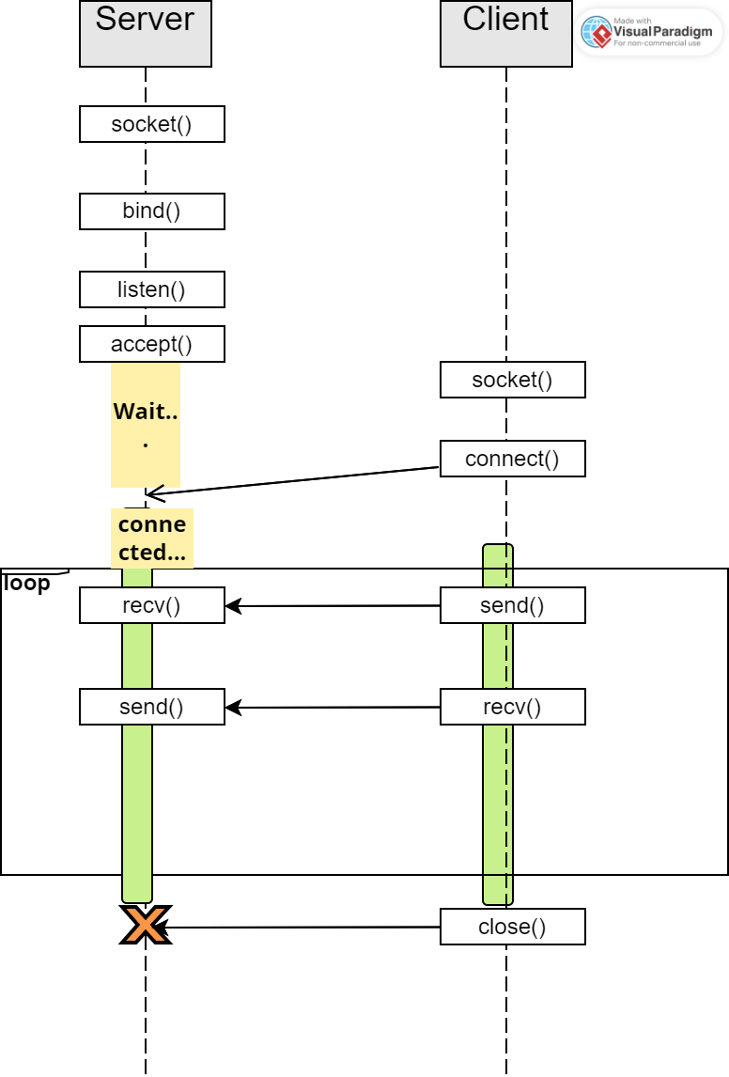
Big Picture of a Sample TCP connection
Server
Create one “half” socket
Set it to listen mode and wait
Once you receive a client request, accept it and create a new “full” socket
Use the new full socket for send() recv()
Use the normal close() to close the socket
The old “half” socket is still usable to listen for new connections.
Client
Create one “half” socket
Establish connection with a server creating a “full” socket.
Use the new full socket for send() recv()
Use the normal close() to close the socket

Slide 59
Socket: Process – Server side for a SOCK_STEAM
sockfd=socket(AF/domain, Type, Protocol)
bind(sockfd, &sockaddr, addr_len)
listen(sockfd, connection_backlog)
newfd=accept(sockfd, &sockaddr, &addr_len)
fd = socket(AF_INET, SOCK_STREAM, 0)
bind(fd, &local, sizeof(local));
listen(fd,2);
newfd=accept(fd,&cliaddr, &cliaddr_len) - at this point you can find remote process address and port
2--
struct sockaddr_in {
sa_family_t sin_family; /* address family: AF_INET */
in_port_t sin_port; /* port in network byte order */
struct in_addr sin_addr; /* internet address */
}; ….
struct sockaddr_in local;
local.family= AF_INET
local.sin_addr.s_addr = htonl(INADDR_ANY);
local.sin_port = htons(33333);
Socket now set to listen mode
Waiting for a connection here

Slide 60
Socket: Process – Server side for a SOCK_STEAM (contd…)
When you exit the accept you have a newfd which is a complete socket and use it:
send(newfd, data_buff, data_length, flags)
recv(newfd, data_buff, buff_size, flags)
…. Repeatedly…
close(newfd)
char str[100]=“Hello World\n”; n=send(newfd,str, strlen(str), 0);
n=recv(newfd, str, maxlen, 0);
close(newfd);

Slide 61
Socket: Process – Client side for a SOCK_STEAM
sockfd=socket(AF_INET, SOCK_STREAM, 0);
connect(sockfd, &server, sizeof(server));
…
char str[100]=“Hello World\n”; n=send(sockfd,str, strlen(str), 0);
…
n=recv(sockfd, str, maxlen, 0);
close(sockfd);
2--
struct sockaddr_in server;
server.family= AF_INET;
server.sin_addr.s_addr = inet_addr(server_ip_string);
server.sin_port = htons(server_port_int);

Slide 62
Simple server vs concurrent server
lsockfd = socket(…); // setup the address bind(lsockfd,…); listen(lsockfd,…);
Loop{ newfd=accept(lsockfd,…);
fork and create a child.
In the child:
send(newfd,…);
recv(newfd,…);
... … close(newfd); exit();
close(newfd); }
lsockfd = socket(…); // setup the address bind(lsockfd,…); listen(lsockfd,…); newfd=accept(lsockfd,…); send(newfd,…);
recv(newfd,…);
... … close(newfd); close(lsockfd);

Slide 63
Examples on github
See: ipc/sockets/
Simple tcp server – client : Single message exchange
Concurrent tcp server – long running client (5 messages)
Simple udp server – client : Single message exchange
Simple udp server in a loop that echos any client message
Simple unix domain socket server – client : Single message exchange
You can see connection states: netstat –a ( ..| more)
Sockets don’t vanish as soon as your program exits… So be patient.
Good practice to unlink Unix domain sockets at the beginning.

Slide 64
Sockets… there is more
Socket programming in practice is a more elaborate topic that is covered typically in a network programming course

Slide 65
Signals as a way to communicate
P1
[Despite the name it has nothing to do with condition variables or semaphores ☺ ]
Unlike most other methods it is inherently asynchronous to the program instructions.
Processes can send a signal to another process.
“kill” (despite the name) is a command line utility to send a signal to a process
The kill() system call
The receiving process executes a signal handler in response to a signal
Reminiscent of ‘interrupts’, ‘event handlers’ or ‘threads’
P2
Signal Handler Usually other signals are blocked during this time

Slide 66
Signals are used inside the operating system in a rather elaborate way!
A signal is generated when
Illegal memory access
Illegal instruction code
Child exits
Divide by zero
Out of some limits
Process stop/continue/end from user
SIGUSR1, SIGUSR2
kill(pid, signum)
signal(signum, handler)
New alternate sigaction()
Command line eg:
kill –s SIGUSR1 <pid>
SIG_IGN and SIG_DFL handlers
Usually the default handlers do the appropriate thing for each of these.
Exits the program on receiving SIGSEGV
Ends the process on receiving SIGKILL
SIGKILL and SIGSTOP cant be caught or ignored !
Checkout
man signal
kill –L
A negative PID has an interesting meaning
See: misc/sig.c

Slide 67
Summary: Communication methods in OS
Shared memory between processes too
Named Pipes
Message queues
Sockets – can be used between different systems as well.
Signals
We also saw a POSIX standard implementation of several of these.

Slide 68
This ends the lectures on Concurrency Coordination and Communication

