Slide 1
Miscellaneous topics

Slide 2
Resources, limits and notions of time

Slide 3
Safety via resource limits
Permission related security: (rwx, user, group)
Processes are created associated with users and groups
Paging system and filesystem provide their own way of protection.
Shared IPC resources - semaphores, shared memory, named pipes etc provide user control on the permissions of the resource they create.
Limits related safety
So that no single user or process runs away with all the available resources, we have per user and per process limits.
There are also system wide configurations. These are sometimes just constants that are worth knowing and some times they are limits to make sure the system stays within operating range so it behaves well.

Slide 4
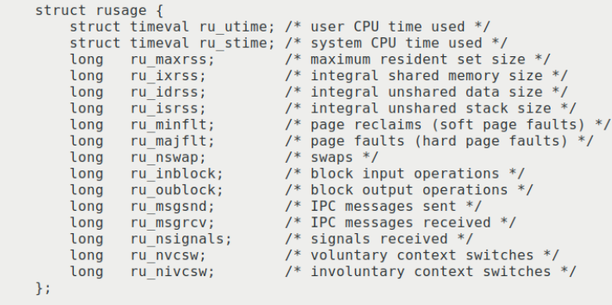
Resource limits and usage information
ulimit [-a] or getrlimit() : Per process limits; hard and soft limits
getrusage() … info on actual usage,
Includes interesting dynamic behavior counters eg:

Slide 5
System wide configurations
getconf [-a] or sysconf() : System wide configurations
See example in misc/showlim.c for both getrusage() and sysconf().

Slide 6
System time, User time, Real(wall clock) time
Measuring Time
“time <command>” to see the amount of time spent consumed by the execution of <command>… real time, user mode time, kernel mode time
We can also get this with getrusage()
See a simple example with a command line “time” and procs/loopy.c
You can also get the time of the day using gettimeofday() – μsec level time.
Count Down Timers
It is also possible to get a signal and be notified when a certain amount of time has elapsed
alarm(<time>); sets SIGALRM
setitimer() sets alarms separately for user mode/ system mode / wall clock
Distinguishes the system, user and real times
getitimer()

Slide 7
Doing things regularly at the OS level
cron is a daemon process. It becomes active every minute.
When it is active it inspects some files with specific information:
An example of such a file is /etc/crontab
The file contains lines each with two parts
A time specification, and
A command to execute
If a time spec matches the current time, then it executes the corresponding command
See /etc/crontab and man cron for detailed information
It also logs the commands executed

Slide 8
Beyond the kind of OS we studied so far

Slide 9
Structurally different: Monolithic vs microkernel architecture
Thus far we have only seen kernels like UNIX or windows
The filesystem, memory management, process management, IPC are all implemented in the kernel. These are called monolithic kernels.
Quite a lot of code.
However there is philosophy which says the lesser the kernel the better.
Interrupt/ exception handling, Scheduling, memory management, some IPC, some hardware control are considered “core”.
The rest can possibly be implemented in user level as services.
This is called a microkernel architecture

Slide 10
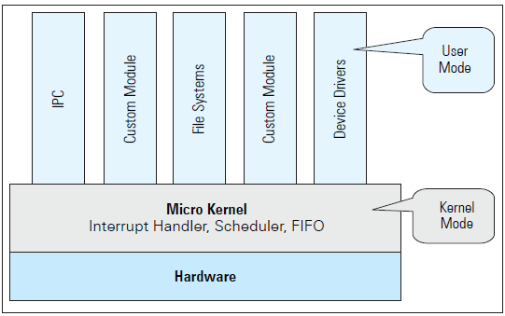
The OS is implemented as a bunch of services in the user mode
Some kernel level support is needed anyway to communicate with hardware
Also kernel support needed for scheduling, interrupt handling, IO, etc.

Slide 11
Monolithic vs Microkernels - Pros and Cons
Monolithic OS
Microkernel OS
Arch: Single large kernel
Pro – High performance
Pro – ease of communication
Pro – driver subsystems close to Hardware
Con – one bug can require the whole system to be restarted
Arch: Small kernel + System services(User mode)
Pro – Modular design – a bug/ security issue/ hang in one subsystem, doesn’t effect the other
Con – overhead to communicate to HW
Reality – people have decided to create more modular code within monolithic systems – Windows NT/ ; MacOS(XNU) – these are called hybrid OSes.

Slide 12
Functionally different / with different emphasis
Embedded systems and real time OS
Application specific optimizations, eg HPC

Slide 13
The move to embedded systems
Systems for controlling – Pacemakers, Critical use robotics, reactor control, etc.
Early embedded systems did not have any operating systems
The scheduler, filesystem, IPC and all the other code were considered overheads since embedded systems did a predetermined set of things.
Also embedded systems may be real-time. Which means something like round-robin intended to improve overall metrics like average turn around time, does not meet specific limits for an individual task.
So the general purpose OS (GPOS) like Windows or UNIX was considered not ideal for embedded systems
Applications were programmed directly on the microcontroller with no OS.

Slide 14
Real Time OS (RTOS)
So while real time systems found the OS to be unsuitable, their complexity grew too – multiple threads/ synchronization etc., making a need for some software infrastructure different from the GPOS.
This motivated the birth of RTOS
Here the programmer has a lot more control of the scheduling of threads, memory mapping etc, to get time bound execution of tasks.
Often these have much smaller space consumption than GPOS.
Lower overheads, highly tunable.
Examples include Contiki OS and FreeRTOS.

Slide 15
OS for Large scale computing / High Performance Computing

Slide 16
The End

Slide 17
Processes, Process Groups, session, session leader, tty, foreground process-group
$ ./loopy busy & $ ./loopy busy & $ sort | more Notice all these are running, not yet done.
….
On another terminal lets do a ps and know more about these 4 processes
PID PPID COMM TT STAT UID GID PGID SID
1312 2485 bash pts/4 Ss 1000 1000 1312 1312
2007 1312 loopy pts/4 R 1000 1000 2008 1312 2009 1312 loopy pts/4 R 1000 1000 2009 1312
2088 1312 sort pts/4 S+ 1000 1000 2088 1312
2089 1312 more pts/4 S+ 1000 1000 2088 1312

Slide 18
Real and protected Mode
Real is the old 32 bit times intel CPU mode:
All addresses are real (20bit), though segmented
No support for kernel-mode / user-mode – Previlage levels
No support for memory protection
Basically no support that modern OS – es need
Protected mode is all the good stuff we are used to now

