Slide 1

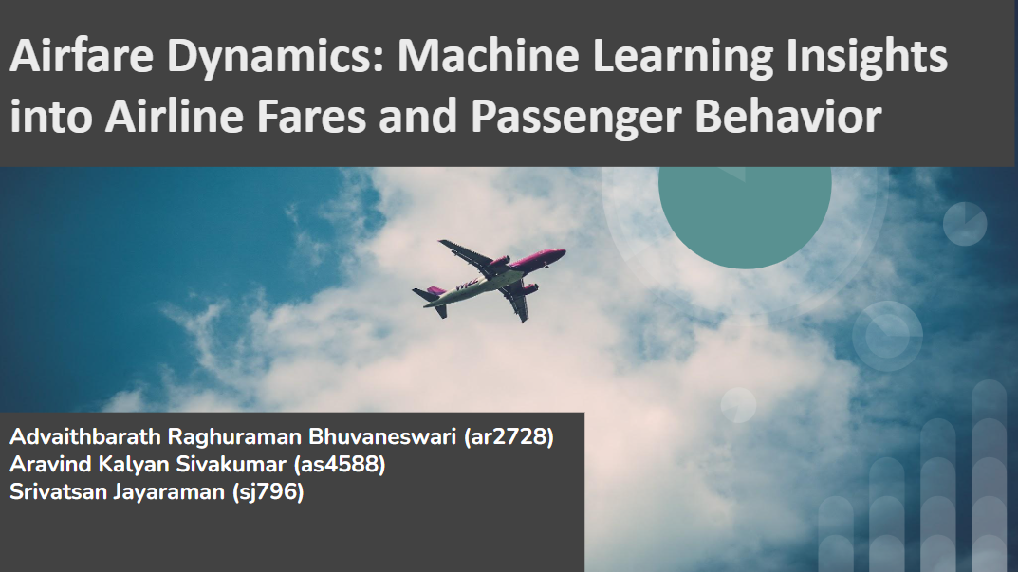

Slide 2
INTRODUCTION:
Dynamic Nature of Airfare Pricing:
Airfare prices fluctuate based on demand, route distances, carrier competition, and seasonal trends.
This creates challenges for both consumers and airlines in understanding and optimizing pricing.
Purpose of the Project:
This study aims to use advanced machine learning techniques to predict airfare prices accurately.
By analyzing historical data, it uncovers patterns and trends in passenger behavior and fare dynamics.
Significance of the Work:
Airlines can use the insights to enhance revenue management and optimize route profitability.
Travelers gain actionable data for smarter booking decisions, ensuring cost-effective travel planning.

Slide 3
Objectives:
Develop Accurate Prediction Models:
Implement machine learning models like Random Forest, XGBoost, and LightGBM to predict airfare prices.
Optimize accuracy using metrics such as RMSE and R² for reliable forecasts.
Analyze Passenger Behavior:
Examine factors like booking trends, price sensitivity, and seasonal patterns.
Use insights to understand route profitability and traveler preferences.
Provide Actionable Insights:
Help airlines optimize pricing and resource allocation through predictive analytics.
Enable consumers to plan travel cost-effectively by identifying optimal booking windows.

Slide 4
Literature Review:
Previous Studies:
GRU + ABSA: Effectively captures consumer sentiment but lacks scalability for pricing.
Decision Trees and Gradient Boosting: Outperform traditional methods like linear regression.
Key Insights from Literature:
Tree-based models offer robust accuracy for predicting non-linear trends in pricing.
LSTM is effective for time-series pricing but requires high computational power.

Slide 5
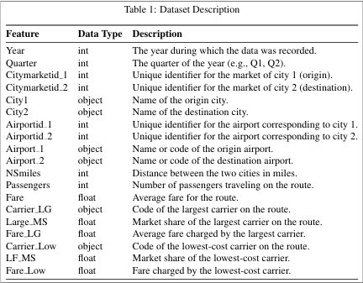
Dataset Description

Slide 6
Dataset Description
Dataset Source: Consumer Airfare Report (data.gov).
Details:
Volume: 245,956 records, 19 features.
Key Attributes:
Fare, Booking Time, Route Distance, and Passenger Count.
Carrier Type and Seasonal Indicators.
Critical Features:
"Days to Departure": Reflects booking trends closer to travel.
"Fare per Mile": Normalizes fare variations across different distances.
Seasonality: Peak and off-peak travel periods.
Insights: Highlighted trends of short vs. long-haul route preferences and price volatility.

Slide 7
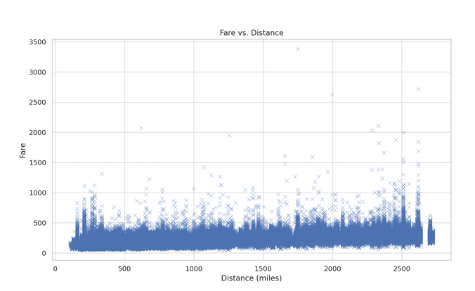
Exploratory Data Analysis (EDA):
Longer distances often correlate with higher fares but are not always linear.
Booking closer to departure leads to price spikes.
Seasonal trends show increased prices during holidays.

Slide 8
Preprocessing and Feature Engineering
Steps Performed:
Handled missing and duplicate data records.
Normalized numerical attributes for consistency.
Encoded categorical variables (e.g., airline carriers).
Removed extreme outliers to avoid skewing model predictions.
Derived Features:
Days before Departure: Booking window trends.
Fare per Mile: Route-specific fare normalization.
Travel Seasonality: Categorized into peak and off-peak periods.

Slide 9
Machine Learning Models:
Models Used:
Random Forest: Best for handling non-linear relationships.
LightGBM: Efficient gradient boosting for large datasets.
XGBoost: Optimized for categorical and temporal data.
Neural Network: Captures complex feature interactions
Model Training:
Split data into 80% training and 20% testing.
Hyperparameter tuning using grid search.

Slide 10
Model Evaluation:
Evaluation Metrics:
Root Mean Squared Error (RMSE): Measures prediction accuracy.
Mean Absolute Error (MAE): Indicates average error magnitude.
R² Score: Explains variance captured by the model.
Results:
Random Forest: RMSE = 0.2043, R² = 0.9999 (Best Accuracy).
LightGBM: RMSE = 0.2534, R² = 0.9987.
Neural Network: RMSE = 0.3087, R² = 0.9982.

Slide 11
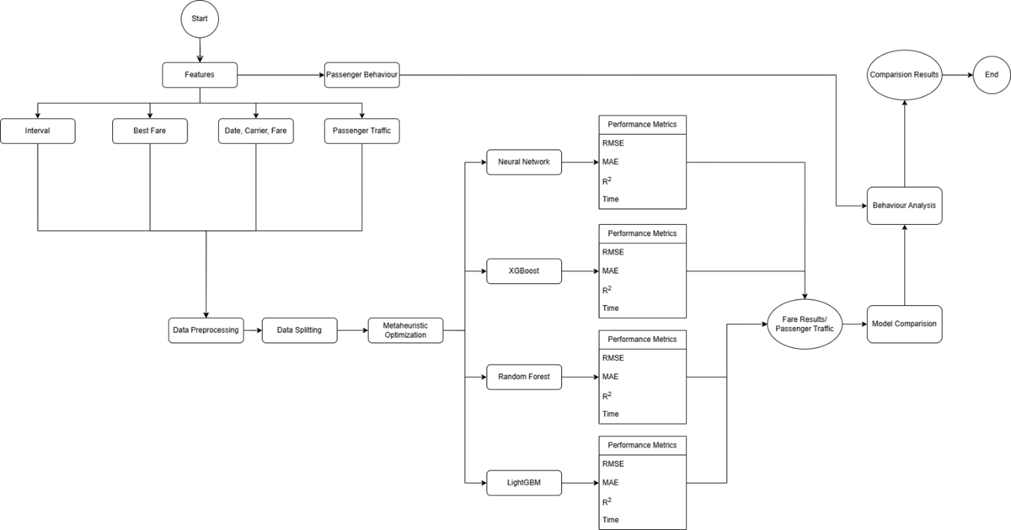
Methodology FlowChart:

Slide 12
General Key Factor Influencing Fare
Key Factors Influencing Fare:
Date: If you have plenty of days before your flight, you fare will be low
Route : Longer routes see reduced passenger volumes due to cost and time factors.
Seasonality Impact: Higher traffic during peak seasons (summer holidays, year-end festivals).
Carrier: Different Carrier , Different Fares
Occupancy: If flight more empty, you fare will be low

Slide 13
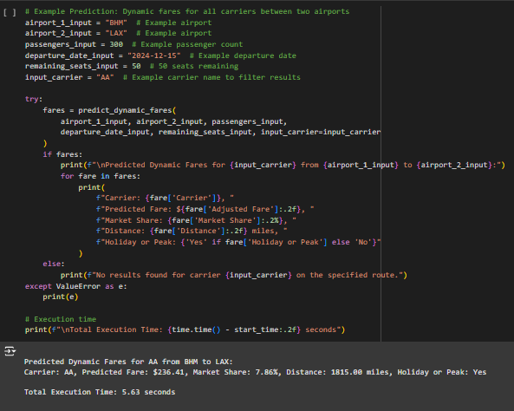
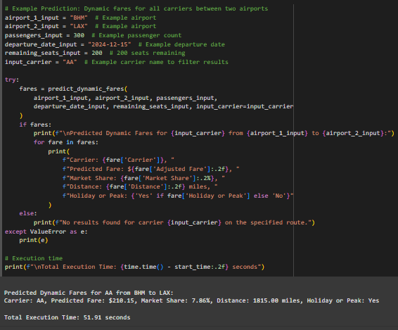
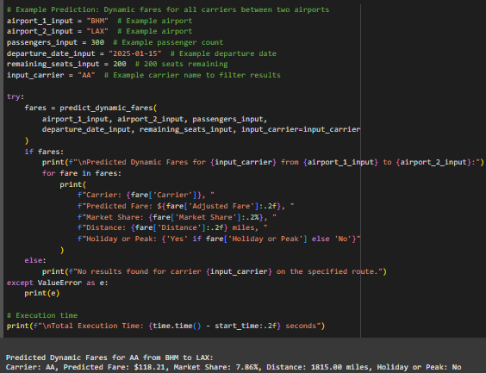
Occupancy
Dates

Slide 14
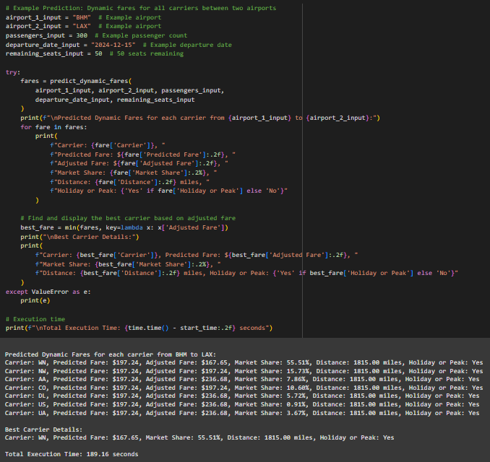
Route
Carrier

Slide 15
Fare Based on Day Interval
Key Factors Influencing Fare:
Route : Longer routes see reduced passenger volumes due to cost and time factors.
Fare per Mile: Passengers favor routes with lower fare per mile, even for longer distances.
Seasonality Impact: Higher traffic during peak seasons (summer holidays, year-end festivals).
Carrier: More Carrier, More options
Occupancy: If flight more empty, you fare will be low
ML Insights:
LightGBM effectively identifies critical features for fare prediction.
Random Forest demonstrates stability but less accuracy in long-distance predictions.

Slide 16
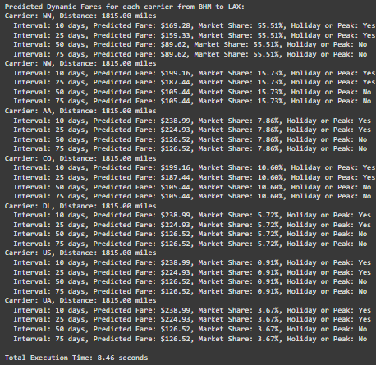
Output

Slide 17
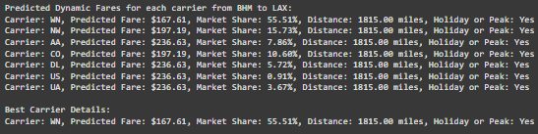
Best Fare Based on Route and Date
Key Factors Influencing Fare:
Route : Longer routes see reduced passenger volumes due to cost and time factors.
Fare per Mile: Passengers favor routes with lower fare per mile, even for longer distances.
Seasonality Impact: Higher traffic during peak seasons (summer holidays, year-end festivals).
Date: If you have plenty of days before your flight, you fare will be low
Occupancy: If flight more empty, you fare will be low
ML Insights:
LightGBM effectively identifies critical features for fare prediction.
Random Forest demonstrates stability but less accuracy in long-distance predictions.

Slide 18
Fare Based on Route and Carrier
Key Factors Influencing Fare:
Route : Longer routes see reduced passenger volumes due to cost and time factors.
Fare per Mile: Passengers favor routes with lower fare per mile, even for longer distances.
Seasonality Impact: Higher traffic during peak seasons (summer holidays, year-end festivals).
Carrier: Low Cost carrier, you will pay less
Date: If you have plenty of days before your flight, you fare will be low
Occupancy: If flight more empty, you fare will be low
ML Insights:
LightGBM effectively identifies critical features for fare prediction.
Random Forest demonstrates stability but less accuracy in long-distance predictions.

Slide 19
Passenger Traffic Analysis:
Key Factors Influencing Traffic:
Route Distance: Longer routes see reduced passenger volumes due to cost and time factors.
Fare per Mile: Passengers favor routes with lower fare per mile, even for longer distances.
Seasonality Impact: Higher traffic during peak seasons (summer holidays, year-end festivals).
ML Insights:
XGBoost effectively identifies critical features for traffic prediction.
Random Forest demonstrates stability but less accuracy in long-distance predictions.

Slide 20
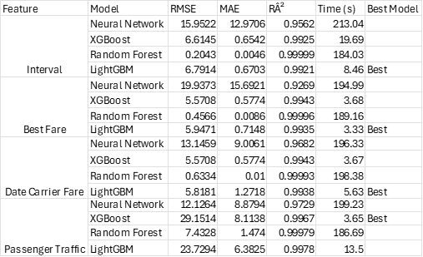
Which model is best

Slide 21
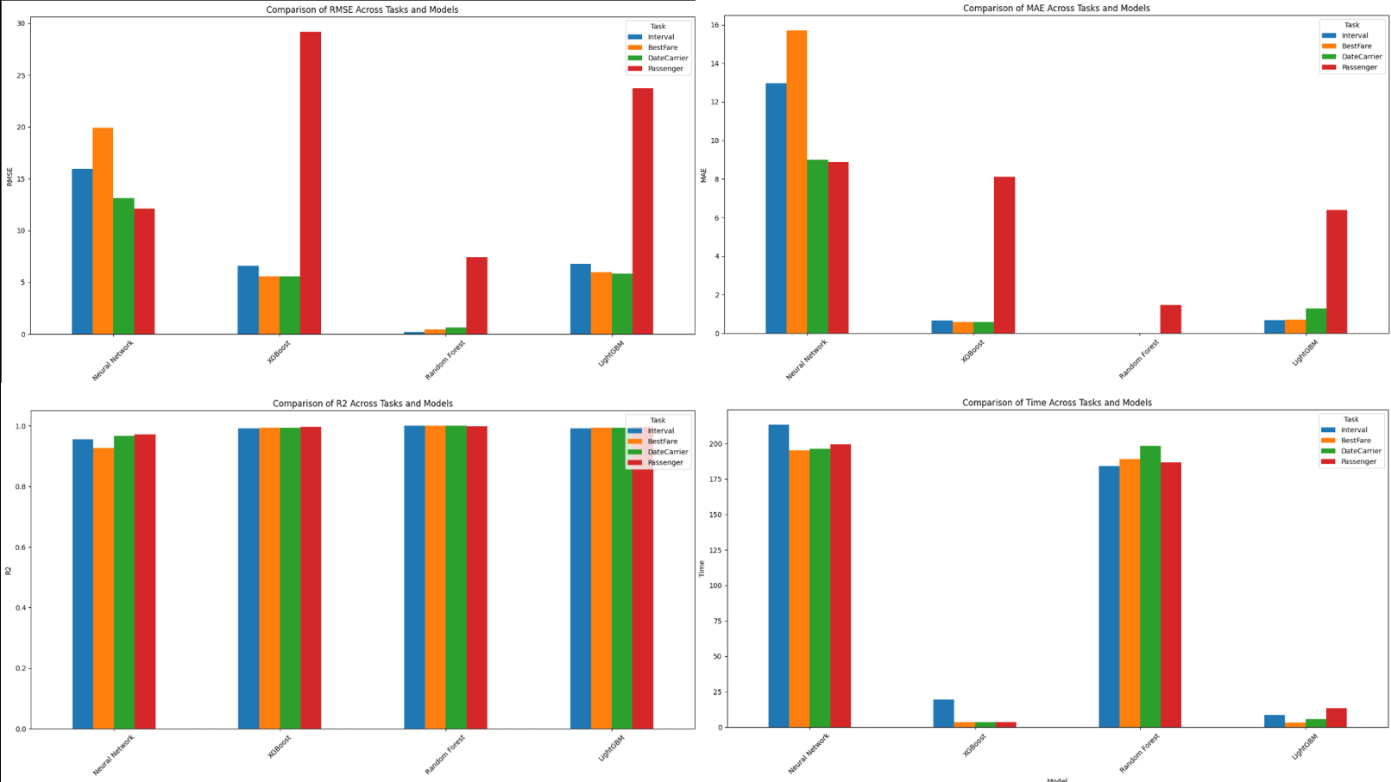
Which model is best

Slide 22
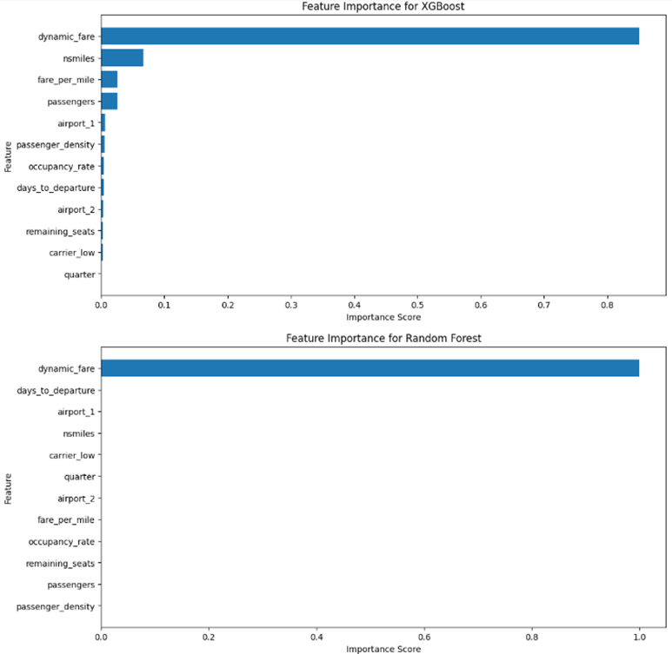
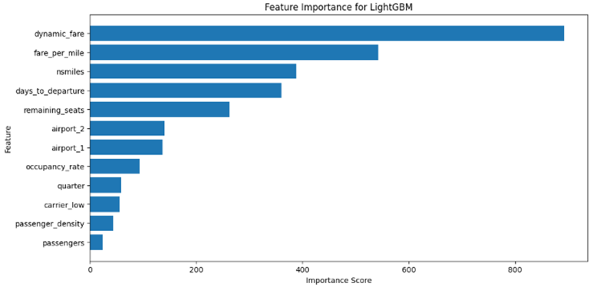
Fare Prediction Feature Score Graph

Slide 23
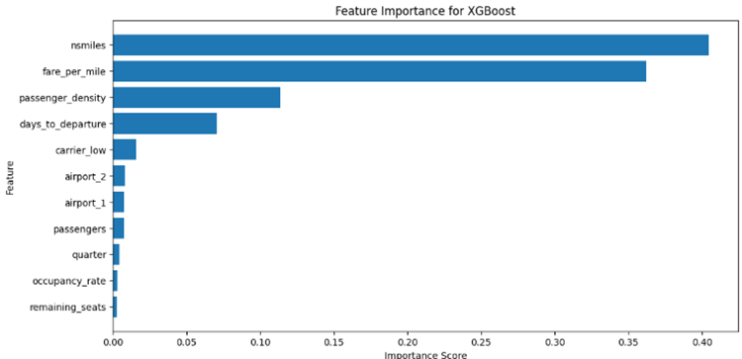
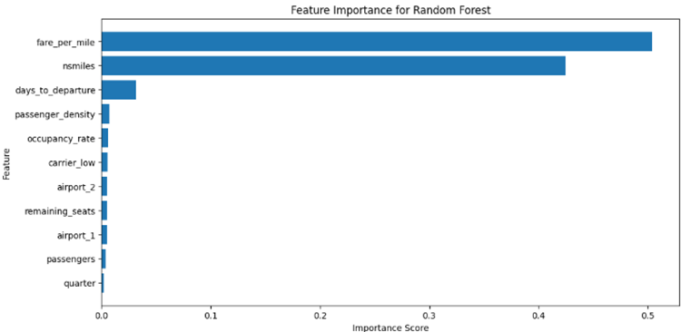
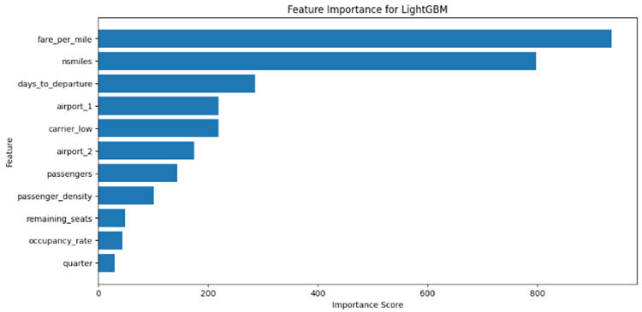
Passenger Traffic Feature Score Graph

Slide 24
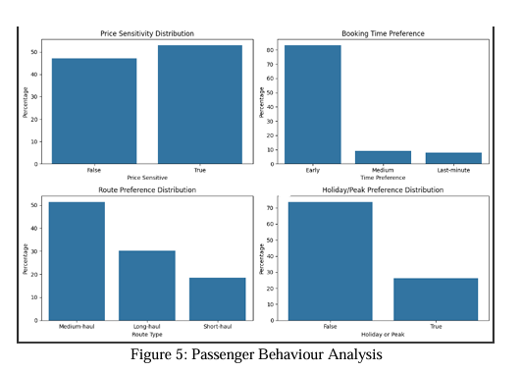
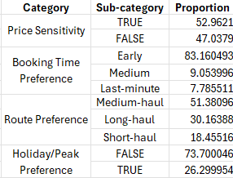
Passenger Behavior Analysis:
Insights on Passenger Behavior:
Fare Sensitivity: Over 52% of passengers prioritize finding the lowest possible fare, indicating high price elasticity in the market.
Booking Preferences:
83% of passengers book tickets well in advance (30–45 days before departure).
Last-minute bookings account for only 7.75%, often with significantly higher fares.
Route Patterns: Medium-haul flights (51.38%) are the most popular among passengers, compared to short-haul (27%) and long-haul (21.62%).

Slide 25
Feature Importance (Random Forest vs XGBoost
Feature Importance (Random Forest vs. XGBoost)
Detailed Analysis:
Random Forest:
Highlights “Days to Departure” as the most critical feature for predicting airfare trends.
Captures non-linear relationships between fare and route distance.
XGBoost:
Excels at capturing seasonality trends (e.g., peak vs. off-peak pricing).
Identifies minor factors like carrier preferences and time of travel (morning vs. evening flights).
Comparison Insights: Random Forest is better for generalized trends, while XGBoost excels in specific pricing scenarios.

Slide 26
Real-World Applications:
Benefits for Airlines:
Dynamic Pricing: Predict demand surges and adjust fares to maximize revenue.
Route Optimization: Identify profitable routes based on passenger traffic analysis.
Marketing Strategies: Tailor promotions for low-traffic periods or high-yield customers.
Benefits for Consumers:
Predict optimal booking windows for cost-effective travel planning.
Use predictive tools to compare fares across airlines and routes.
Benefits for Policymakers:
Monitor market competition and fare accessibility to improve regulations.
Ensure affordable travel options for underserved routes.

Slide 27
Insights:
Optimal Booking Window:
Fares are lowest 30–45 days before departure. Bookings closer to the travel date result in price surges.
Seasonality Impact:
Peak season fares are 15–25% higher compared to off-peak times, driven by demand surges.
Route Profitability:
Medium-haul routes consistently show the highest profitability, balancing demand and pricing flexibility.
Consumer Preferences:
Budget-conscious passengers dominate, but airlines can explore upselling opportunities for premium services.

Slide 28
Challenges Faced:
Data Challenges:
Missing or inconsistent records in fare datasets impacted initial modeling accuracy.
Outliers, such as extreme fare values, required extensive preprocessing.
Modeling Challenges:
Random Forest faced overfitting issues with small datasets.
Neural Networks required significant computational resources, limiting scalability.
External Factors:
Lack of real-time data on economic trends (e.g., fuel prices) reduced prediction accuracy for volatile markets.

Slide 29
Future Work:
Enhancements to the Model:
Integrate real-time pricing data via airline APIs for dynamic predictions.
Include external variables like fuel costs, taxes, and competitor pricing for more robust predictions.
Hybrid Model Development:
Combine strengths of Random Forest and XGBoost for improved performance.
Use LSTM to incorporate time-series analysis for sequential fare trends.
Interactive Tools:
Build consumer-facing dashboards with visualization tools to predict fares and recommend booking times.

Slide 30
Conclusion:
Machine Learning Applications:
Models like LightGBM and XGBoost have proven highly effective for airfare prediction tasks than random forest.
Insights into passenger behavior and route profitability drive better decision-making for airlines.
Practical Outcomes:
Airlines can optimize pricing and marketing strategies based on real-world demand trends.
Travelers benefit from cost-effective planning and improved transparency in pricing.
Future Potential:
The methodology has broader applications in dynamic pricing for hotels, events, and other industries.

Slide 31



Thank You

