Slide 1

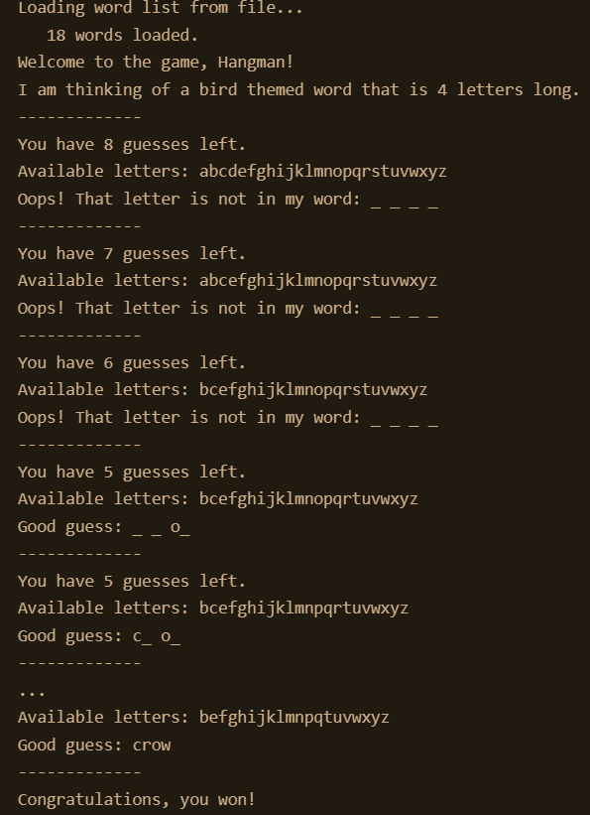
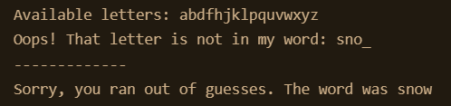
H
A
N
G
M
A
N
Do you have what it takes to SAVE the man? Or will you HANG the man?
A fun word-guessing game! Choose from African Capitals, Holiday, or Birds themed games!
Coded By: Rachel Baker
Original Code: Albert Randolph

